Slide 1
Unit 1
Connected by Technology
Form , Meaning & Function
Mega Goal 2.1
Done by : Entisar Al-Obaidallah

Slide 2
Lesson Goals
Distinguish
Use
01.
02.
Use
Use
03.
04.
between the comparative and superlative form of an adjective
need to be ( done ) correctly
Have or get with the past participle correctly
The past participle as adjective correctly

Slide 3

Open
Student's book
p.(16)

Slide 4
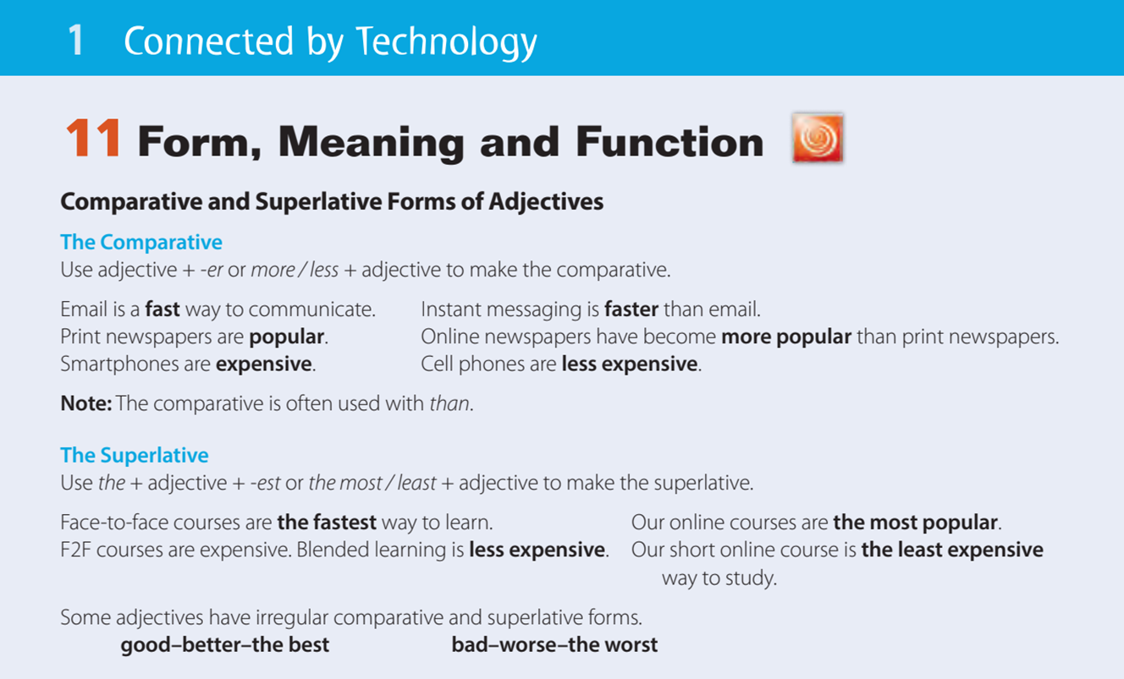

Slide 5
The Comparative
Student book p. (16)

Slide 6


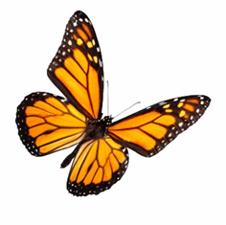
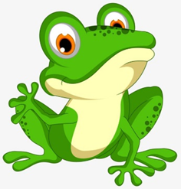
Comparative
➔Comparatives are used to show the difference between two objects.
The ant is smaller than the elephant
Butterfly is more beautiful than frog .

Slide 7

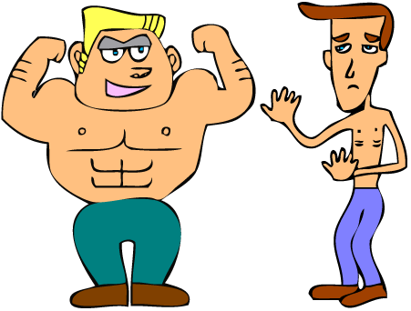
Rules
1- When we compare using short adjectives (one or two syllables), we add –er + than at the end of the adjective.
Example :
Sami is taller than Maher.
tall
taller
The blond man is stronger than the thin man.
strong
stronger

Slide 8
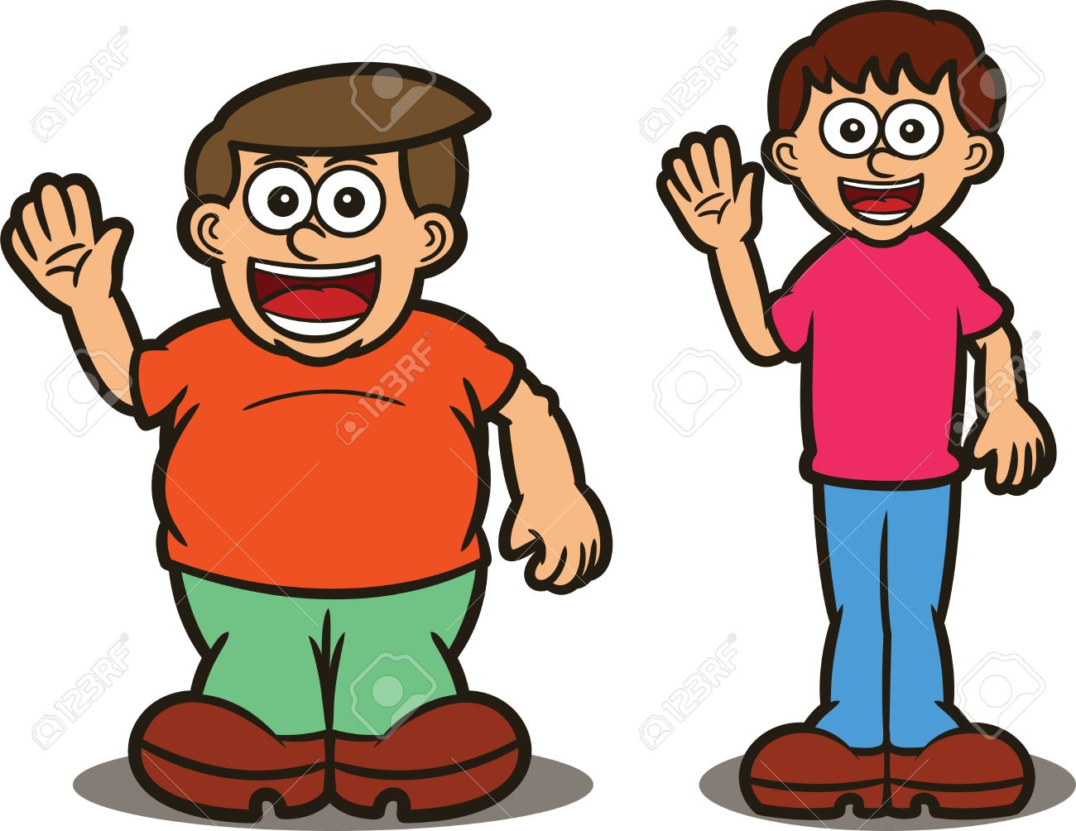
Rules
2- If an adjective ends in one vowel + consonant
(a , e ,i, o , u) (b , c , d , f , g , h , j , k , l , m....)
➔we double the consonant and add -er
Example :
Salem is fatter than Saad
fat
fatter

Slide 9


Rules
3- If and adjective ends with –y, we change it to –i and add –er
Example :
The blue whale is heavier than shark
heavy
heavier

Slide 10

Rules
3- If and adjective ends with e, we add –r only
Example :
Batman is braver than iron man
brave
braver

Slide 11
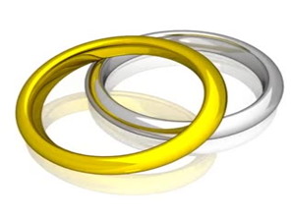
Rules
4 – When we compare 2 things or people using long adjectives
(three or more syllables), we add:
more + adjective + than
Example :
Gold is more expensive than silver
expensive
More expensive

Slide 12
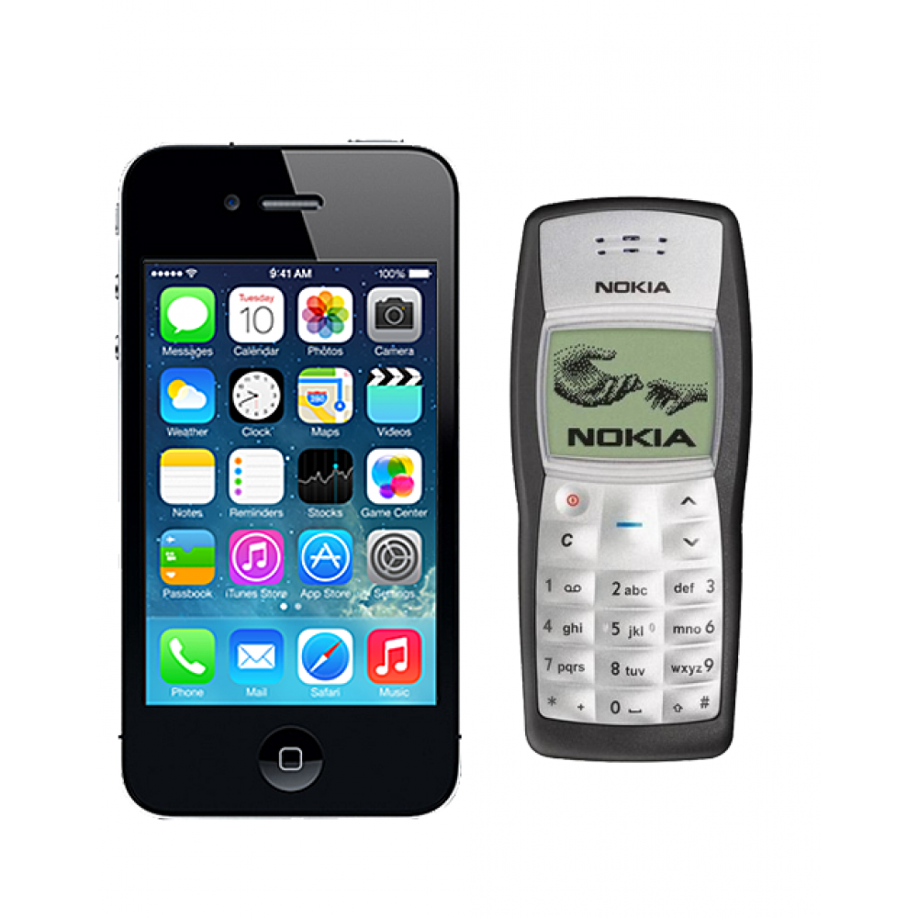
Rules
5 – When we compare 2 things or people using long adjectives (three or more syllables), we add:
less + adjective + than
Example :
Nokia is less expensive than iPhone
expensive
less expensive

Slide 13
Rules
5- There are a few exceptions:
Example :
Good
Better than
bad
Worse than
far
Farther than

Slide 14
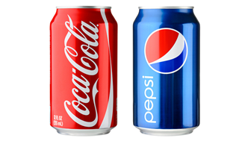
Examples
Coca Cola is better than Pepsi.
Good
Better than

Slide 15

Remember
when using a comparative form of adjectives , you must always follow it with the word
“ than”.

Slide 16
The Superlative
Student book p. (16)

Slide 17
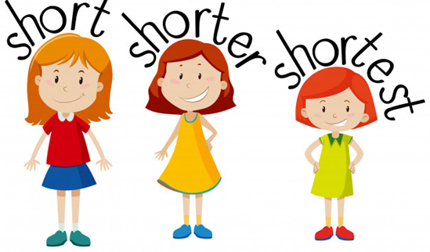
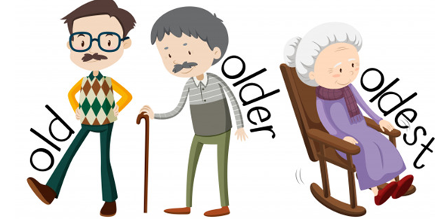
Superlative Rules
1- When we compare using short adjectives (one or two syllables), we add :
the + adjective + – est
Example :
Sara is the shortest
short
The shortest
She is the oldest
old
oldest

Slide 18
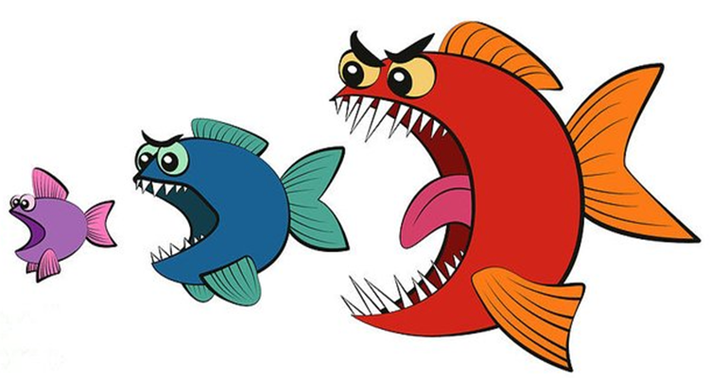
Superlative Rules
2- If an adjective ends in one vowel + consonant
(a ,e ,I ,o ,u ) (b, c, d, f, g, h, j, k, l, m....)
➔we double the consonant and add -est
Example :
The red fish is the biggest of all
big
The biggest

Slide 19
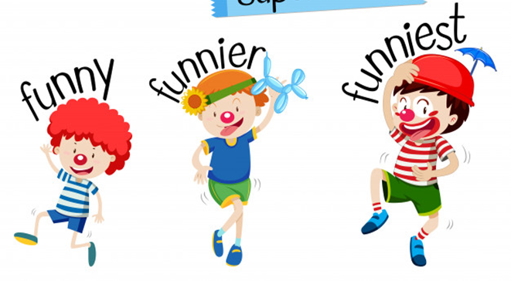
Superlative Rules
3- If and adjective ends with –y, we change it to –i and add –est
Example :
The clown with red hat is the funniest of all
funny
funniest

Slide 20
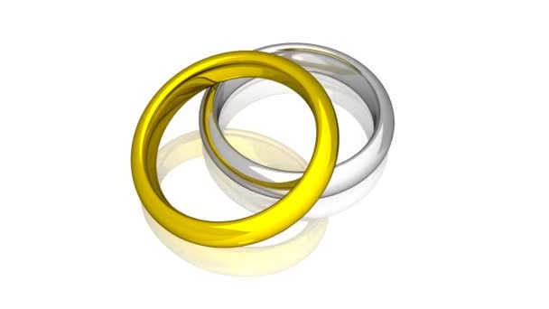

Superlative Rules
4 – When we compare using long adjectives ( three or more syllables) we add:
the most + adjective
Example :
Dimond is the most expensive of all
expensive
The most expensive

Slide 21
Rules
5- There are a few exceptions:
Example :
Good
The best
bad
The worst
far
The farthest

Slide 22
Open
Student's book
p.(17)

Slide 23
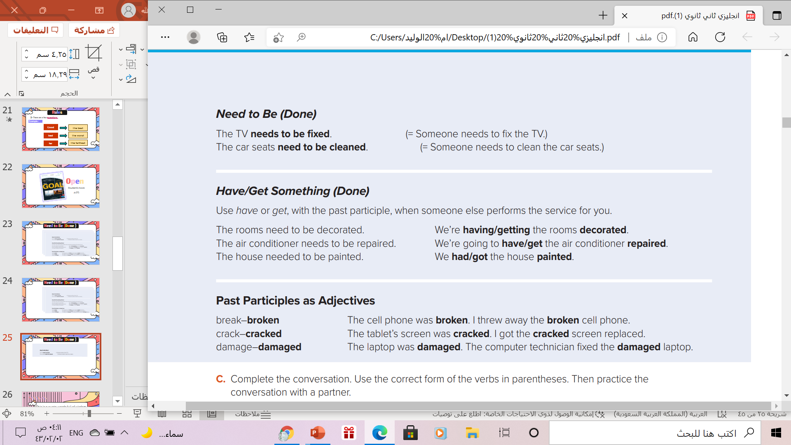
Need to Be (Done )
Form :
Thing
Need - Needs
To be
V( P.P.3)
Example :
The walls need to be repainted.

Slide 24
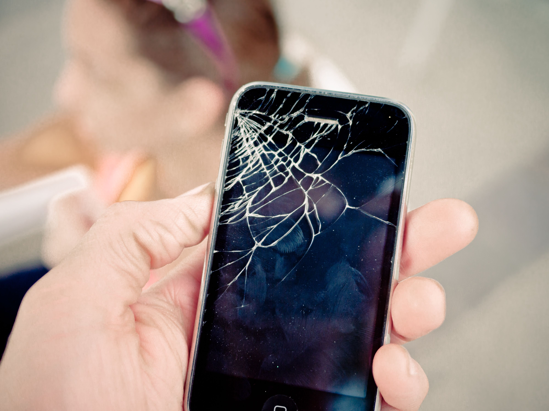

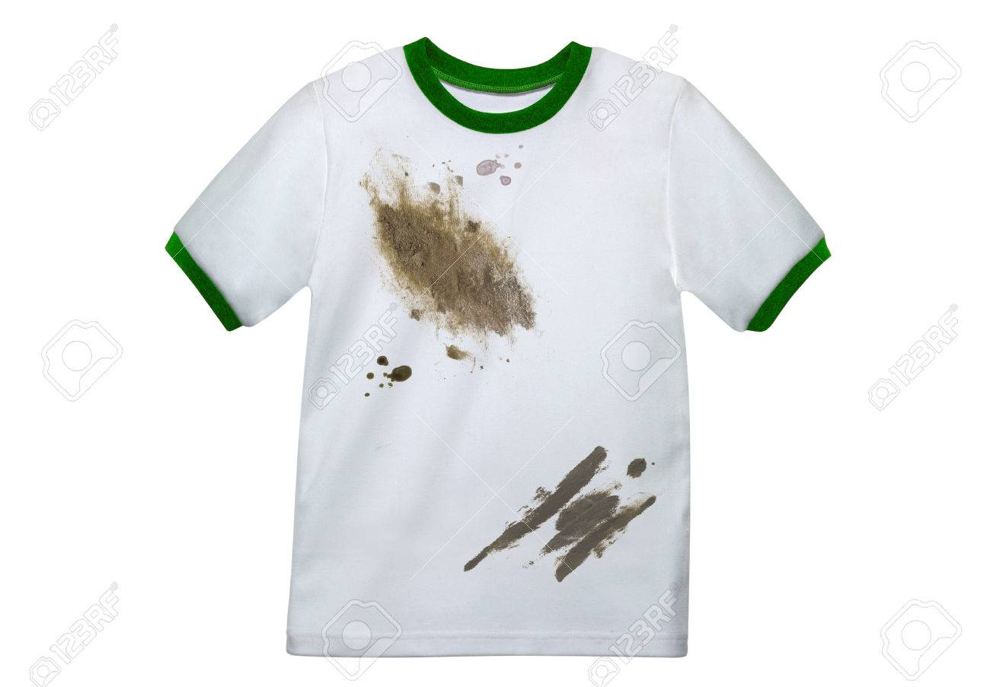
Let’ s Practice
Write a sentence using ( need to be done):
The phone needs to be fixed.
The shirt needs to be washed( cleaned)

Slide 25
Have /get something(Done )
Form :
Subject
Have - get
object
V( P.P.3)
Example :
I will have/get my house painted tomorrow.
(someone else will paint the house) (future)

Slide 26
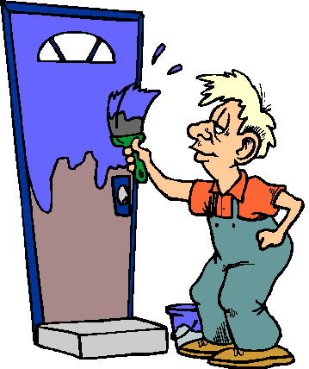
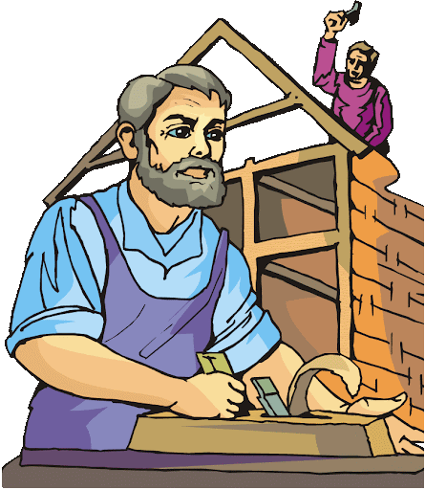
Have /get something(Done )
The door needs to be painted .
I have my door painted
The house needs to be built .
I have my house built

Slide 27
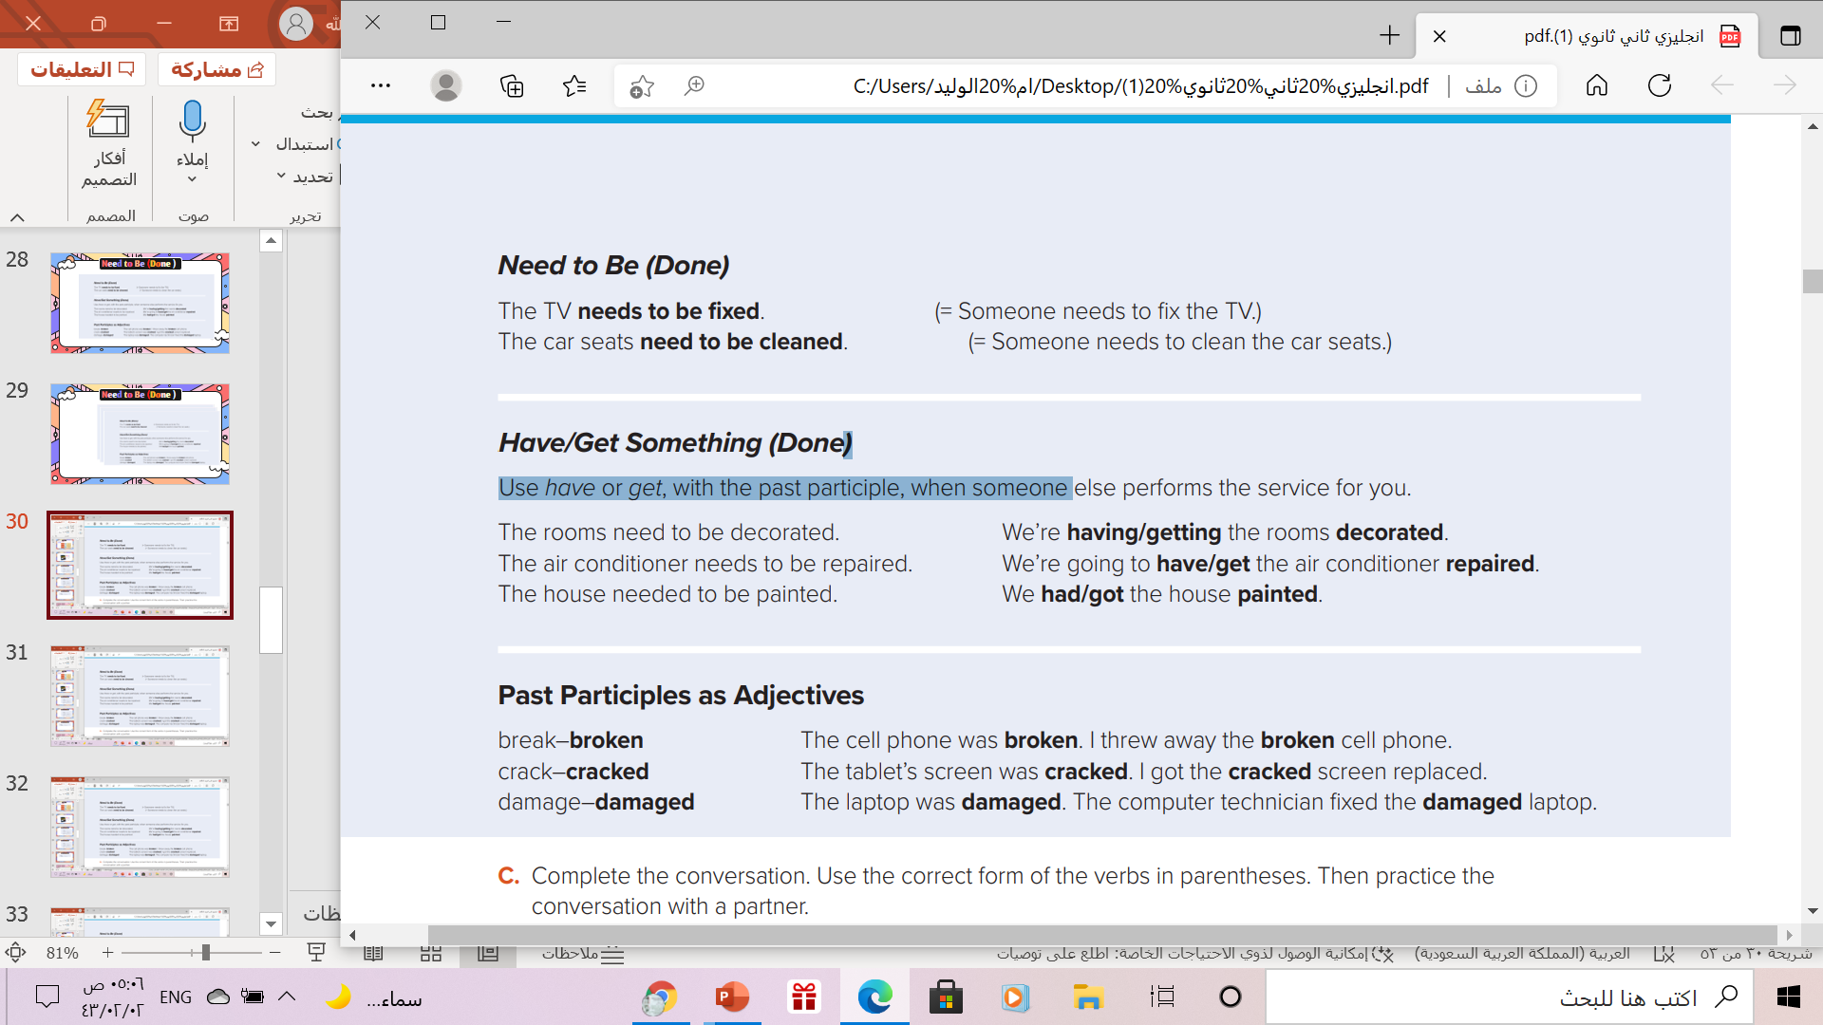
Past Participle as adjectives
Transitive verbs
Use
Past participles can be used as an adjective to describe a noun.
only transitive verbs (verbs that take an object) can be used as adjectives in the past participle form.
Verbs that describe a state of being rather than an action, such as ( be, and verbs that are not used with objects, such as smile, cannot be used as past participle adjectives.

Slide 28

Homework
Workbook p.(92) , exercise (Q)

Slide 29


Thanks!
Thanks!

