Slide 1
Unit 1
Connected by Technollogy
Conversation & Listening
Mega Goal 2.1
Done by : Entisar Al-Obaidallah

Slide 2




Lesso Goals
Listen
for specific details
Use
the "real talk" phrases in a conversation.
Practice
using some texting abbreviation & Acronym
Classify
the words into the correct category

Slide 3
Warm Up

Slide 4

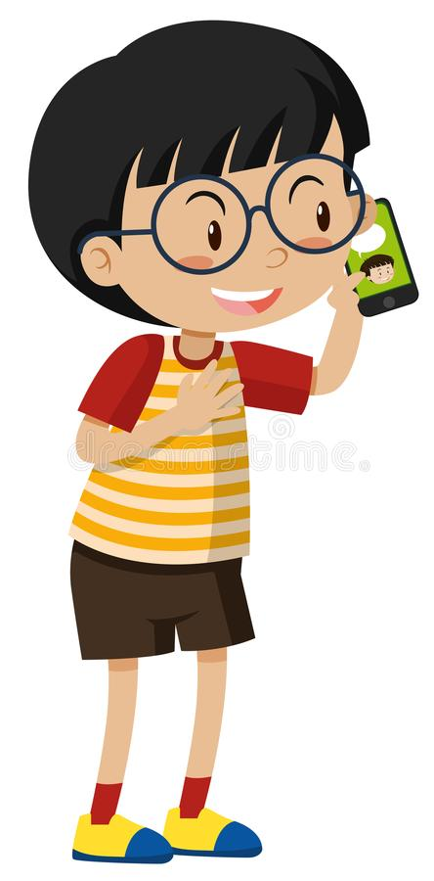
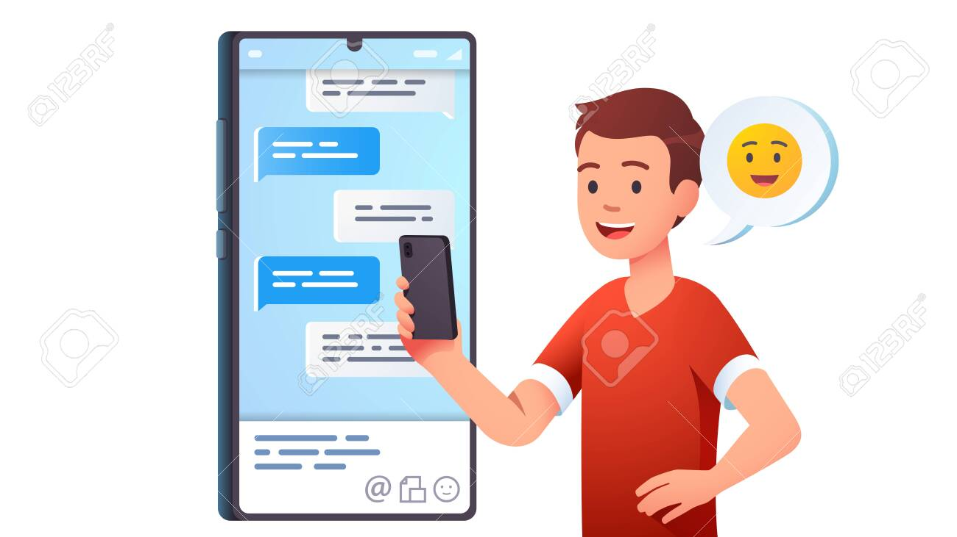
What are they doing?
He is texting
He is calling
He is chatting

Slide 5
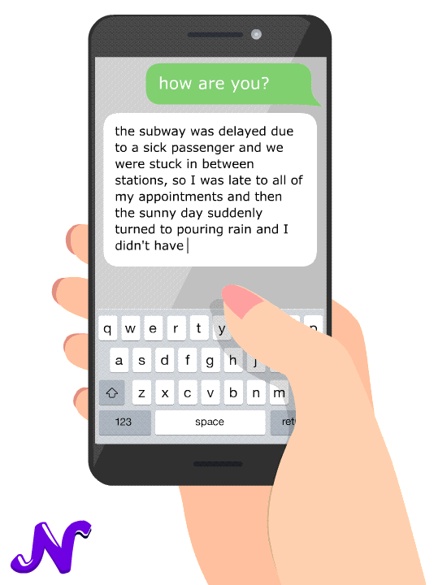

Is texting a common
means of communication?
How do people text in
your language?
Do you use abbreviations?

Slide 6


Give some examples of abbreviations which used in texting?

Slide 7
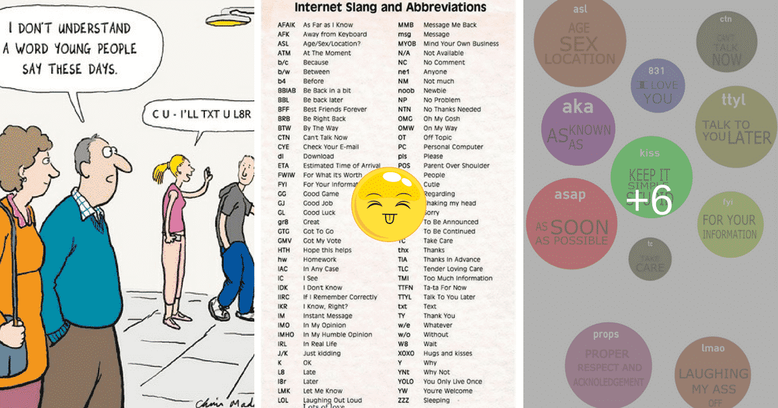
What are the abbreviations mentioned in this picture?
CU
U
I’ll
L8R
TXT

Slide 8

Open
Your students book Page(10)

Slide 9
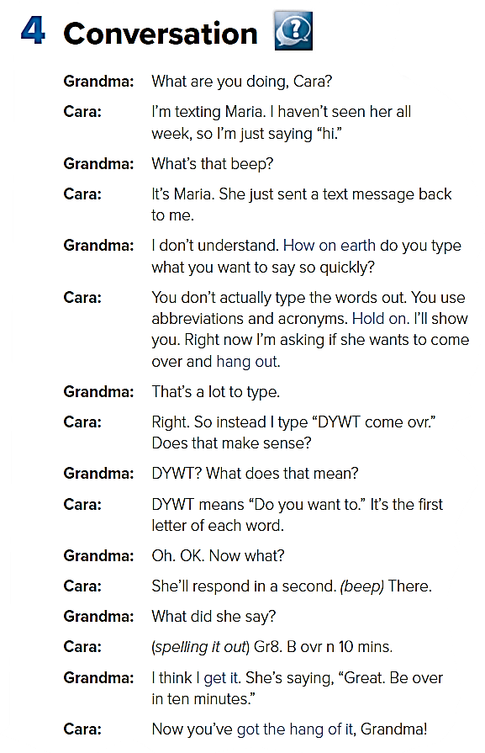


Open UR book p.(10)
Listen & Discuss

Slide 10
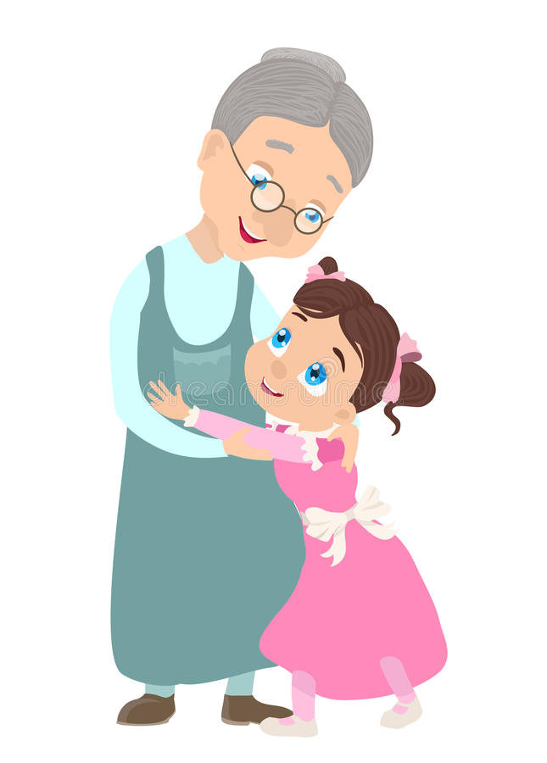
What is Granddaughter's name?
Cara
What is Cara’s friend name?
Maria
What is Cara doing?
texting her friend Maria
Does Cara’s grandmother know how to text?
No, she doesn’t

Slide 11



What sets us apart?
What is the differences between “ acronym” & “ abbreviation” ?
a short form of a word
PLZ = please
ovr = over.
Gr8 = great
B4 = before
A word formed from the first letters of other words.
OMG = Ohh my God
DYWT = Do you want to.
WU? = What’s up?
B4N = bye for now

Slide 12
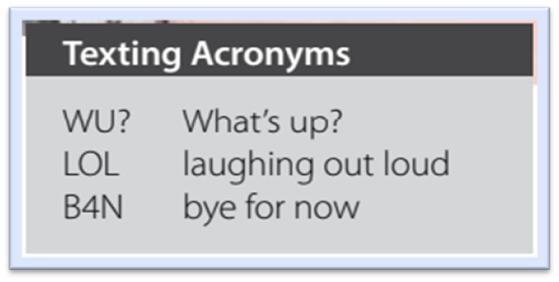
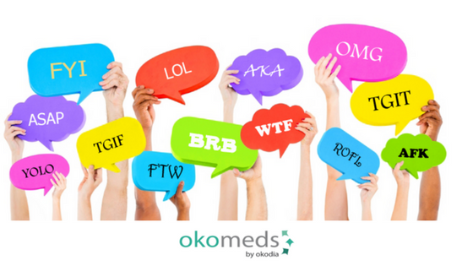

Slide 13








Guess
See you
By The Way
Great
Oh my God
Thanks
Laughing Out Loud
For Your Information
Be Right Back

Slide 14
Listen to the conversation again and underline the expressions written in BLUE

Slide 15

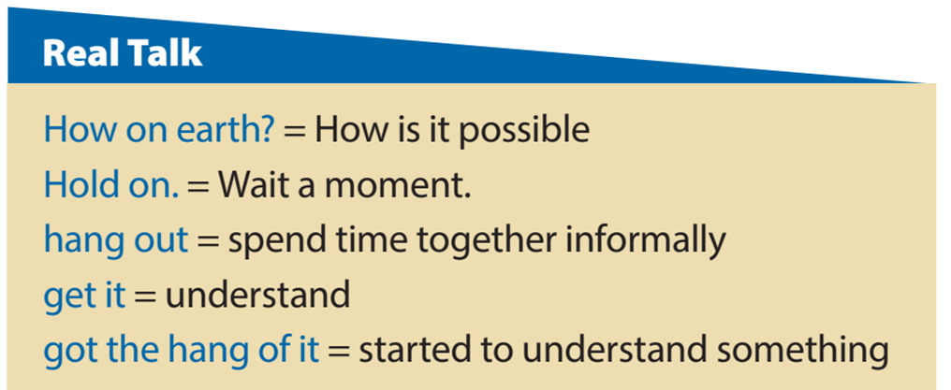

Read the words and their meaning:

Slide 16
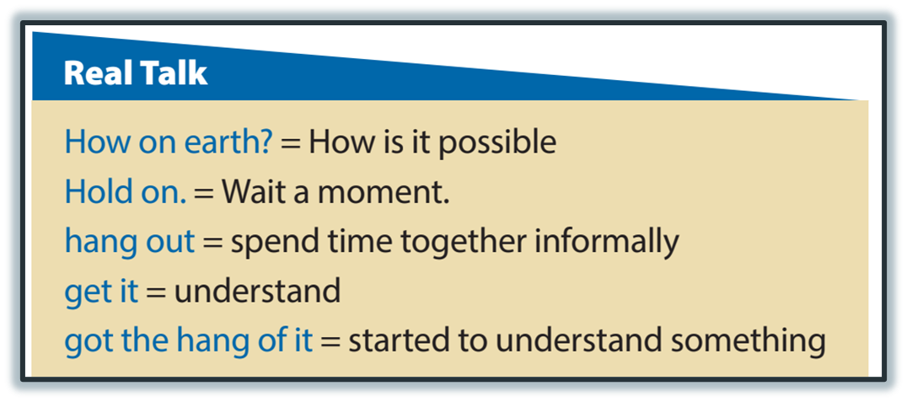
Who says, “How on earth” ?
Grandma
Who says, “Hold on” ?
Cara
Who says, “Hang out” ?
Who says, “get it” ?
Cara
Grandma
Who says, “got the hang of it” ?
Cara

Slide 17

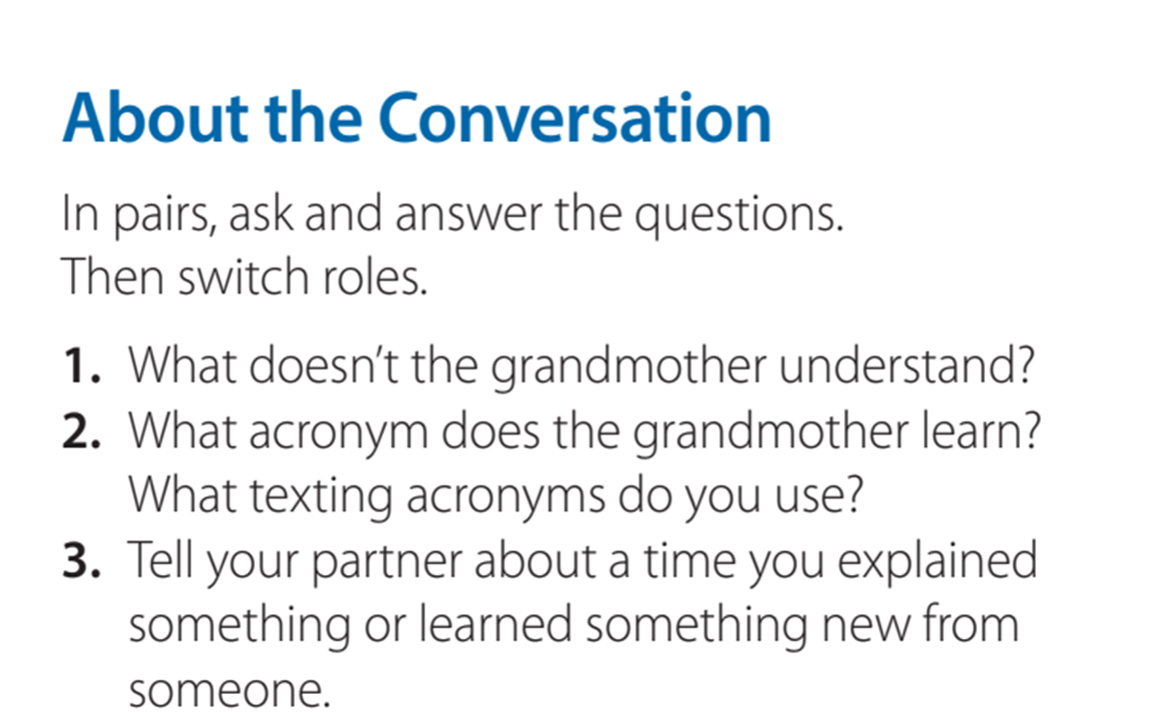

She doesn’t understand how can Cara type a text so quickly.
She learns “DYWT,” or “do you want to.”

Slide 18
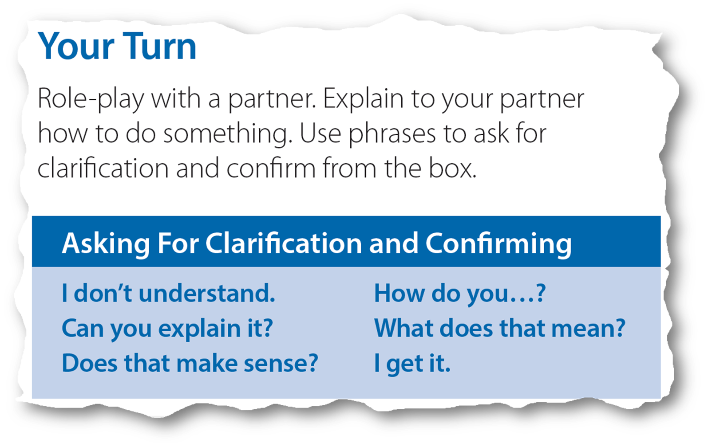


Which things would you say when you:
don’t understand something or want an explanation?

Slide 19

What do you say when you :
understand something ..

Slide 20

What do you say when you :
want to know if your explanation is clear?
2016
2017
2018
2019

Slide 21
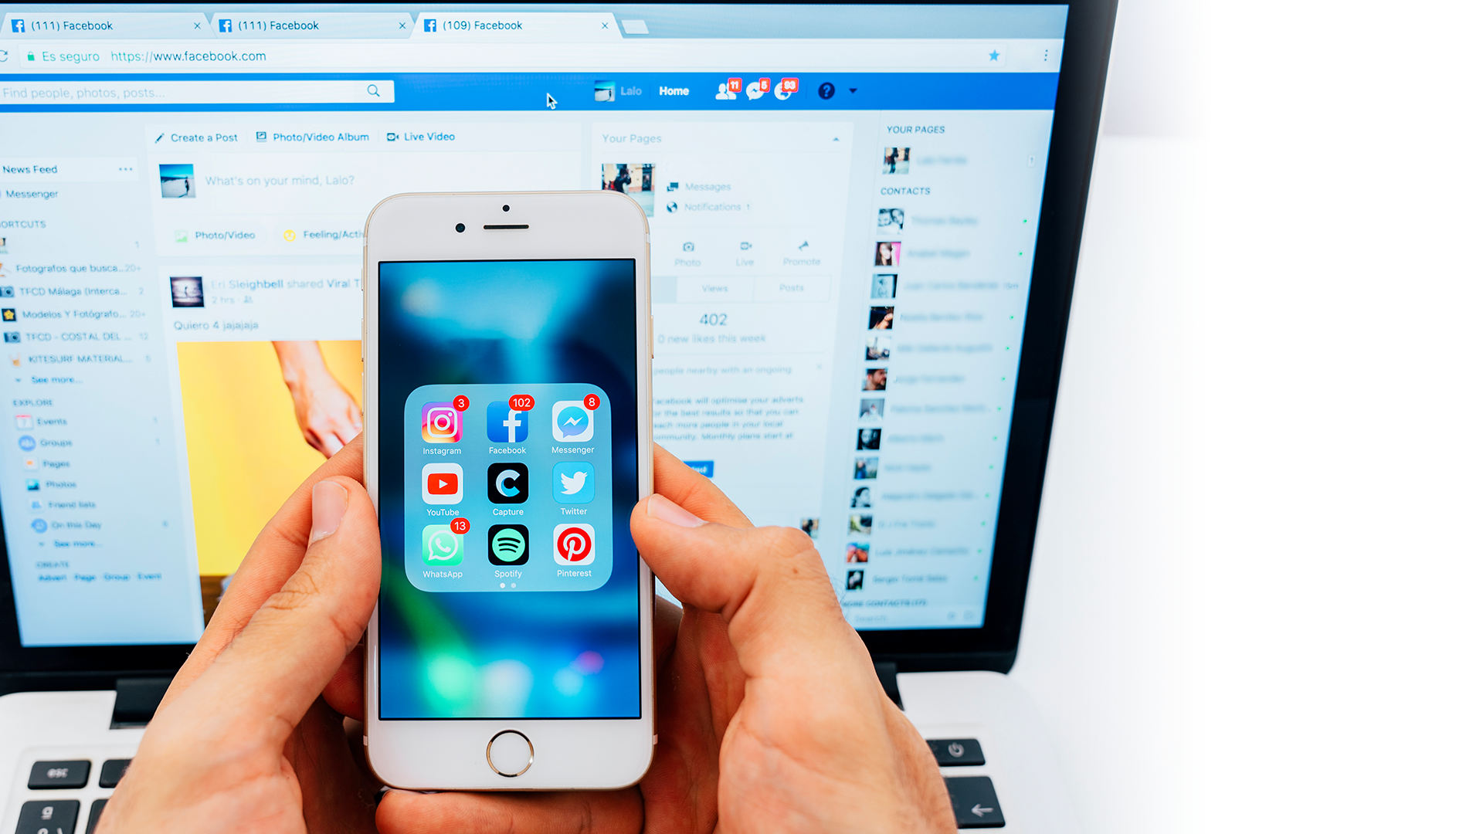
Open your student’s book p.( 11)

Slide 22
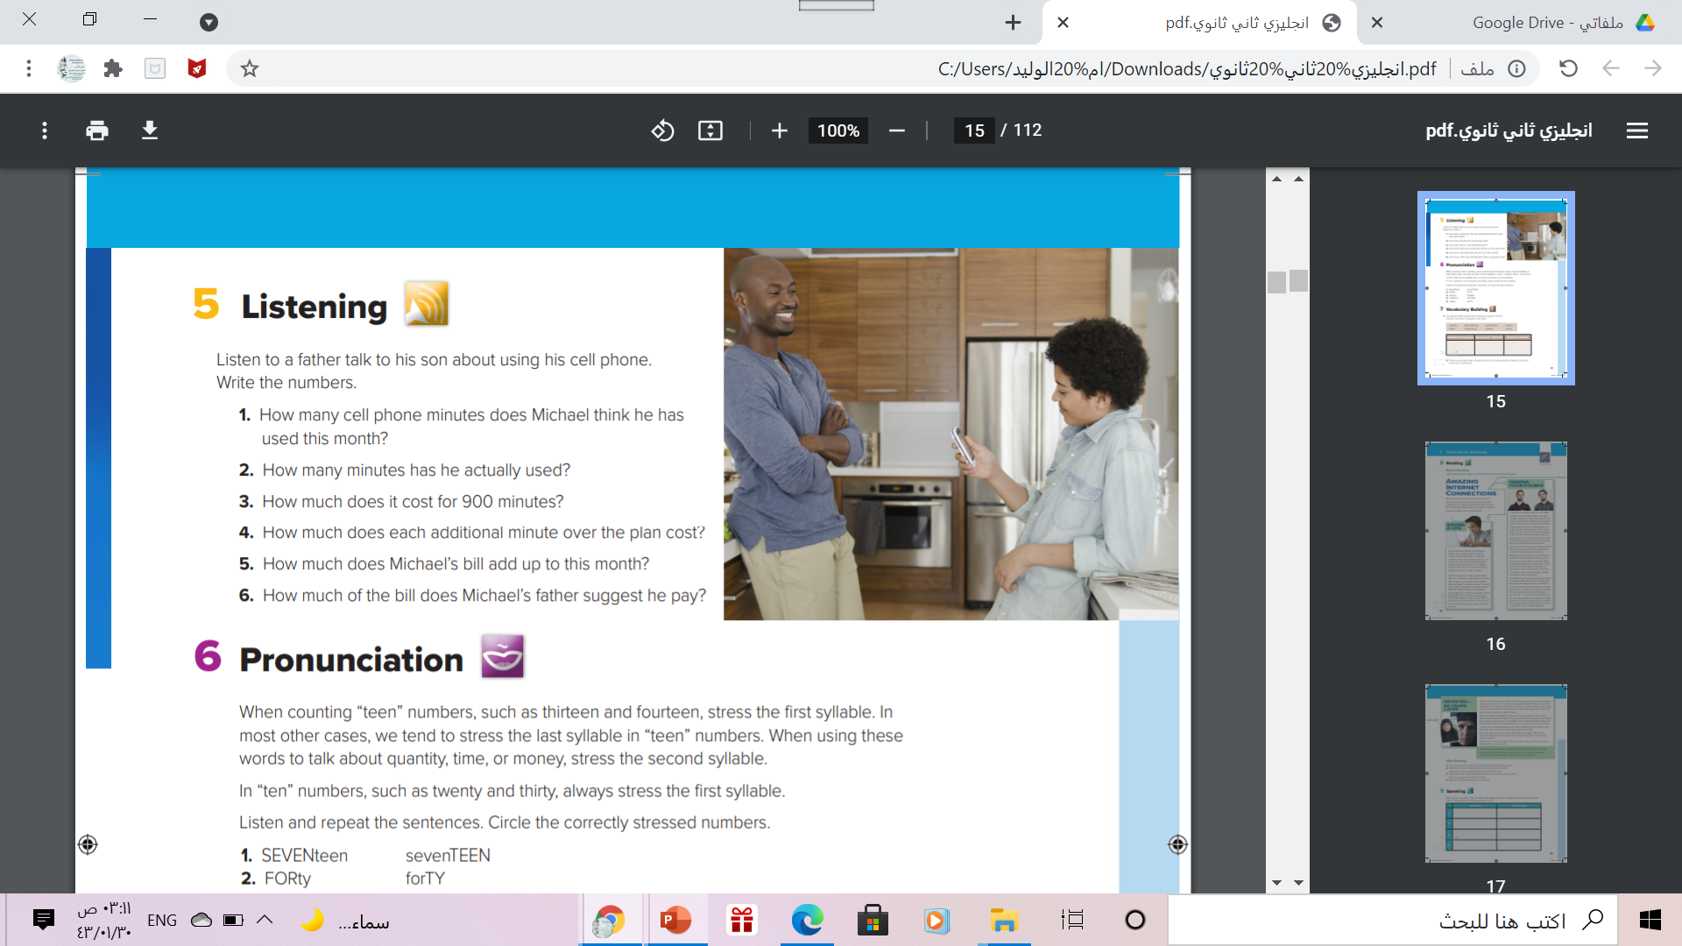
Listening

Slide 23
Listening
300
950
$79
$0.40
$20
one-third

Slide 24
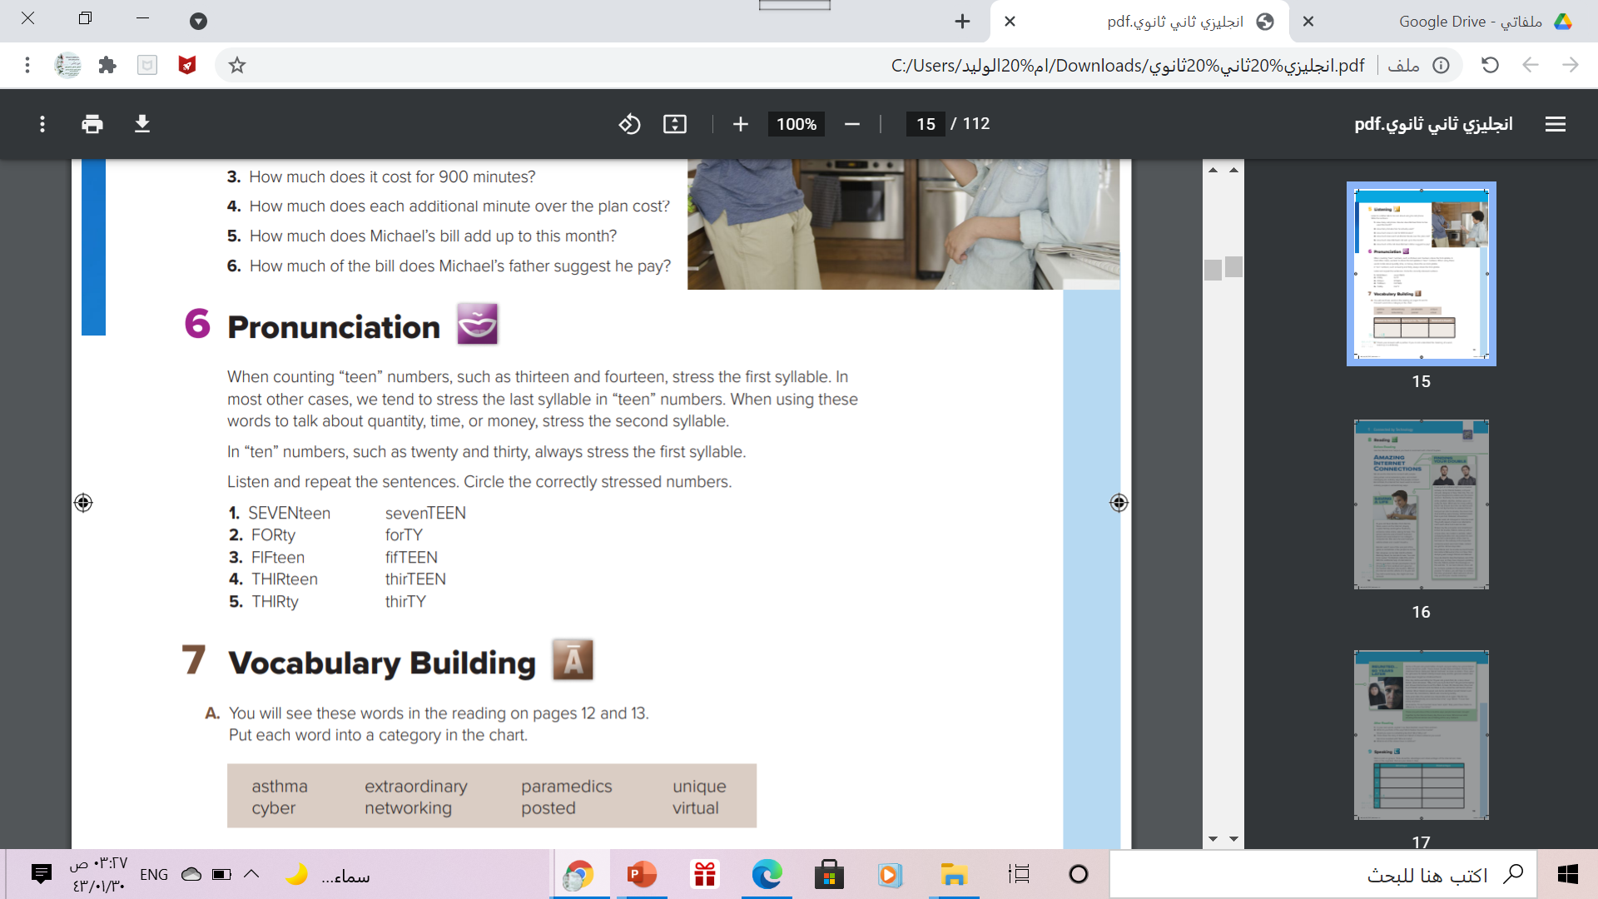

Slide 25
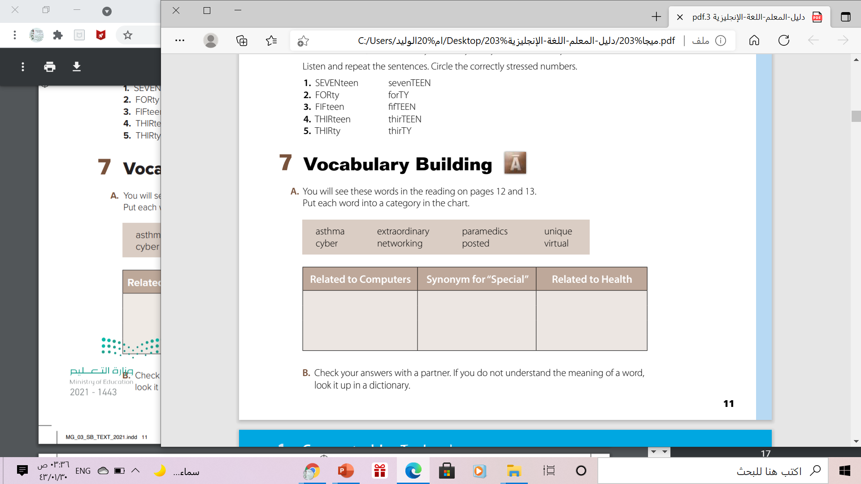
networking, virtual,
cyber, posted
unique, extraordinary
asthma, paramedics

Slide 26
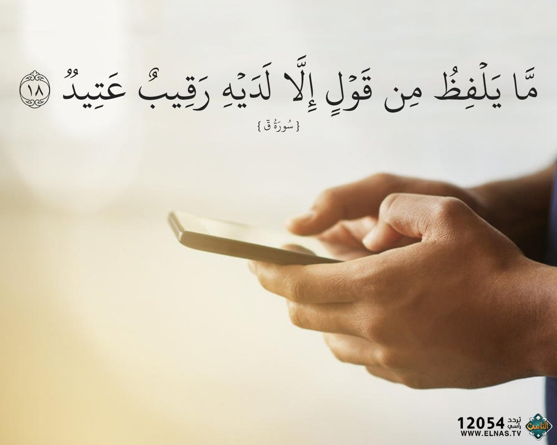
From The Holy Qura’an

Slide 27
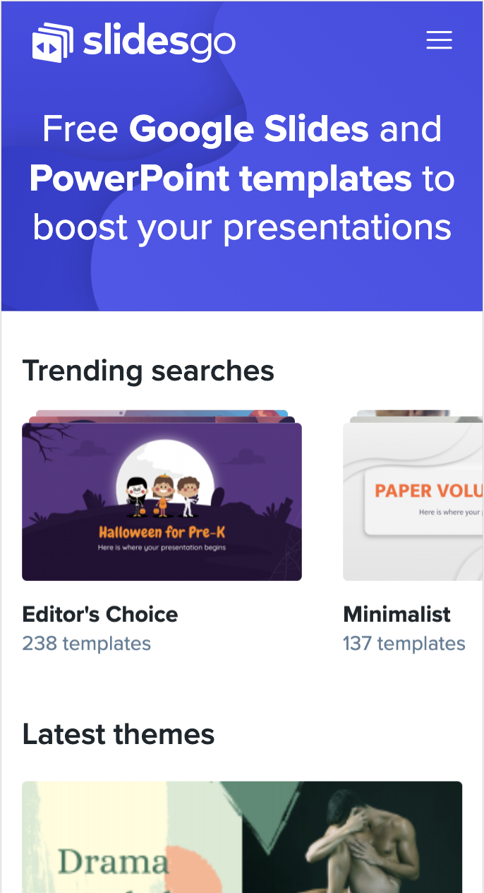

Homework
Workbook, P.(85),
exercise ( E)(

Slide 28

Thanks

