Slide 1
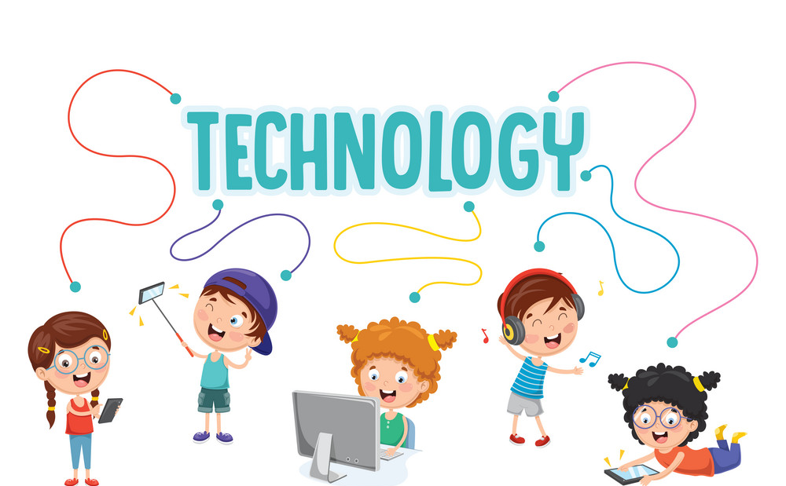
Connected by
conversation
By : Asma AlMjlad

Slide 2
Objectives
1
2
Asking about clarifications in a conversation
3
Make use of ( real talk ) phrases in conversation
Jude some teens habits

Slide 3
Where do you see this symbol ?
What do you think it is refer to ?

Slide 4
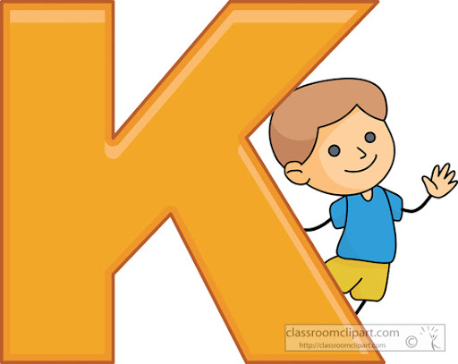
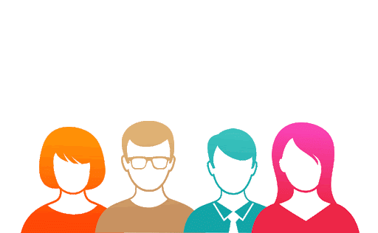

Slide 5
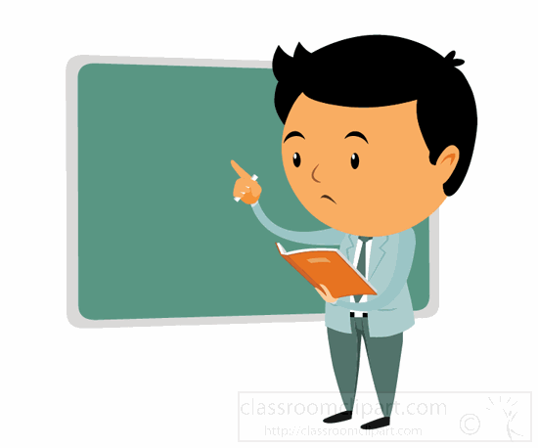
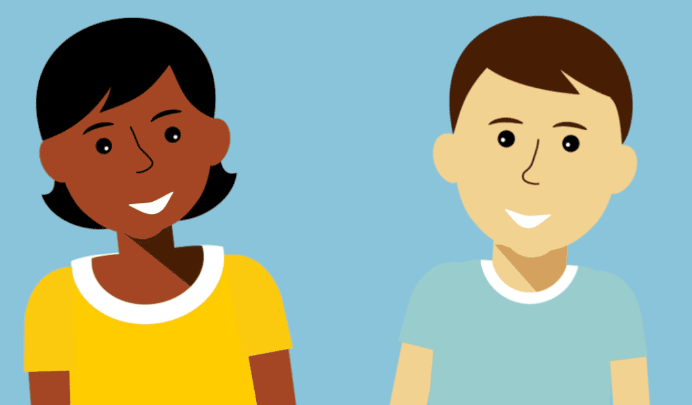
Hi I’m T. Fahad
Hi I’m Dr. Ahmad
He is a teacher
He is a doctor

Slide 6
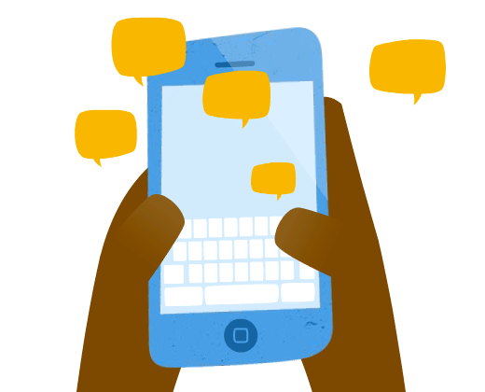
Is texting a common means of communication?
How do people text in your language?
Do you use abbreviations?

Slide 7
@ page 8 + 9

Slide 8
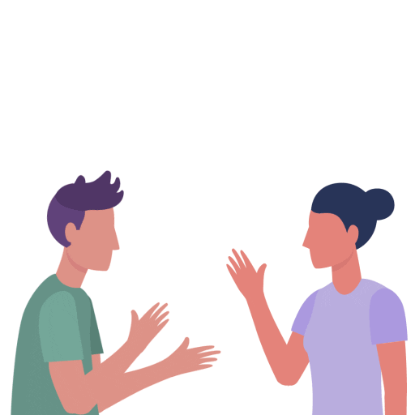
How many characters in this conversation ?
Who are the people?
What are they probably talking about?

Slide 9
What’s Cara doing?
Does Cara’s grandmother know how to text?

Slide 11
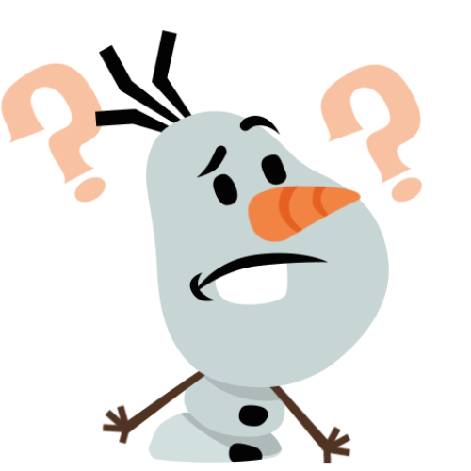
Who says How on earth?
Who says Hold on?
Who says hang out?
Who says got the hang of it?

Slide 12
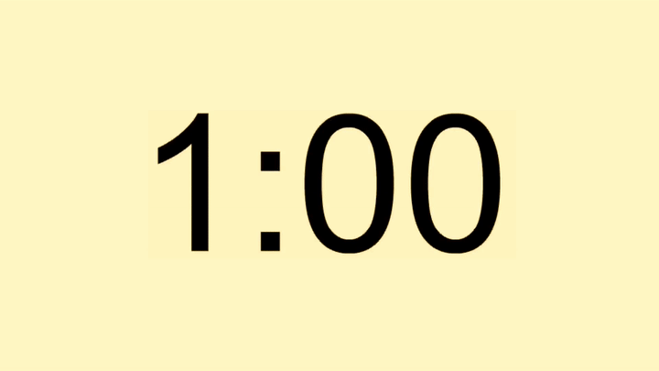
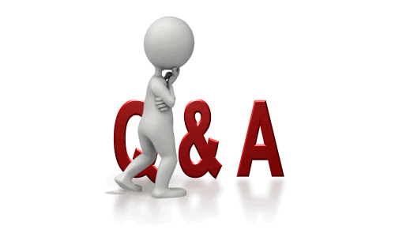
1. The grandmother doesn’t understand how Cara types a text message so quickly.
2. The grandmother learns the acronym, “DYWT,” or “do you want to.”

Slide 13
Which things would you say when you don’t understand something or want an explanation?
What do you say when you understand something?
What do you say when you want to know if your explanation is clear?

Slide 14
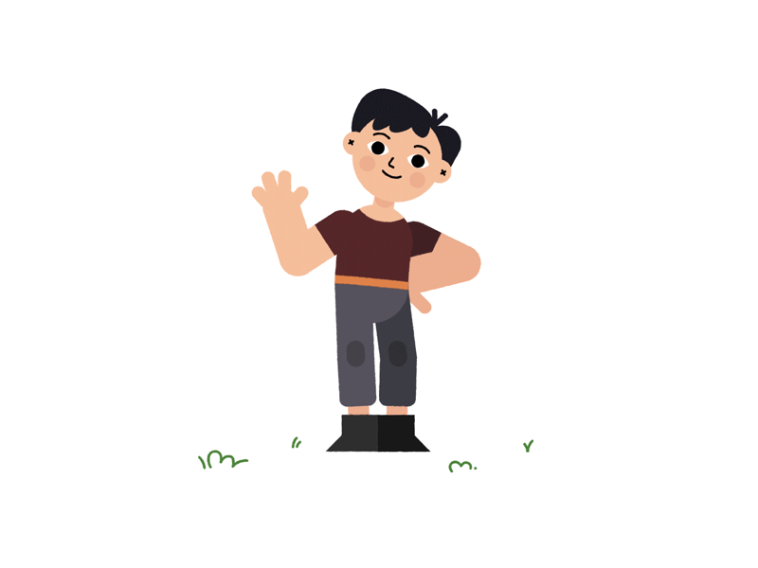
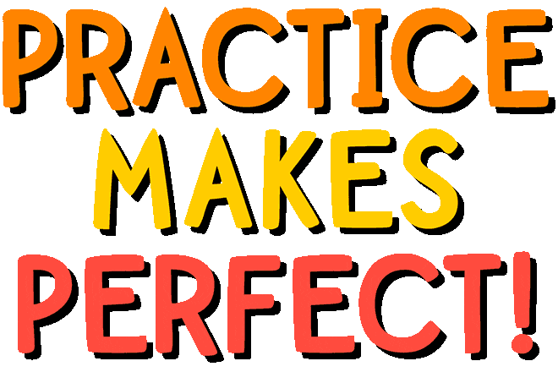
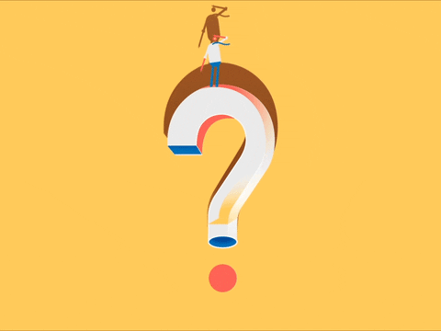

Slide 15
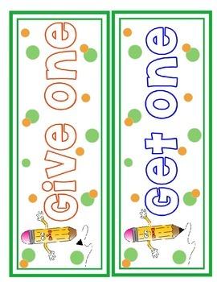
THX
IDK
SYS
DM

Slide 16
WRU?WU B ovr sn?
HzNGT meet us. Hz Bzy
Wz gvnULTInformtn?
OC, ILDI4U. UVhelpt meSMTmz.
√ TStrOTCrnr. It’s Chpr

Slide 17
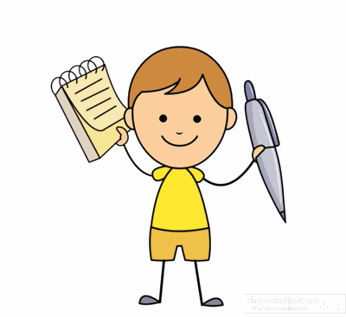

Slide 18
By: ET Asma AlMjlad

