Slide 1
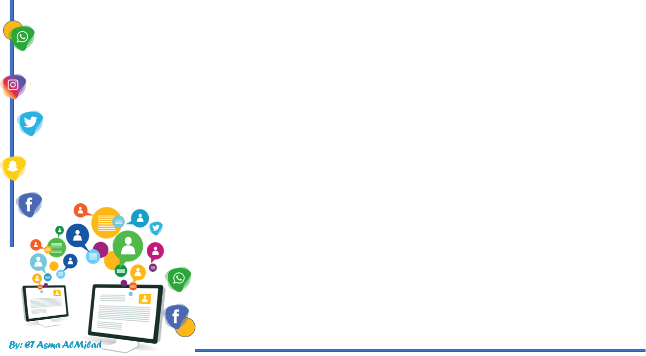

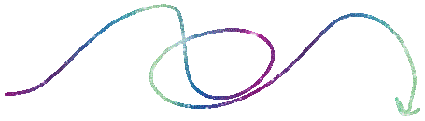
    Connected by
Reading
By : Asma AlMjlad

Slide 2
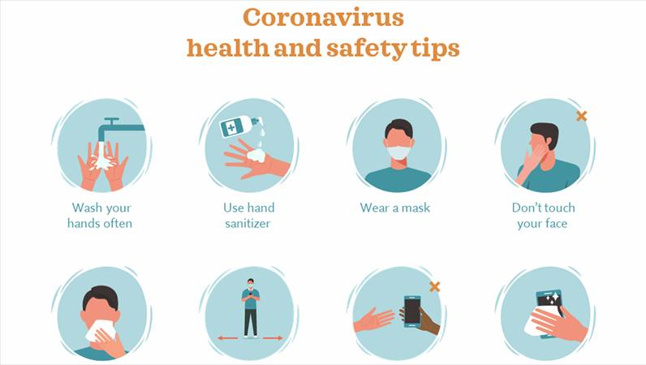

Slide 3
Objectives
1
Summarize a story about reconnecting with a friend via the internet
2
Name ways to connect via the internet
3
Answer questions about the text

Slide 4
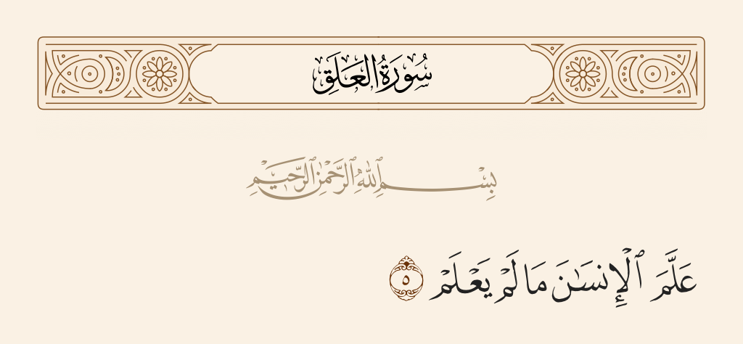
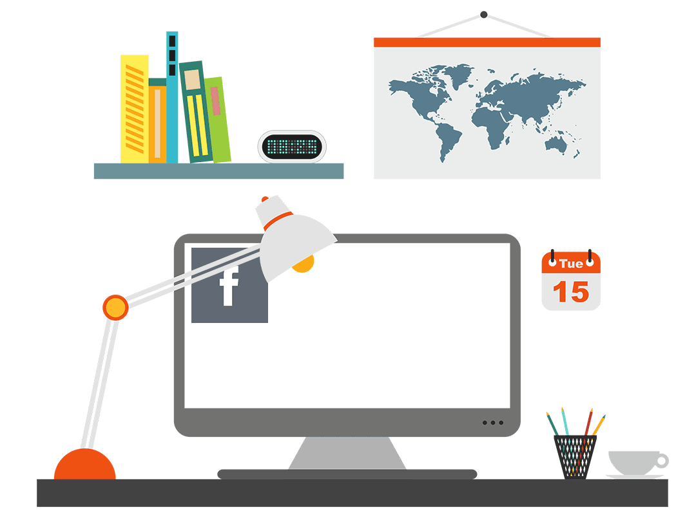

Slide 5

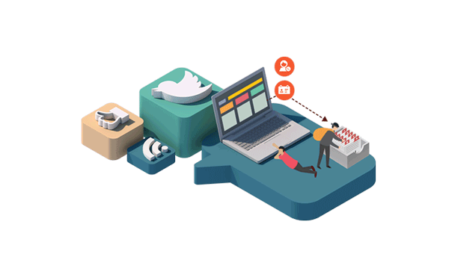
Name some ways to connect via the internet
What do you use the internet for ?
Has the Internet ever helped you meet or reconnect with a friend?

Slide 6
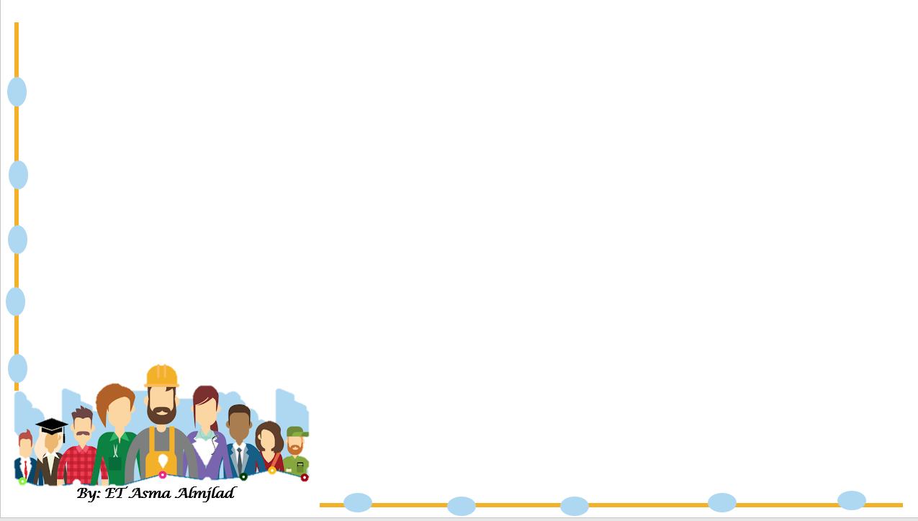
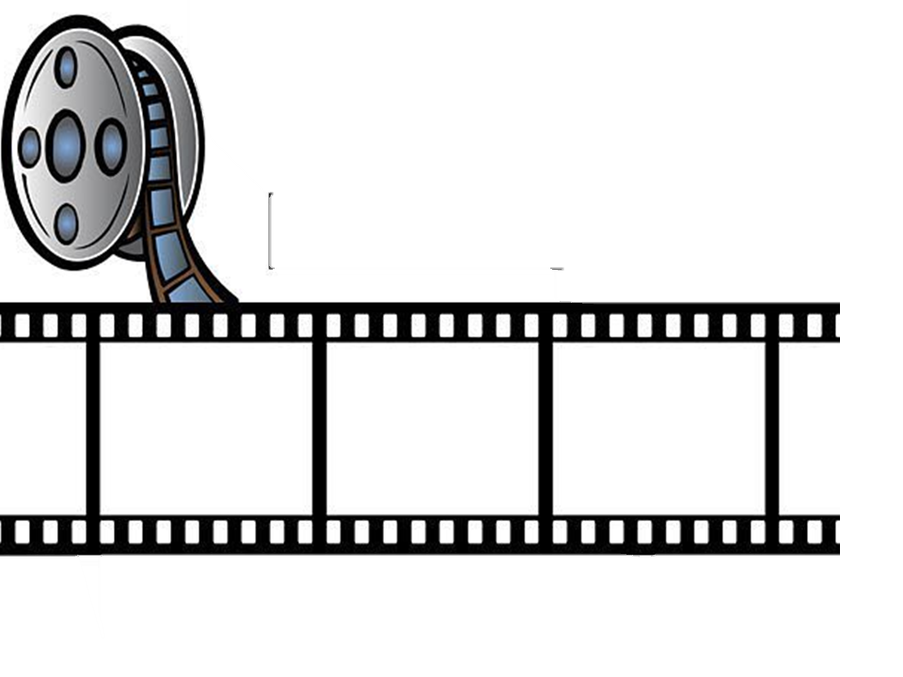
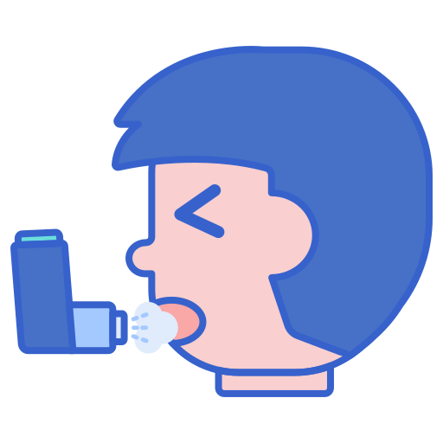
Let’s remember
Tom suffers from …….…..attack .

Slide 7
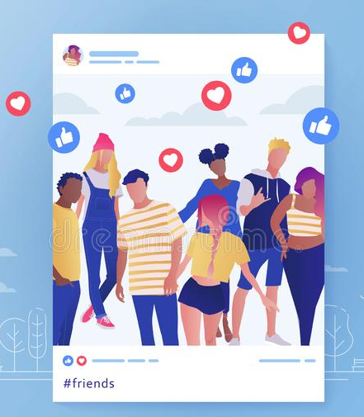
Let’s remember
You ………. your photo on Instagram .

Slide 8
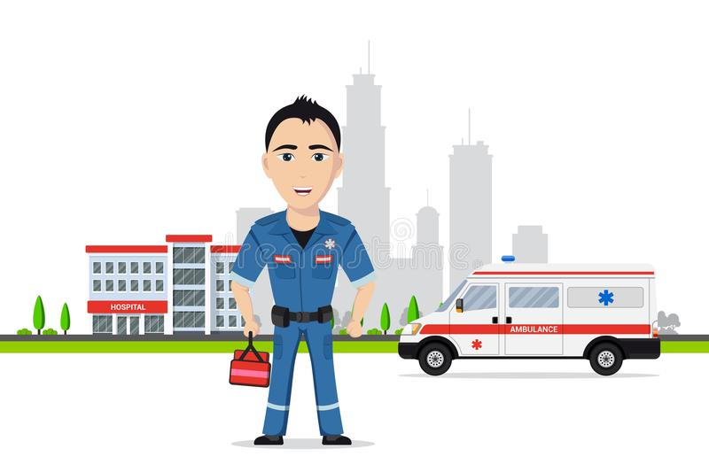
Let’s remember
a person who is trained to give emergency medical treatment ……………....

Slide 9
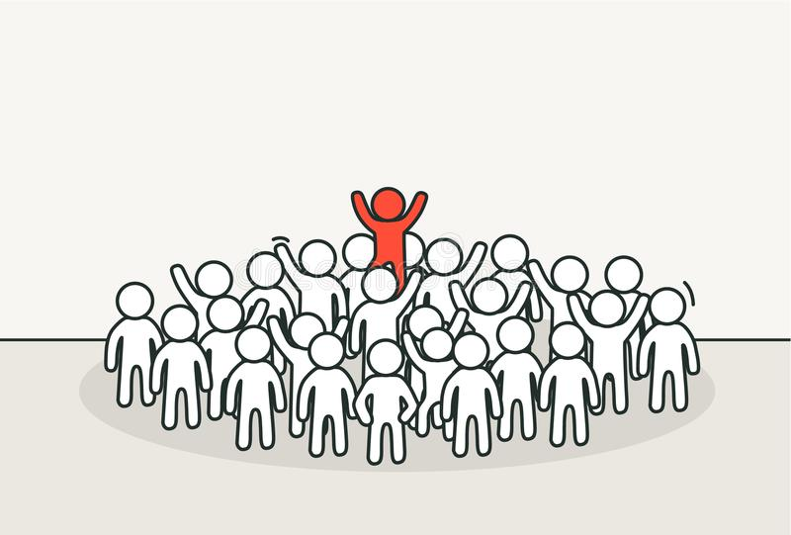
Let’s remember
You have to be ………and different

Slide 10

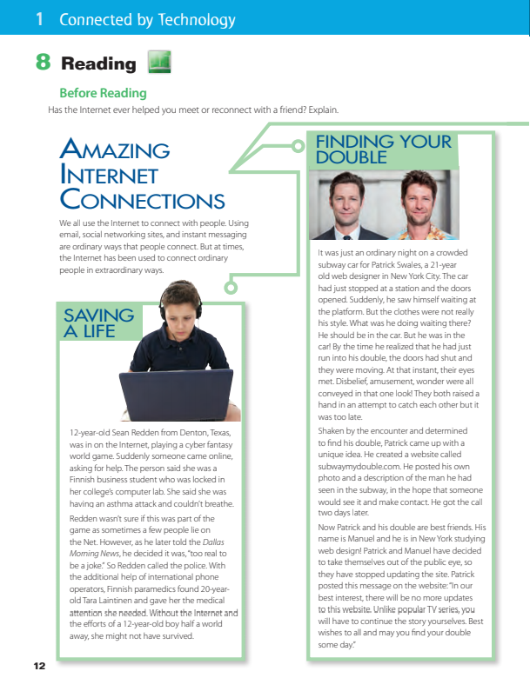
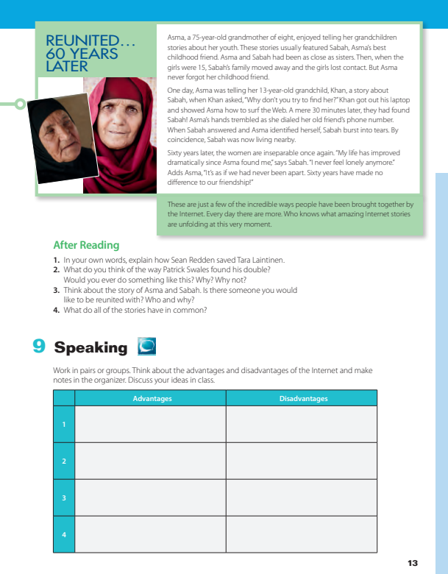
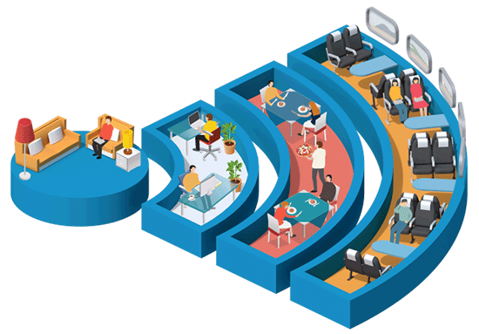
Open your book @ page 12-13
What is the tittle ?
How many paragraphs are they ?
What can you see in this pictures ?

Slide 11
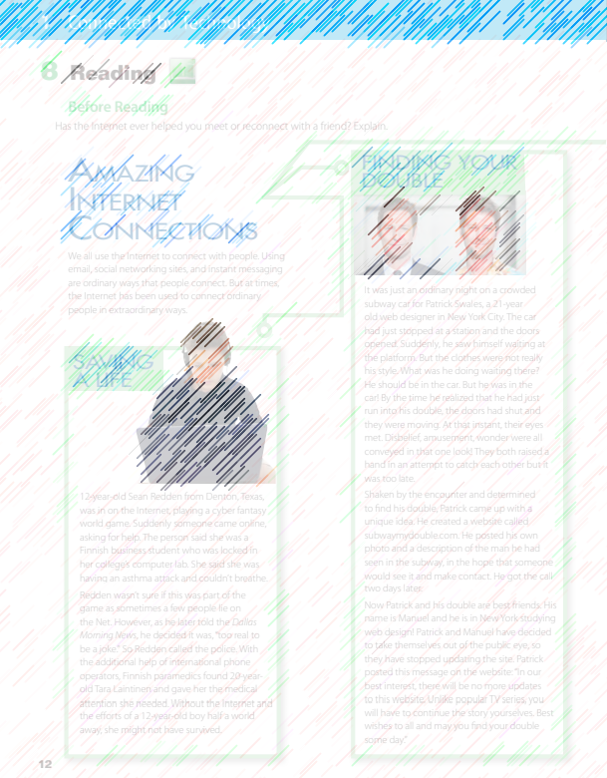
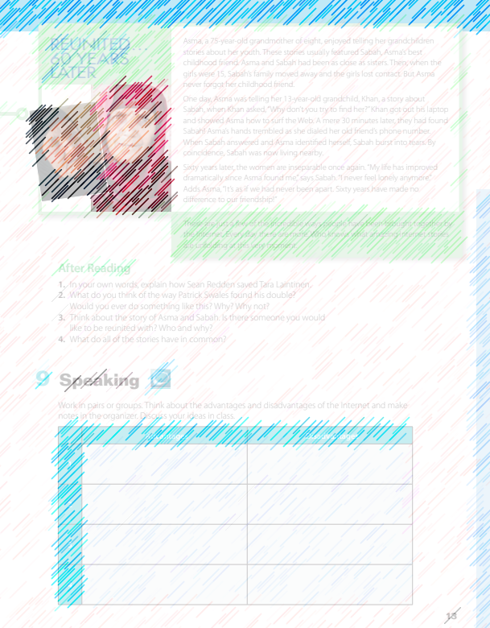
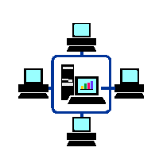


Listen

Slide 12
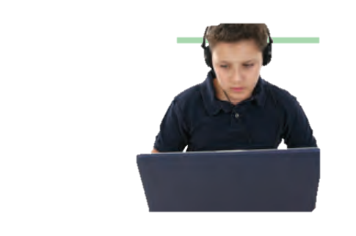

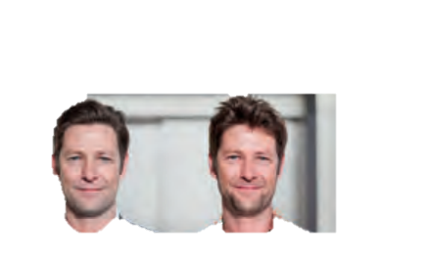
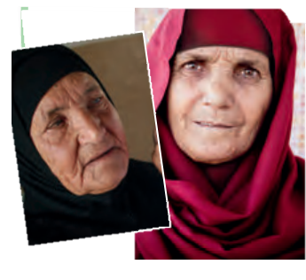
What can you tell about the people in the pictures?
How old are they?
Where are they?
What are they doing?

Slide 13
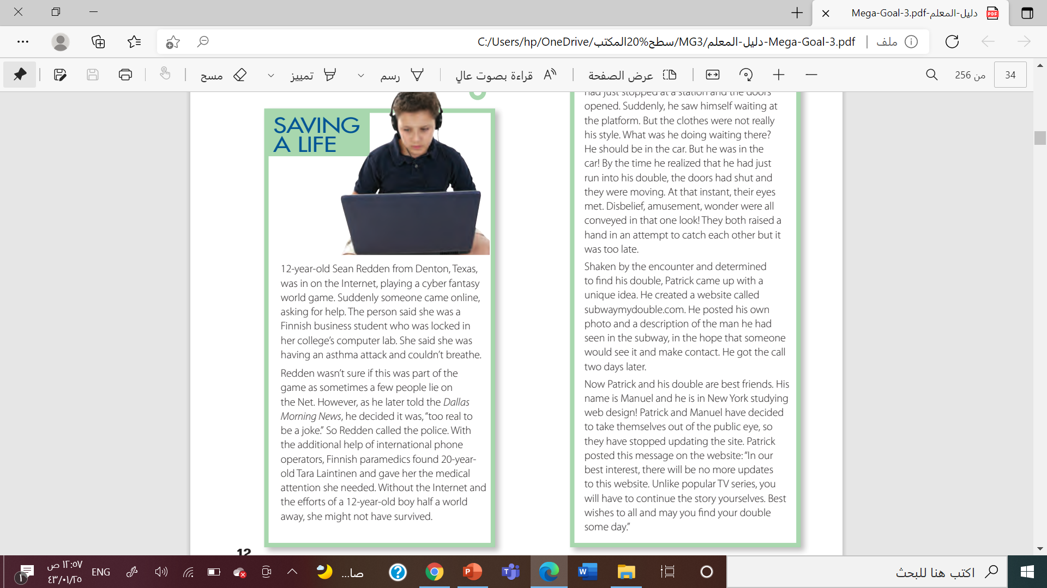
What was Sean Redden doing?
What problem was the Finnish woman having?
Why couldn’t she get help?
Was this part of the game or was it real?
what did Sean do?

Slide 14
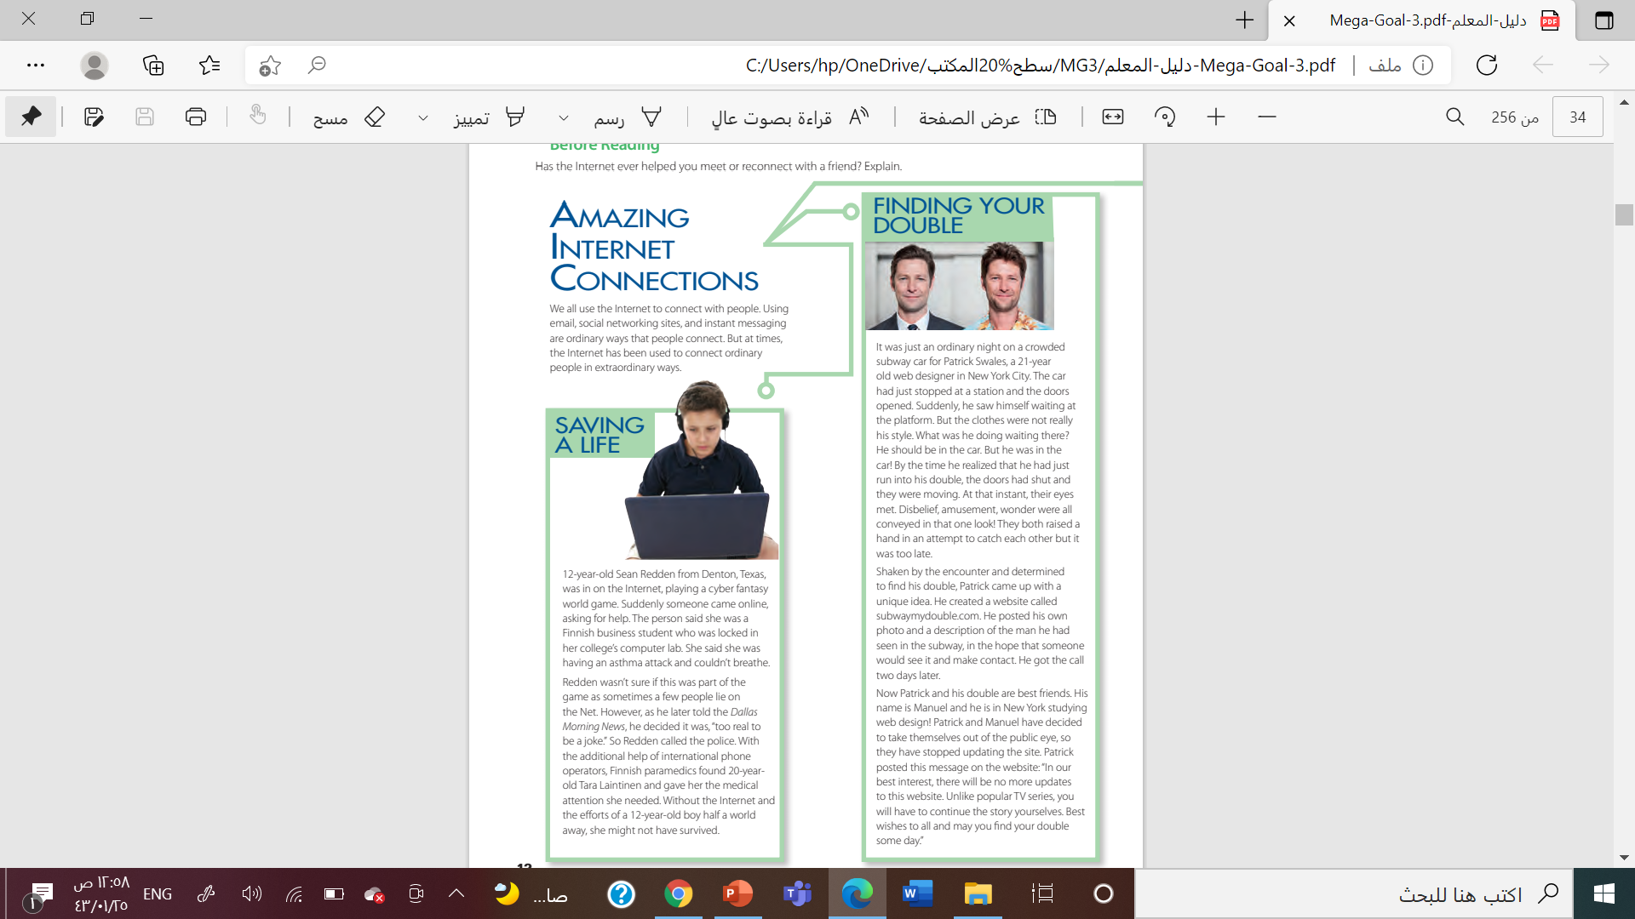
Who is Patrick Swales?
Who did he see on the subway?
Why didn’t he speak to him?
How did he find him?
What are Patrick and Manuel doing now?

Slide 15
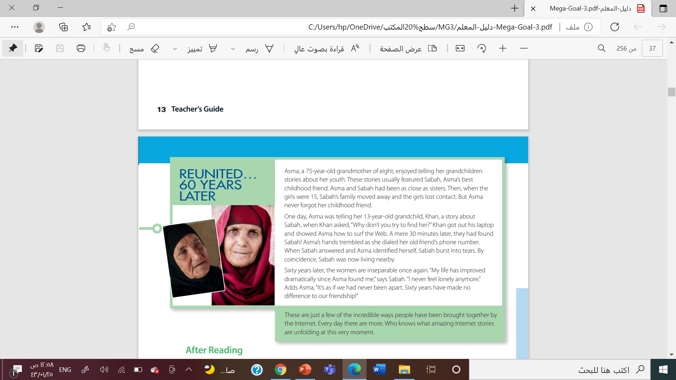
What was the relationship between Asma and Sabah in the past?
Why did they lose contact?
Who helped Asma find Sabah? How?
What is the relationship between Sabah and Asma now?

Slide 16
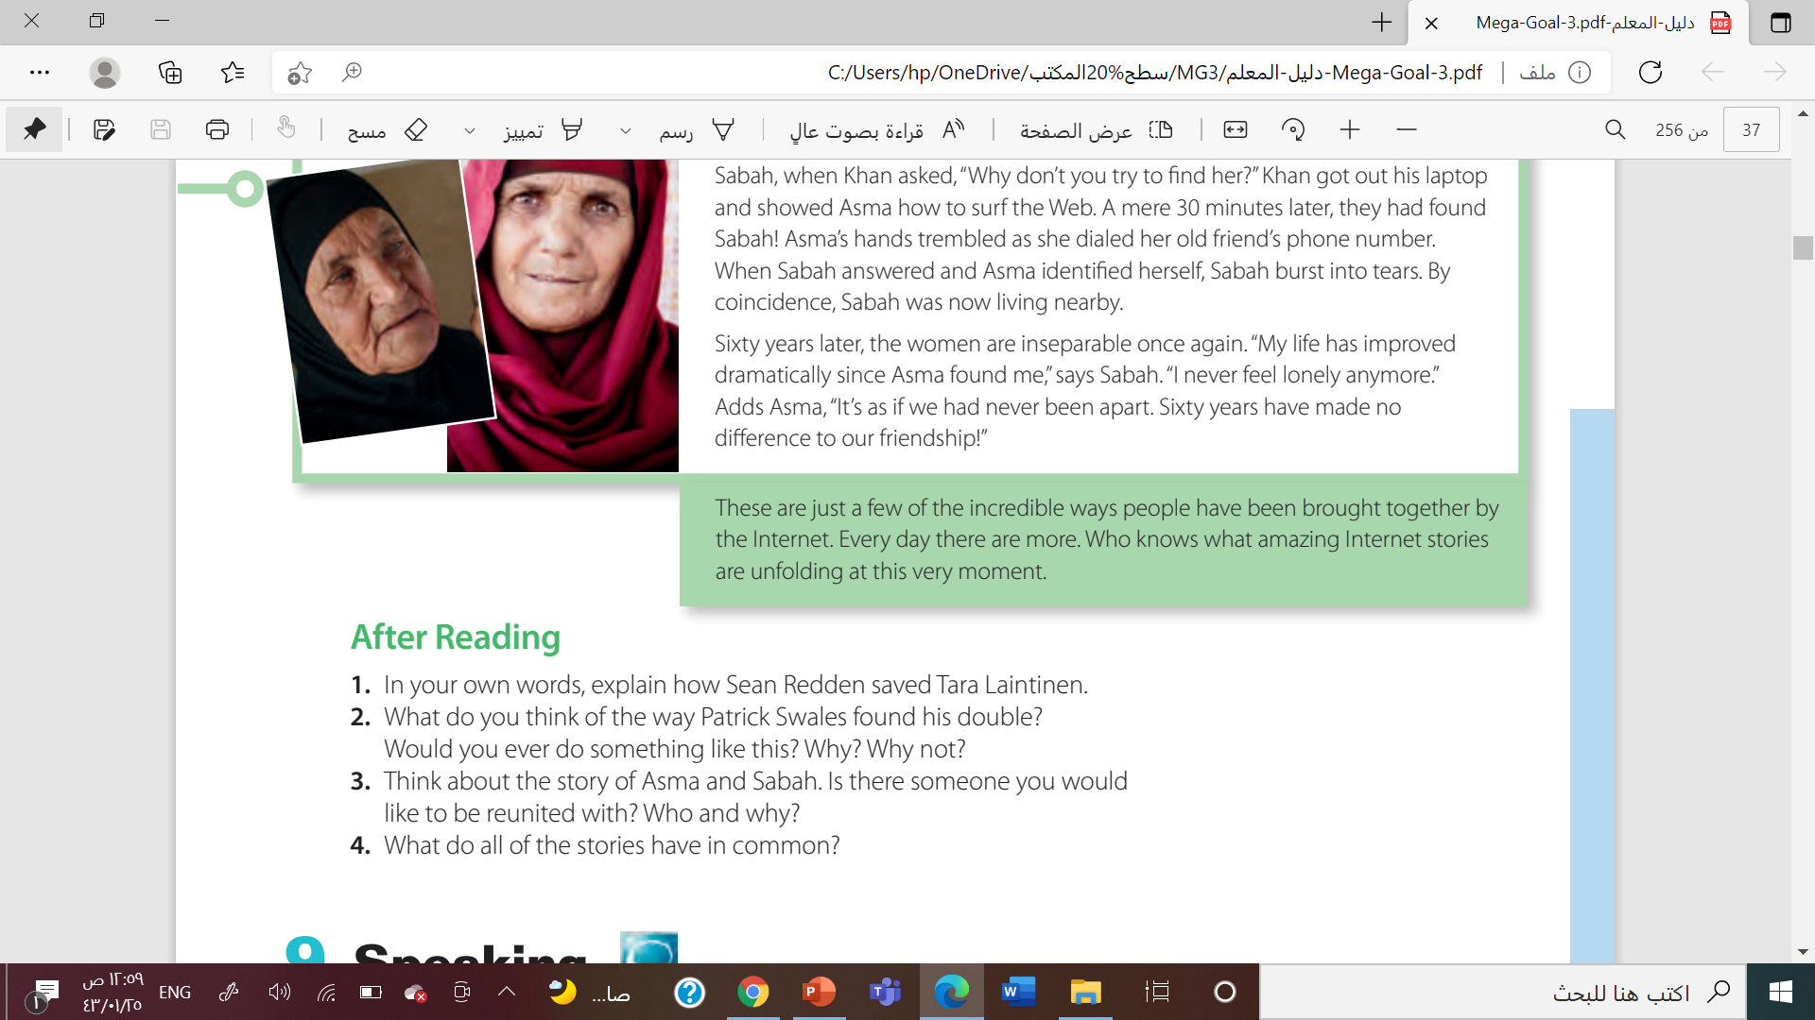
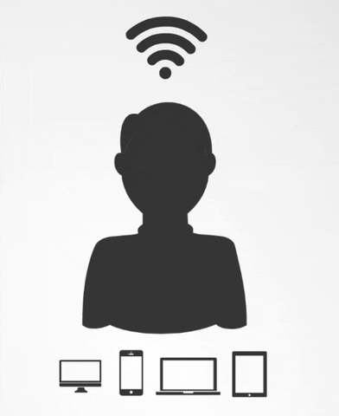

Slide 17
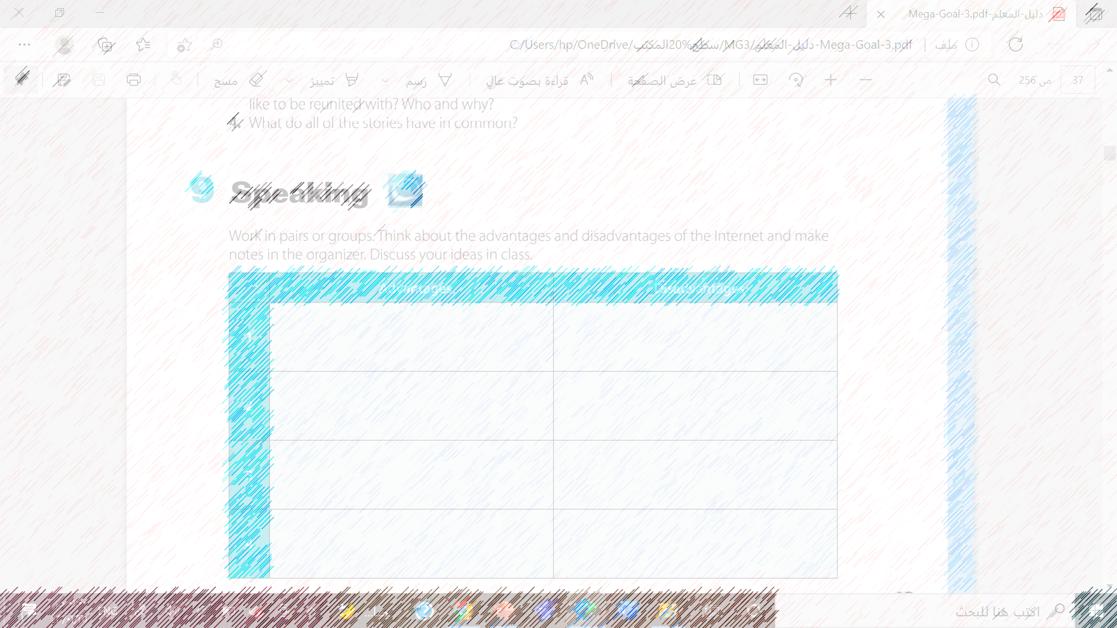
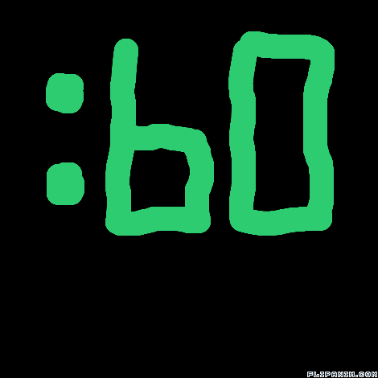
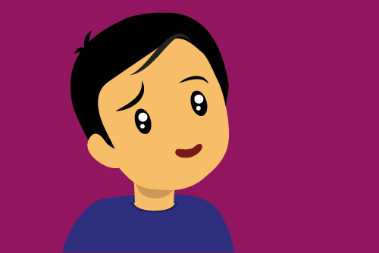


Slide 18
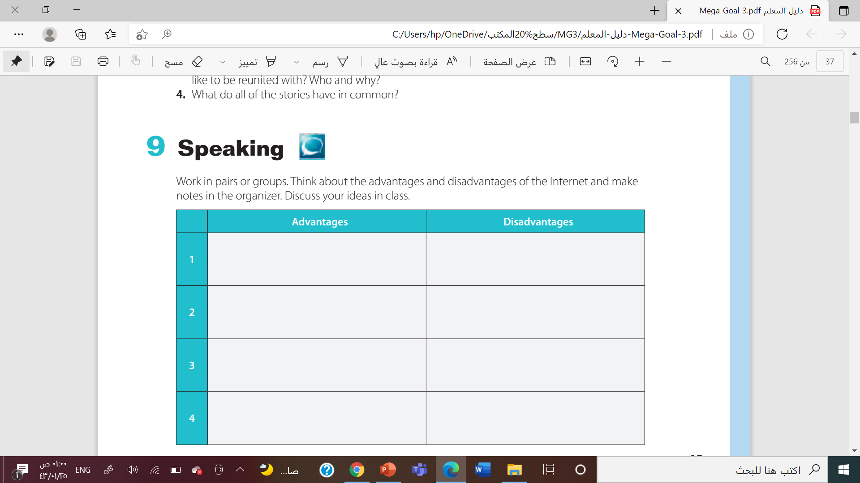
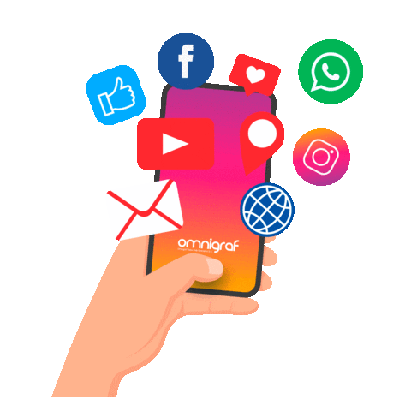
It makes communication much easier
Threat of our privacy
Source Of Information
Waste time
Buying and selling things online
Virus are spread in the internet
Source of Entertainment
Not Safe Place For kids

Slide 19

Work book

Slide 20
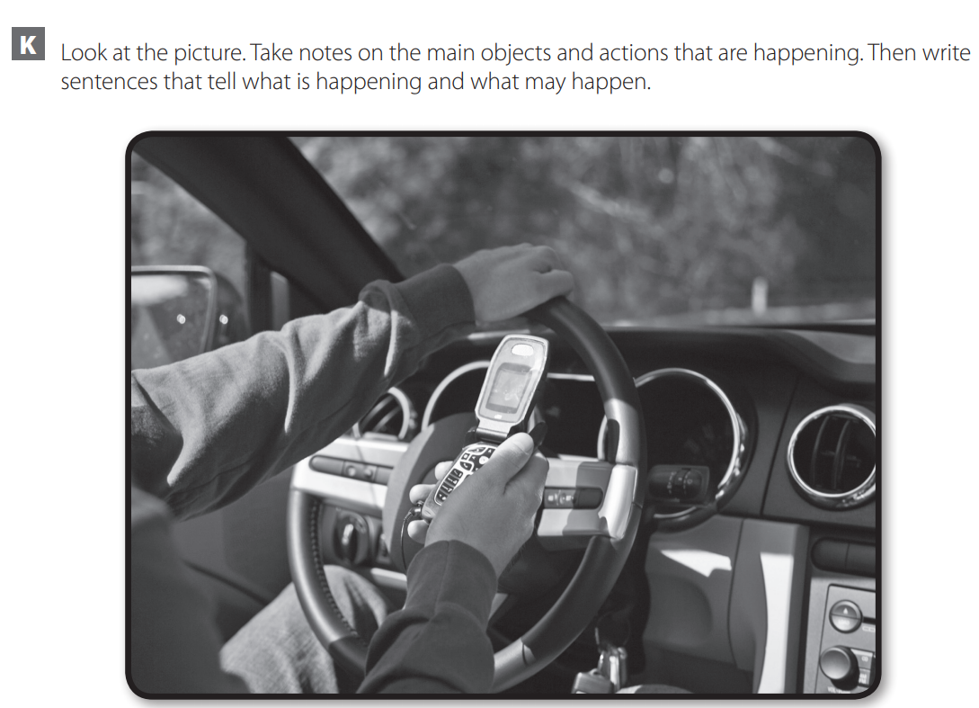
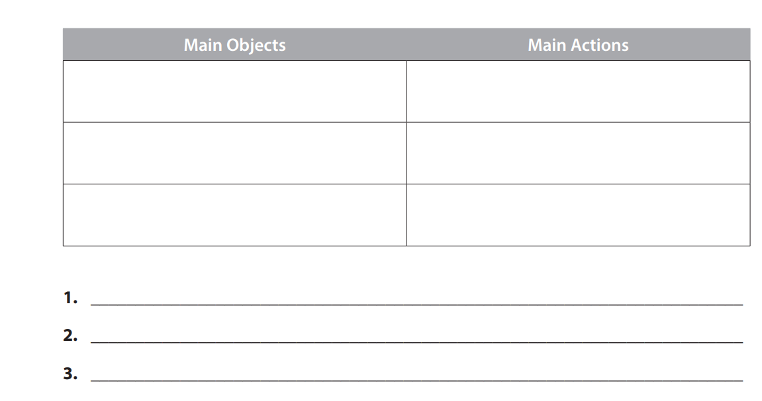

Slide 21


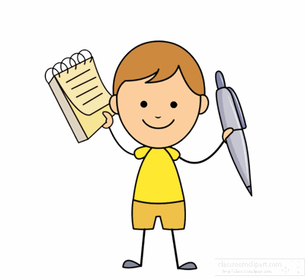


Slide 22
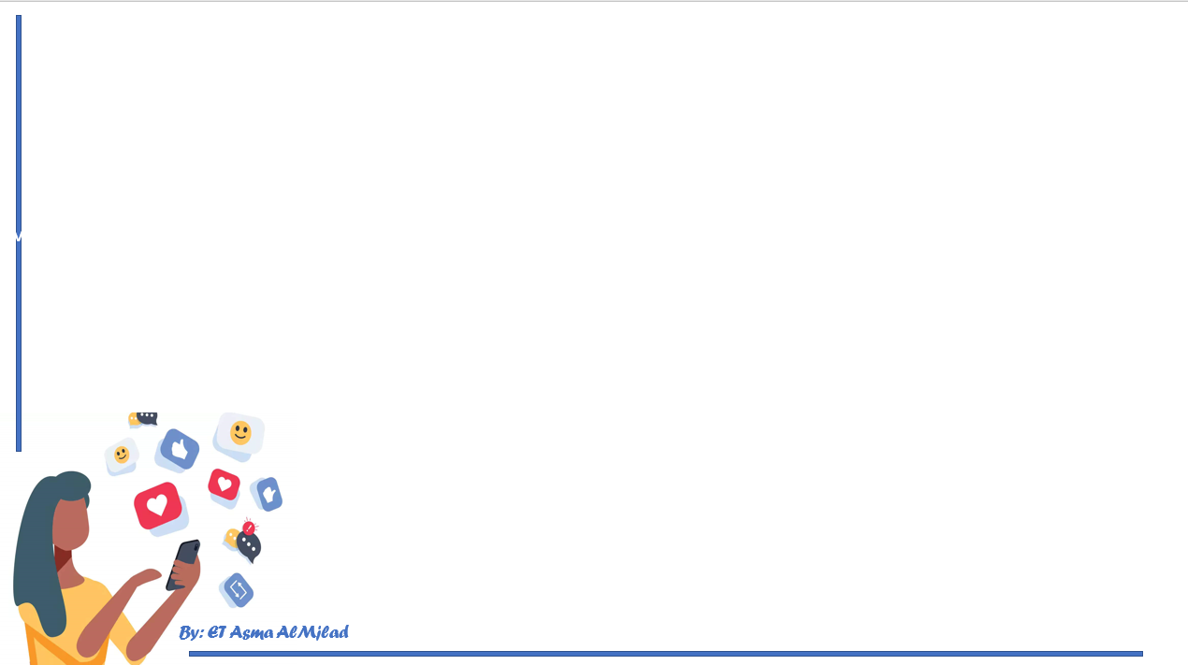

By: ET Asma AlMjlad

