Slide 1
Super Goal 1

Slide 2
Unit 1

Slide 3

The objectives of the lesson :
At the end of this session, the students will be able to :
Follow the rules of writing to correspond questions with answers
Design an organized project

Slide 4
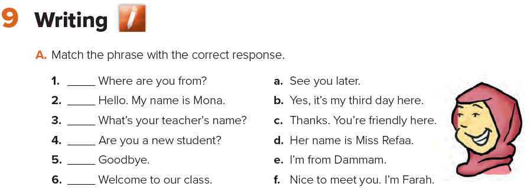
e
f
d
b
a
c

Slide 5
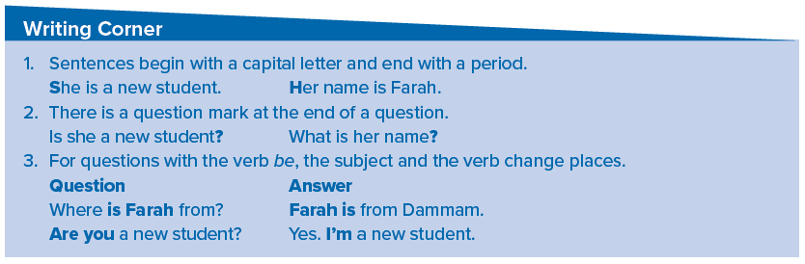
Which other words have capital letters?
Names of people, names of cities, and titles such as “ Miss, Mr., Mrs. ”

Slide 6
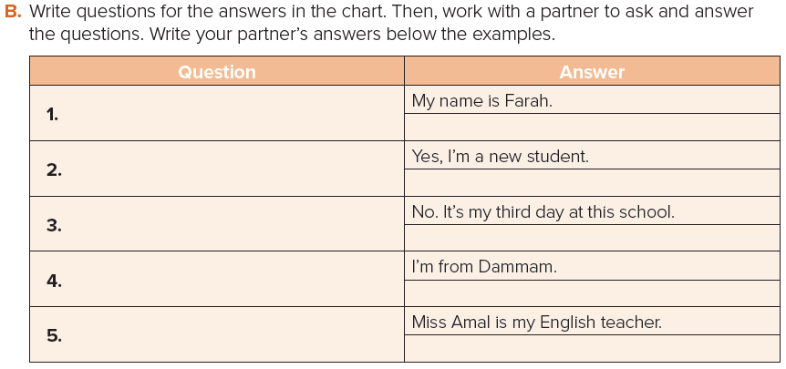
What’s your name ?
Are you a new student ?
Is this your first day at school ?
Where are you from ?
Whose your English teacher ?

Slide 7


Slide 8
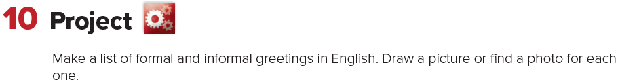


Slide 9

Page 92

