Slide 1


Slide 2


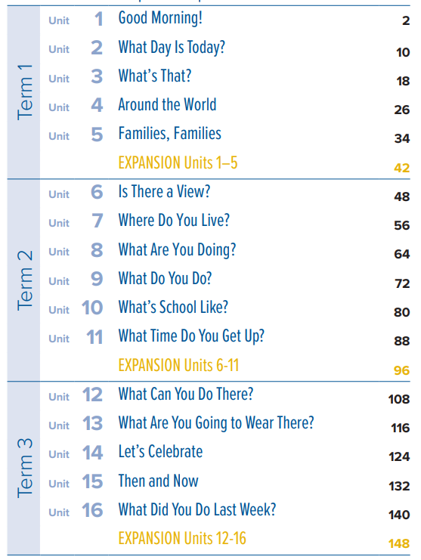

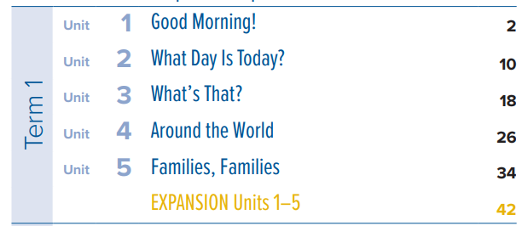


طبعة جديدة
الأول متوسط

Slide 3



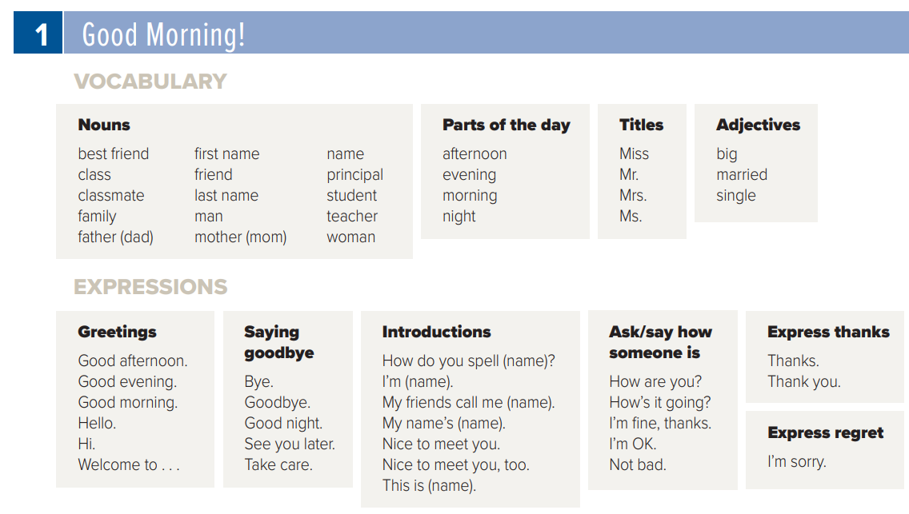
صفحة 156
كلمات تكتب في
دفتر اللغة الإنجليزية
4 كلمات من كل عمود فقط

Slide 4

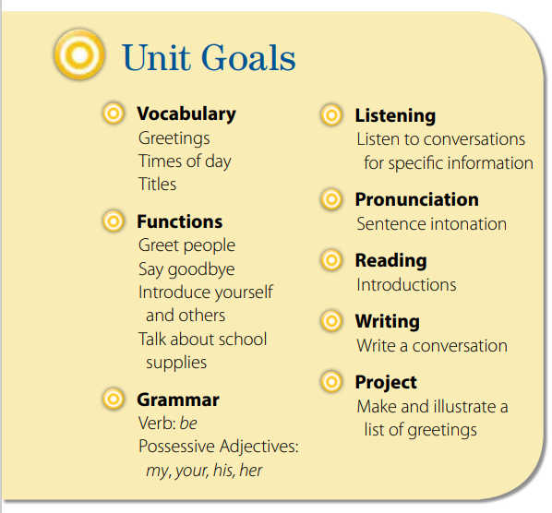

Slide 5


Slide 6

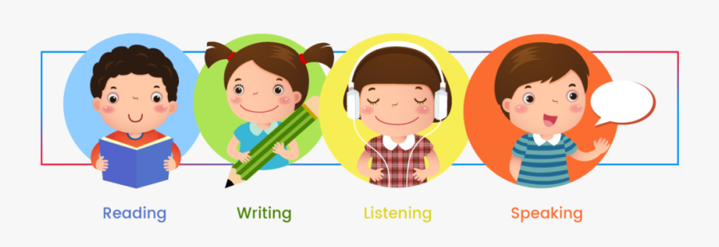

Slide 7
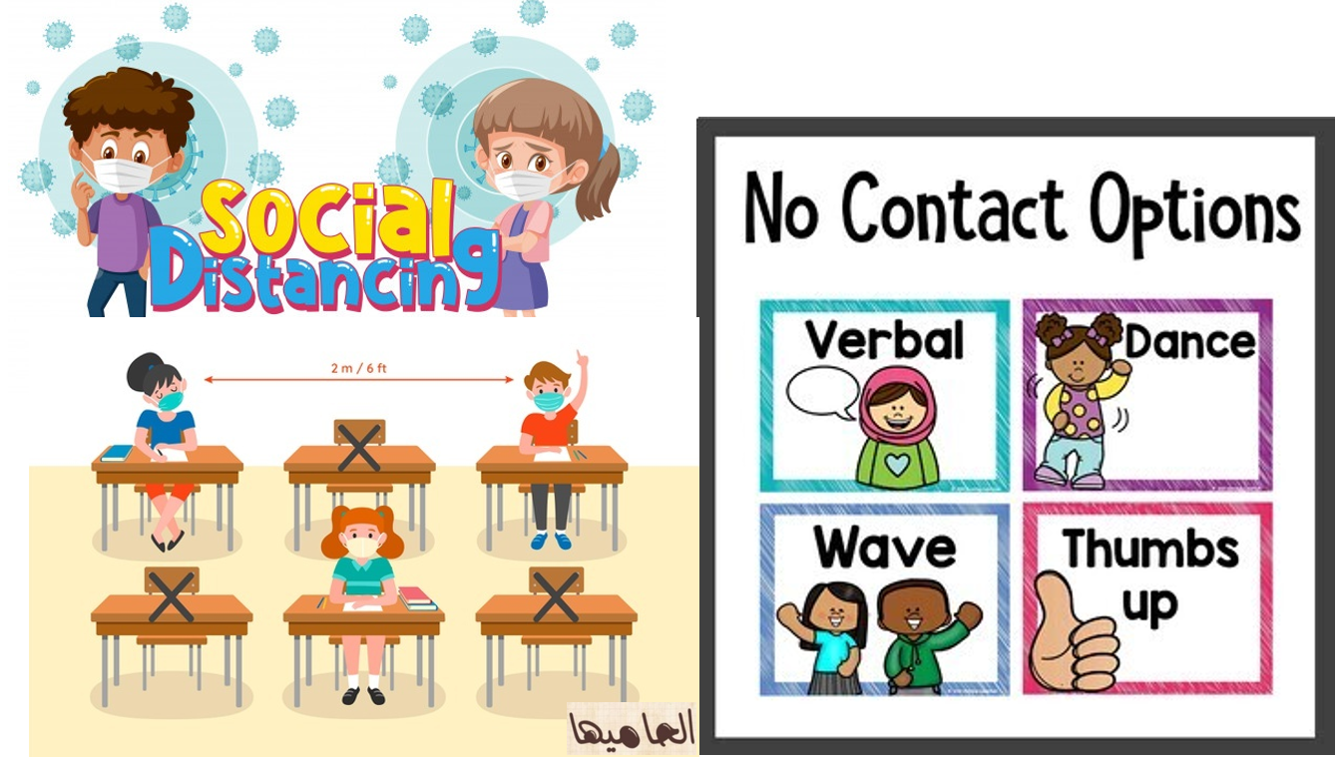

Slide 8
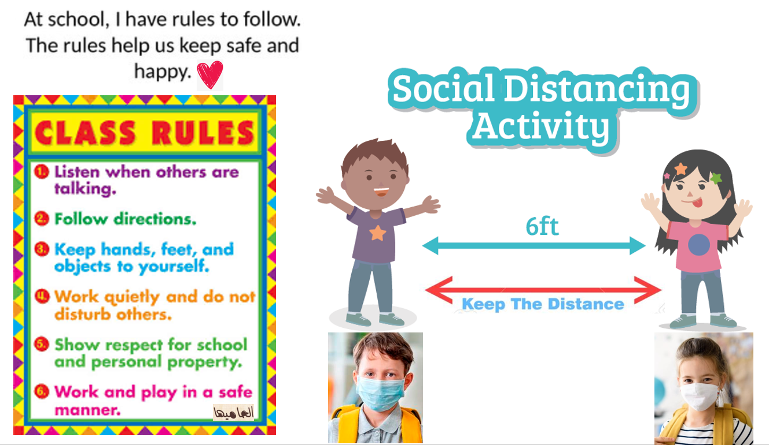

Slide 9
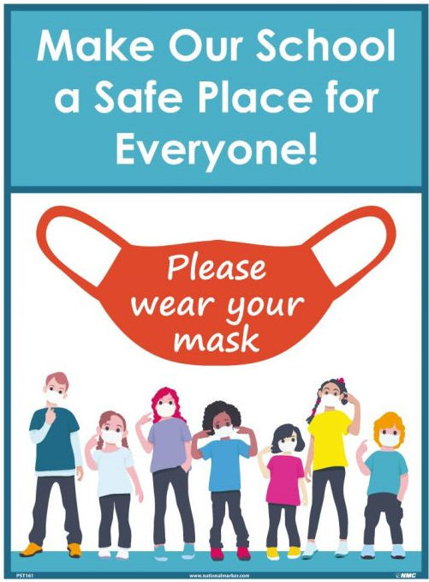
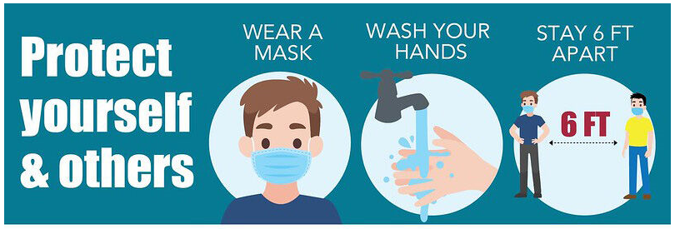

Slide 10
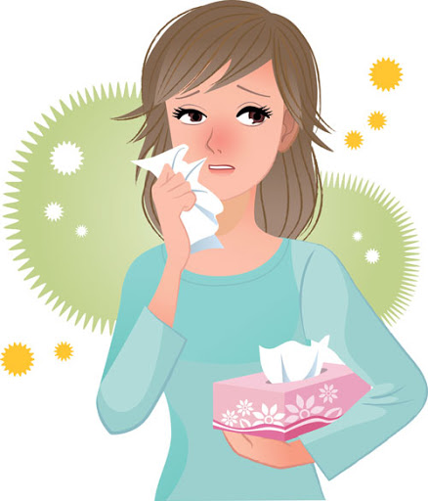
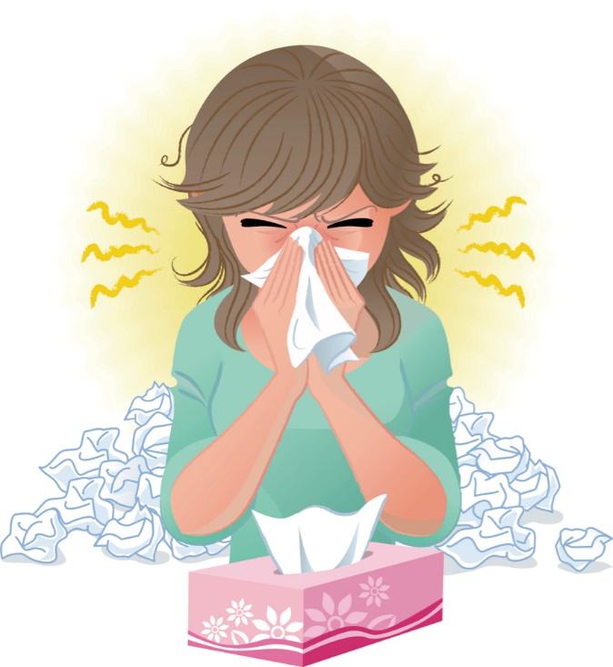
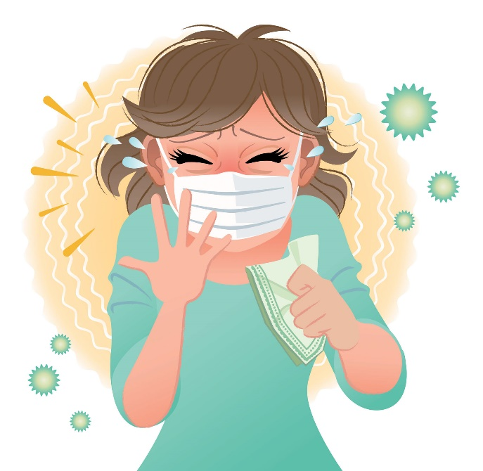
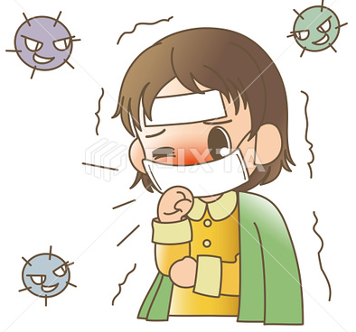
Covid 19
☺Avoid gathering !
☺We must wear a mask before
going out.
☺Social distancing is not a
choice, it is a must!
☺Keep a distance of 2 meters
to avoid accountability
☺wash hands constantly.

Slide 11

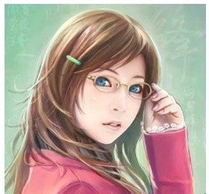







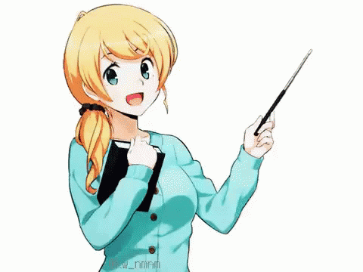
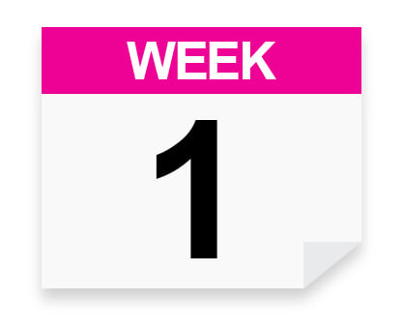
Today: Thursday
Date:
5 -2-1443 H
1st Sept\ 2022
everyone,
How is everything going?

Slide 12
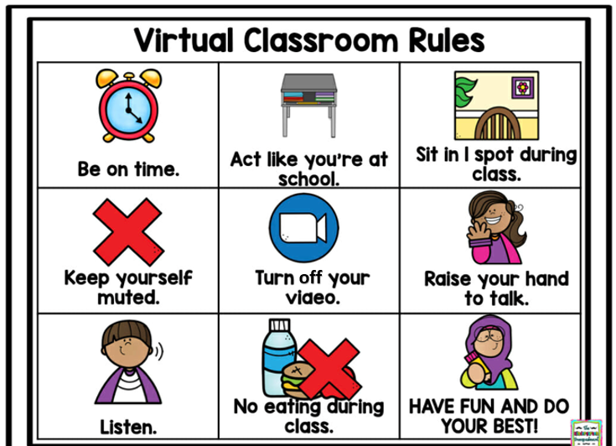

Slide 13
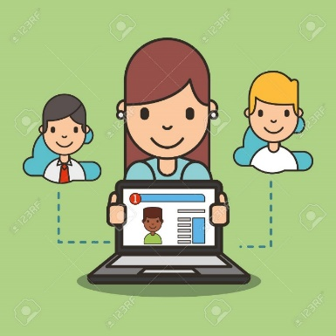



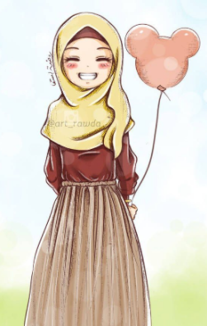
ارجو الالتزام بعدم كتابة أي تعليقات غير لائقة بالأدب العام. علماً بأنه أي محادثة نصية او كتابية مسجلة تحت اسمك ورقم هويتك
وعلية سيتم معاقبة من لم تلتزم بالذوق العام والسلوك الحسن خلال تواجدك في المنصة او الفصول الافتراضية.
وذلك برفع شكوى وبلاغ رسمي ضدك بما تم كتابته او قولة والتواصل مع ولي الأمر والمسؤولين لاتخاذ الاجراء اللازم مع المخالفة.
ونتمنى وضع صوره في ملفك التعريفي لائقة بالمنصة التعليمية

Slide 14
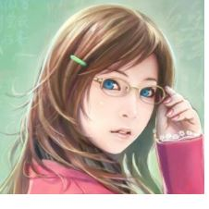



SG1 U1
Page 5 & 6
♥
practice low intonation in questions
give full meaning answers to WH questions
Listen to the conversation on p.6 for specific information
answer questions about a conversation
Make a conversation

Slide 15

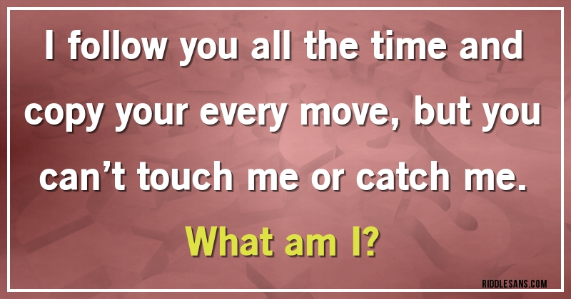

Slide 16
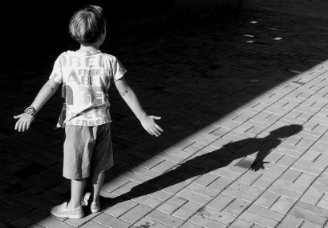


Slide 17

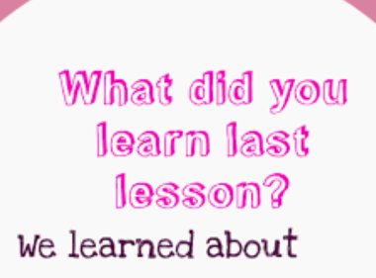

What do you know about greetings.

Slide 18






The subject pronouns

Slide 19

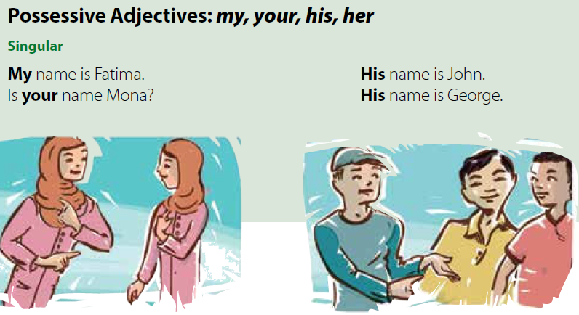
Page 4
Write the possessive adjective
that goes with each
I
you
He
she
my
your
his
her

Slide 20


Imagine that Rasha is new in your class.
What will you say to her?
to elicit simple questions like asking about ( name - nationality ......etc ☺

Slide 21







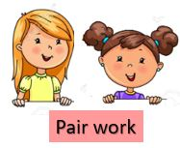
Page 5
practice the pronunciation of questions.
Does the speaker’s voice go up or down at the end of the question?
It goes down.
Repeat or speak along with the recording.
Practice asking and answering the questions

Slide 22

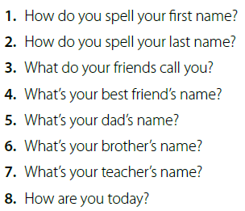

Page 5
Read the list of questions.
Take turns asking and answering the questions.

Slide 23
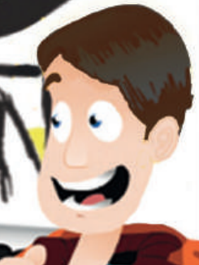
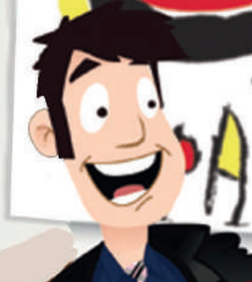


Choose the correct answer:
Character map
Carlos
Rick
Unit:1
works in a company as a ………
travels to……..
Carlos
Ricks
SG1
driver
chef
France
Spain
Conversation
Carlos picks up passengers
from the ..…
Page 6
Rick is very …..
1443H
2021
hospital
bored
T.Noureyah Alghamdi
airport
excited
Friday 19th of Muharram 1442
March24th \2021
https://www.liveworksheets.com/1-cs2097882td

Slide 24
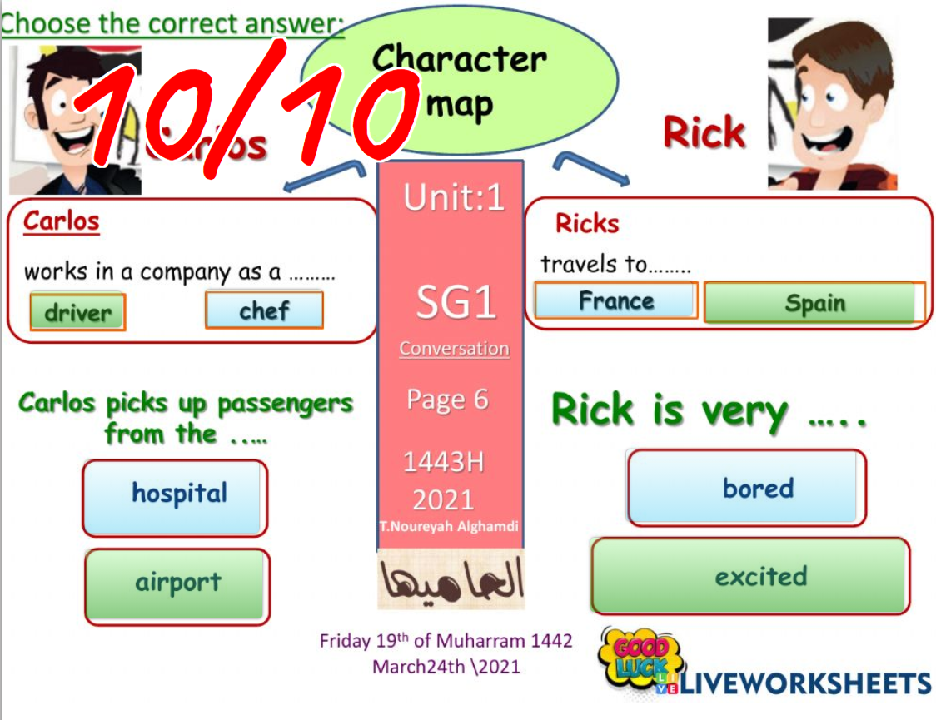
https://www.liveworksheets.com/1-cs2097882td

Slide 25



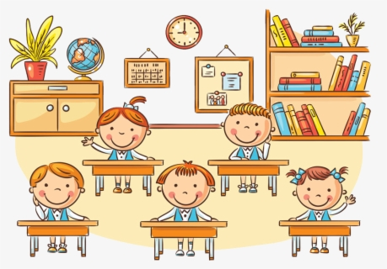
Pre-listening activity
Imagine that Rasha is new in your class,
what will you say to her?
name – are you from - nice to meet

Slide 26
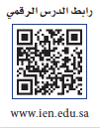

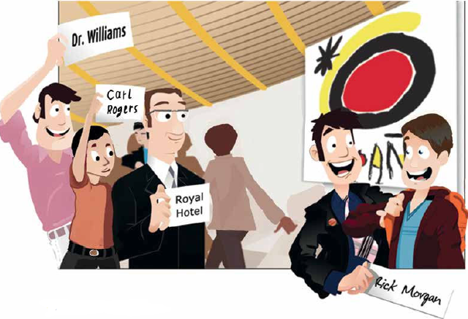
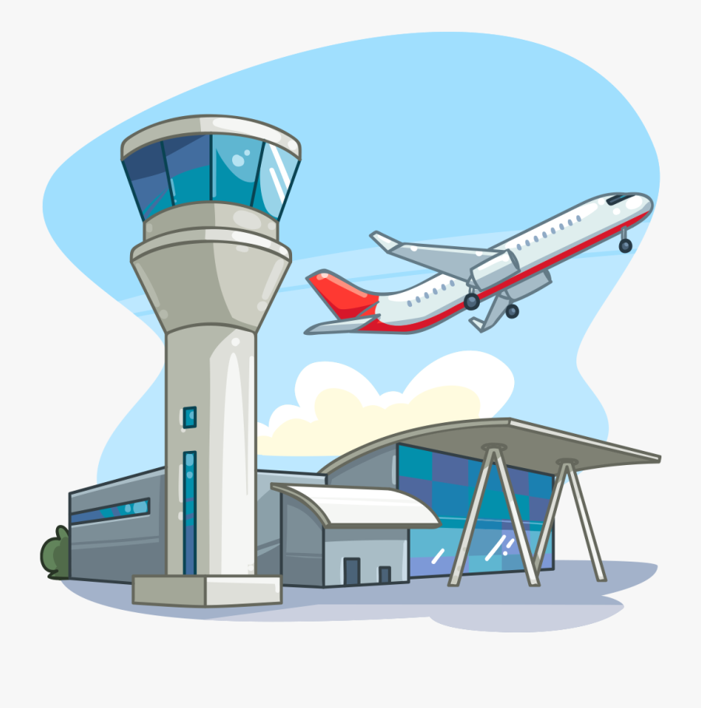
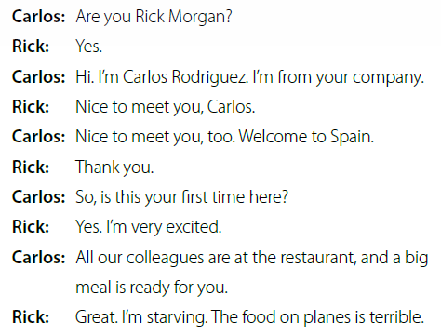
SG1 U1
Page 6
look at the picture
Where are the people in the picture?
They’re at an airport.
They’re waiting for people to arrive.
☺the signs with the names of people that they are waiting for.

Slide 27



SG1 U1
Page 6
Listen and reading along.
Find Carlos and Rick in the picture.
Carlos is holding the sign with Rick’s name on it.
What country is Rick visiting?
Spain.

Slide 28



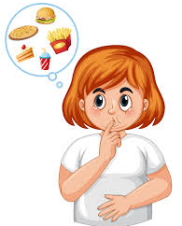
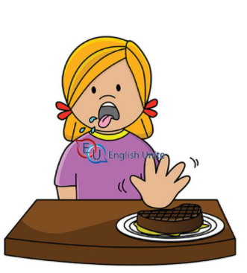
welcome means to be pleased about something.
starving means that Rick is very hungry.
terrible means very bad.

Slide 29


1.What country is Rick visiting?
Spain
2. Find an adjective:
Large – excited - terrible
3. The opposite of small is ……
big

Slide 30

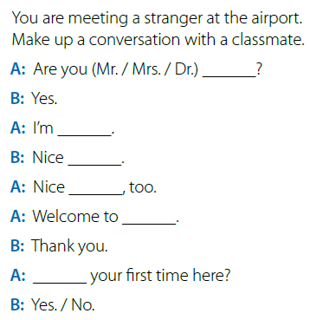
Page 6
Write down and complete conversation in your books or notebooks.
Work in pairs to complete the conversation.
Rana
Lura Fadi.
to meet you Lura.
to meet you, too
Jeddah
Is this
Practice the conversation, changing roles each time.

Slide 31




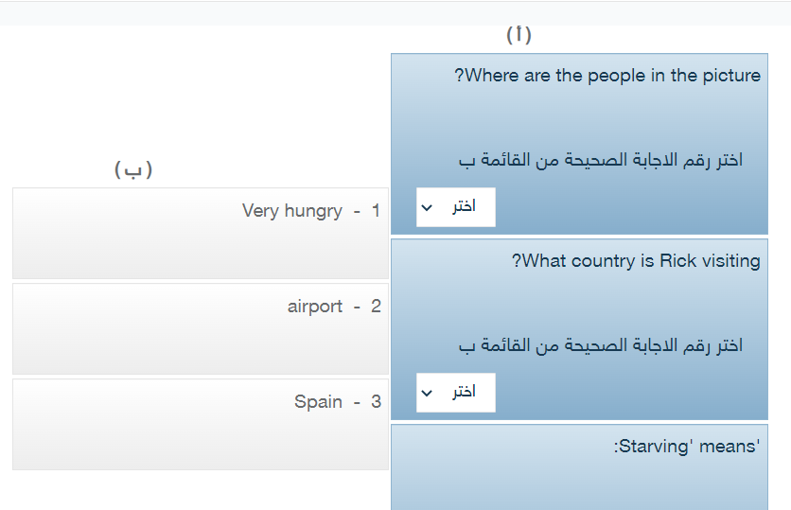
Platform
2
3
واجب بنك
أسئلة المنصة
1

Slide 32



أتمنى الاهتمام بمتابعة الدروس في قنوات عين الرسمية من وزارة التعليم

Slide 33


أتمنى الاهتمام بمتابعة الدروس في قنوات عين الرسمية من وزارة التعليم
T.Noureyah Alghamdi
The end

