Slide 1
U 2
What are they making?
TR. Nora Khalid

Slide 2

What is your favorite sport?
My favorite sport is …..

Slide 3


What does “Martial art” mean?

Slide 4
Do you like Martial arts films?

Slide 5
What are the names of some famous martial arts films?

Slide 6
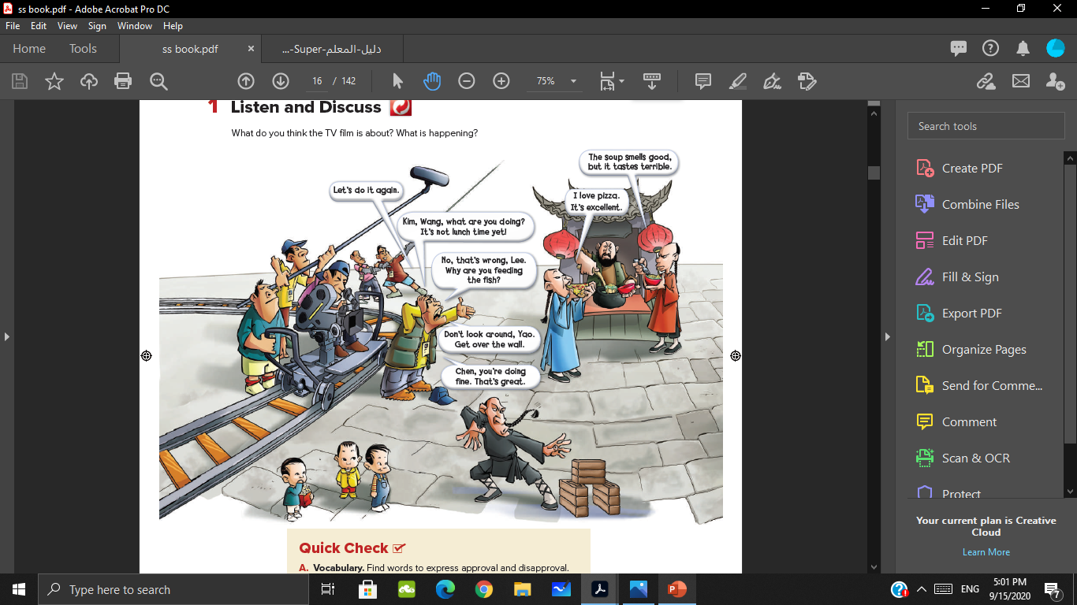
What do you think the TV film is about? What is happening?
Some actors are eating.
The director is directing the actors

Slide 7
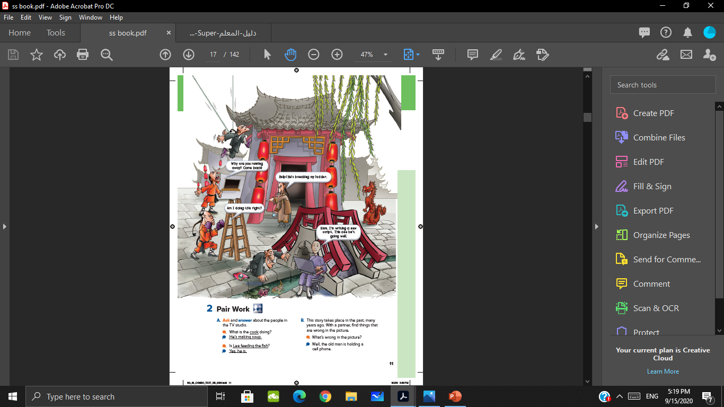
What is happening?
One person is using a laptop.

Slide 8
Read the conversation

Slide 9
Who is the director talking to?
To The actors
What are the actors’ names?
(Kim, Wang, Lee, Yao, Chen)

Slide 10
Why is one of the actors going up a wall?
He is running away.
Who is eating?
(Kim, Wang)

Slide 11
Who is feeding the fish?
Lee.
Does the director want him to feed the fish?
No

Slide 12
Are all the actors acting right now?
No, four of them are taking a break.

Slide 13

Listen:

Slide 14
Listen and repeat after each speaker

Slide 15


Approval
Disapproval

Slide 16
Find words to express approval and disapproval

Slide 17
Approval

Slide 18
Disapproval

Slide 19
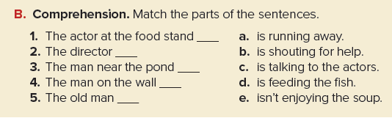
e
c
d
a
b

Slide 20
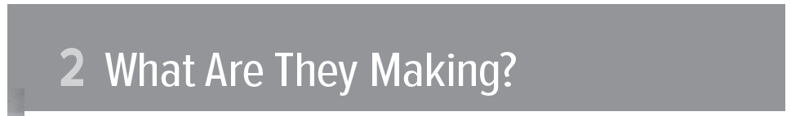
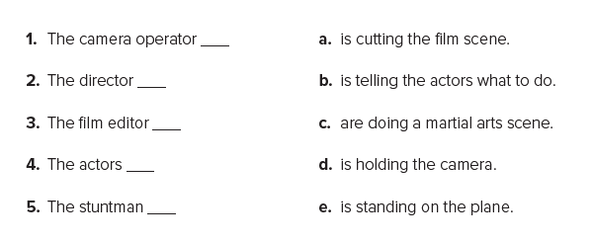
d
b
a
c
e

Slide 21
Thank you

