Slide 2
It’s Nice to Meet You!
Finding Out Time

Slide 3
Objectives
Practice a conversation with a colleague about personal information,.
Match the correct information to the right person according to the audio.
Relate each subject pronoun to its right to BE.

Slide 6
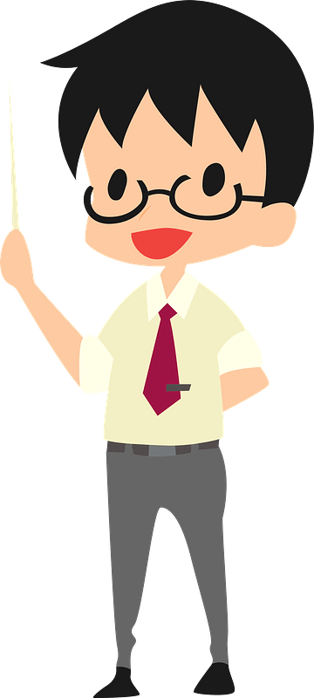
Hi, I’m ……………………..
I’m your English teacher.

Slide 7
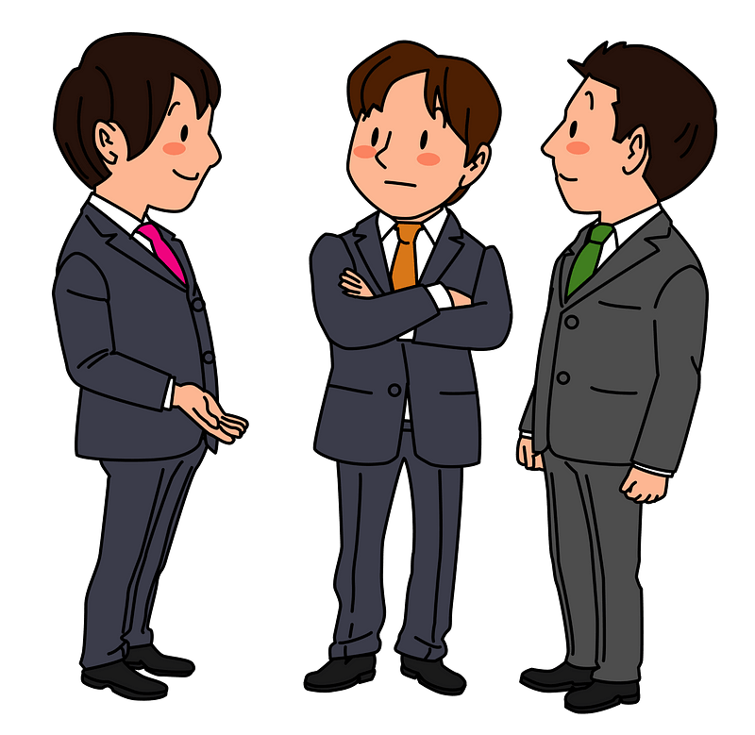
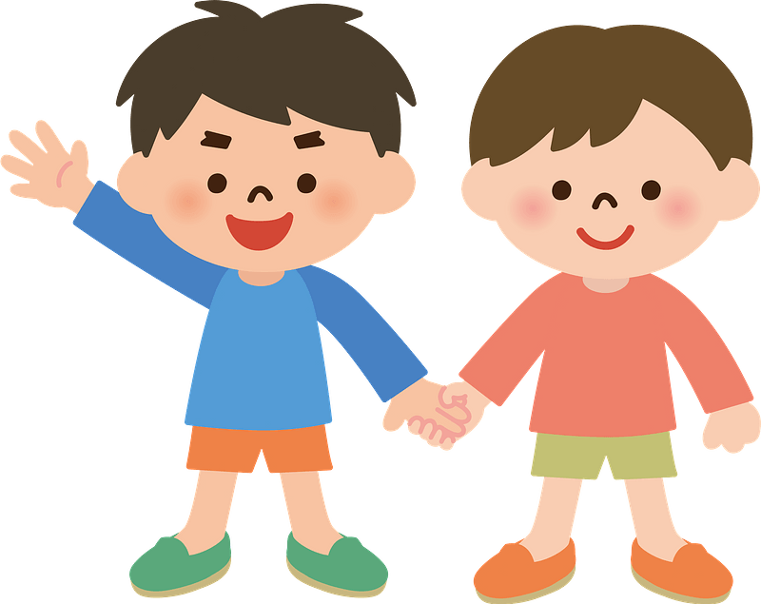
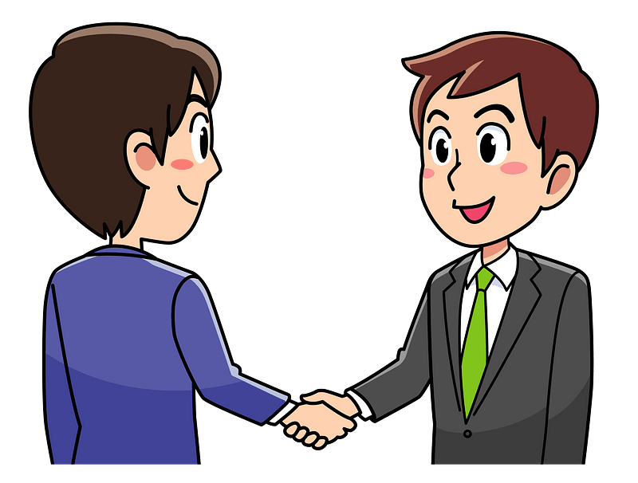
When you meet someone at the first time what do you say ?
My name is Khalid.
Hi , I am Ahmad.
What’s your name?

Slide 8
introduce yourself

Slide 9
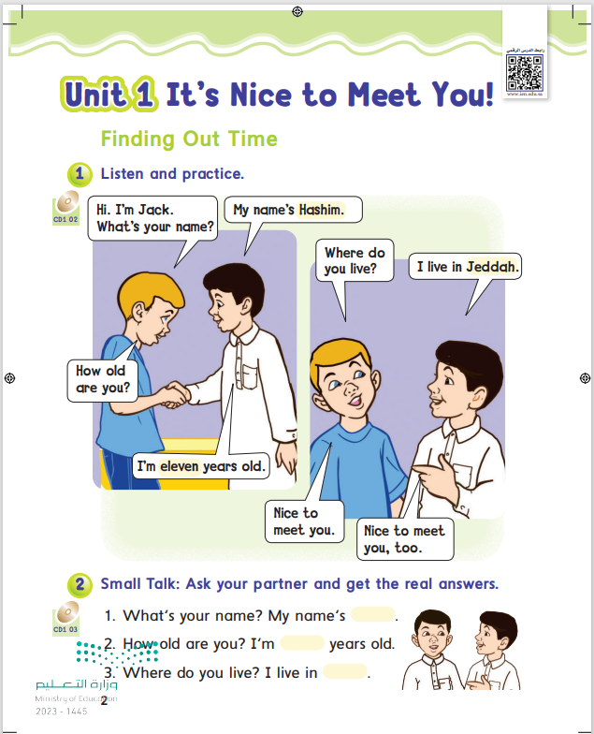
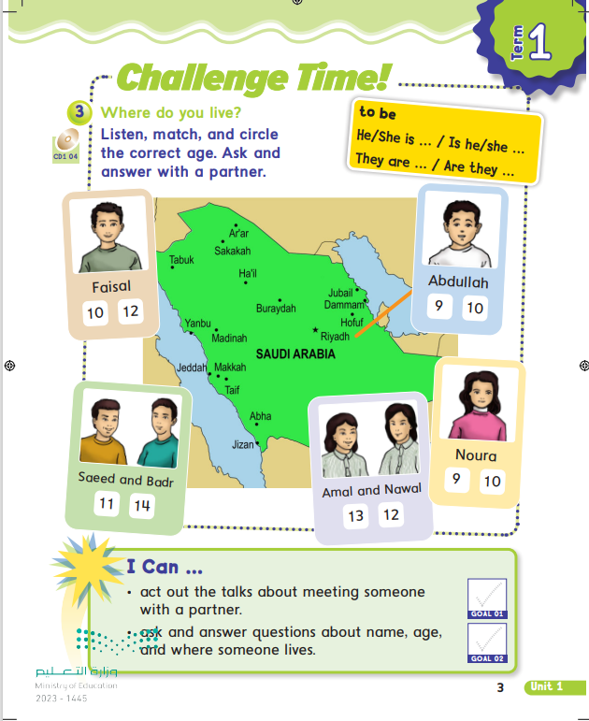
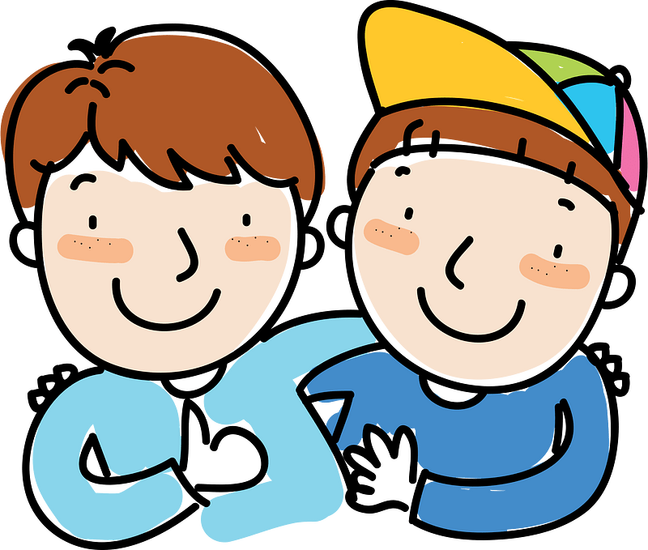

Slide 10
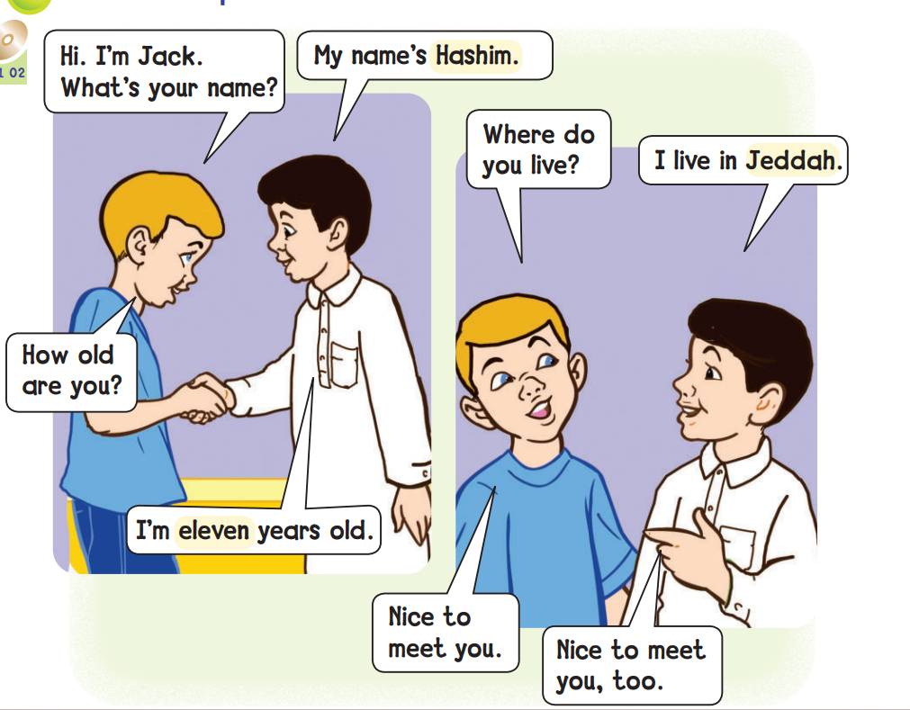
listen

Slide 11
What’s your name?
How old are you?
Where do you live?
Nice to meet you.

Slide 12
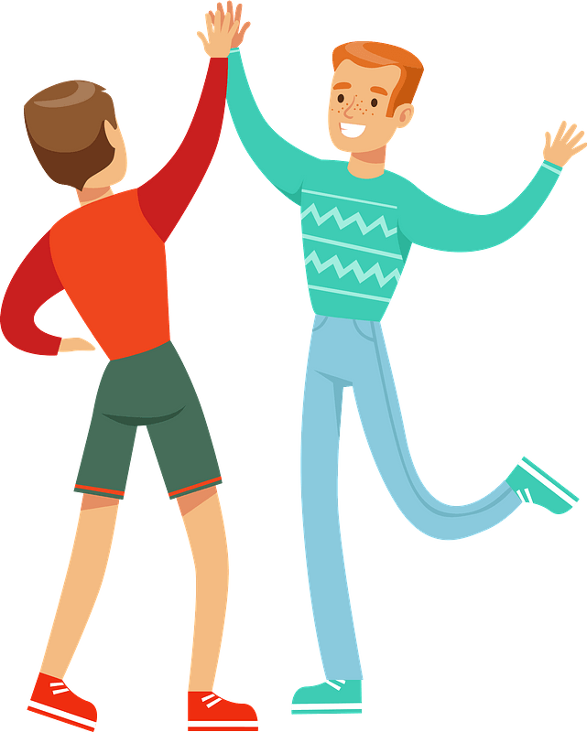

Slide 13
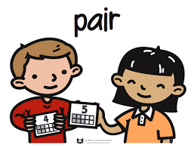
listen

Slide 15
They
You
he
She
You
he
They
She
are
is

Slide 16
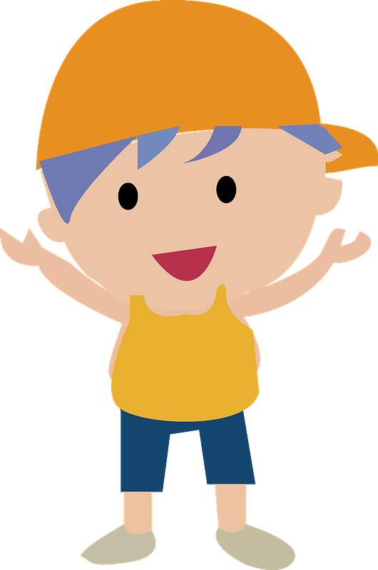
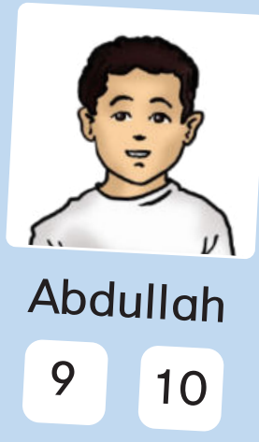
What’s his name?
How old is he?
Where does he live?
listen
Riyadh

Slide 17
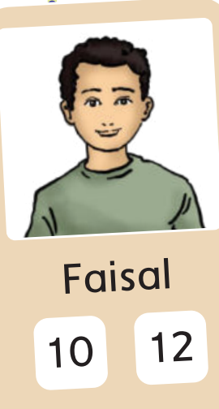
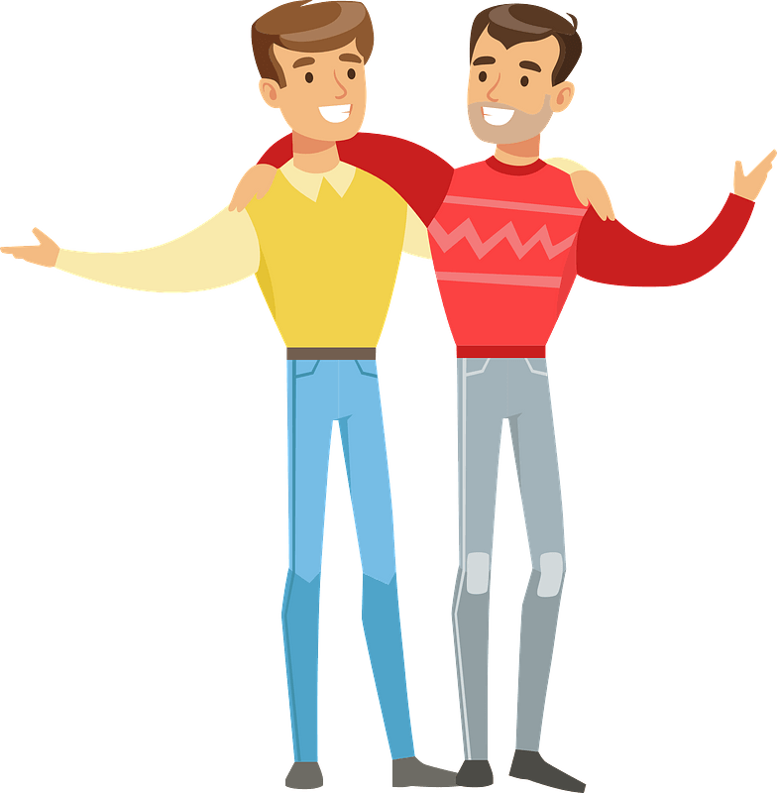
listen
Abha

Slide 18
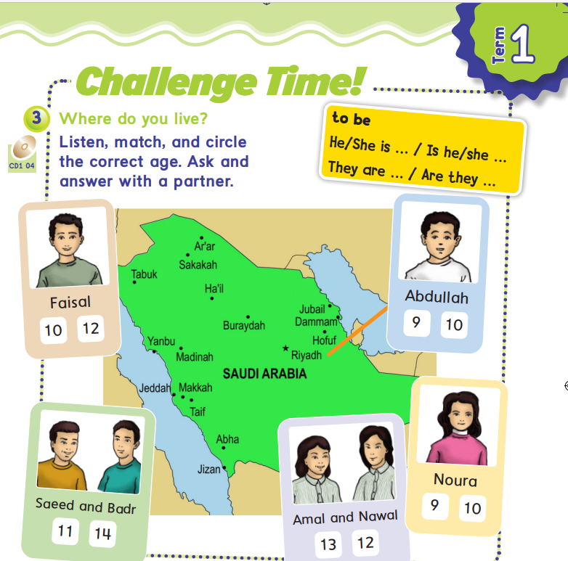
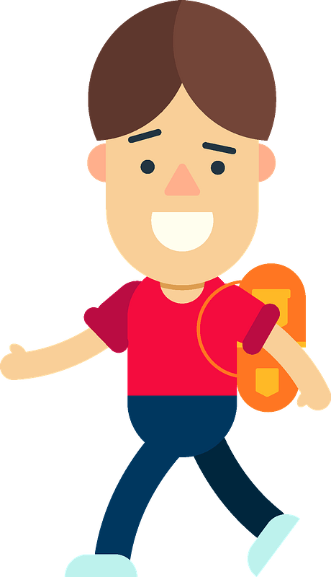

Slide 19
What’s your name?
Hi
start
where do
you live?
How old are
you?
It’s nice to
meet you

Slide 20
where do you live?

Slide 21
…………. do you live?
what
where

Slide 22
What ….your name?
is
are

Slide 25
Work
book

Slide 26
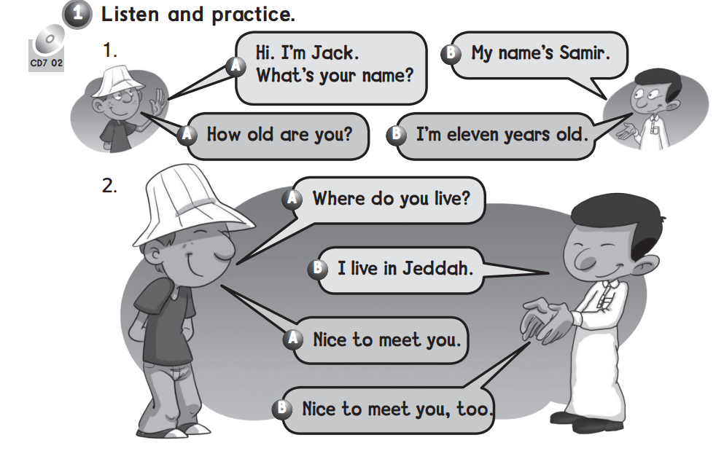

Slide 27
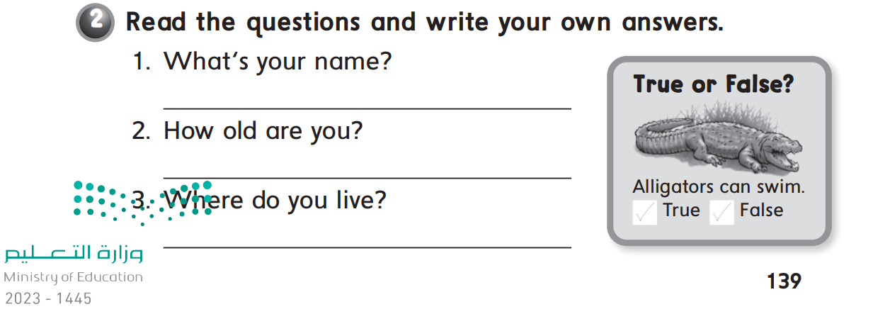

Slide 29
