Slide 1




Slide 2
Unit -1-
Big Changes
12-
Project
13 –
Self-Reflection

Slide 3


Slide 4
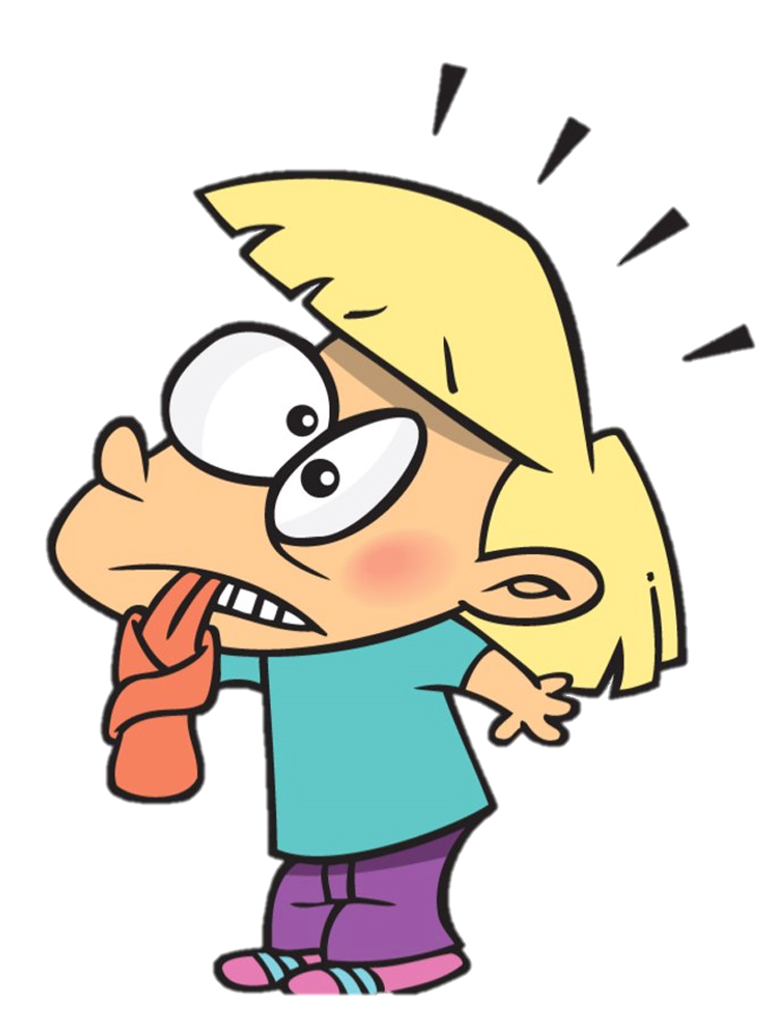
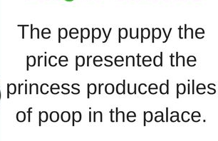

Tongue Twister

Slide 5

Choose the correct answer:
1-Were you ,,,,,,,,,,?
A
slept
B
sleep
C
sleeping
D
sleeps
>
tekhnologic

Slide 6
The Objectives:
1
3
5
Appreciate the achievmentsof Saudi Arabia
Role play in making the interview
Determine the aspect of a successful interview
Fill in the chart with the given answers
Say verse of aya about hard working
2
4

Slide 7
1-Find a person – a relative or a friend who has lived or lives
in another country in the Gulf, the Arab world, Europe, or
another part of the world.
2-Prepare questions that you would like to ask them in an
interview. You can use some of the questions from the
conversation on page 11 as examples
3-Interview the person and write the answers in the chart
in note-form. You might have to interview your friend or
relative over the phone

Slide 8

Name of the person you are interviewing
The person’s answers | Your questions
I know that Saudi Arabia hosted and led the event, so you must feel very proud! | What do you know about the G20 2020 Summit?

Slide 9
13 Self Reflection
Things that I didn’t like very much: | Things that I liked about Unit 1:
Things that I found difficult in Unit 1: | Things that I found easy in Unit 1

Slide 10
I need to study/ practice more | I can do this quite well. | I can do this very well. : | Unit 1 Checklist
 |  |  | discuss past world events and present effects
 |  |  | talk about global issues
 |  |  | use the simple present
 |  |  | use the simple present versus the present progressive
 |  |  | use the simple past versus the present perfect
 |  |  | use the simple past tense
 |  |  | ask questions and give short answers with ‘did’
 |  |  | use time expressions for the past
 |  |  | use the past progressive tense
 |  |  | Past progressive + when + simple past tense

Slide 11
Things that I didn’t like very much: | My five favorite new words from Unit 1:
read through the unit again • listen to the audio material • study the grammar and functions from the unit again • ask your teacher for help | ------------------------------- ------------------------------ ----------------------------------

Slide 12

Hissah Alotaibi

