Slide 1
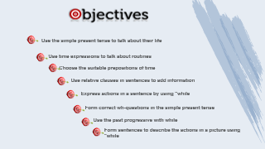
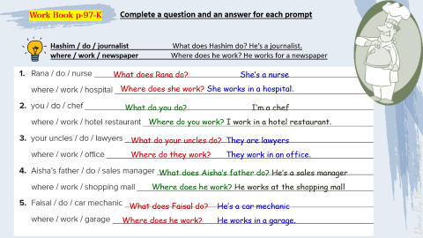
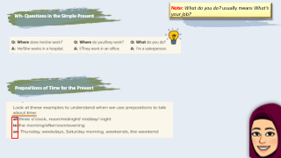
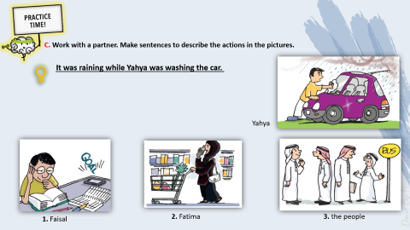



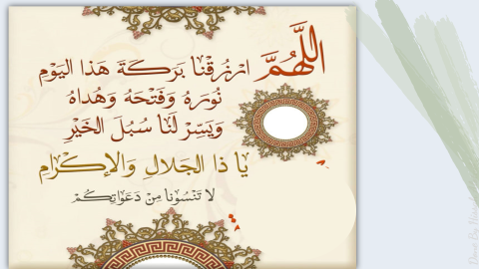
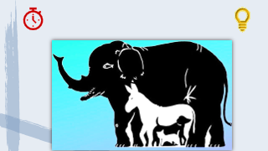
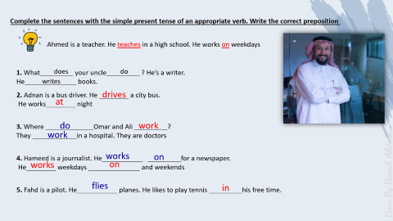


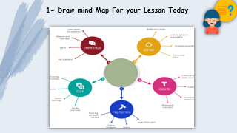
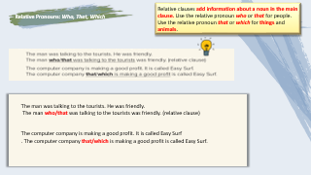


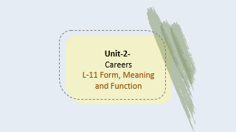
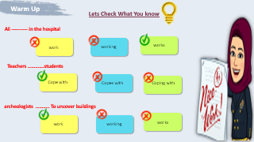
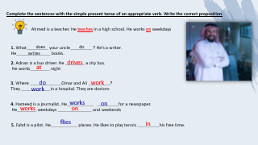
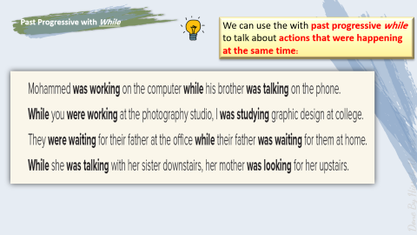



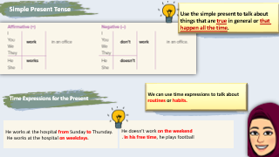
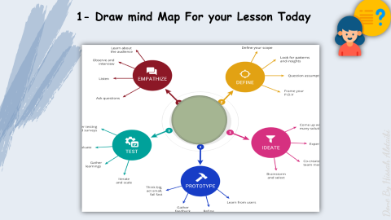
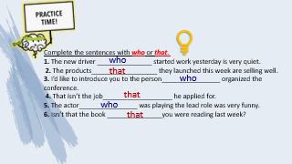
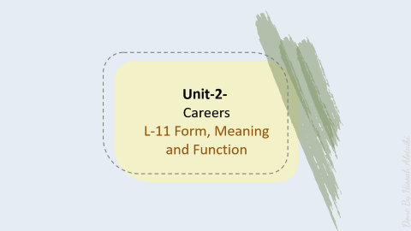
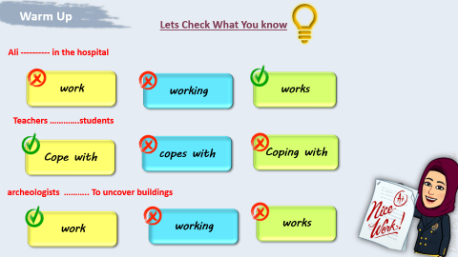
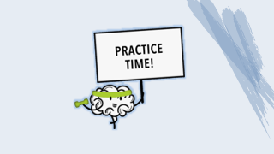
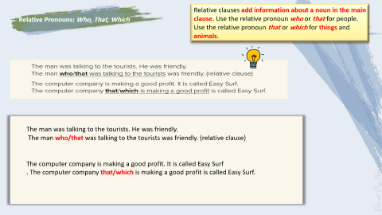
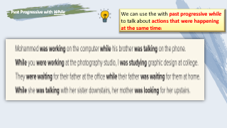
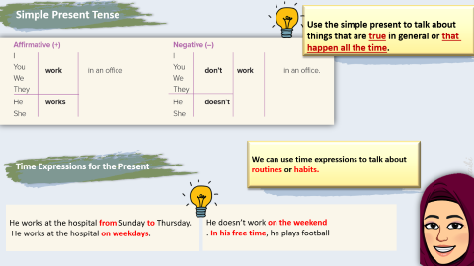
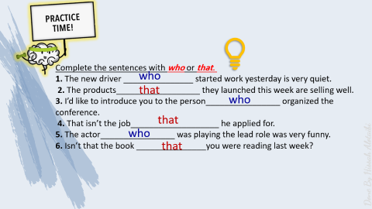
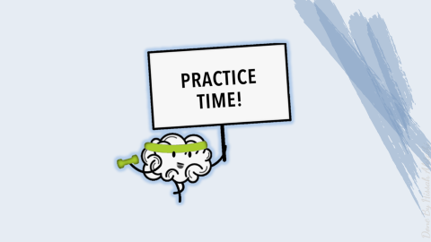
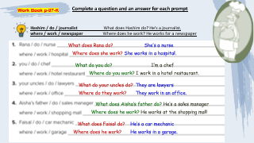


Slide 7


Slide 8


Slide 9
Unit-2-
Careers
L-11 Form, Meaning and Function

Slide 10


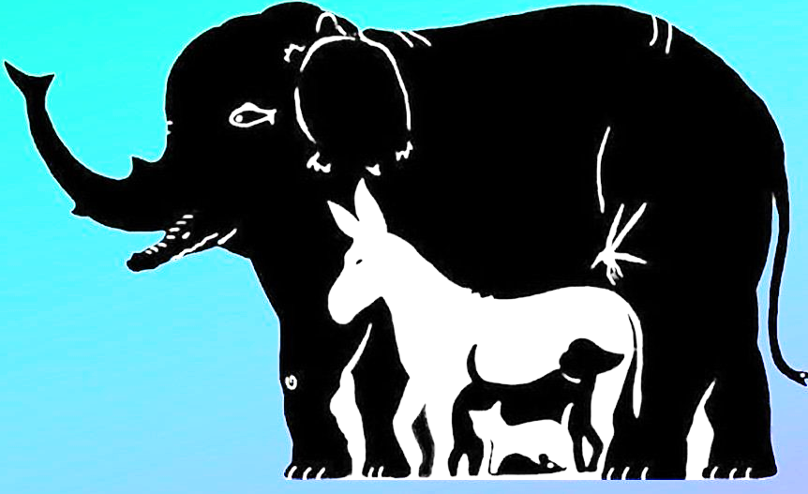


Slide 11


Use the simple present tense to talk about their life
Use time expressions to talk about routines
Choose the suitable prepositions of time
Use relative clauses in sentences to add information
Express actions in a sentence by using "while
Form correct wh-questions in the simple present tense
Use the past progressive with while
Form sentences to describe the actions in a picture using "while

Slide 12
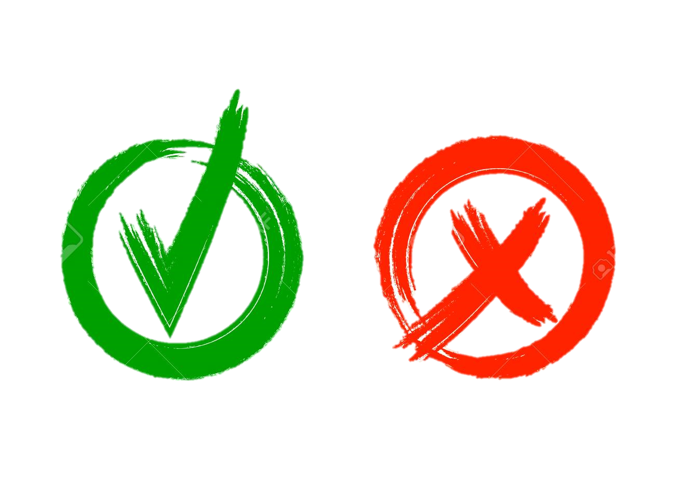

Warm Up
Lets Check What You know
Ali ---------- in the hospital
work
working
works
Teachers ………….students
Cope with
copes with
Coping with
archeologists ……….. To uncover buildings
working
works
work

Slide 13

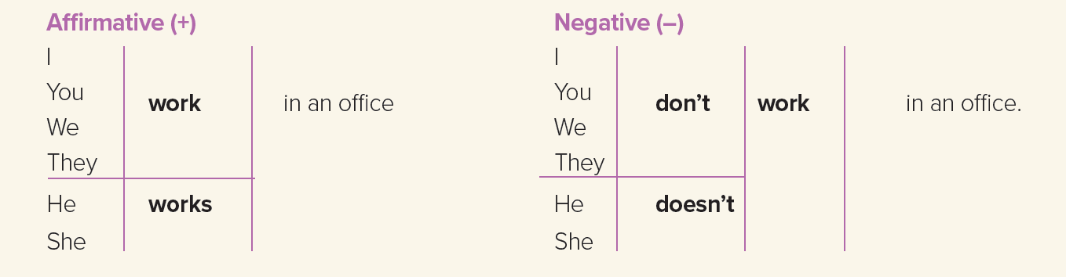

Simple Present Tense
Use the simple present to talk about things that are true in general or that happen all the time.
Time Expressions for the Present
We can use time expressions to talk about routines or habits.
He works at the hospital from Sunday to Thursday.
He works at the hospital on weekdays.
He doesn’t work on the weekend
. In his free time, he plays football

Slide 14
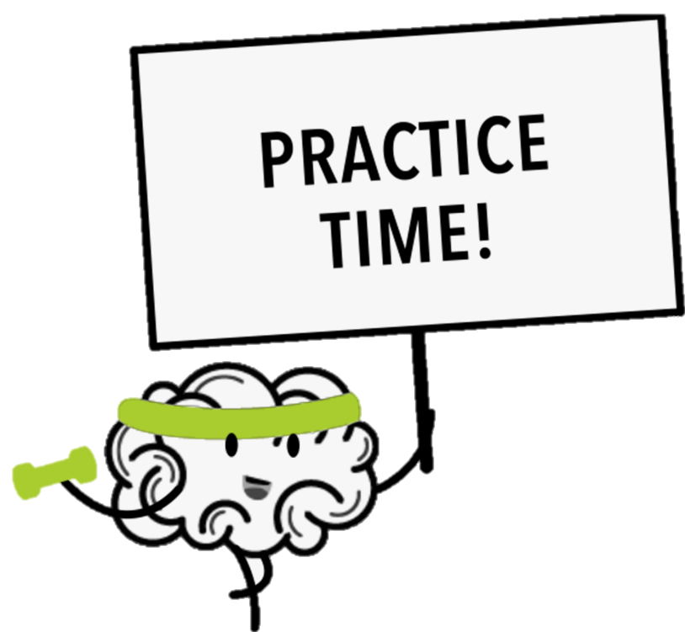

Slide 15
Complete the sentences with the simple present tense of an appropriate verb. Write the correct preposition
Ahmed is a teacher. He teaches in a high school. He works on weekdays
1. What_________ your uncle_________ ? He’s a writer.
He______________ books.
does
do
writes
2. Adnan is a bus driver. He ________ a city bus.
He works________ night
drives
at
3. Where _____________Omar and Ali _________?
They ____________in a hospital. They are doctors
do
work
work
4. Hameed is a journalist. He___________ _________for a newspaper.
He________ weekdays ______________ and weekends
works
on
works
on
5. Fahd is a pilot. He___________ planes. He likes to play tennis _________his free time.
flies
in

Slide 16
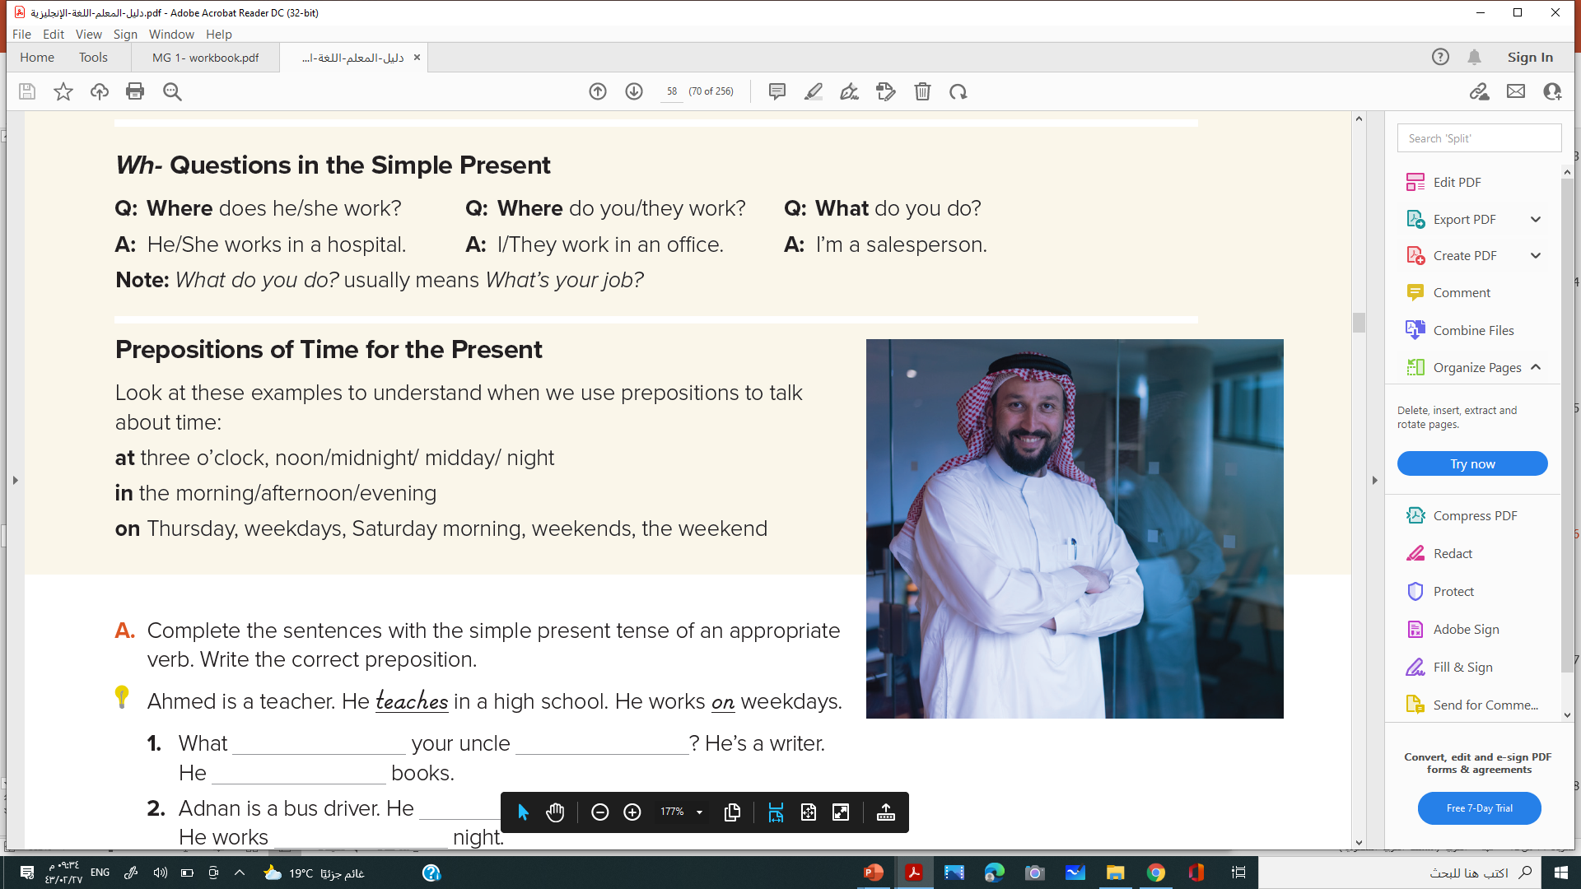
Wh- Questions in the Simple Present
Note: What do you do? usually means What’s your job?
Prepositions of Time for the Present

Slide 17
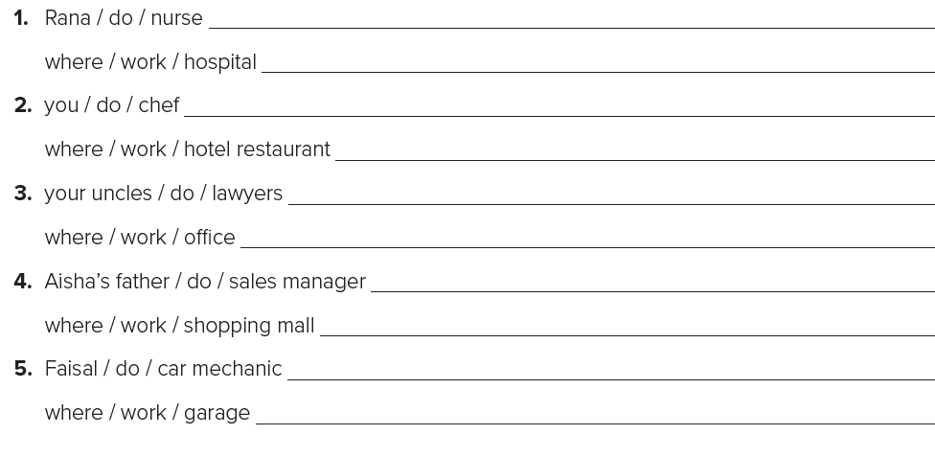
Work Book p-97-K
Complete a question and an answer for each prompt
Hashim / do / journalist What does Hashim do? He’s a journalist.
where / work / newspaper Where does he work? He works for a newspaper
What does Rana do? She’s a nurse
Where does she work? She works in a hospital.
What do you do? I’m a chef
Where do you work? I work in a hotel restaurant.
What do your uncles do? They are lawyers
Where do they work? They work in an office.
What does Aisha’s father do? He’s a sales manager
Where does he work? He works at the shopping mall
What does Faisal do? He’s a car mechanic
Where does he work? He works in a garage.

Slide 18
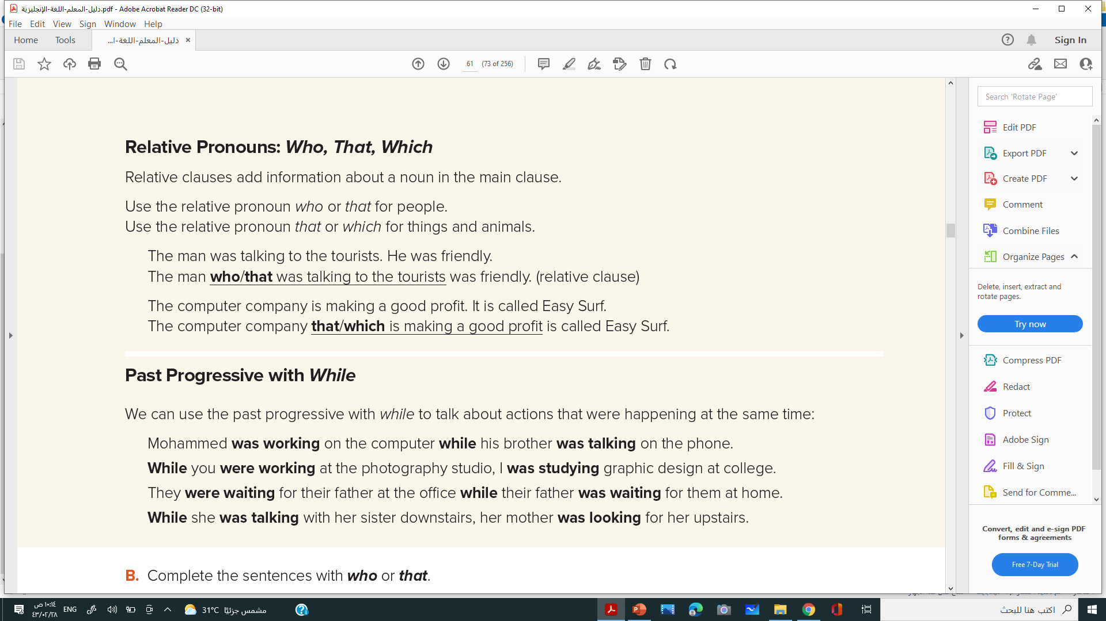
Relative Pronouns: Who, That, Which
Relative clauses add information about a noun in the main clause. Use the relative pronoun who or that for people. Use the relative pronoun that or which for things and animals.
The man was talking to the tourists. He was friendly.
The man who/that was talking to the tourists was friendly. (relative clause)
The computer company is making a good profit. It is called Easy Surf
. The computer company that/which is making a good profit is called Easy Surf.

Slide 19
Complete the sentences with who or that.
1. The new driver _______________ started work yesterday is very quiet.
2. The products__________________ they launched this week are selling well.
3. I’d like to introduce you to the person________________ organized the conference.
4. That isn’t the job___________________ he applied for.
5. The actor________________ was playing the lead role was very funny.
6. Isn’t that the book _______________you were reading last week?
who
that
who
that
who
that

Slide 20
Past Progressive with While
We can use the with past progressive while to talk about actions that were happening at the same time:

Slide 21
C. Work with a partner. Make sentences to describe the actions in the pictures.
It was raining while Yahya was washing the car.
Yahya
1. Faisal
2. Fatima
3. the people

Slide 22

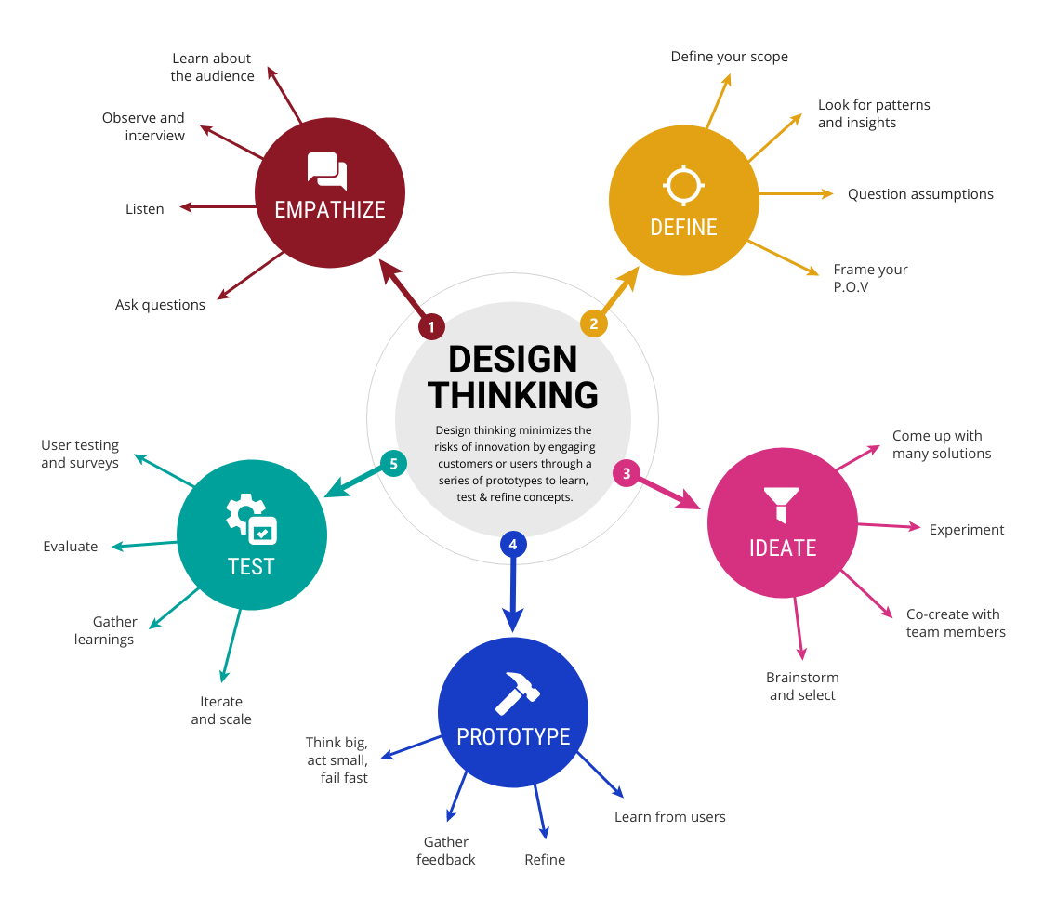
1- Draw mind Map For your Lesson Today

Slide 23

W.B.P 97-98

Slide 24

Done By Hissah Alotaibi

