Slide 1
Mega Goal 1
U: 3
What will be , will be
Listen and Discuss
By: Yousef Alyazedi

Slide 2
Lesson Goals
Make predictions about the future.
Express opinions .
Answer some questions .
Discuss the reading .

Slide 3
Keep
your books
closed

Slide 4
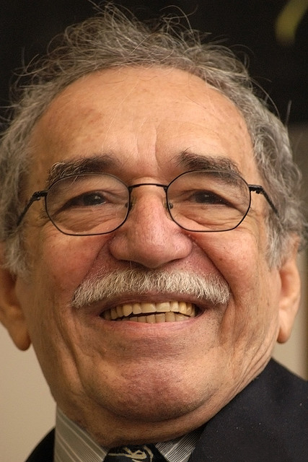
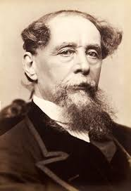
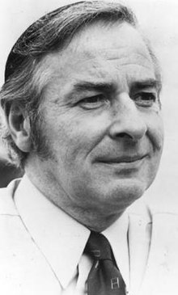
Warm Up
What kind of books do you like to read ?
Have you ever read a novel ?
Who is your favorite author ?

Slide 5
Discuss the following Pictures .

Slide 6
A period of 100 years .
We are in the 21th century

Slide 7
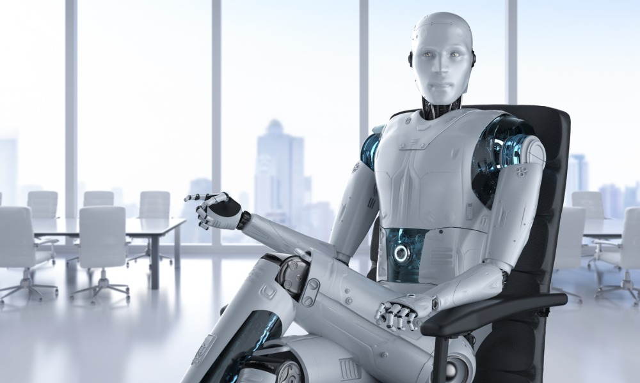
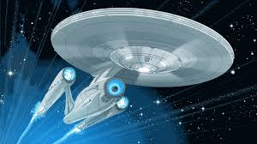
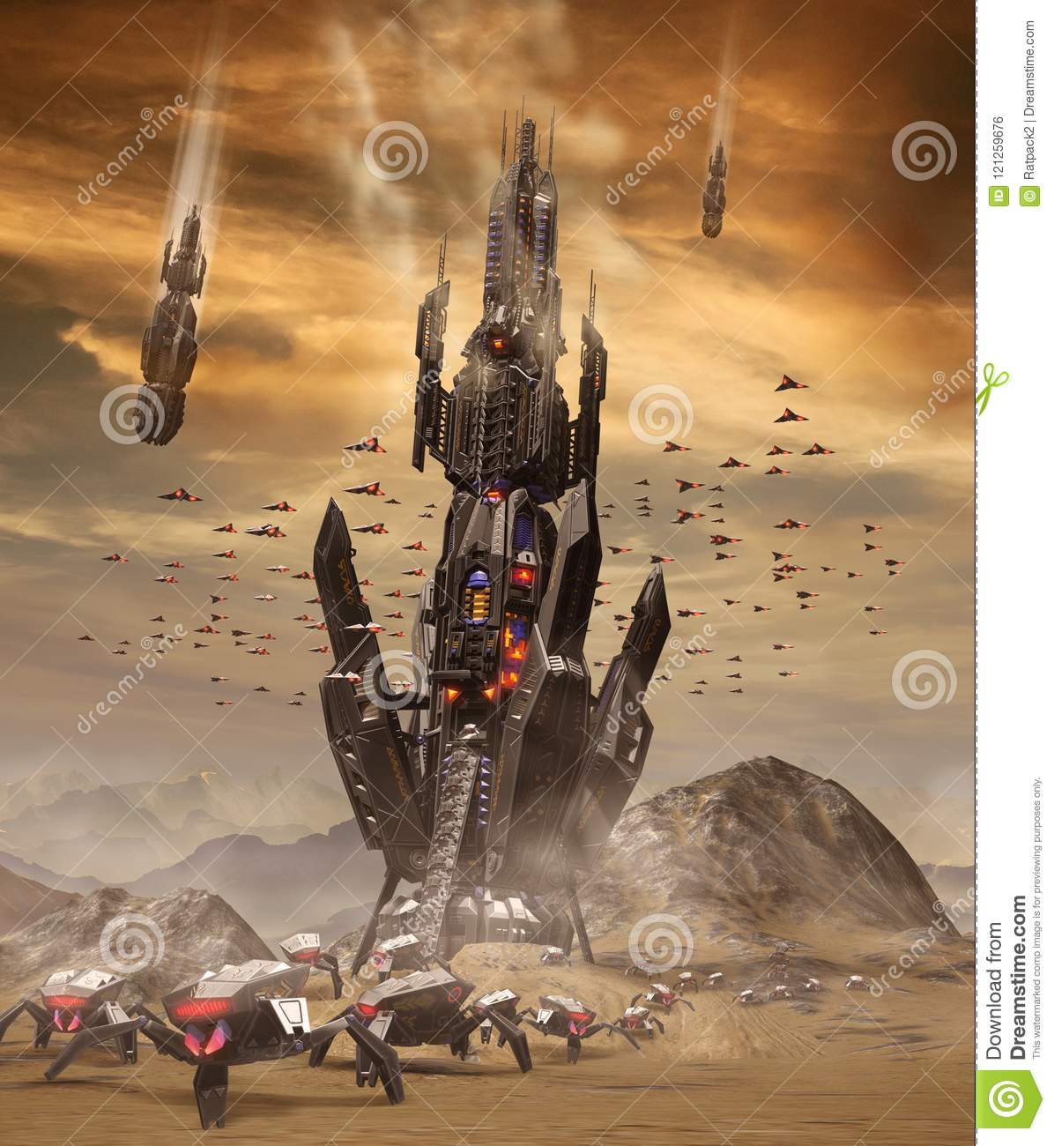
What do these pictures refer to ?
Science fiction

Slide 8
Open your Student’s book at page: 34

Slide 9
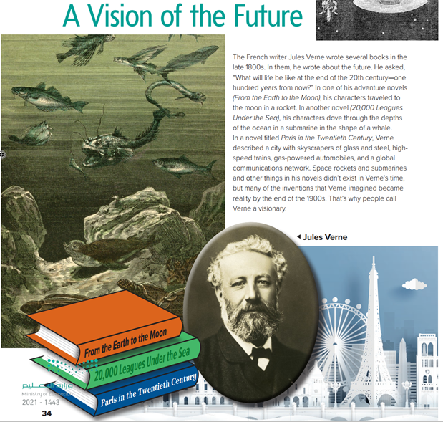
What’s the title ?
How many pictures do we have ?
What’s the name of the author ?
What’s his nationality ?

Slide 10
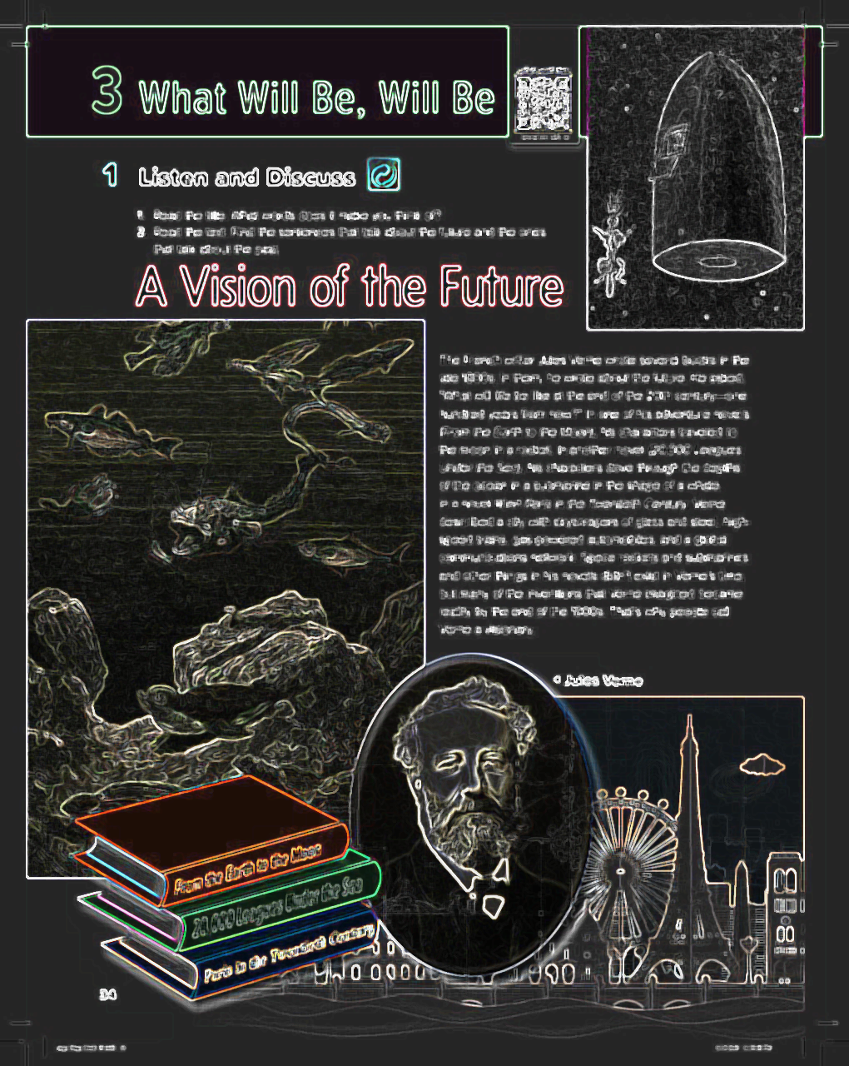

Slide 11
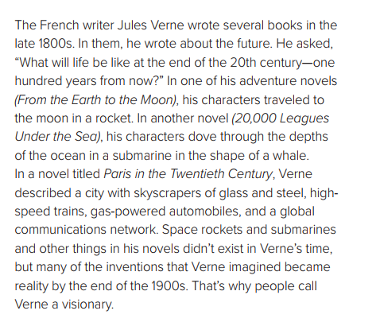
When did he write his books ?
What did Verne write ?
Is he French ?
What are the name of his novels ?
What do people call Verne a visionary ?

Slide 12
A Vision to the Future

Slide 13
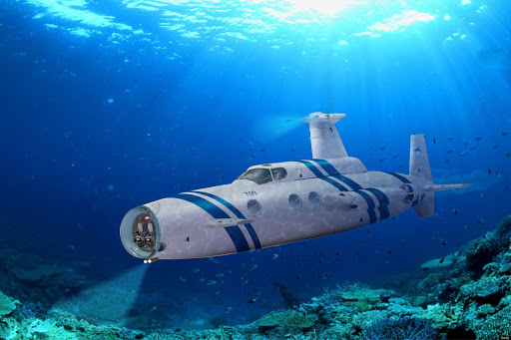
Submarine

Slide 14
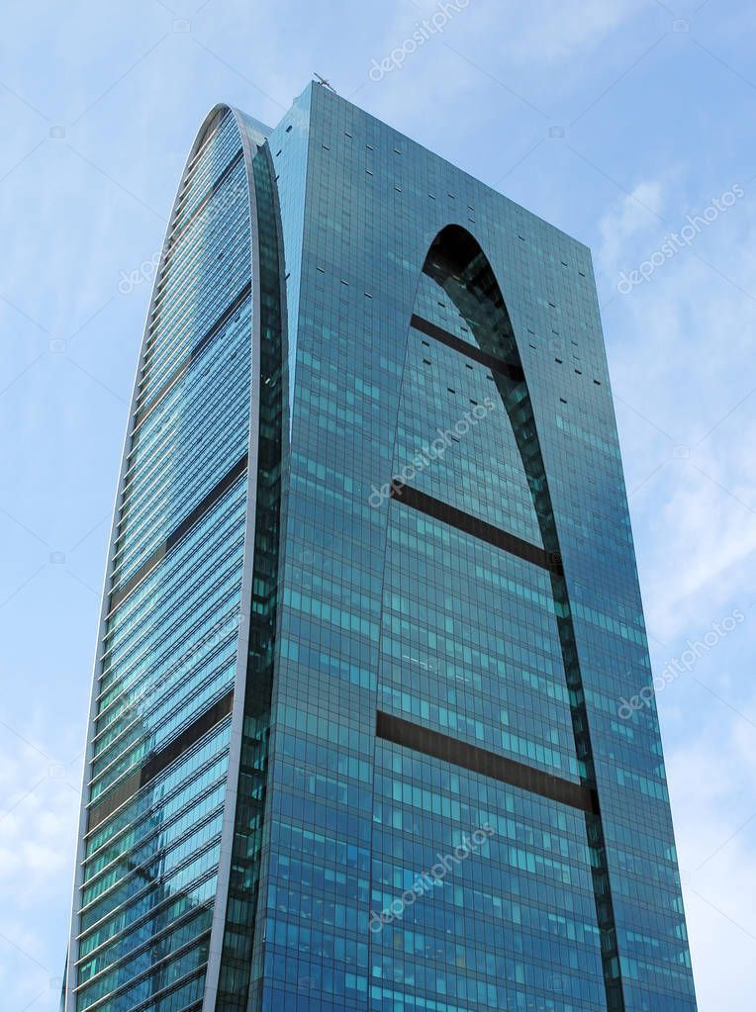
Skyscraper

Slide 15
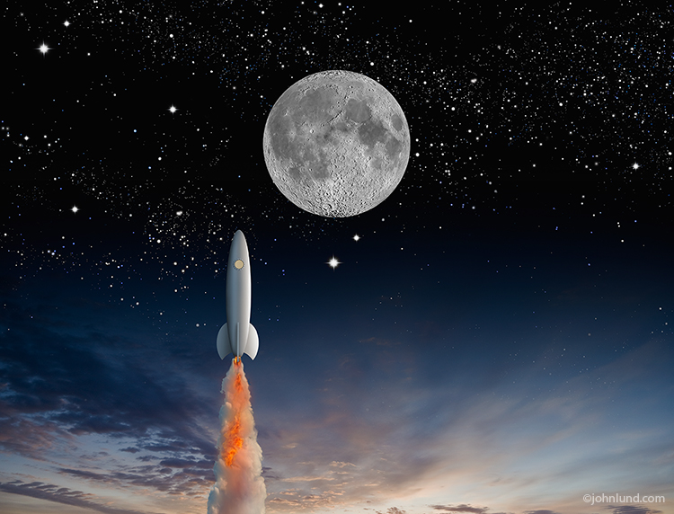
Rocket to the Moon

Slide 16
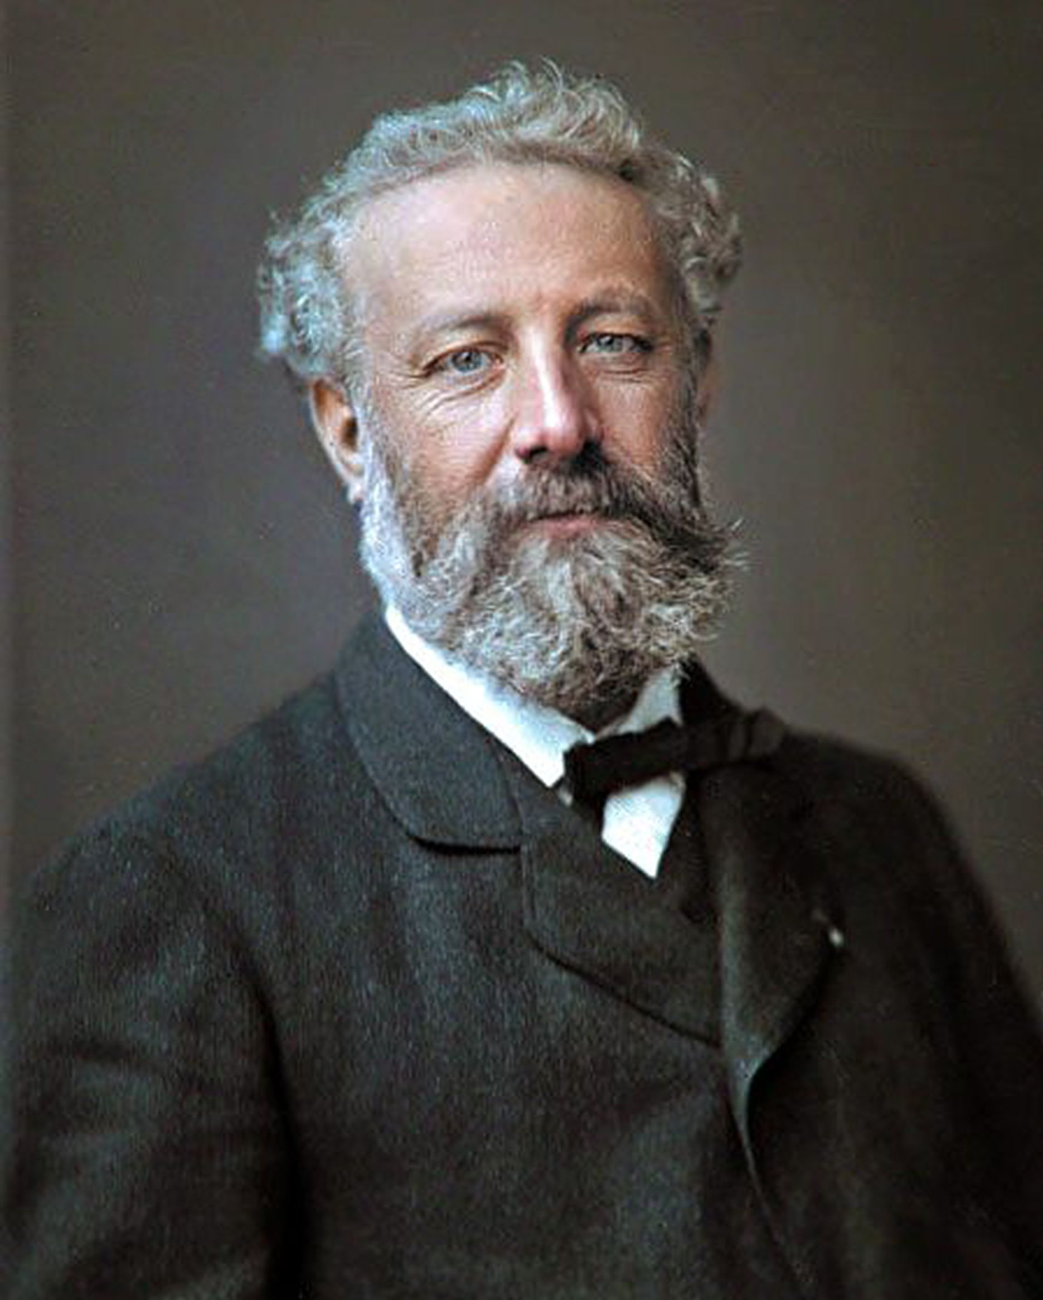
What do you know about this man ?
He is Jules Verne .
He was a French novelist .
He lived from 1828 - 1905
He wrote about the future .
He considered the father of science fiction .

Slide 17
He wrote three books
From the Earth to the Moon
20,000 Leagues Under the Sea
Paris in the Twentieth Century

Slide 18
Open your Student’s book at page: 35

Slide 19
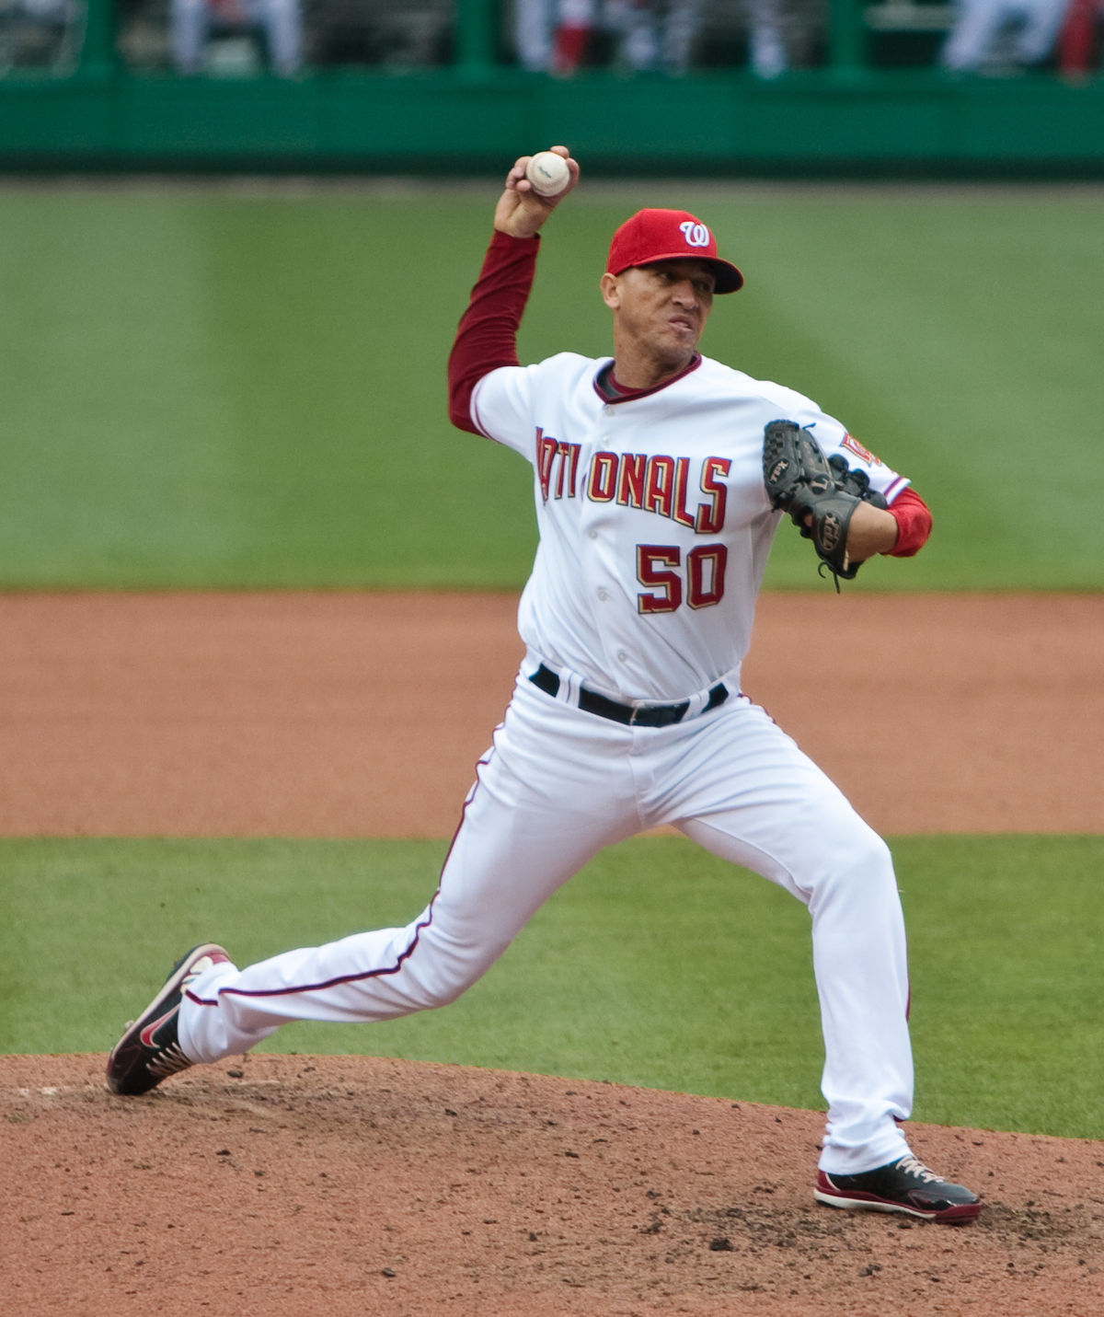
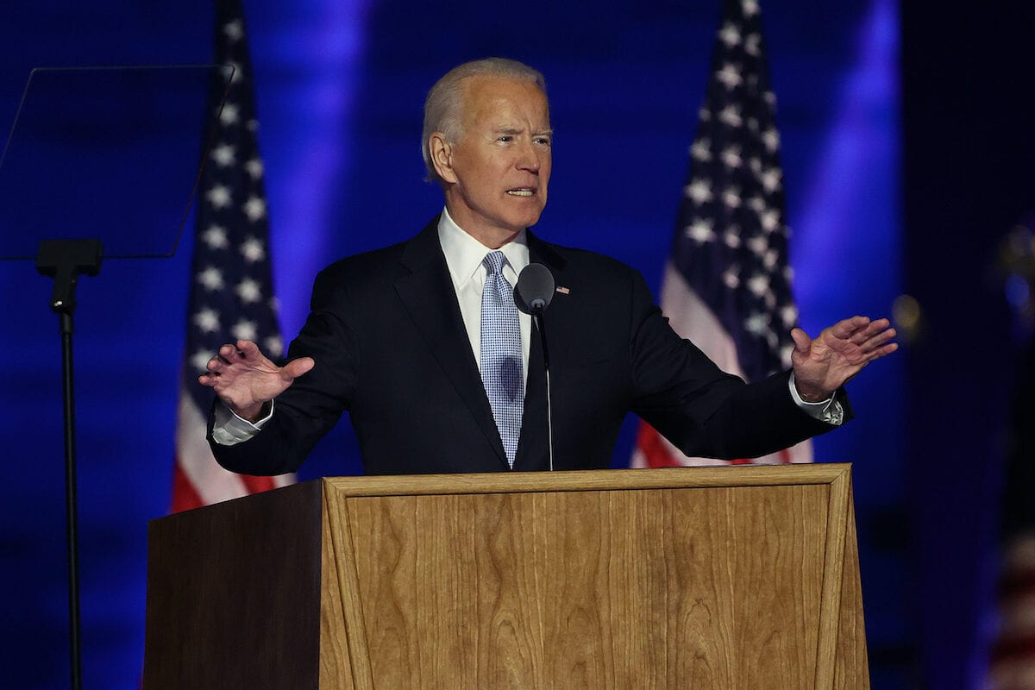
Look at these pictures and discuss .
Fast food Restaurant
Baseball player
President

Slide 20
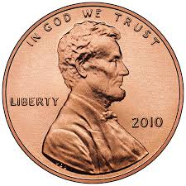
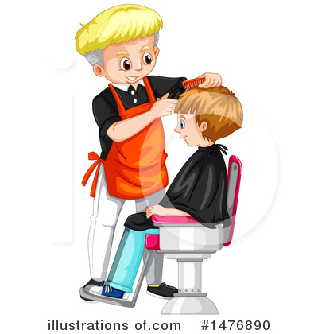
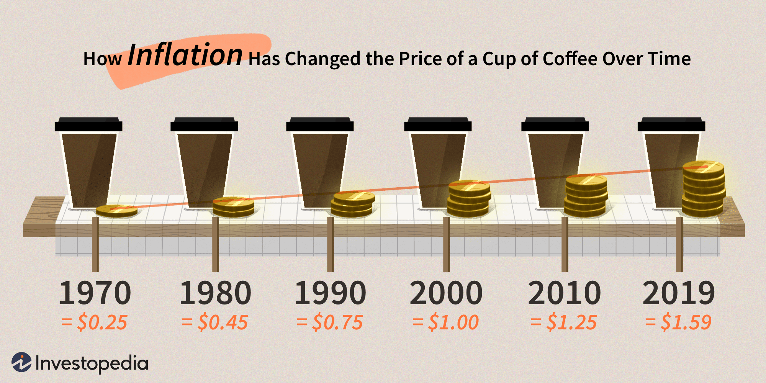
Cent
Refrigerator
Hair cut
Inflation

Slide 21
Describe the photos ?

Slide 22
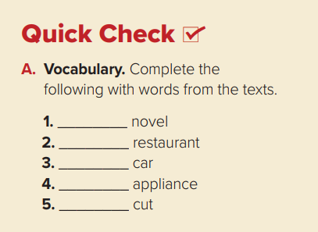
adventure
fast food
used
kitchen
hair

Slide 23
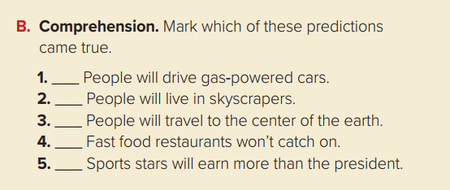
✓
✓
✓

Slide 25
