Slide 1
Mega Goal 1.1
U: 2
Careers
Form , Meaning and Function
By: Yousef Alyazedi

Slide 2

Lesson objectives
Use simple present tense in affirmative and negative sentences .
Make Wh-Question in the simple present .
Know the differences between prepositions of time for the present
Know relative pronouns and their uses .
Use ( while ) in the past progressive .

Slide 3
Today we have 4 parts
Simple Present Tense
Prepositions of Time
Relative Pronouns
Past Progressive with While

Slide 4
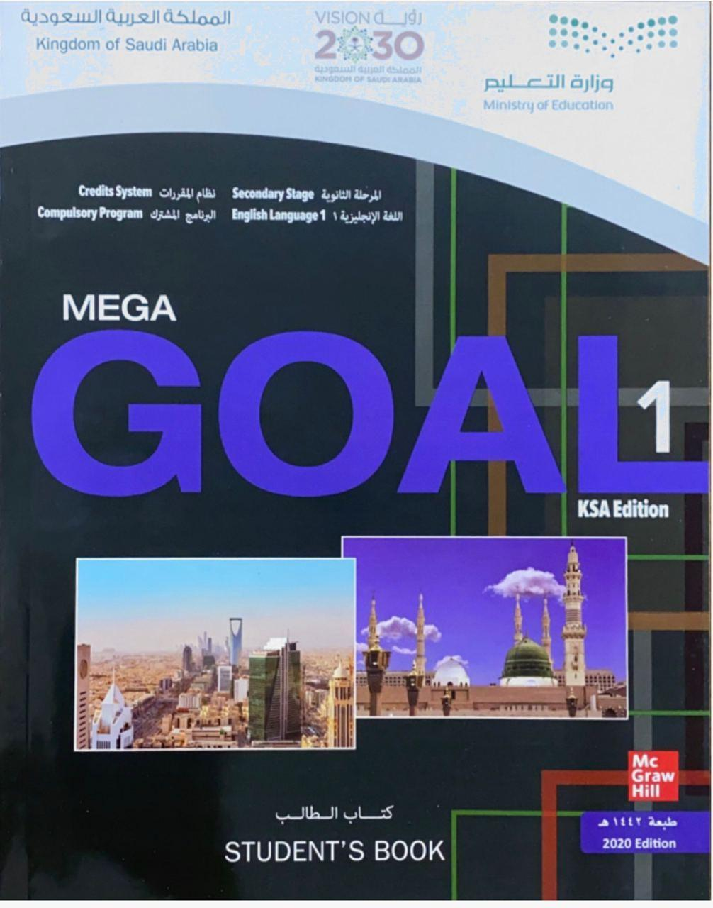

Open your Student’s book at page: 30

Slide 5
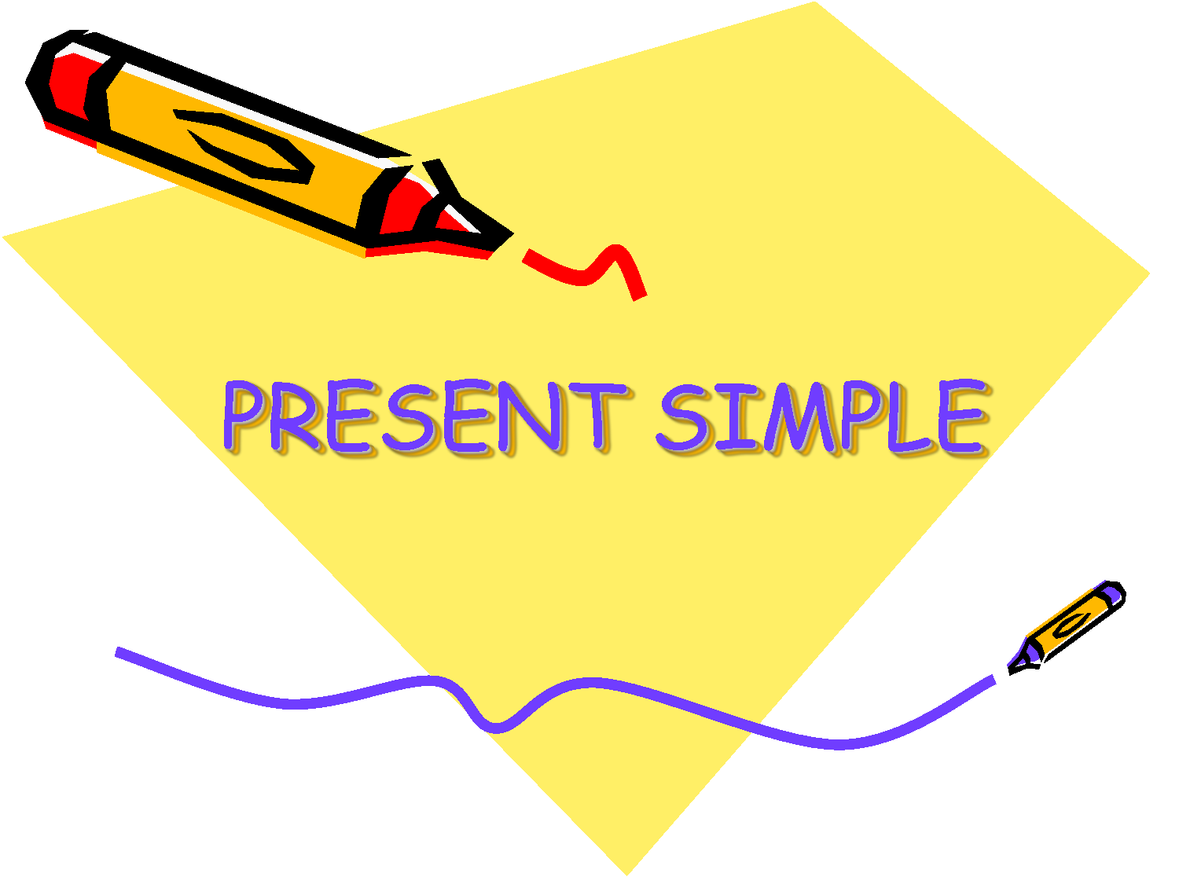

Slide 6
Examples
He goes to school every day .
They always study hard .
Ali doesn’t speak English .
We don’t walk slowly .

Slide 7
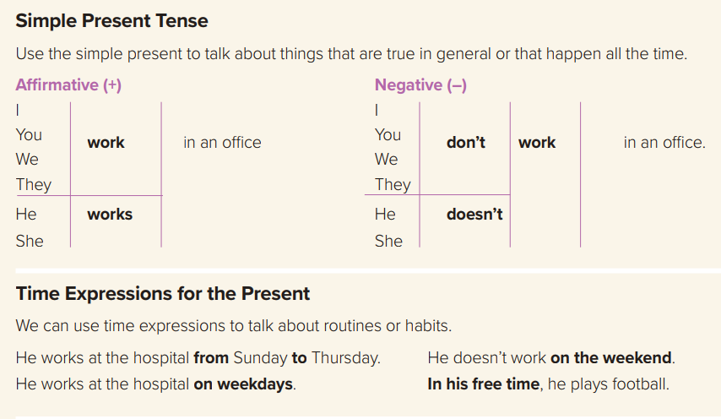

Slide 8
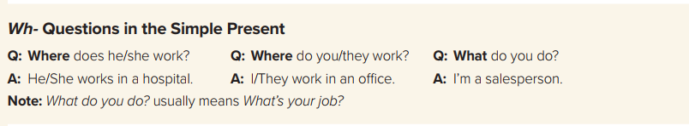
Where does he travel ?
What do you study ?
Why does she go to Spain ?

Slide 9
Wh- Questions in the simple present
He works in a hospital . ( Where )
Where does he work ?
They read sport magazine . ( What )
What do they read ?

Slide 10
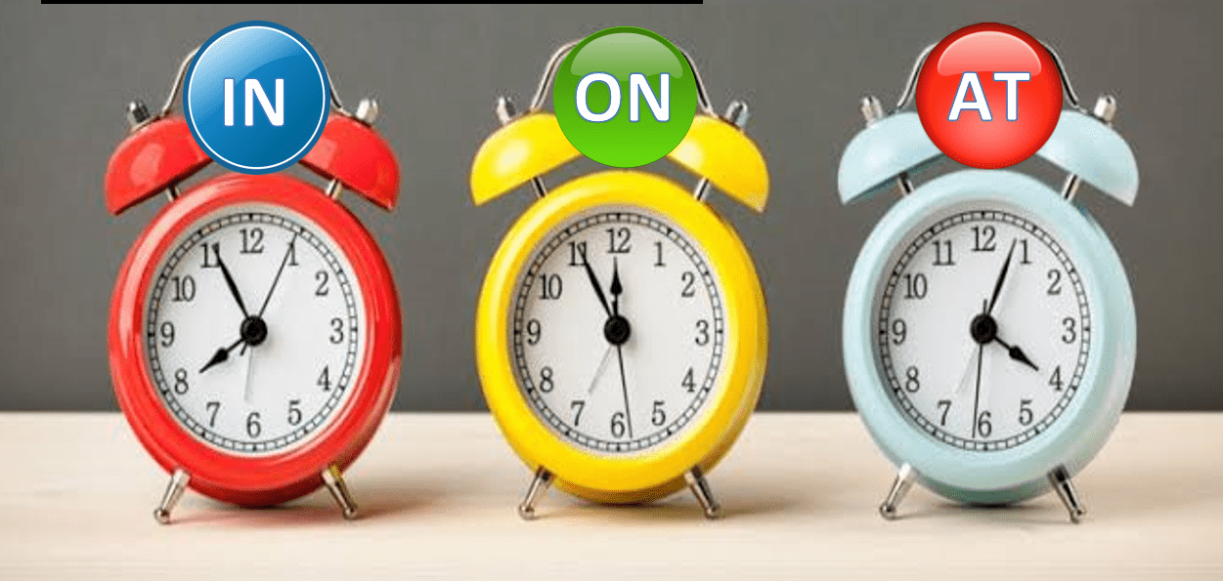
Prepositions of Time

Slide 11
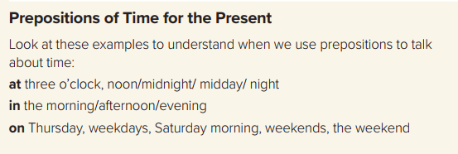
They work hard on Monday .
She sleeps in the morning .
The meeting starts at 2:30 pm .

Slide 12
At
Times of day
10:30 , seven o’clock , noon , midnight , night
In
Months
Years
Parts of the day
On
Days
Dates

Slide 13
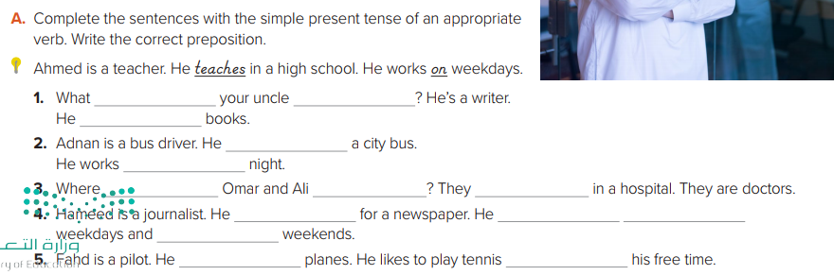
does
do
writes
drives
at
do
work
work
writes
works
on
on
flies
in

Slide 14
Write ( C ) if a sentence has the correct form and ( I ) for incorrect .
C
He writes a diary regularly .
I
She don’t eat fish .
I
Ali gets up early at Sunday .
I
The train doesn’t leave on 12 am.

Slide 15
Open your Student’s book at page: 31

Slide 16


Slide 17
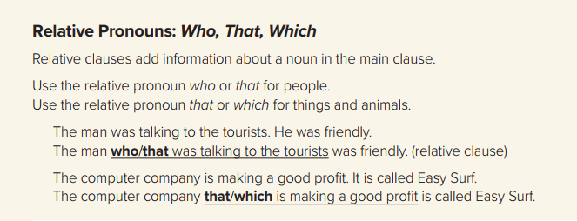

Slide 18
Relative Pronouns
Which
That
Who
People
Animals
things
For both

Slide 19
Choose the best answer :
1- The student ……………… was talking to you was the best .
a – who b- which
2- The bookstore ……………… is selling books is called Jarir .
a – who b- which

Slide 20
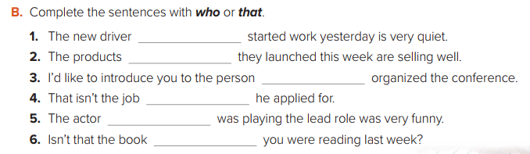
who
that
who
that
who
that

Slide 21
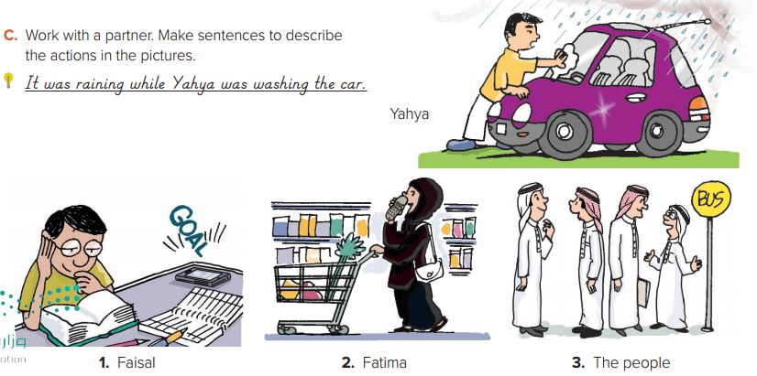

Slide 22
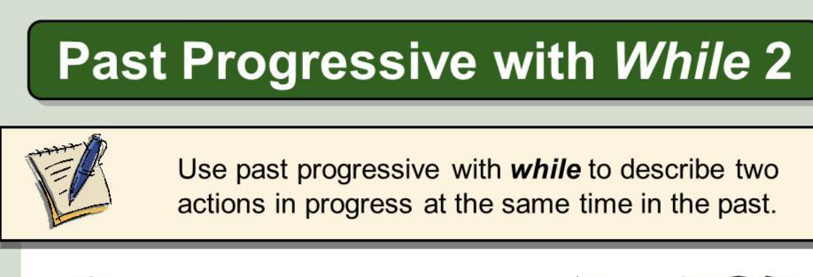
While I was describing the theft, the police officer was writing down .
I was having my dinner while my father was talking on the phone .

Slide 23
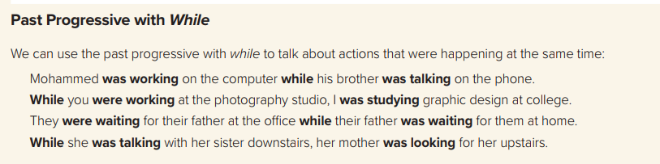

Slide 24
Write ( C ) if a sentence has the correct form and ( I ) for incorrect .
I
The house who we rented was in pink .
C
The woman who lives next door is a doctor .
C
While she was crying , he was laughing .
I
While he was do the washing-up , I was doing the ironing .

Slide 25

Workbook P. 97 ( K )

Slide 26
