Slide 1
Mega Goal 1.1
U: 3
Grammar
By: Yousef Alyazedi

Slide 2
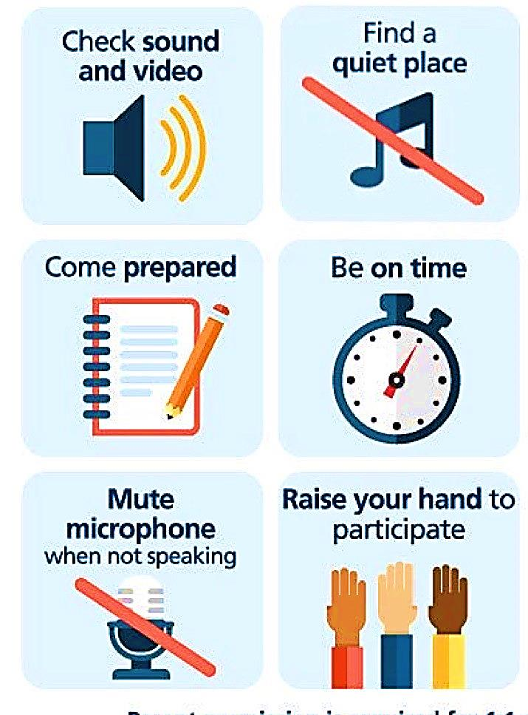
Online Classroom Rules

Slide 4
Lesson Goals
T
The students will be able to :
1 – use will & be going to make predictions about the future .
2 – make negative & questions in the future and answer them.
3 – know the differences between will and be going to .
4 – use the future progressive for continuous actions in the future .

Slide 5
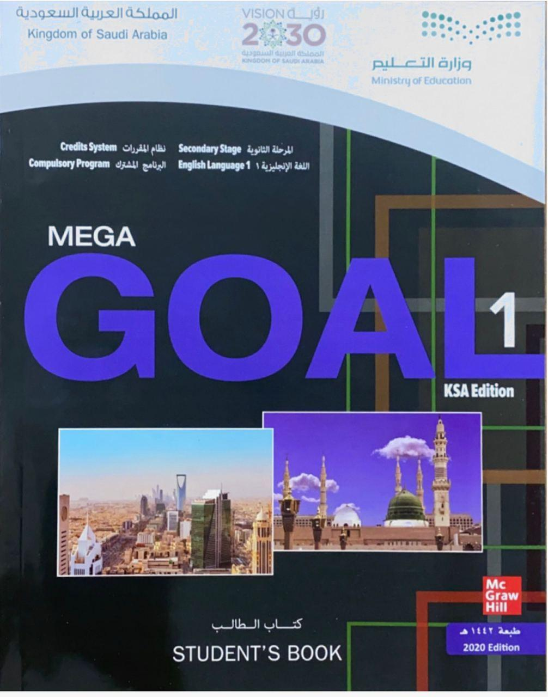
Open your Student’s book at page: 36 34

Slide 6
Examples
I will call you tomorrow
I am going to call you tomorrow
He won’t travel to Japan next year
They aren’t going to travel to Japan next year

Slide 7
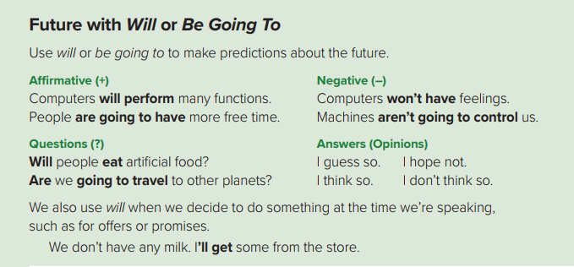

Slide 8
There are several ways to express the future . Let’s see two of those ways .
Will ( ‘ll )
1st
be going to
2nd

Slide 9
Answer the following
The kids will go to the museum alone .
Negative
The kids won’t go to the museum alone .
Affirmative
He isn’t going to watch a movie tonight .
He is going to watch a movie tonight .

Slide 10
Negative
Subject
will
not
Main verb
They will not ( won’t ) fix their car .
Will + not = won’t
Subject
am / is / are
not
going to
Main verb
The sky is not going to rain .

Slide 11
Questions with ( will / be going to )
Will people live in space station ?
Questions ( ? )
Is he going to study Spanish ?
I guess so
I think so
Answers ( Opinions )
( Yes Response )
I don’t guess so
I don’t think so
Answers ( Opinions )
( No Response )

Slide 12
Ali will buy a new TV next Sunday .
Make a question
Will Ali buy a new TV next Sunday ?
My dad is going to buy tickets tonight .
Make a question
Is my dad going to buy tickets tonight ?
Will computers perform many functions ?
Answer
I think so .
I don’t think so .

Slide 13
Question
Will
Subject
Main verb
?
Will Sami visit Jeddah next week ?
Am / Is / Are
Subject
going to
Main verb
?
Are they going to play tomorrow ?

Slide 14
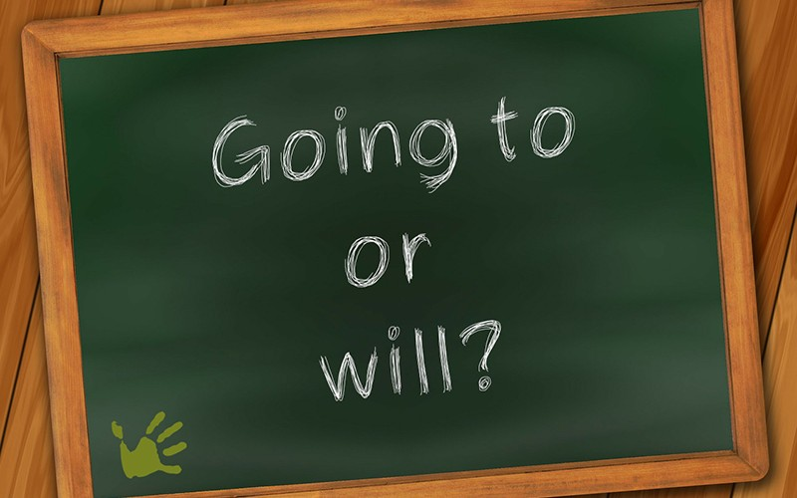
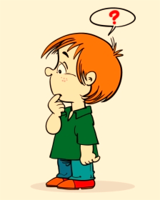

Slide 15
Will
We use will with :
1) a promise
I will call you when I arrive .
2) an offer
She will look after the children .
3) Expressing uncertainty , often with maybe or probably .
He will probably arrive late tomorrow .

Slide 16
be going to
We use be going to with :
1) Expressing a plan that is already made or decide
We are going to spend our vacation in Abha .
2) Predictions based on what we can see at the moment .
Look at the clouds ! It is going to rain .

Slide 20
We use it for continuous actions in the future
Subject
Will
be
V- ing
Subject
am / is / are
going to
be
V- ing
At this time tomorrow, I will be swimming in the ocean .
At this time tomorrow, I’m going to be swimming in the ocean .

Slide 21
Question
Will
Subject
be
V- ing
?
Will they be working on the weekend ?
Am / Is / Are
Subject
going to
be
V- ing
?
Are they going to be working on the weekend ?

Slide 22
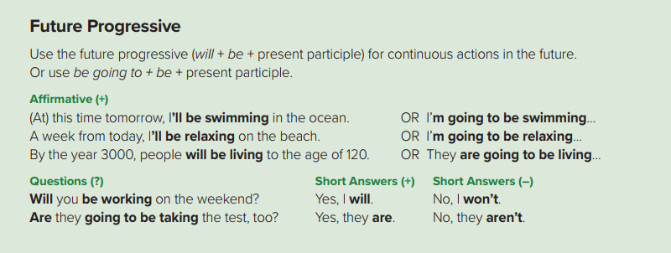

Slide 24
Answers
1 – will live / are going to live / will be living / are going to be living
2 – will study / are going to study / will be studying / are going to be studying
3 – won’t run / aren’t going to run / won’t be running / aren’t going to be running
4 – won’t control / aren’t going to control / won’t be controlling / aren’t going to be controlling
5 – will listen / are going to listen / will be listening / are going to be listening
6 – will be / are going to be

Slide 27
Workbook P. 100
Exercise C

