Slide 1


Slide 2
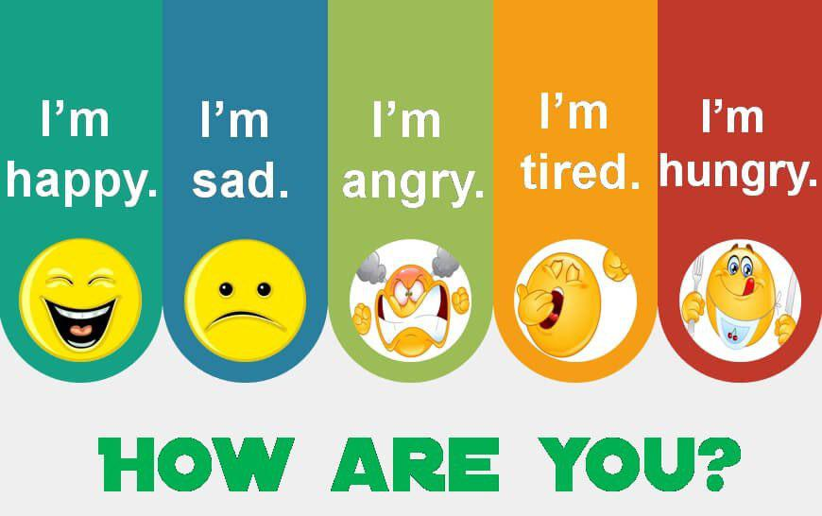

Slide 3

What day is it today?
What is the date?

Slide 4
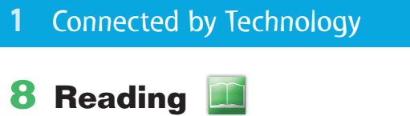

Slide 5
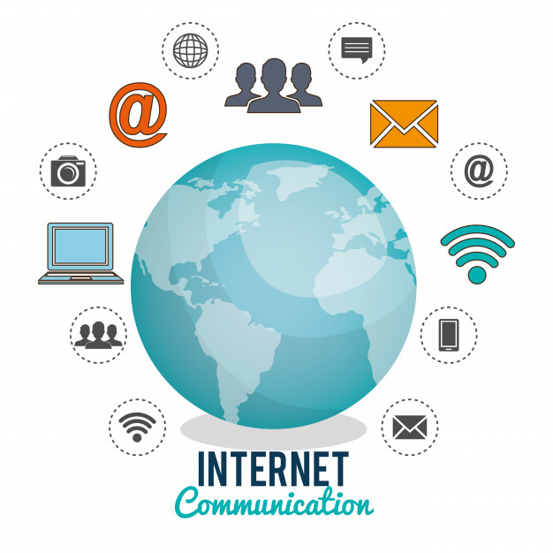
1
2
3
4
5
6
7
8
9
10
11
12
13
14
15
16
17
18
19
20
21
22
23
24

Slide 6
Internet

Slide 7
Has the Internet ever helped you meet or reconnect with a friend?

Slide 8

Open your student’s book

Slide 9
Objectives
In this lesson you are going to:
read the text.
learn new words.
answer the questions about the text.
talk about the advantages and disadvantages of the Internet.

Slide 10

Open your student’s book

Slide 12


Slide 13

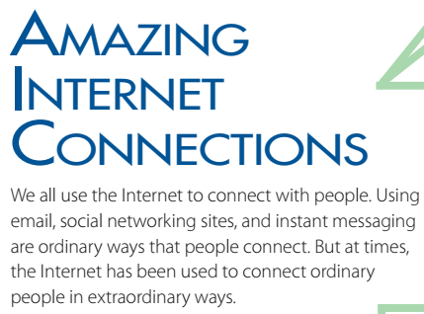

Slide 14
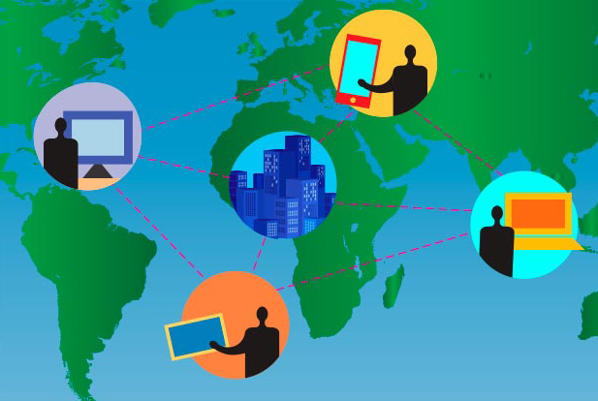
Why do we all use the Internet ?
to connect with people.

Slide 15

Using email, social networking sites, and instant messaging are ordinary ways that people connect.
But at times, the Internet has been used to connect ordinary people in extraordinary ways
common
unusual
special

Slide 16
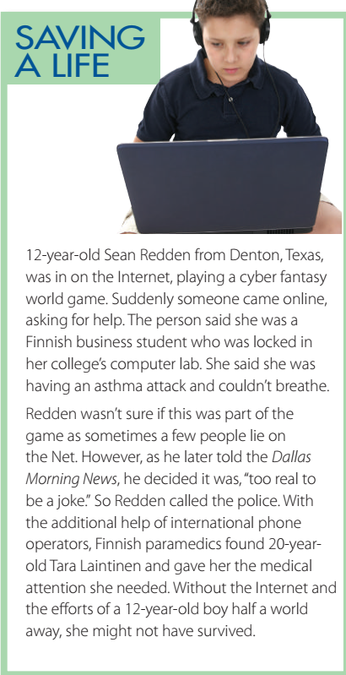

Slide 17
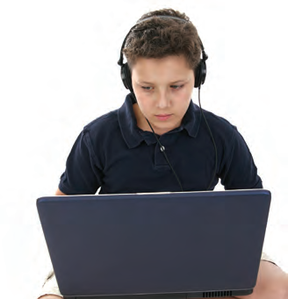
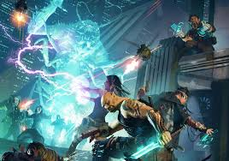
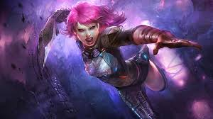

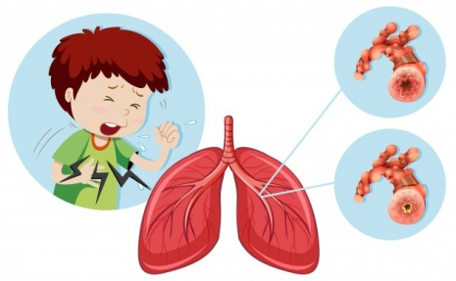
What was Sean Redden doing?
He was playing a cyber fantasy world game.
What problem was the Finnish woman having?
She was having an asthma attack.

Slide 18
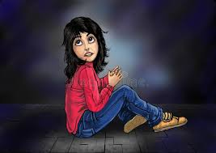
Why couldn’t she get help?
She was locked in the computer lab.
Was this part of the game or was it real?
It was real.
What did Sean do?
He called the police.

Slide 19
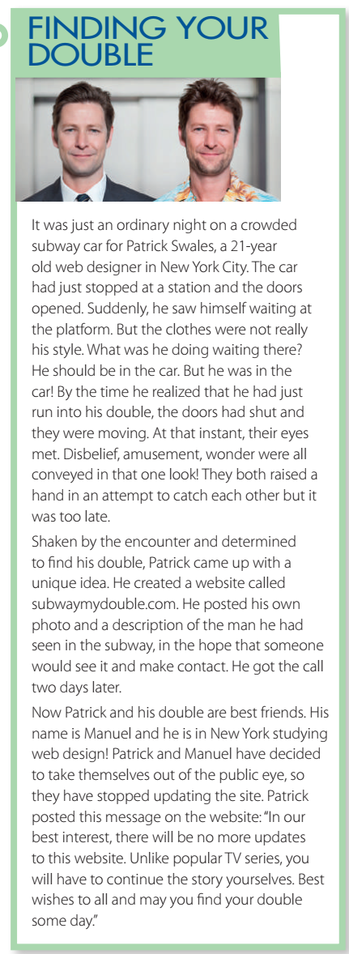

Slide 20
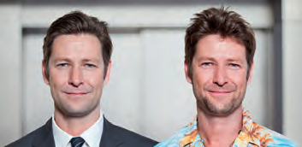
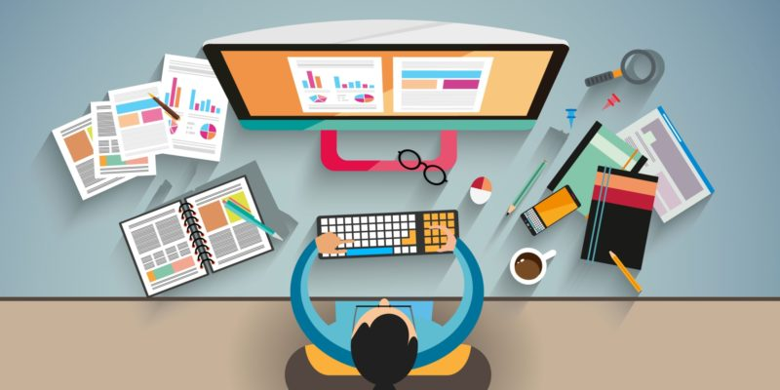
Who is Patrick Swales?
a 21-year old web designer

Slide 21
Who did he see on the subway?
He saw his double.
Why didn’t he speak to him?
The train doors shut and it started moving.
How did he find him?
He created a website and posted a description of the man he had seen.

Slide 22
What are Patrick and Manuel doing now?
They are best friends.

Slide 23
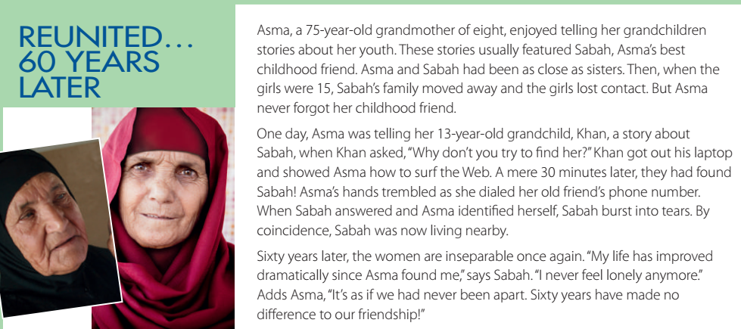

Slide 24
What was the relationship between Asma and Sabah in the past?
They were best friends.
Why did they lose contact?
Sabah’s family moved away.
Who helped Asma find Sabah? How?
Her grandson Khan showed her how to surf the Web, and they found the phone number.
What is the relationship between Sabah and Asma now?
They are inseparable.

Slide 25

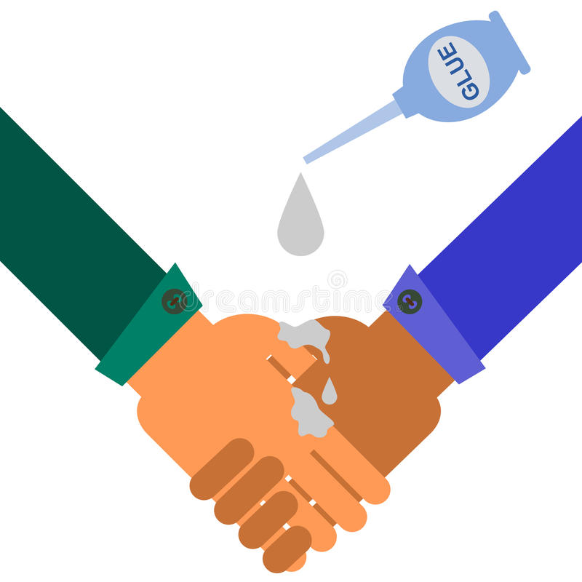
inseparable

Slide 26
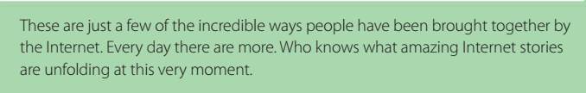

Slide 27
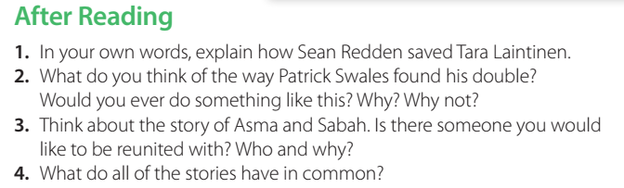
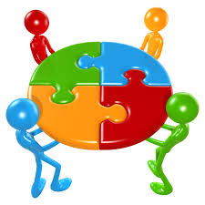
Group work Strategy

Slide 28
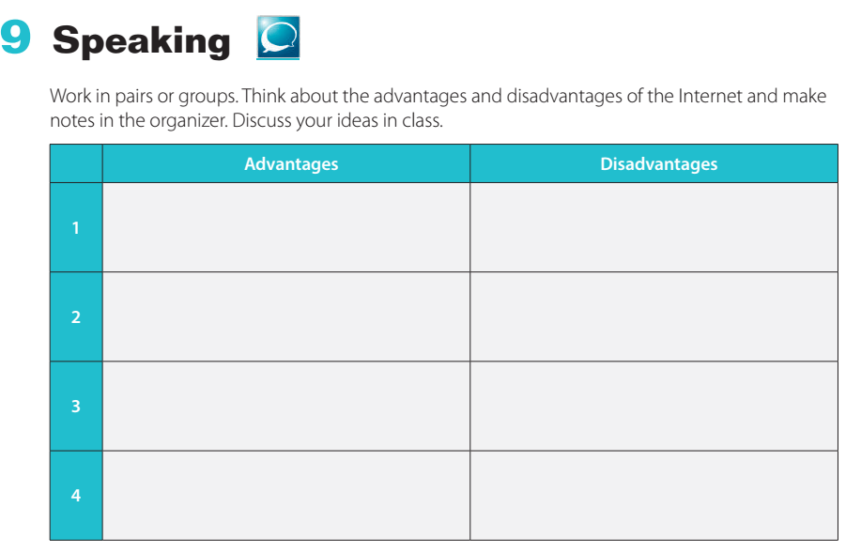
Group work Strategy

Slide 29
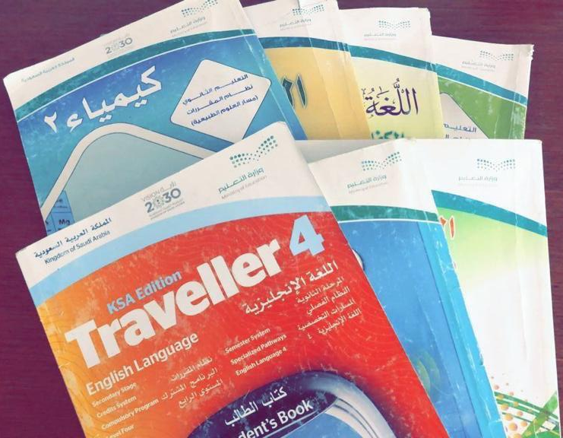
In which school subject can you talk about the advantages and disadvantages of the Internet ?

Slide 30

The Internet is a great blessing from Allah that has a lot of advantages. We should thank Allah for this blessing.

Slide 31
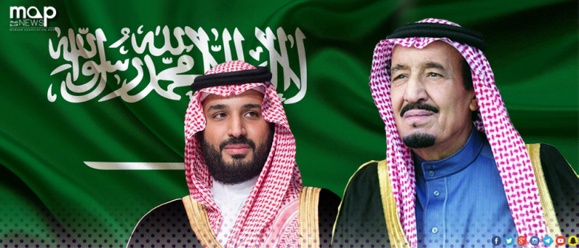

Is the Internet available in your country?

Slide 32
My channel
https://t.me/englishteacher350

