Slide 1






1 Listen & discuss
2 pair work
Today:
Date:
- -1445
Page 10
By: Dalal Al-Juaid

Slide 2


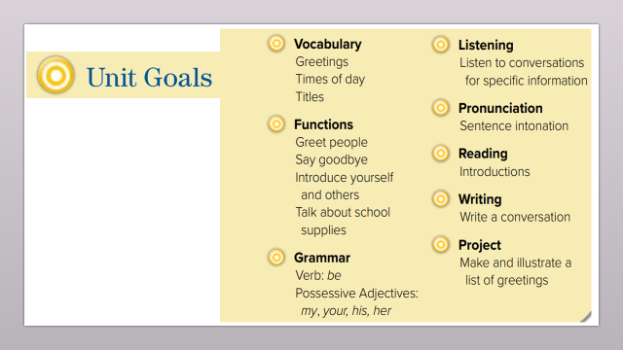
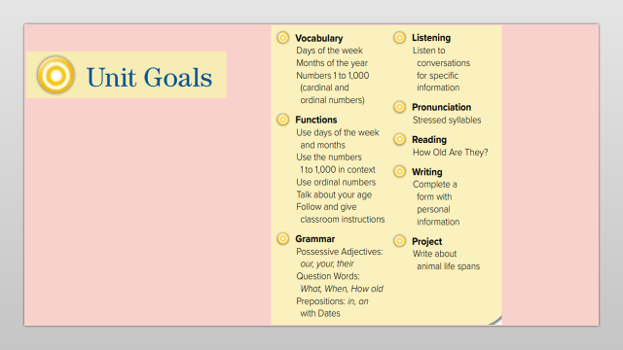
List the days of the week.
List the months of the year.
Warm up
1-Listen
Count to one thousand 1000.
New words
Quick check
Perform a conversation about age & name.
2-Pair work

Slide 3
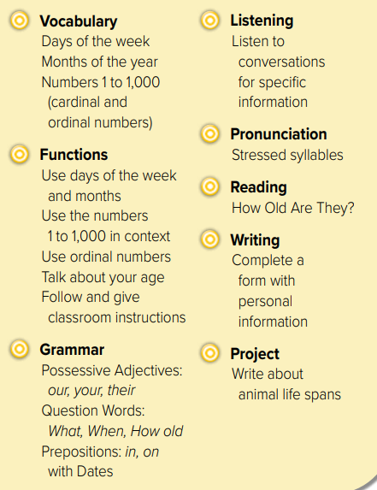
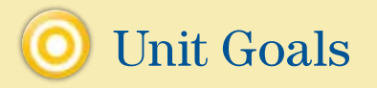

Slide 4





Warm up
1-Listen
New words
Quick check
2-Pair work

Slide 5


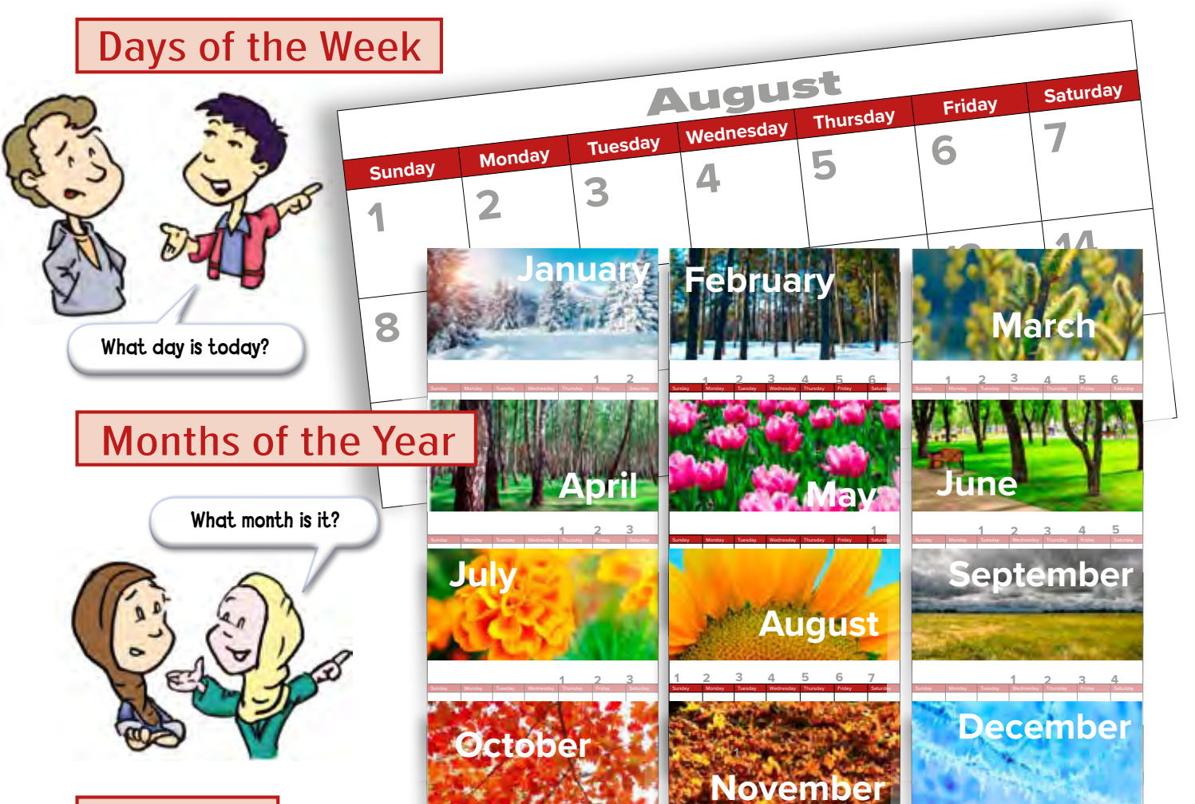
Page 10
Warm up
1-Listen
New words
Quick check
2-Pair work

Slide 6
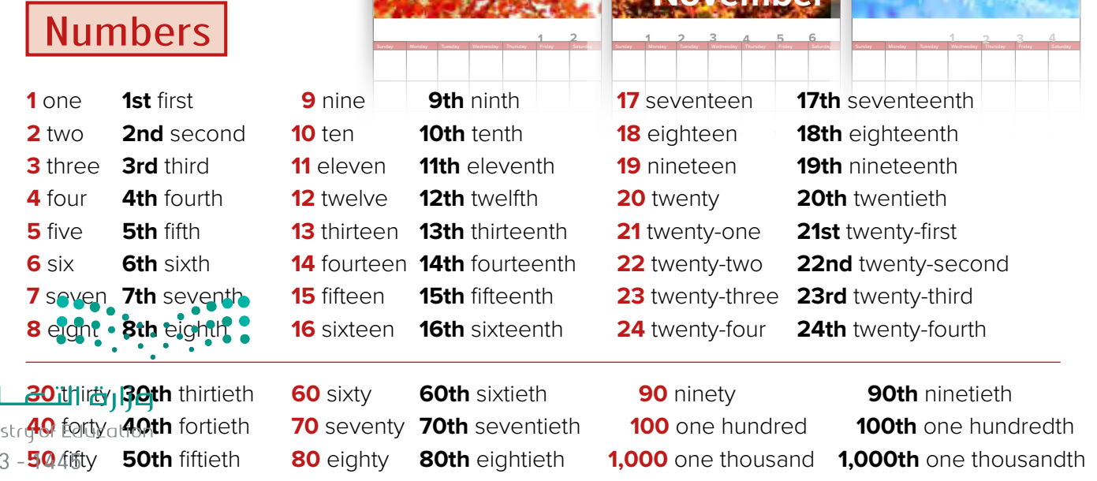
Page 10
Warm up
1-Listen
New words
Quick check
2-Pair work

Slide 7
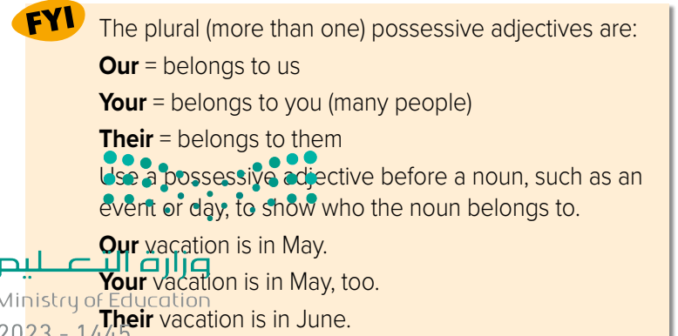
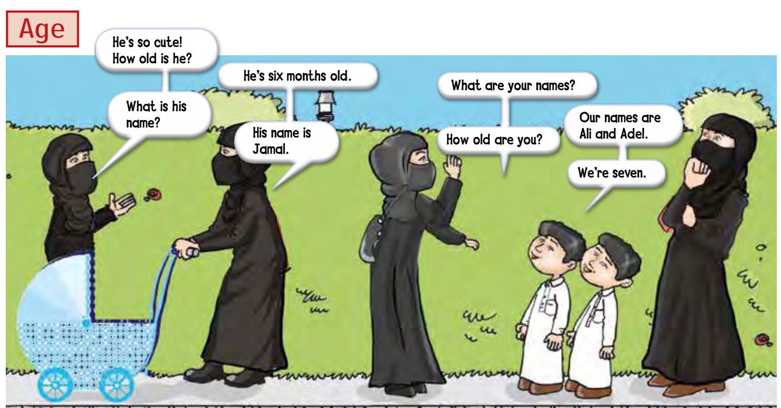
Page 11
Warm up
1-Listen
New words
Quick check
2-Pair work

Slide 8
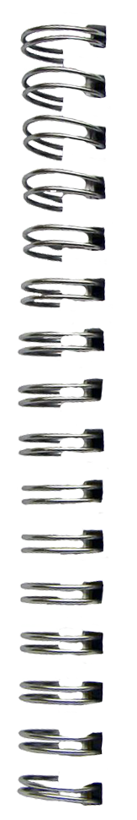


Days:
Sun.
New Words
Mon.
Tues.
Wed.
Thur.
Fri.
Sat.
March 3
Months:
Jan. 1
Feb. 2
June 6
Apr. 4
May 5
Jul. 7
Aug. 8
Sep. 9
Numbers أرقام
Oct. 10
Dec. 12
Nov. 11
Age عمر

Slide 9
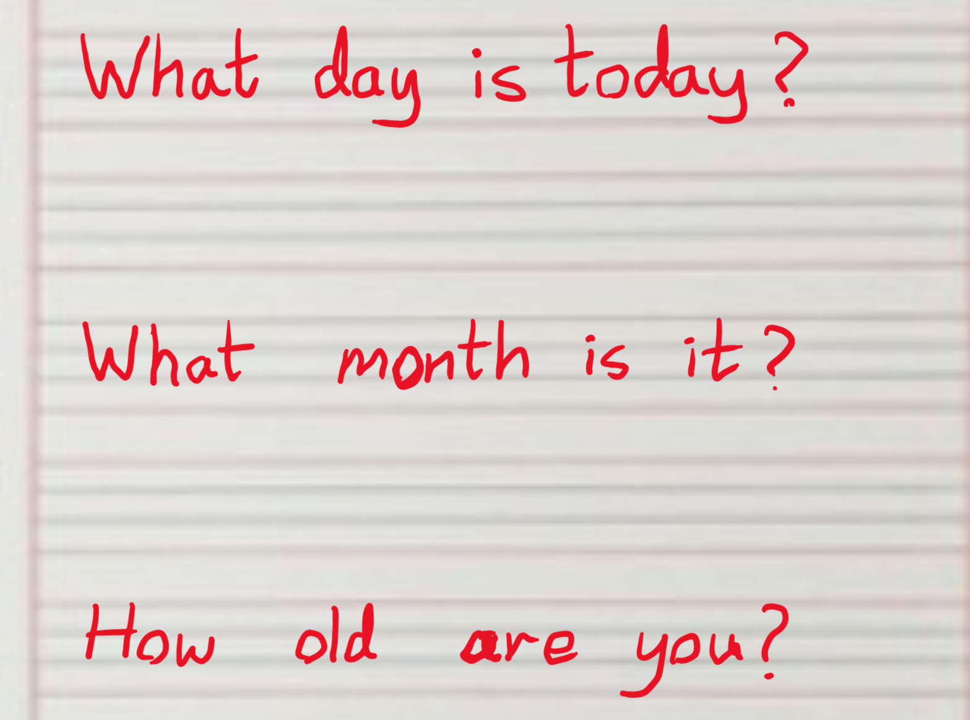

Questions

Slide 10
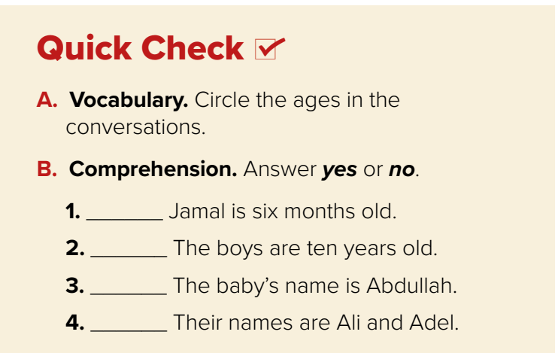
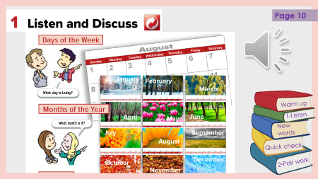
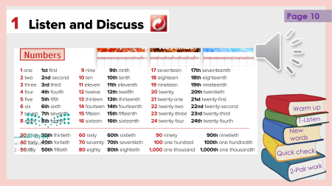
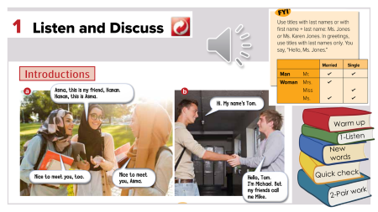
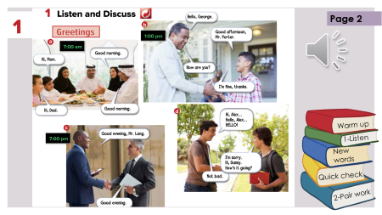
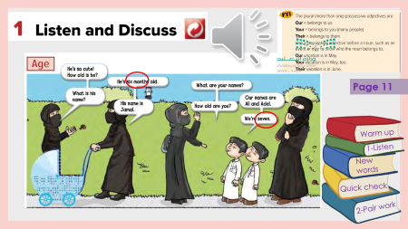
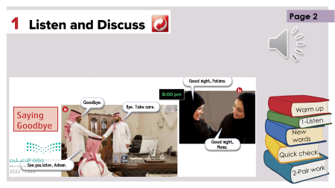
Page 3
yes
Warm up
no
1-Listen
New words
no
yes
Quick check
2-Pair work

Slide 11


Lets play
Warm up
1-Listen
New words
Quick check
2-Pair work

Slide 12

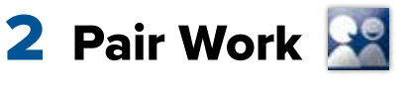
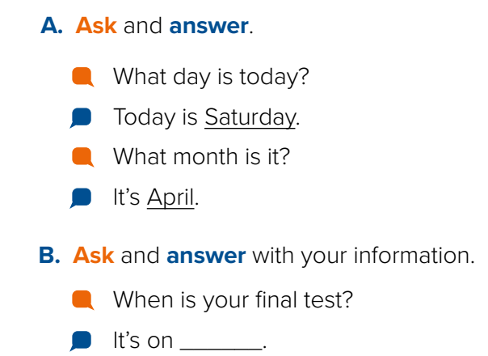


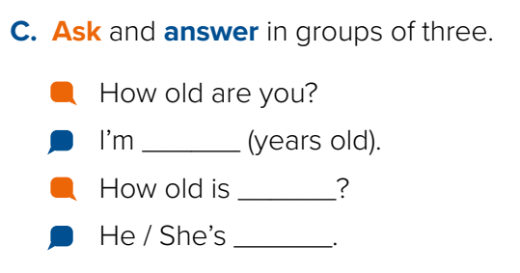
Warm up
1-Listen
New words
Quick check
2-Pair work

Slide 13





page 191 Ex(A-B-C)
for practice new words
Warm up
1-Listen
New words
Quick check
2-Pair work

Slide 14
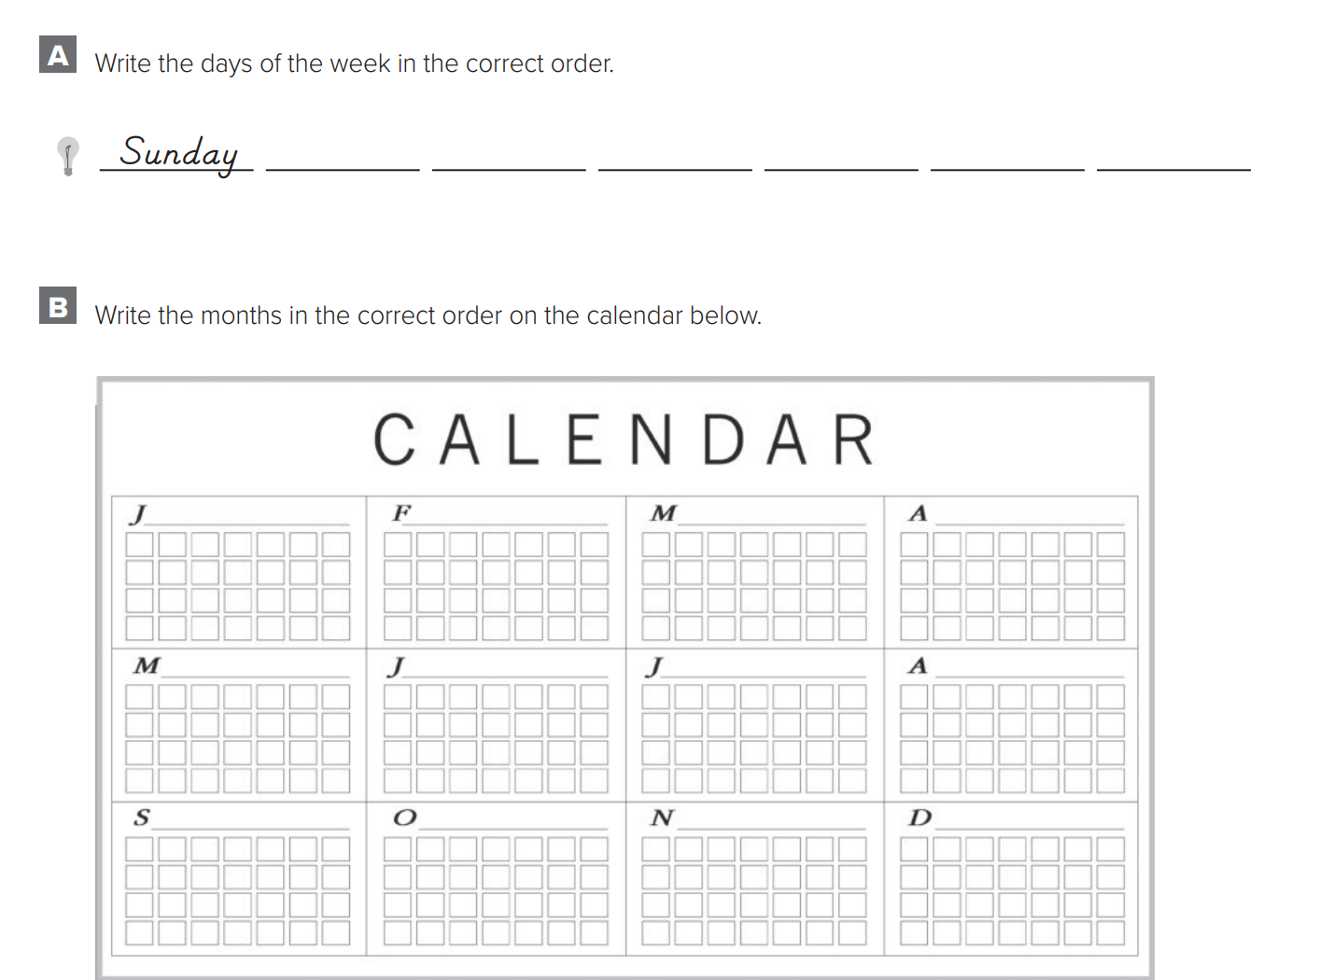
p.191
Monday
Tuesday
Wednesday
Thursday
Friday
Saturday
January
February
March
April
Warm up
May
June
1-Listen
July
August
New words
September
October
November
December
Quick check
2-Pair work

Slide 15
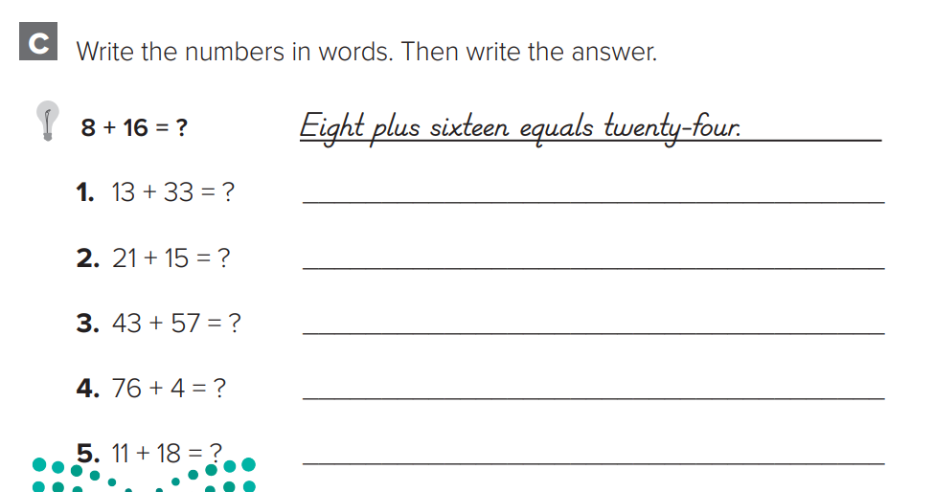
p.191
Thirteen plus thirty-three equals forty-six
Twenty-one plus fifteen equals thirty-six
Forty-three plus fifty-seven equals one hundred
Warm up
Seventy-six plus four equals eighty
1-Listen
New words
Eleven plus eighteen equals twenty-nine
Quick check
2-Pair work

