Slide 1


Slide 2

Day
Monday
Date
19/2/1445
Subject
We can 3
Unit
1 It’s nice to meet you
Lesson
3 Rhythms and Reading
Page
6-7

Slide 3
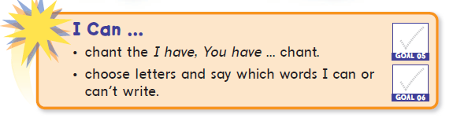
objectives
*Pair work
*Role play
*Problem solving
strategies

Slide 4


Slide 5
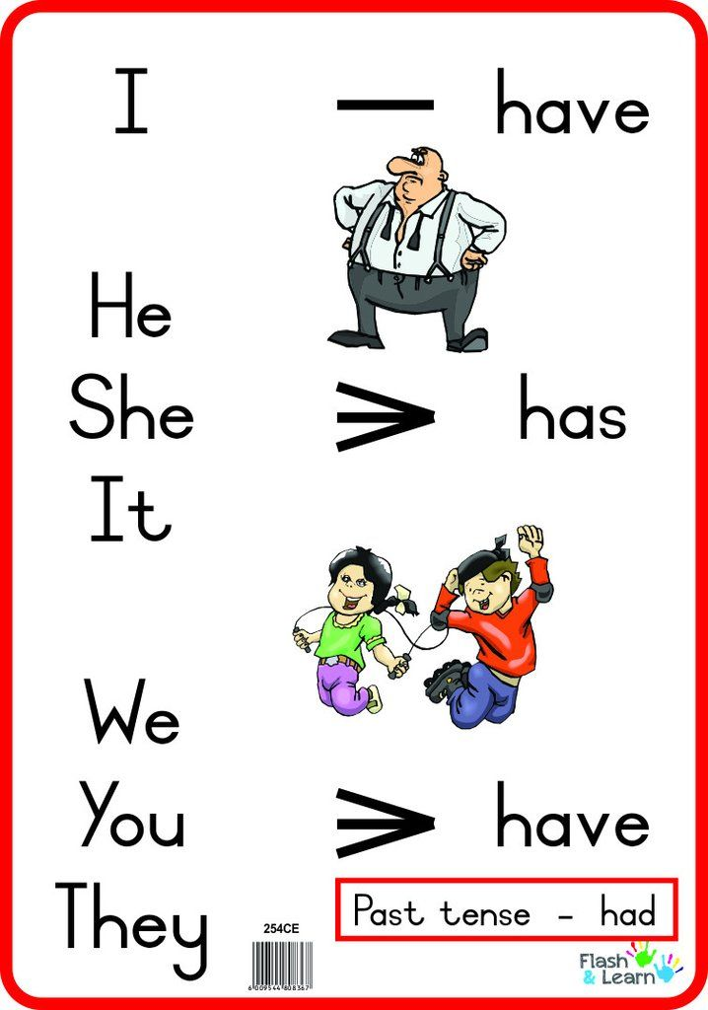

Slide 6
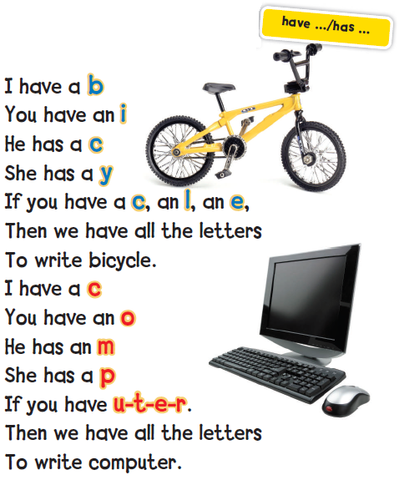

Listen , chant and point
1

Slide 7
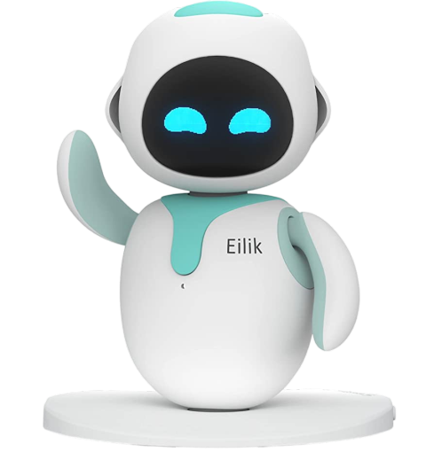
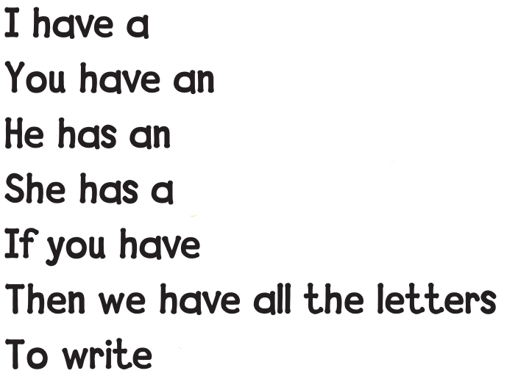


r
o
b
o
t
robot

Slide 8

True
False
or
Correct the false sentence.
1- I has a red dress.
I have a red dress.

Slide 9

True
False
or
Correct the false sentence.
2- She has a hat.

Slide 10
True
False
or
Correct the false sentence.
3- He have a black car.
He has a black car.

Slide 11
True
False
or
Correct the false sentence.
4- We have an English class.

Slide 12

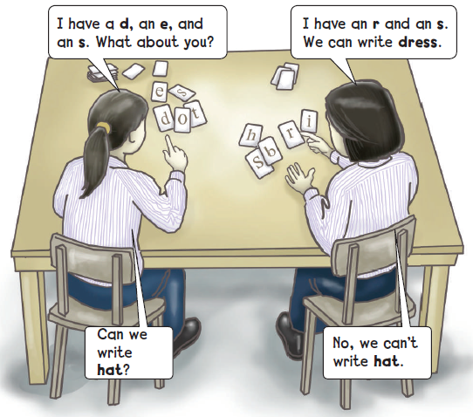

Letter sharing game
Can you write words with your partner?
4

Slide 13

Make words:
A
C
H
T

Slide 14
Cat
Chat
Act
At
Hat

Slide 15
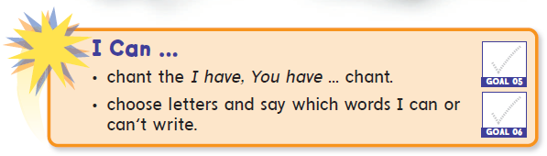

Slide 16
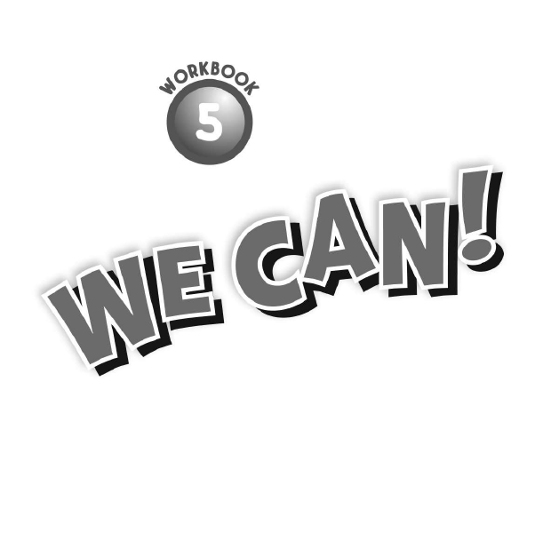
75-76

Slide 17

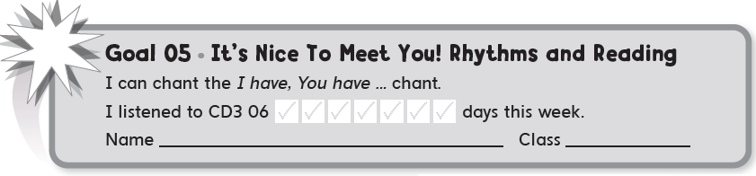

Slide 18


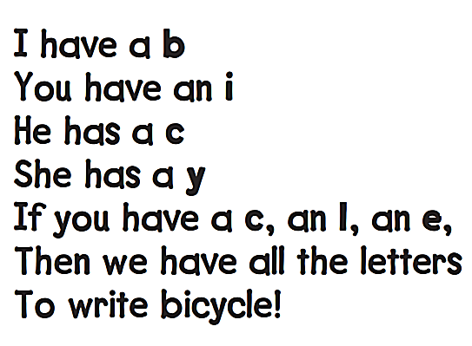
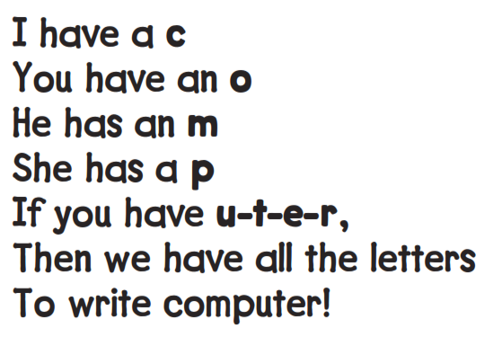


Slide 19



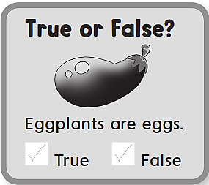

I have a p
You have an e
He has an n
If you have a c , an i , an l
Then we have all the letters to write pencil

Slide 20

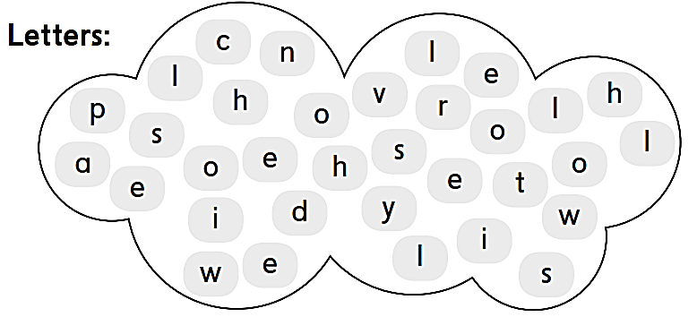

Slide 21
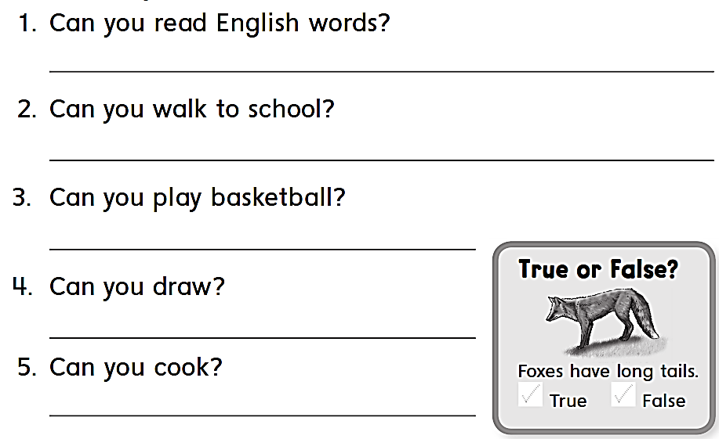
Yes , I can .
No , I can’t
Yes , I can .
Yes , I can .
No , I cant

