Slide 1

Super goal 5
Unit 2
Lesson 3 Language in Context + listening + pronunciation + about you
اعداد المعلم / يحيى المنقري متوسطة المأمون بالهفوف

Slide 2

Learning Objectives
*By the end of this lesson, Ss will be able to:
1-Refer to old habits with (used to).
2-Answer information question about someone’s life.

Slide 3
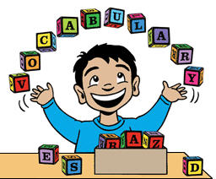

Slide 4





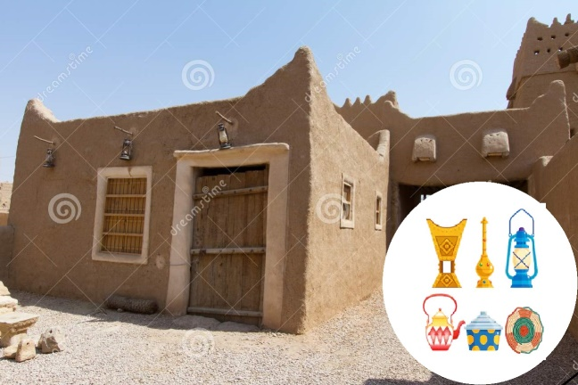
Truck
Shuttle
doll
Heritage

Slide 5
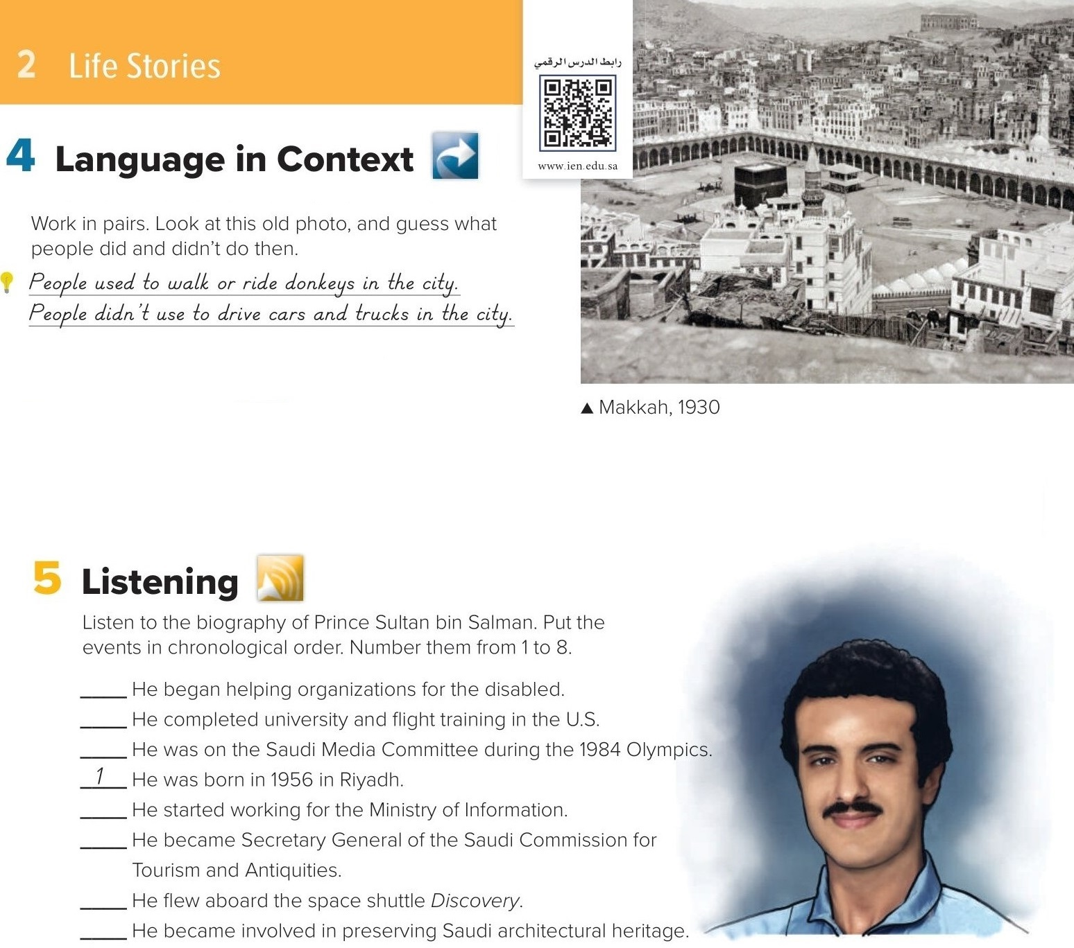

# People used to get news from the radio.
# People didn’t use to get news from the Internet.
# People used to play more games.
# People didn’t use to watch TV.
6
2
4
3
8
5
7

Slide 6
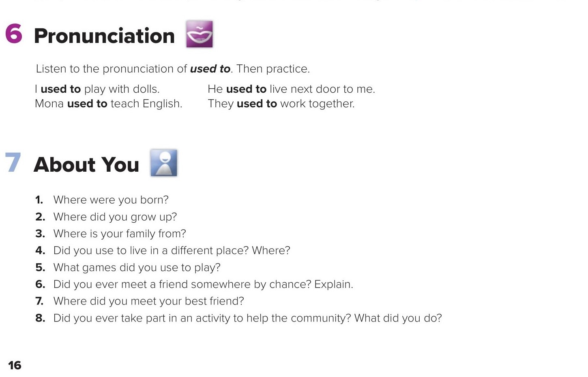

Slide 7


Choose the correct answer :
1-
People didn’t ………. watch TV
Use to
Used to
2-
People used to ……. in the city
Walk
Walking
3-
4-
doll
Truck
Shuttle
Car

Slide 8


Slide 9


Back

Slide 10


Back

Slide 11
page 16 Audioscript
Prince Sultan bin Salman Abdul-Aziz Al-Saud is a member of the Saudi royal family. He was born in Riyadh on June 27, 1956. He is a grandson of King Abdulaziz. Prince Sultan was educated in Riyadh. After high school, he went on to study communications and aviation in the United States. He completed a Bachelor’s in Mass Communications and later a Master’s in Social and Political Science. While in the U.S., he also became a certified pilot. After university, he began working as a researcher for the Department of International Communications in the Saudi Ministry of Information. He also served on the Saudi Media Committee during the Los Angeles Olympics in 1984, and later that same year he was appointed to the Department of Advertising in the Ministry of Information. The following year, Prince Sultan joined the Royal Saudi Air Force and retired with the rank of colonel in 1996. In June 1985, Prince Sultan made history when he became the first Saudi astronaut, the first Muslim, and the first member of royalty to travel in space. He flew aboard the space shuttle STS-51-G Discovery to launch a satellite for the Arab Satellite Communications Corporation. Prince Sultan spent seven days in space and circled the earth 111 times. Following the flight, he helped establish the Association of Space Explorers, an international organization for astronauts who have traveled in space Prince Sultan later devoted his time to helping improve condition for the disabled. In 1988, he became Chairman of the Disabled Children’s Association and later co-founded the Prince Salman Center for Disability Research. The Prince also developed a special interest in preserving Saudi architectural heritage. As a result, he became Honorary President of the Al-Umran Saud Association in 1993 and also founded the Al-Turath Foundation to preserve urban heritage. In 2000, he was appointed Secretary General of the Saudi Commission for Tourism and Antiquities and his term was extended for another four years in 2008.
back

