Slide 1

objectives:
By the end of the lesson you will be able to:
  *Distinguish between all, neither, and none in use and meaning.
  *Use the target language in lifestyle comparison and in meaningful statements.

Slide 11
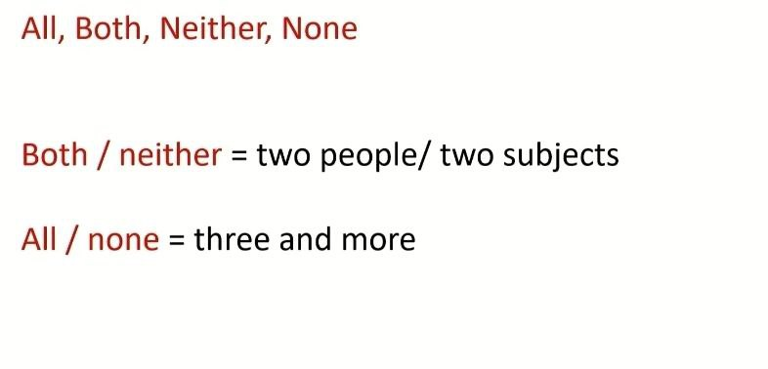
Both (2) – All (3 & more) = positive
Neither(2) - none(3 & more) = negative

Slide 12
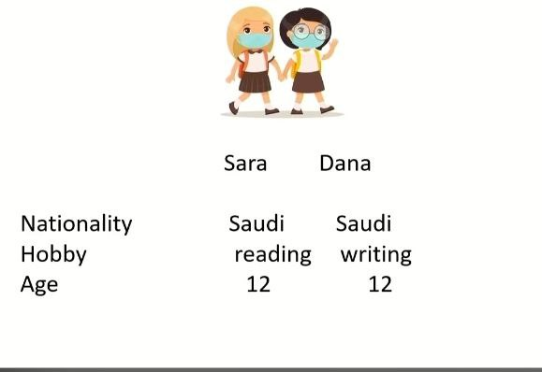

Slide 13
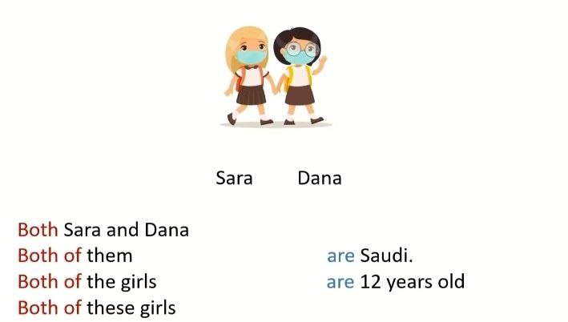

Slide 14
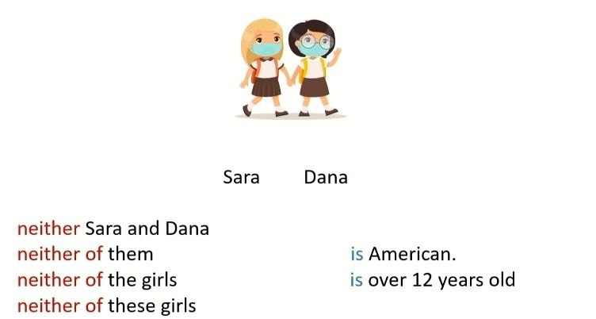

Slide 15
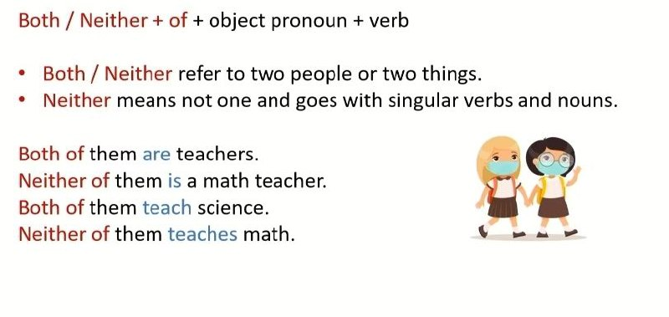

Slide 16
When neither links singular terms, the verb is singular
Neither of them is a math teacher.
Neither of them teaches math.

Slide 17
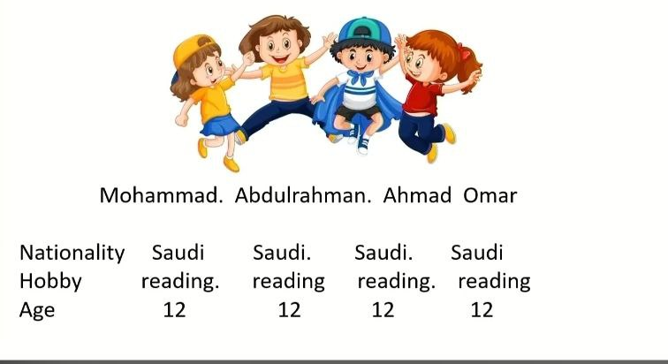

Slide 18
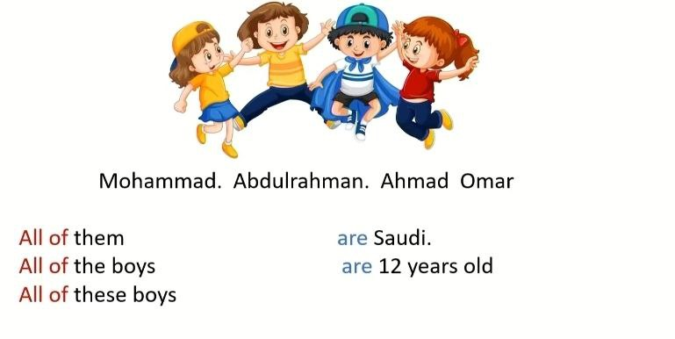

Slide 19
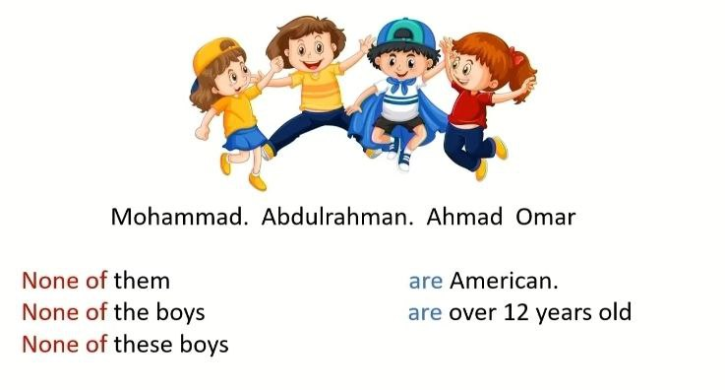

Slide 20
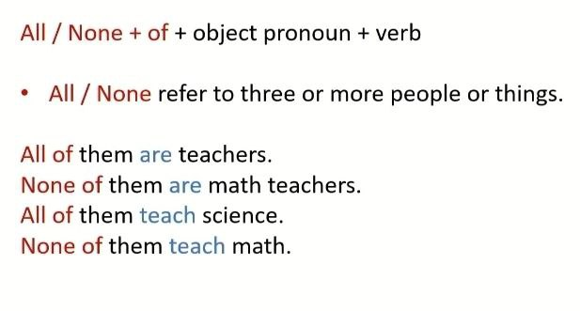

Slide 21
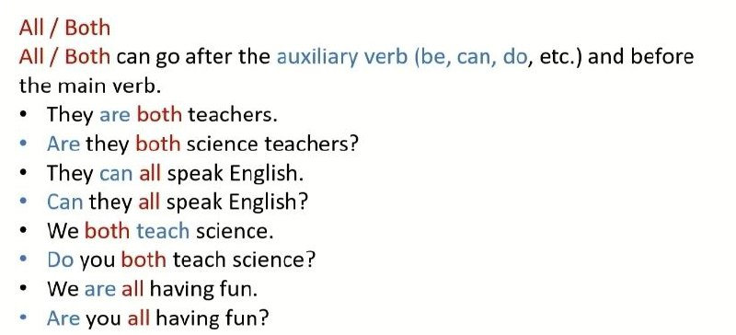

Slide 23
Both of them can cook.
Both of them work out regularly.
Neither of them eats junk food often.
Neither of them drinks a lot of coffee.

Slide 24
None of them are vegetarians.
None of them drink a lot of coffee.
All of them can cook.
Not all of them work out regularly.

Slide 25
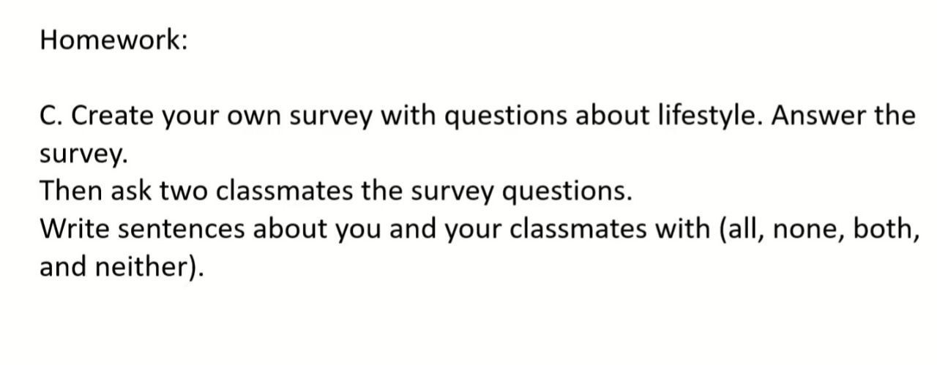

Slide 26
