Slide 1

Super goal 1
Unit 2
Lesson 6 form , meaning & function
اعداد المعلم / يحيى المنقري متوسطة المأمون بالهفوف

Slide 2

Learning Objectives
*By the end of this lesson, Ss will be able to:
1- apply classroom instruction .

Slide 3
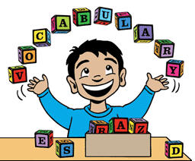

Slide 4

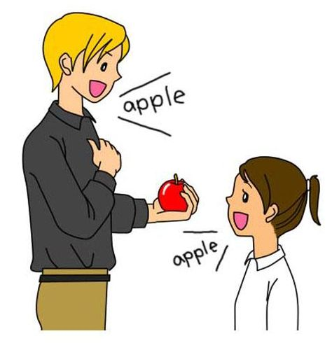
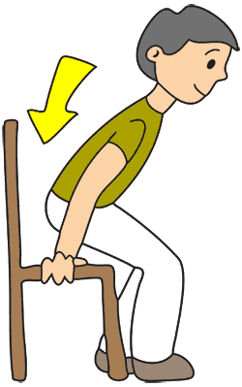


Bag
Repeat
Sit down

Slide 5
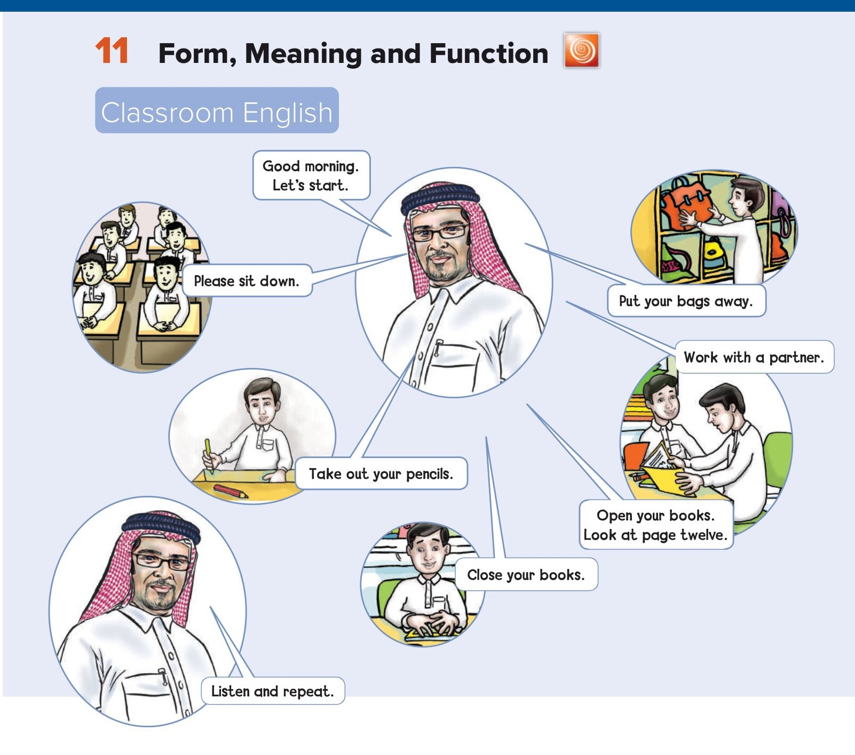

Slide 6
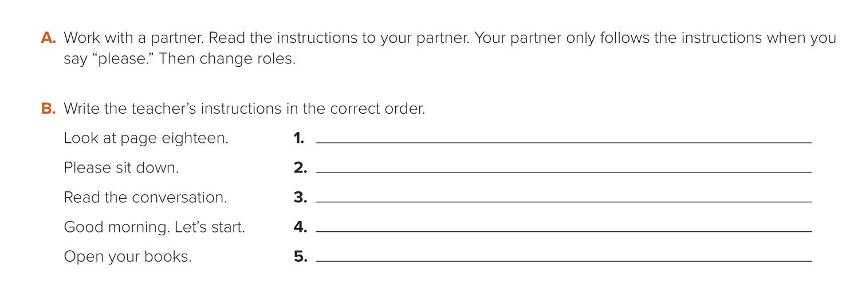
Good morning. Let’s start.
Please sit down.
Open your books.
Look at page eighteen.
Read the conversation.

Slide 7

Choose the correct answer :
1-
………… your book from your table
Look at
Take out
2-
……… your book look at page 9
Open
Close
3-
4-
Ruler
Repeat
Bag
Take out

Slide 8


Slide 9


Back

Slide 10


Back

