Slide 1


Slide 2


Slide 3
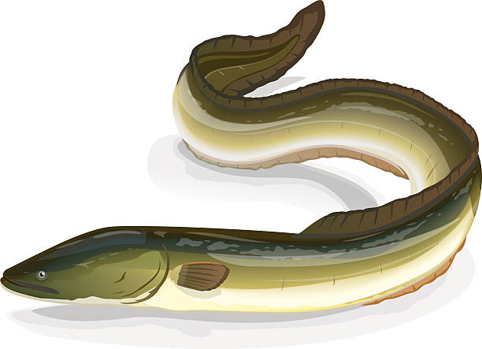
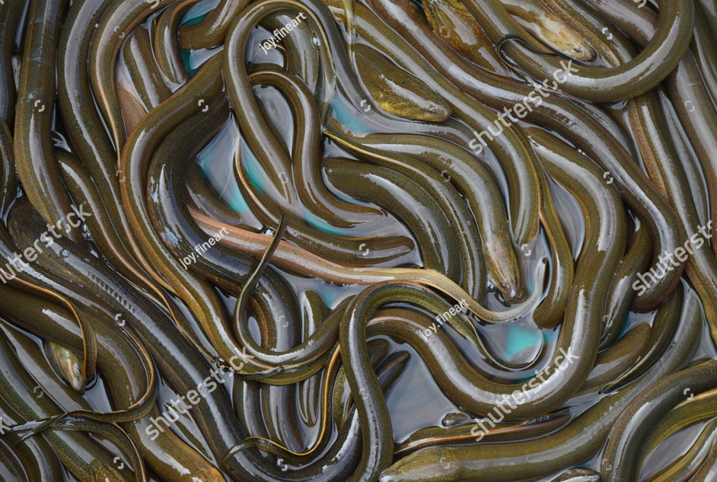
eel
Slippery

Slide 4
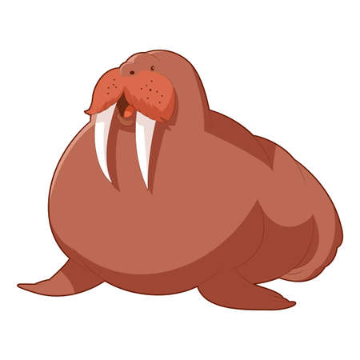
Walrus
Fat

Slide 5
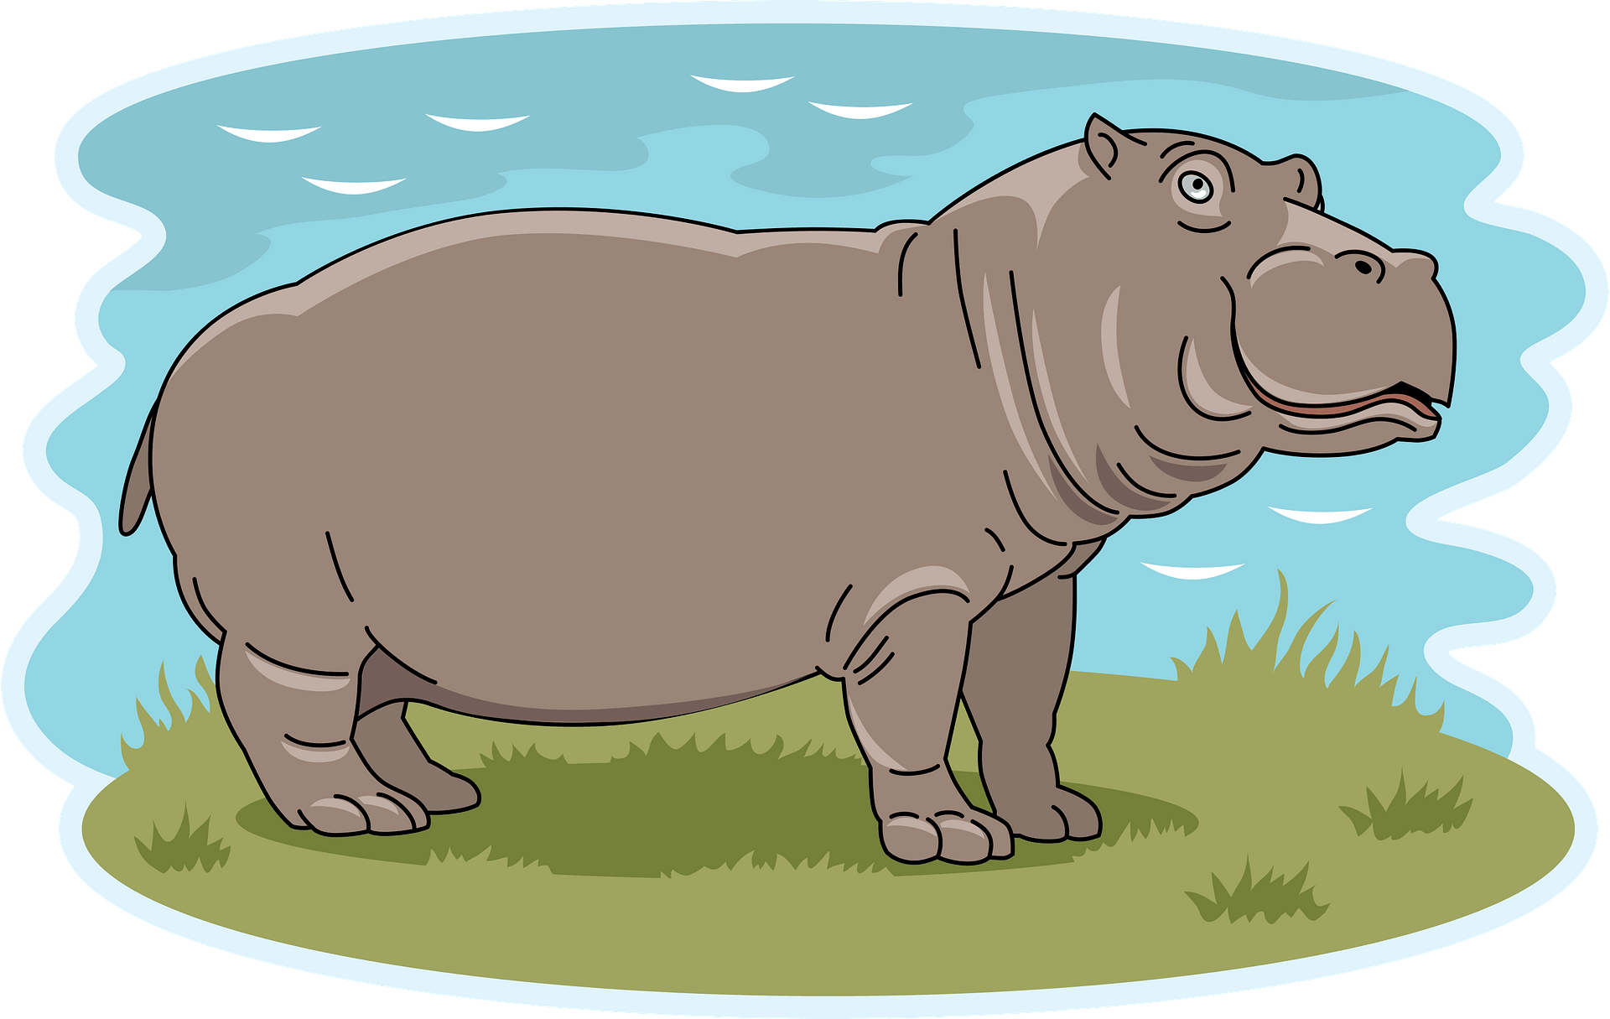
As fat as walrus.
fat
fat
walrus
hippo

Slide 6

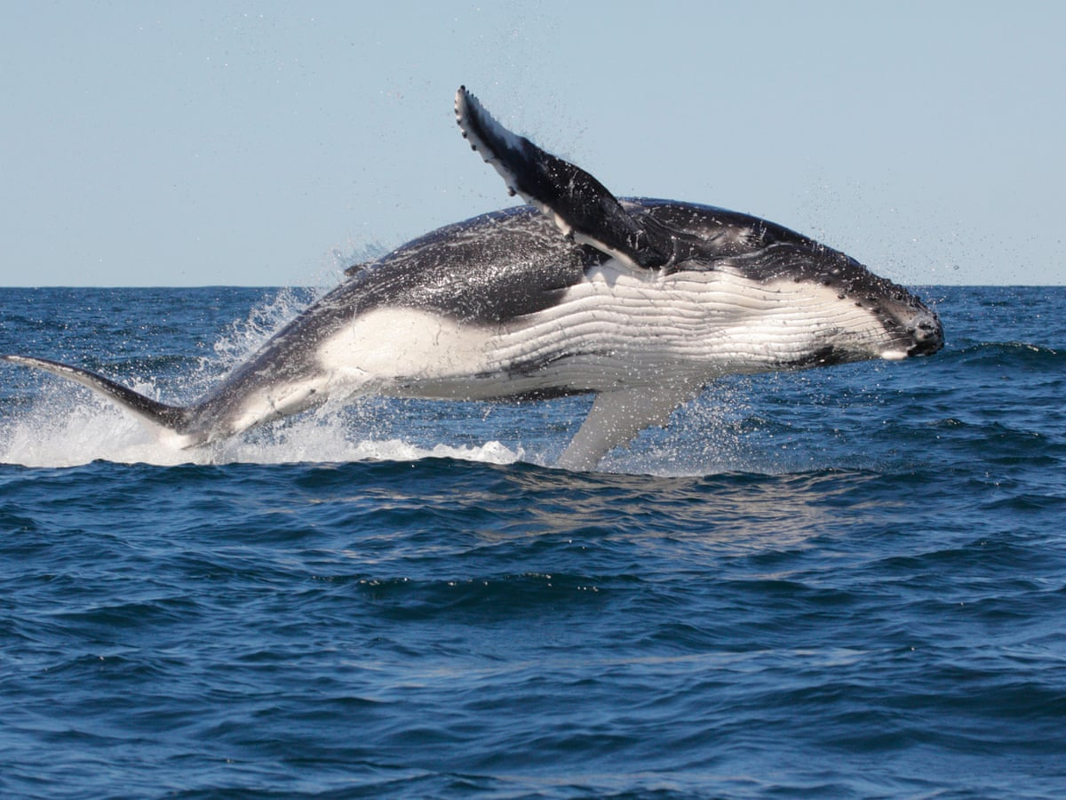
a whale
Big

Slide 7


As big as whale.
big
big
whale
elephant

Slide 8
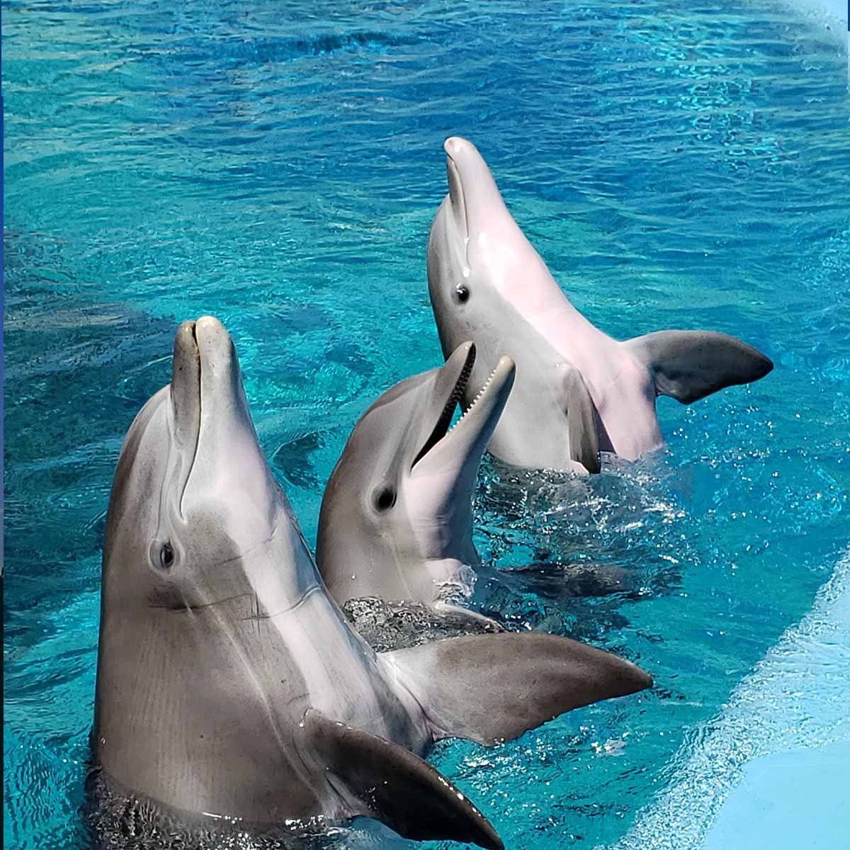
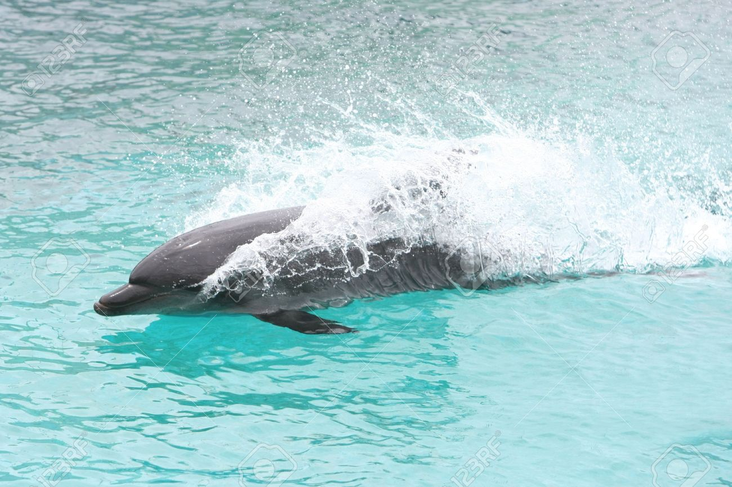
Dolphins
Fast.

Slide 9
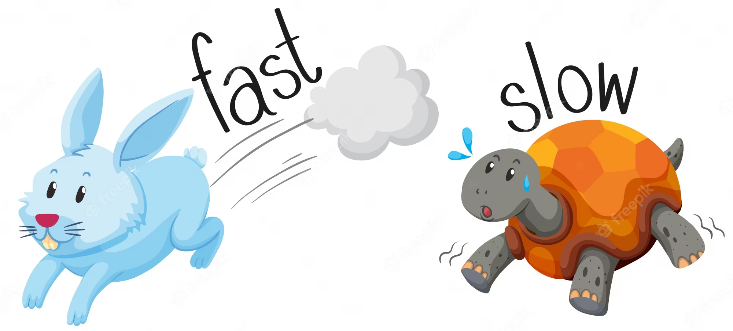
As fast as dolphin.
fast
rabbit
Dolphin

Slide 10
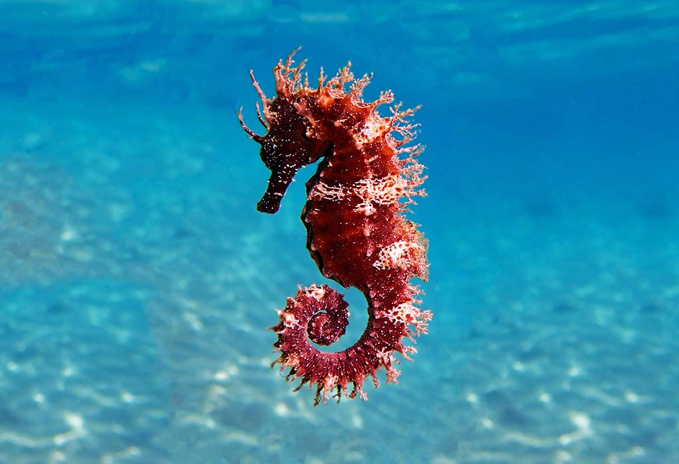
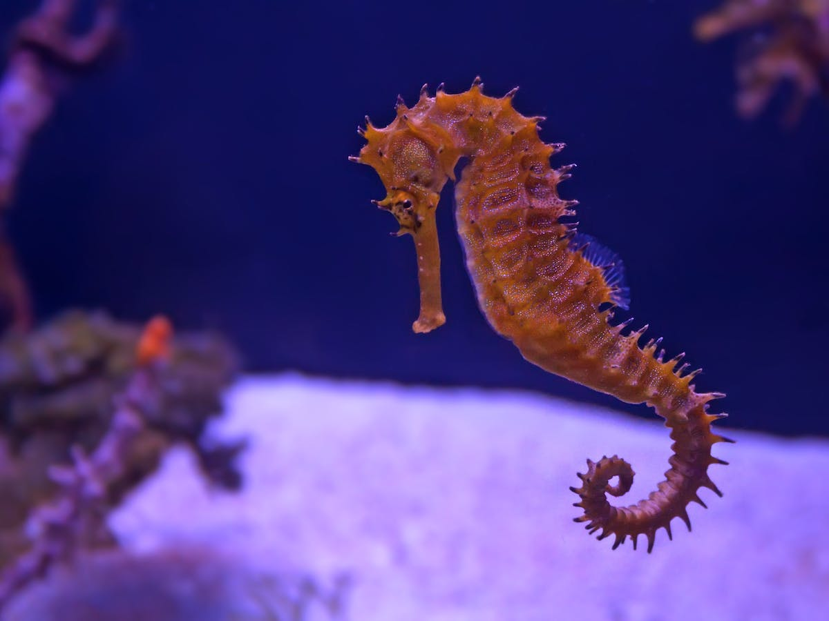
a seahorse
Slow .

Slide 11
As slow as seahorse.
slow
Turtle
Seahorse

Slide 12
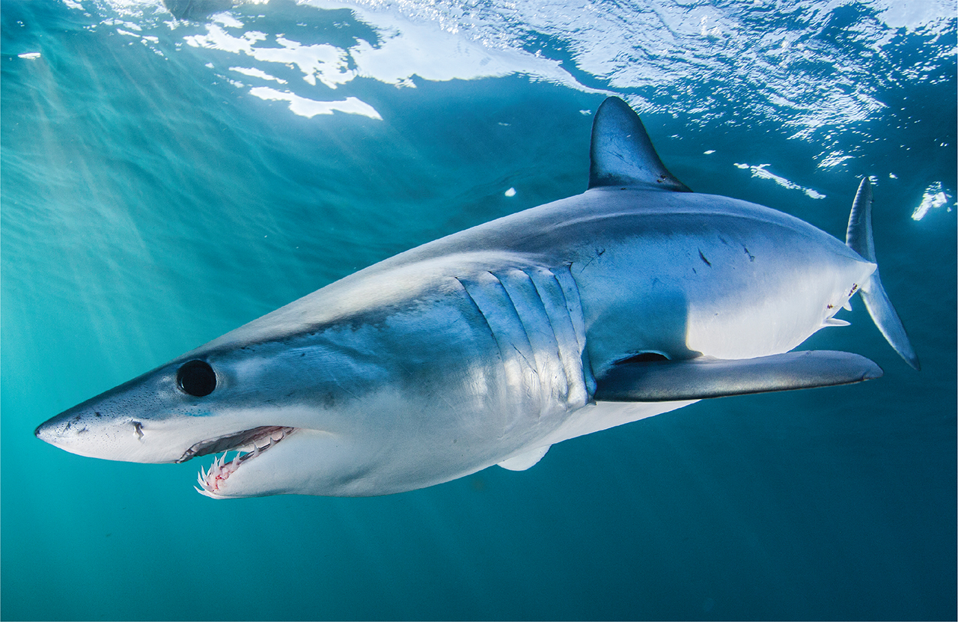
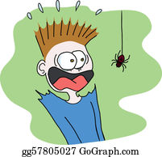
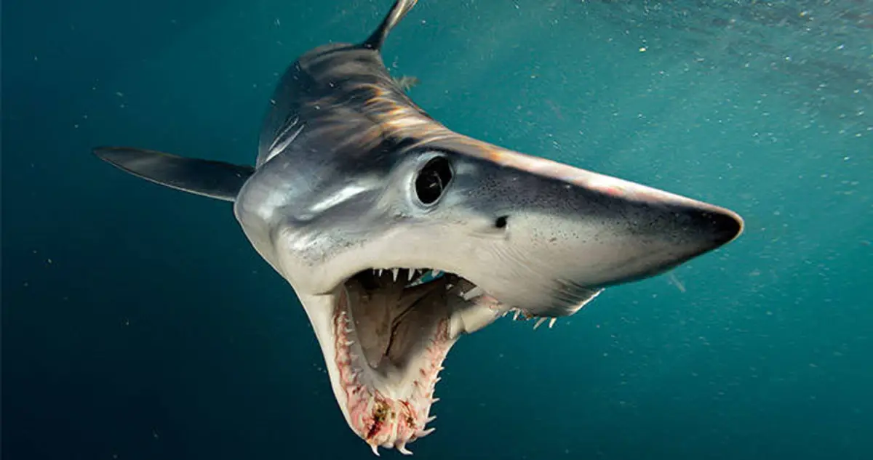
Sharks
Scary

Slide 13
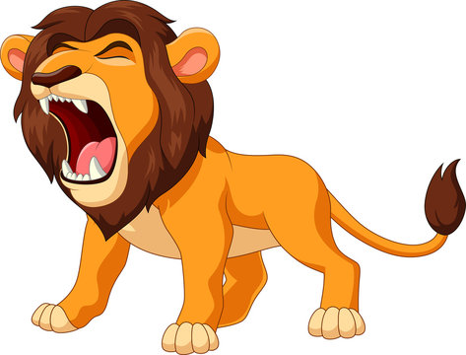
As scary as shark.
scary
scary
shark
lion

Slide 14

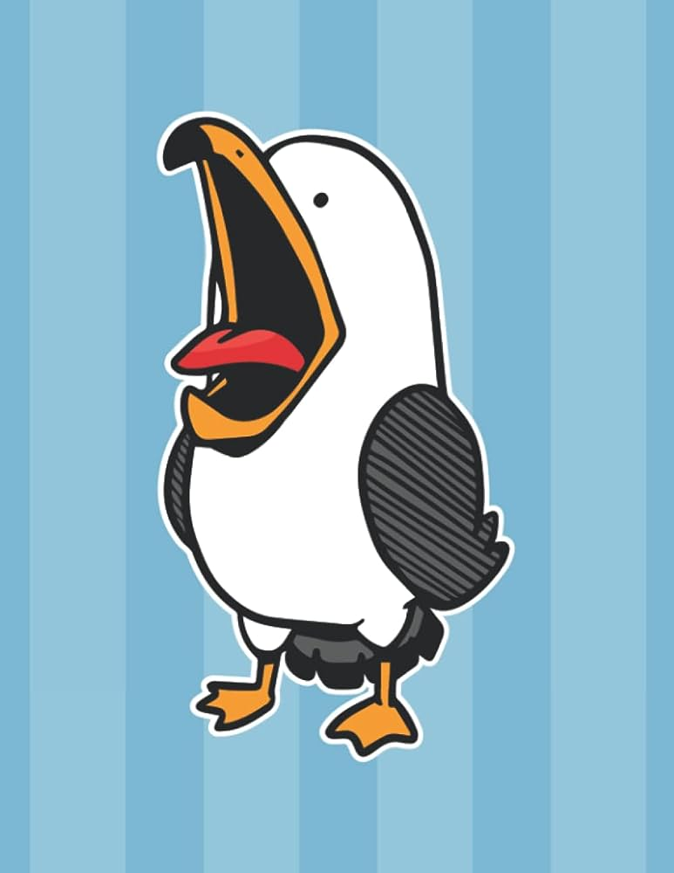
sea gull
noisy

Slide 15
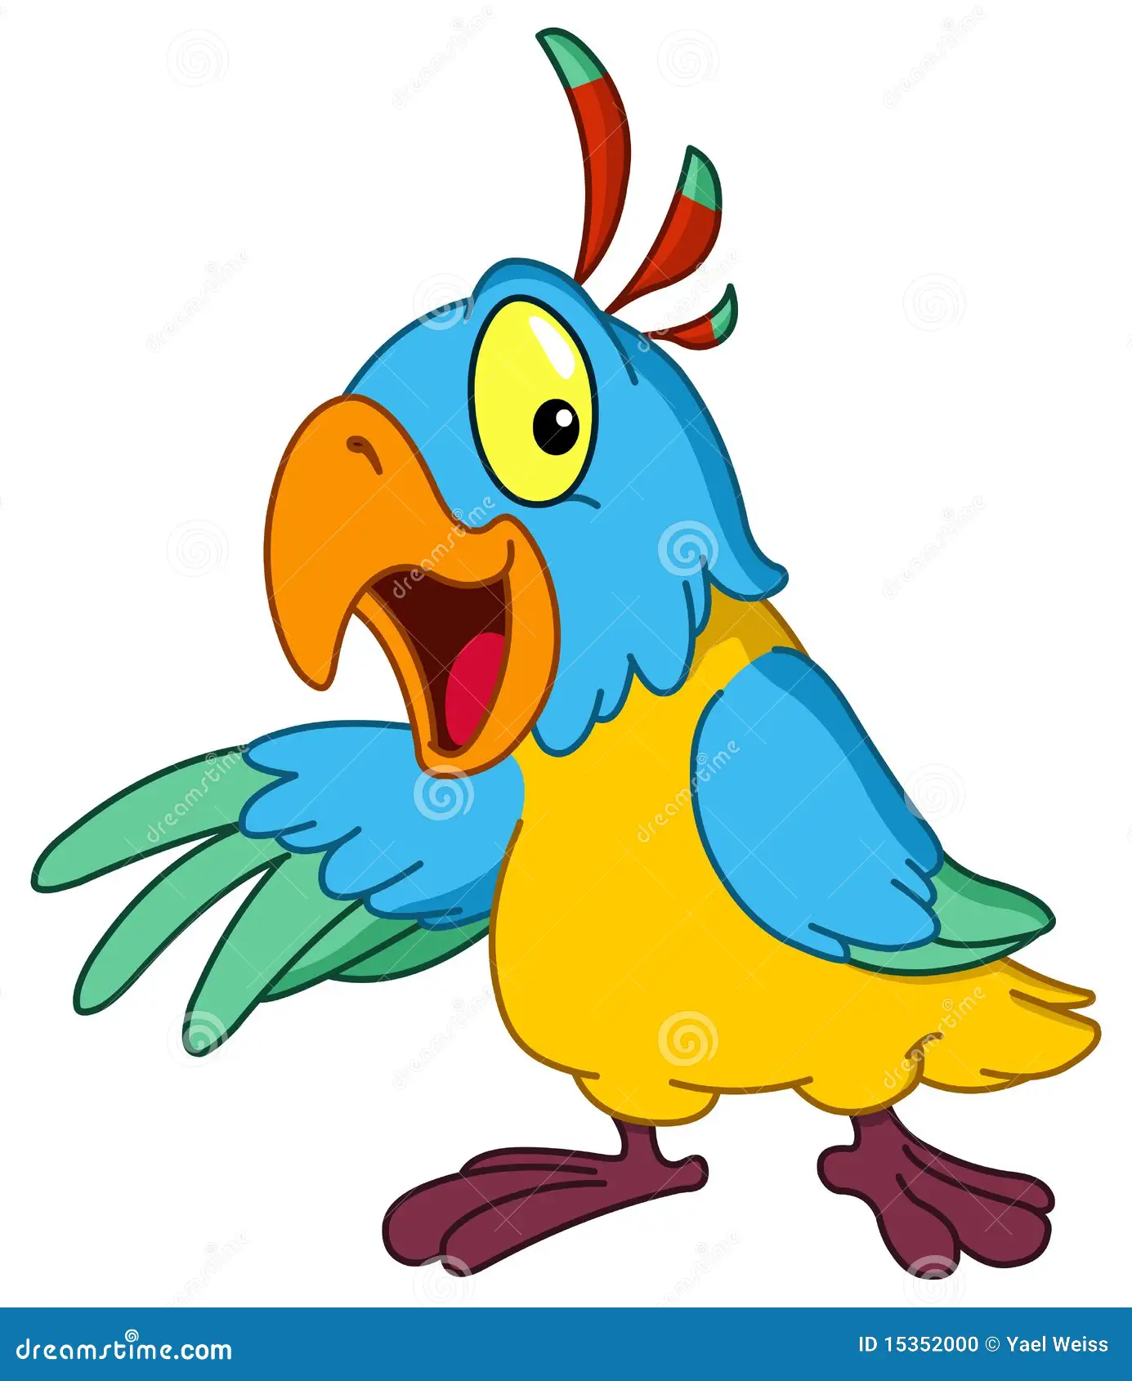
As noisy as parrot.
noisy
noisy
seagull
parrot

Slide 16
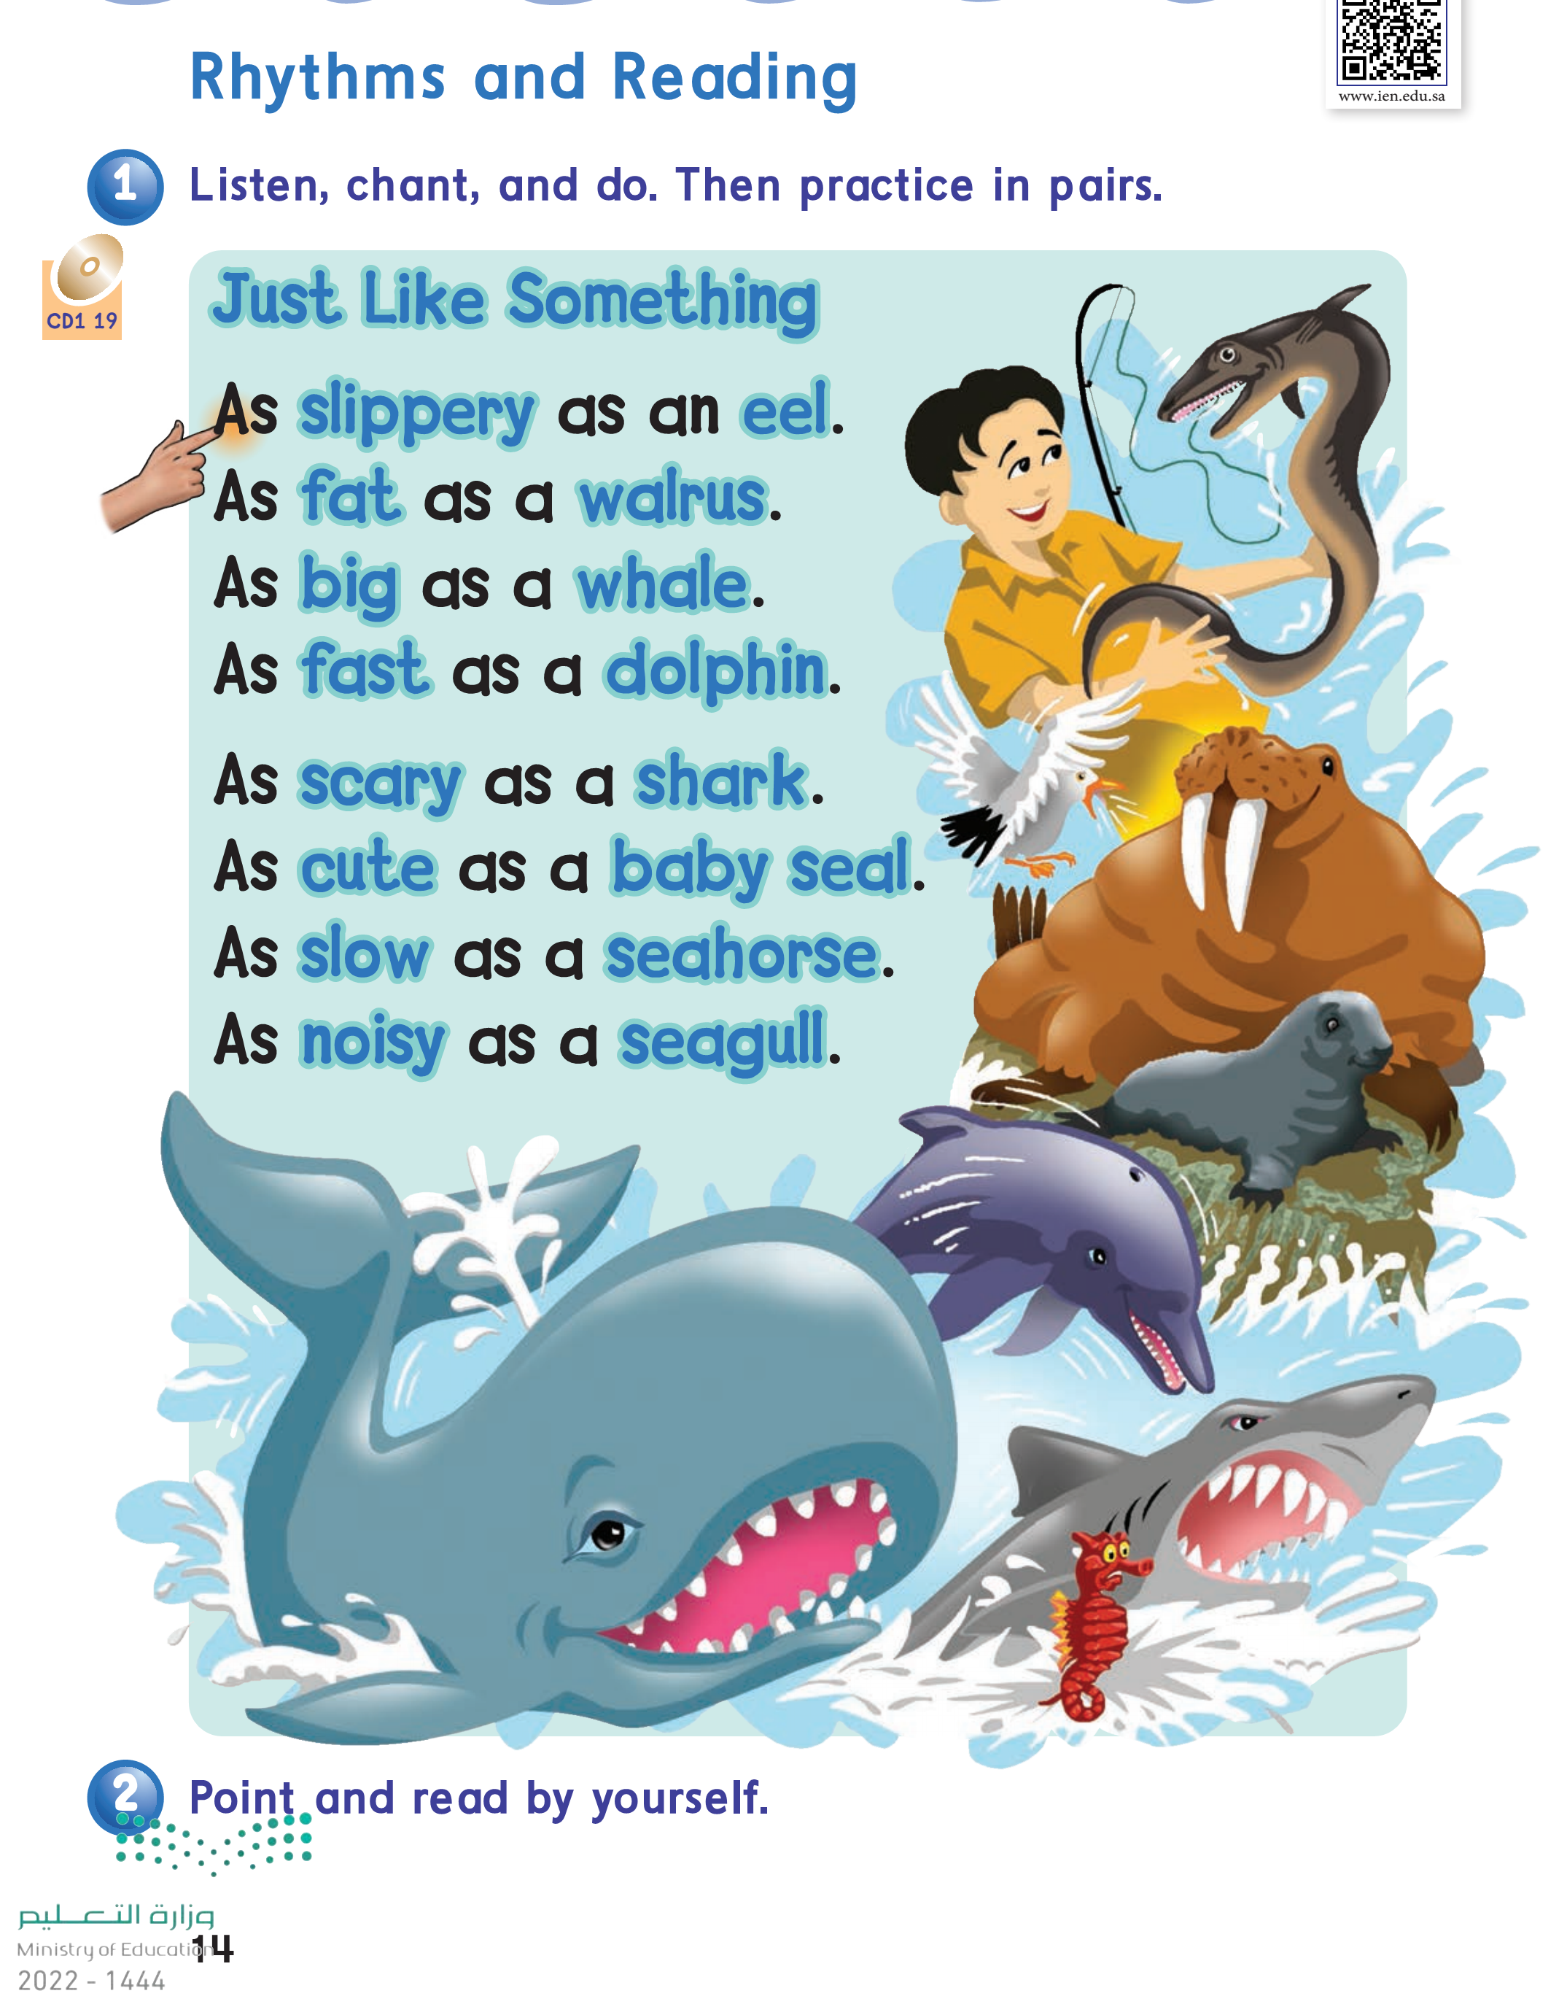

Page : 14

Slide 17
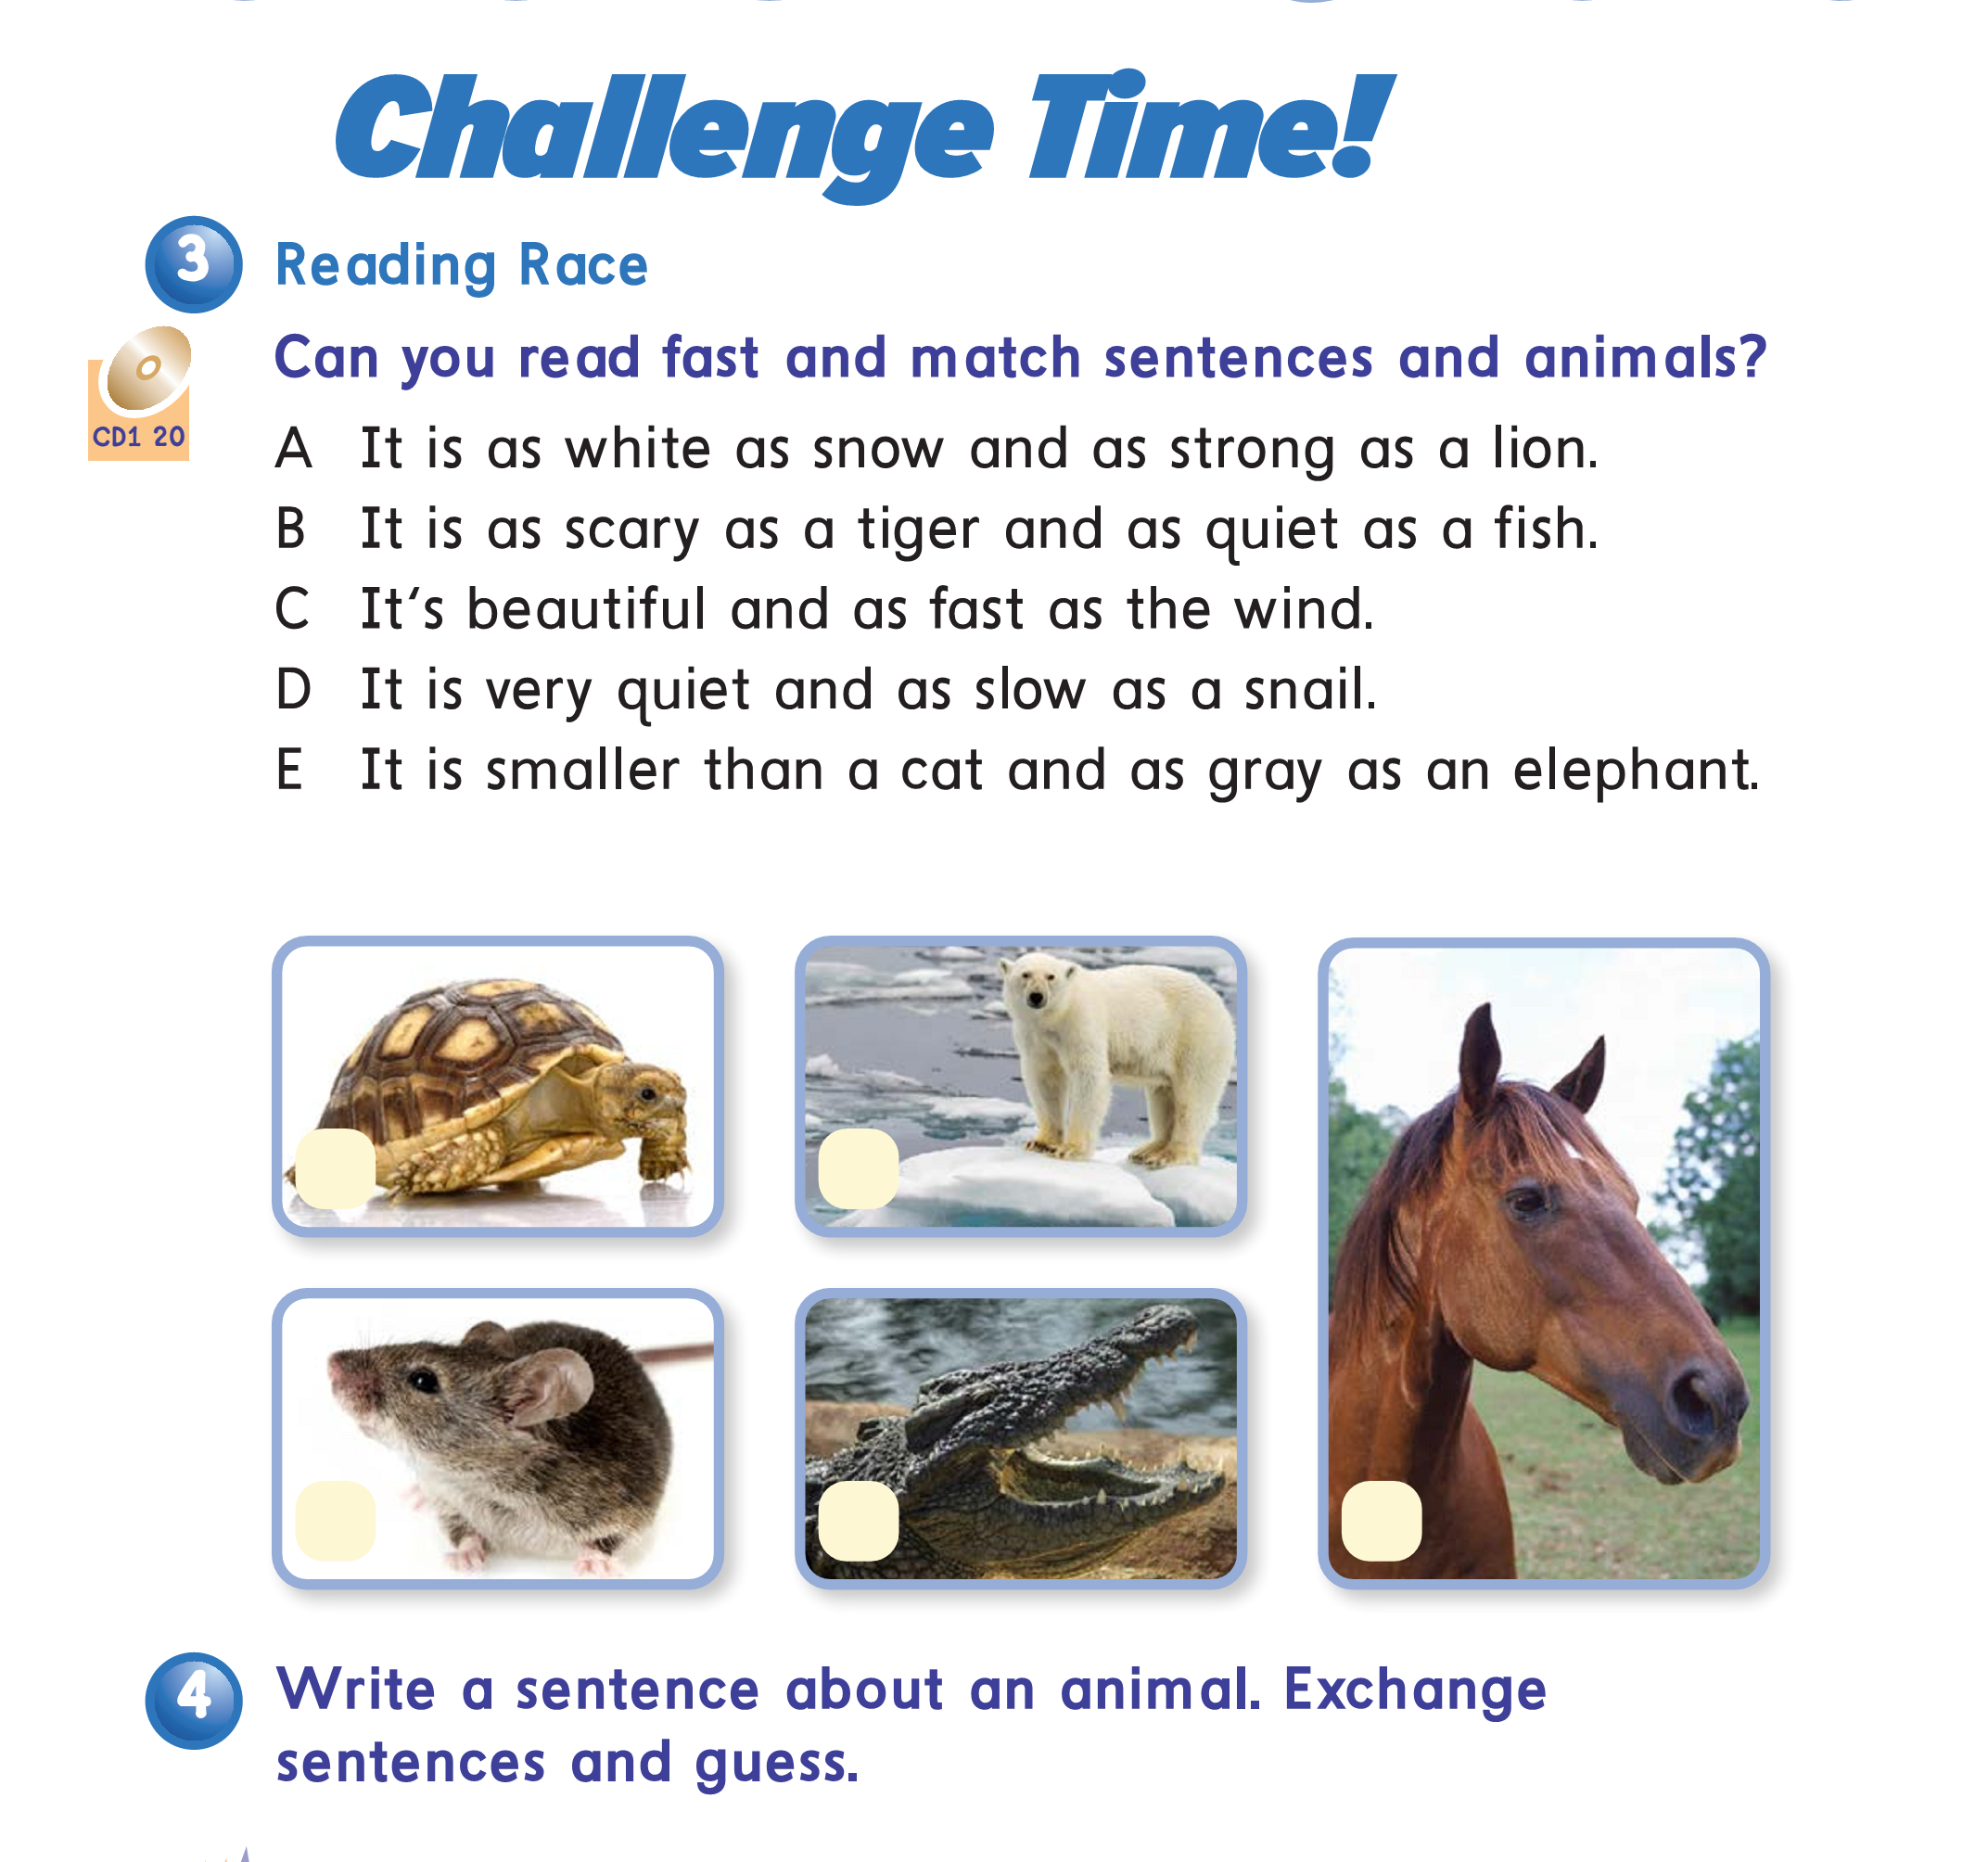
Page : 15
D
A
E
B
C

Slide 18
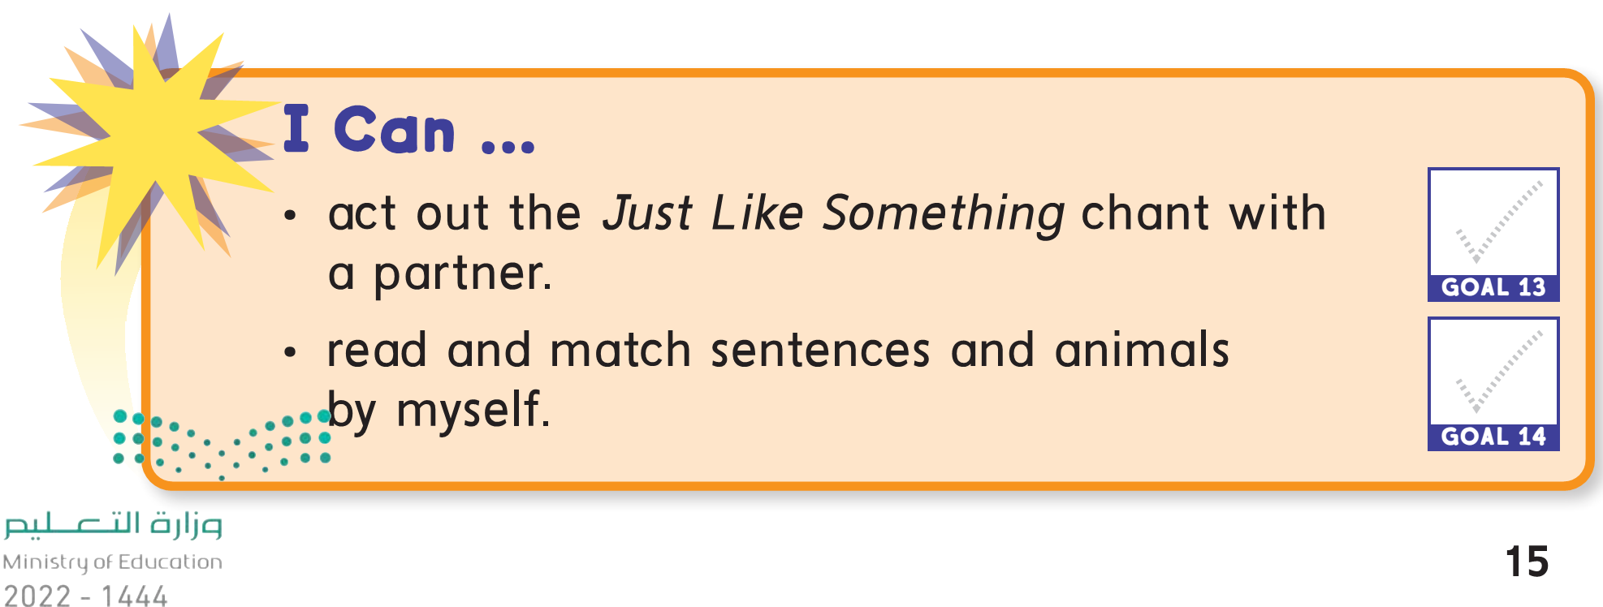

Slide 19

Pages:
151+152

Slide 20
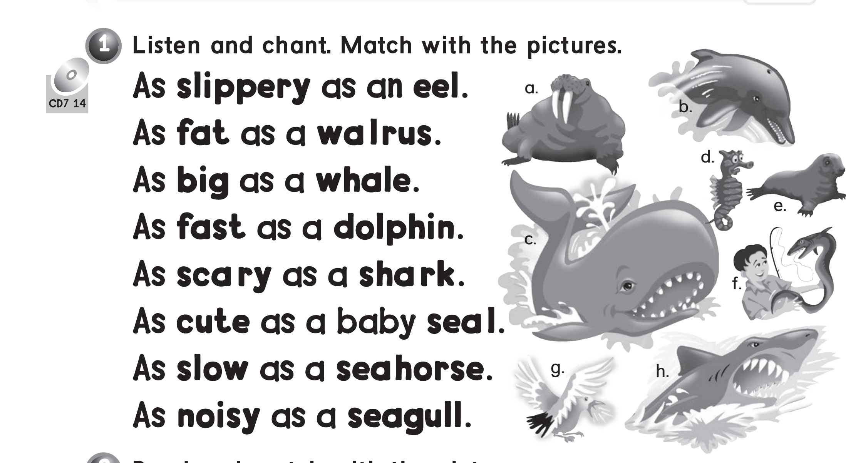
f
a
c
b
h
e
d
g

Slide 21
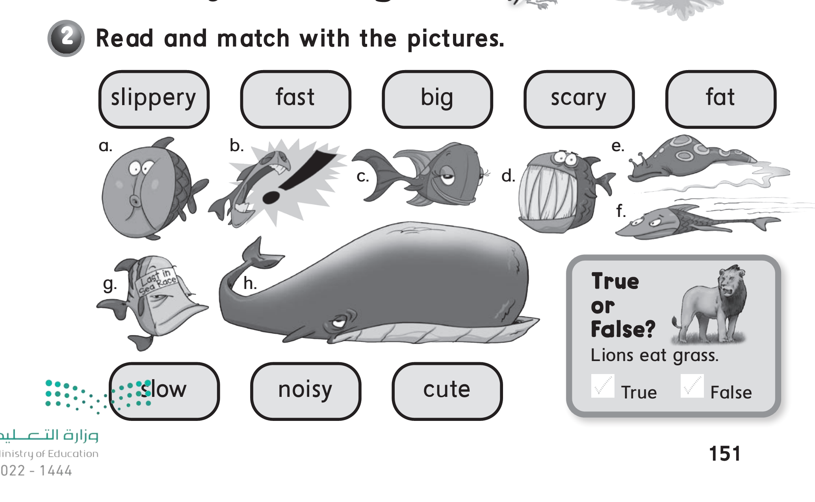

Slide 22
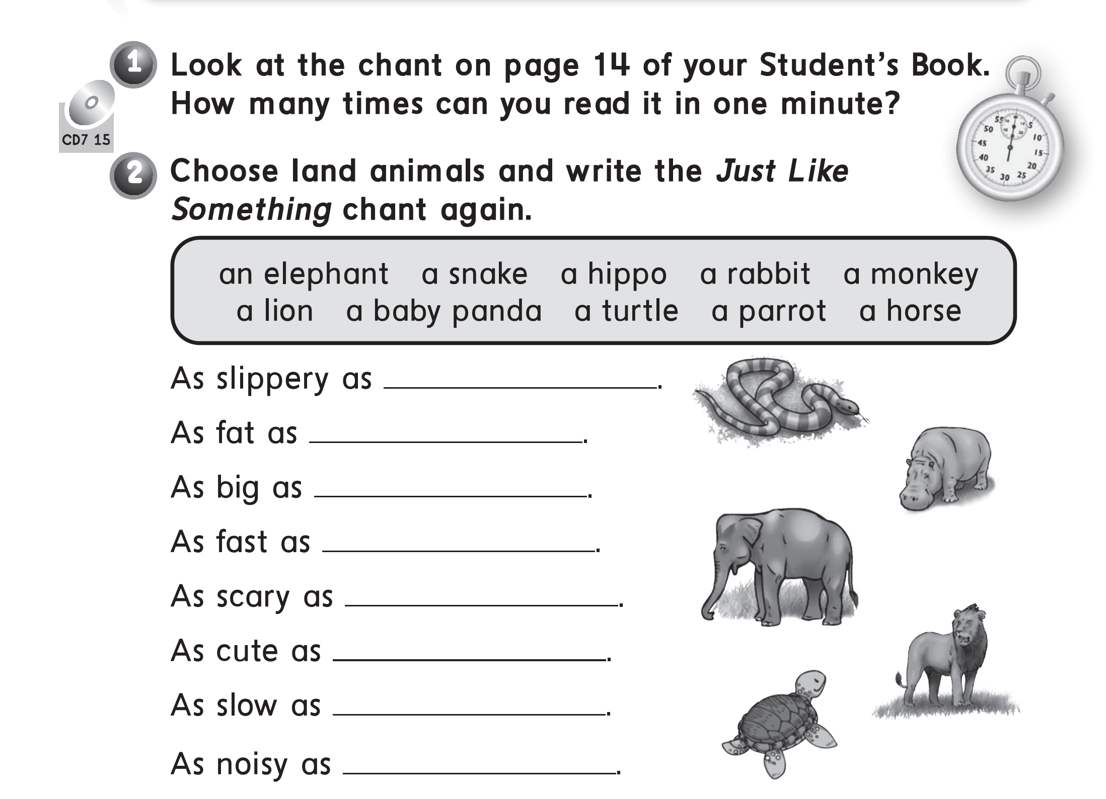
a snake
a hippo
an elephant
a rabbit
a lion
a baby panda
a turtle
a parrot

Slide 23
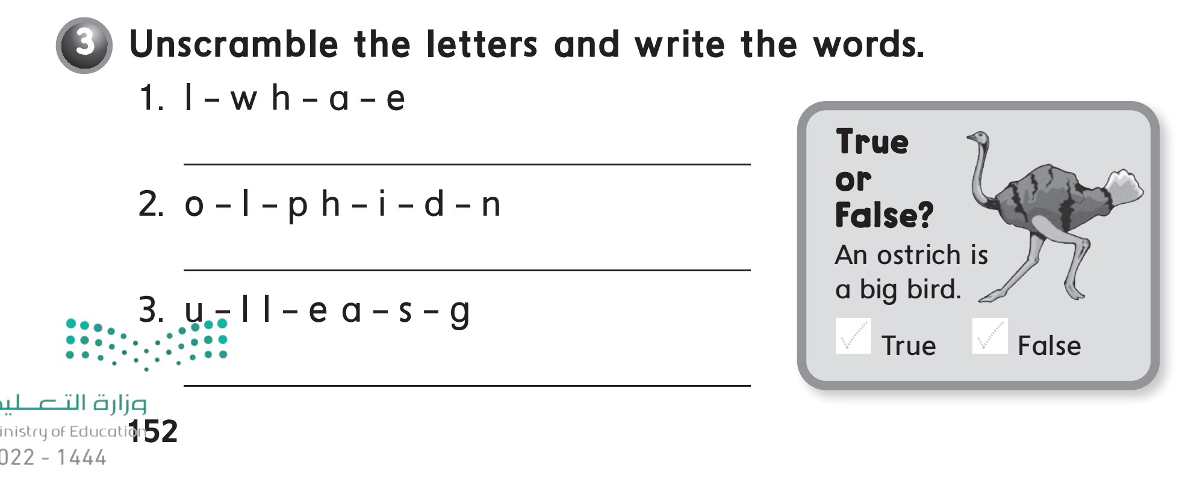
Whale
Dolphin.
Seagull

