Slide 1
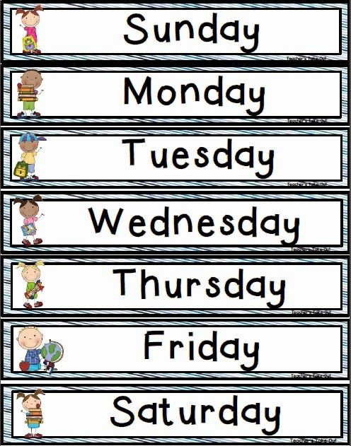
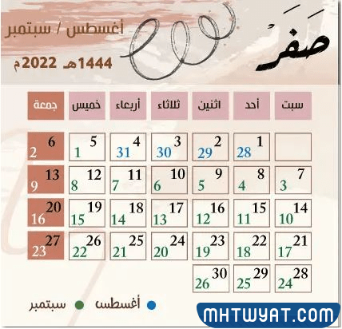

Slide 2

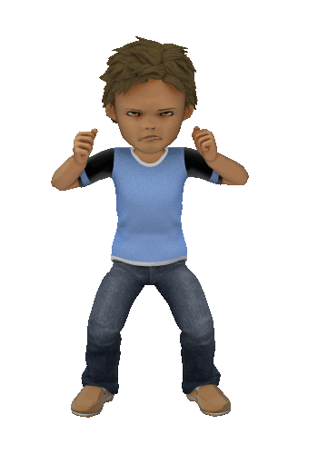
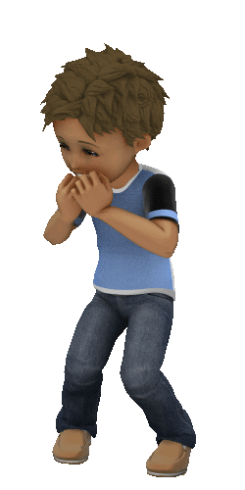
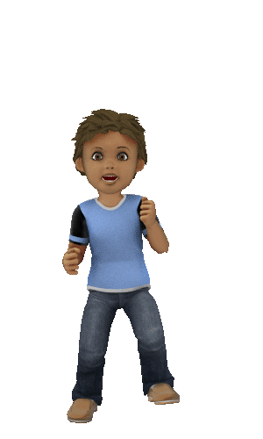
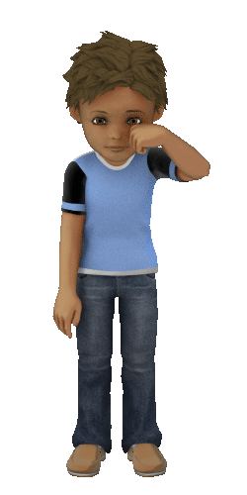
Unit 1
Feelings lesson 4
Notes:
Unit 1 lesson 4
[afterclick]
feelings

Slide 3

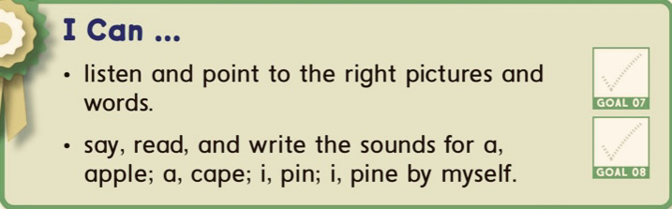

Student will be able to

Slide 4
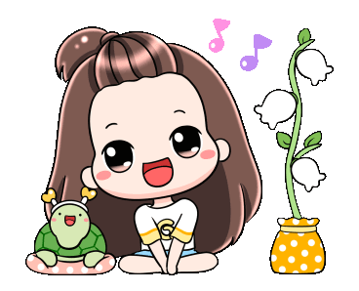
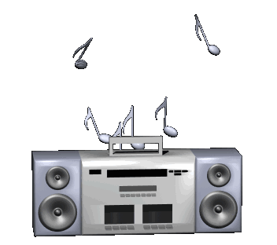
Let`s chant

Slide 5
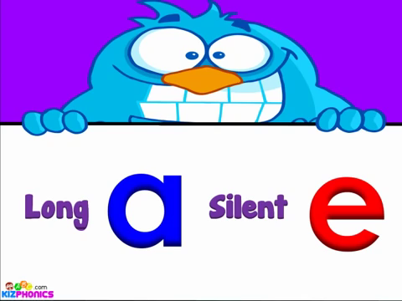

Slide 6
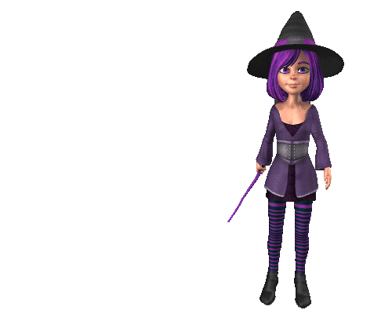
How the magic “e” changes the sound (and meaning) of words
Notes:
The magic e

Slide 7

cap
Notes:
Cap
[afterclick]
Enter the MAGIC e

Slide 8

cape
Notes:
cape

Slide 9

tap
Notes:
Cub
[afterclick]
Enter the MAGIC e

Slide 10
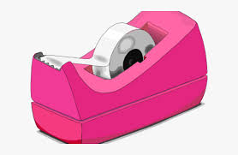
tape

Slide 11
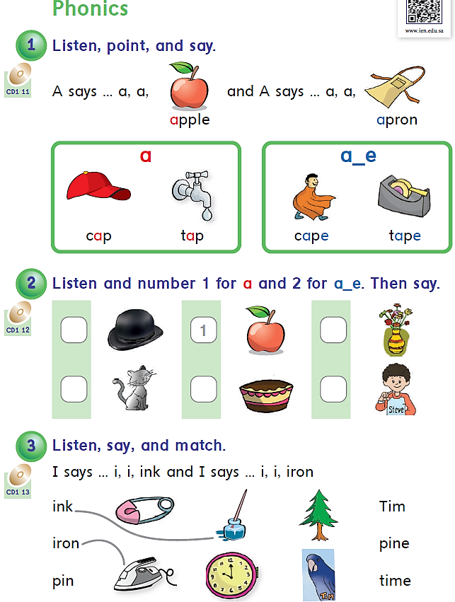



Page 10
1
2
1
2
2
Notes:
Phonics page 10

Slide 12


Slide 13

pin
Notes:
Pin
[afterclick]
Enter the MAGIC e

Slide 14

pine
Notes:
pine

Slide 15
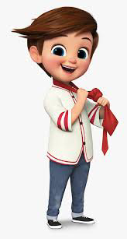
Tim
Notes:
Cod
[afterclick]
Enter the MAGIC e

Slide 16
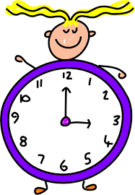
time
Notes:
code

Slide 17
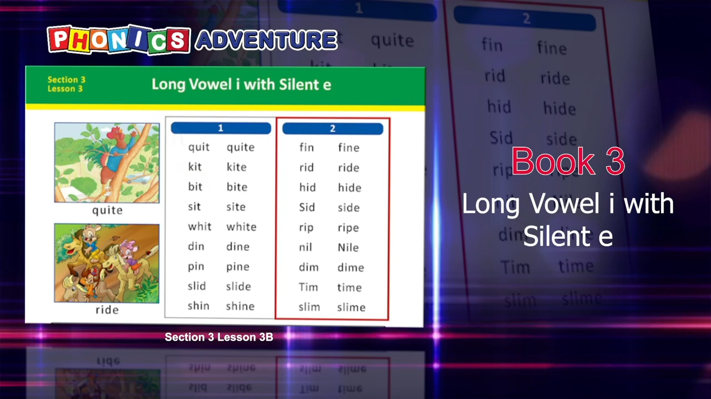

Slide 18
Page 10
1
2
1
2
2
Notes:
Phonics page 10

Slide 19

Start
Magic e
a-e i-e
a | a-e | i | i-e
cap | cape | pin | pine
fat | fate | rid | ride
rat | rate | kit | kite
Notes:
[afterclick]
Magic e
[afterclick]
cap
[afterclick]
cape
[afterclick]
fat
[afterclick]
fate
[afterclick]
rat
[afterclick]
rate
[afterclick]
pin
[afterclick]
pine
[afterclick]
rid
[afterclick]
ride
[afterclick]
kit
[afterclick]
kite

Slide 21


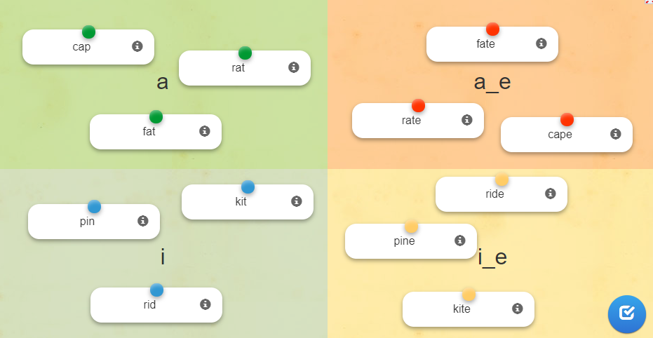

Phonics
A
B
C
D
E
Notes:
Learning app

Slide 22

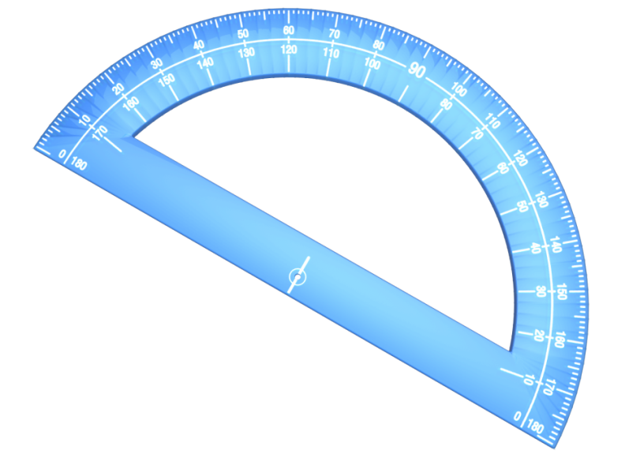




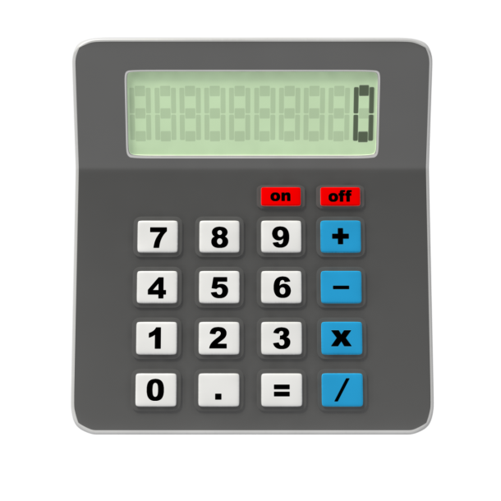




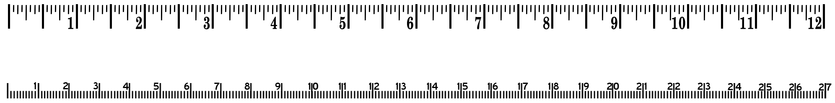
Fun
Time
Let`s play

Slide 23


Good luck smart students!
Notes:
Read more

Slide 24
Fun
Time
Let`s play

Slide 25
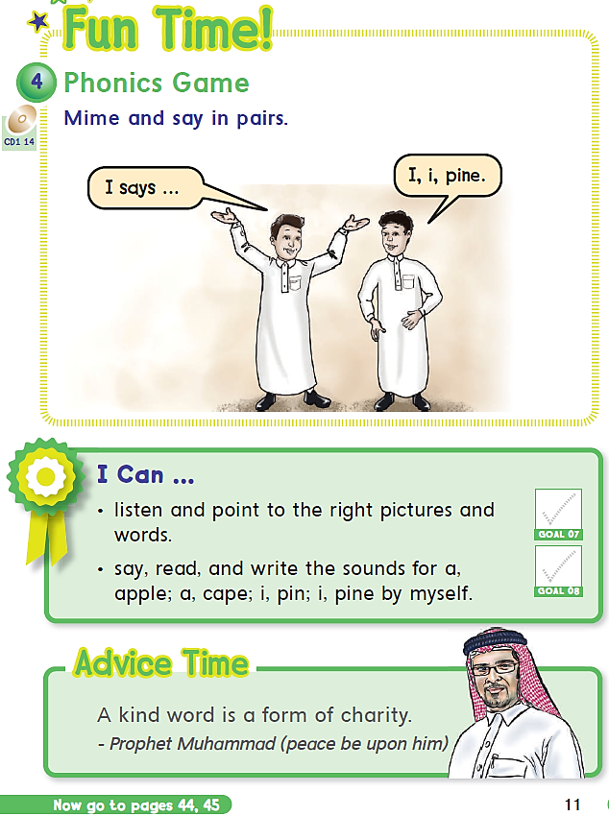

Page 11
Notes:
Fun time page 11

Slide 26


Slide 27
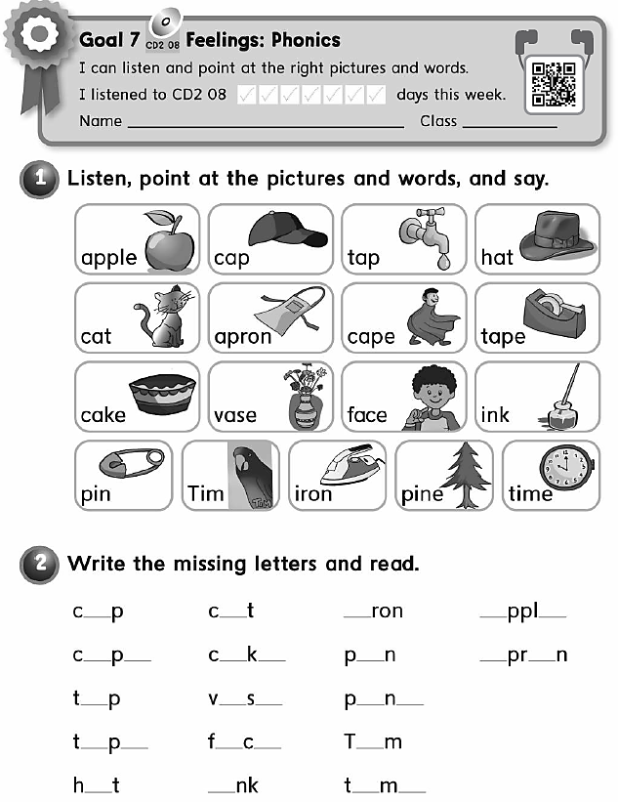

a
a
i
a
e
a
e
a
e
i
a
o
a
a
e
i
e
a
e
a
e
i
o
i
i
e
Notes:
Do homework please

Slide 28
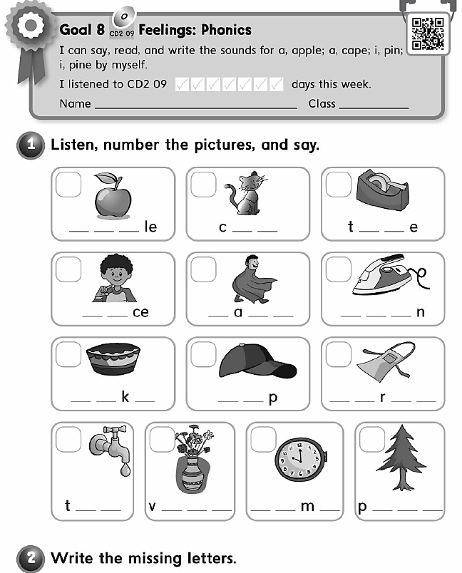
1
3
7
A p p
a t
a p
9
6
11
F a
C p e
I r o
8
4
2
C a e
C a
A p o n
5
10
13
12
a p
a s e
T i e
i n e

Slide 29


Notes:
Good bye

