Slide 1

Teacher : Anfal Al-Ghamdi
@englishanfal

Slide 2




Slide 3


Homework
I can do my homework .

Slide 4
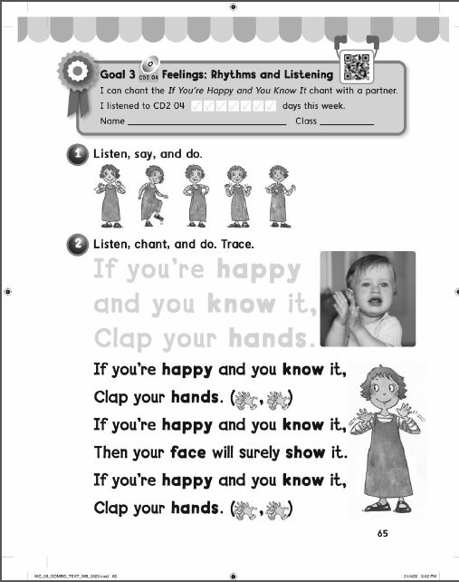

Slide 5
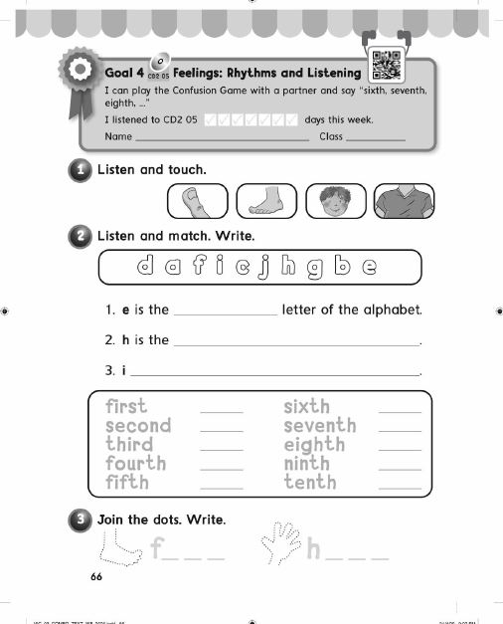

Slide 6

Getting Started
Chant and do :

Slide 7

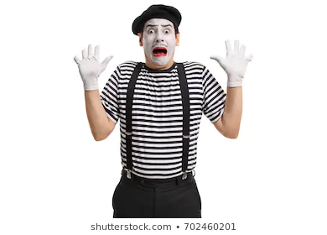
Getting Started

Slide 8
Date : ……………..
Day : ……………..
Period : ………….
Unit : 1 Feelings
Lesson : 3 Words in Action

Slide 9
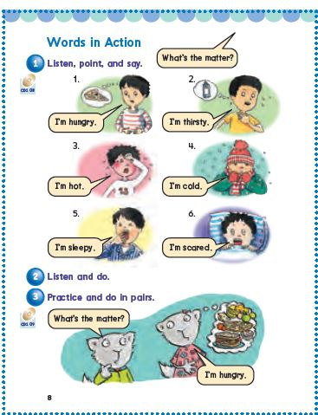
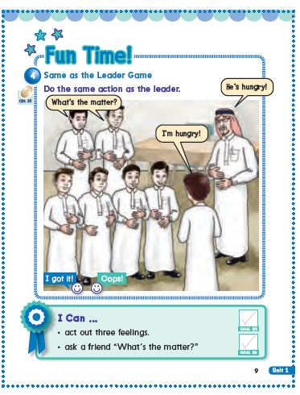
Discuss with your group and determine the objectives of the lesson .

Slide 10
Objectives

Slide 11
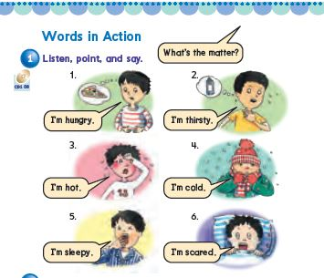
Open your book page 8 . Listen to the CD and point!

Slide 12
Listen again and say the words along with the CD!

Slide 13
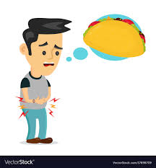
Feelings
hungry

Slide 14
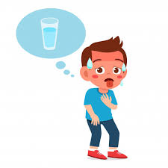
Feelings
thirsty

Slide 15
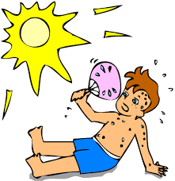
Feelings
hot

Slide 16
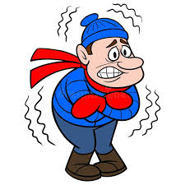
Feelings
cold

Slide 17
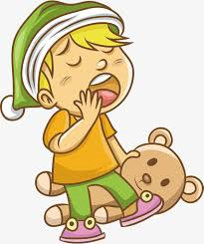
Feelings
sleepy

Slide 18
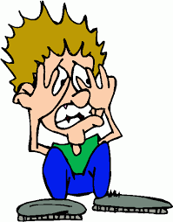
Feelings
scared

Slide 19


Slide 20
Listen and do :

Slide 21
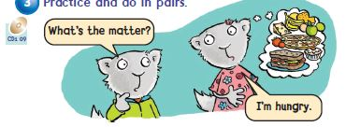
Practice and do in pairs .

Slide 22
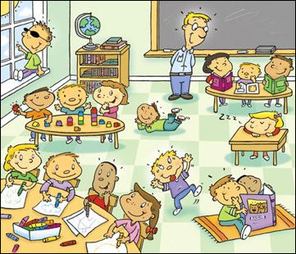
Who – What – Action – Where – When Strategy
Work with your group and fill the chart of the strategy

Slide 23
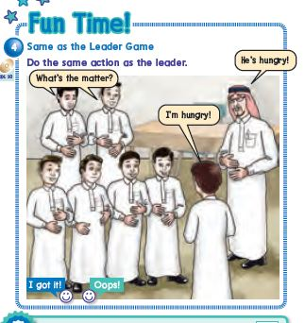

Slide 24
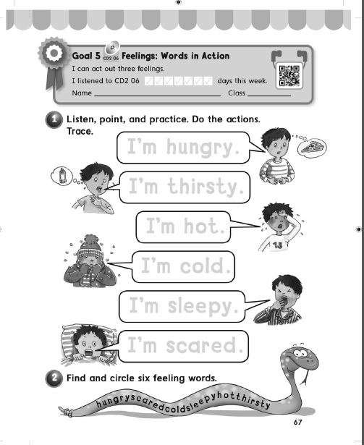
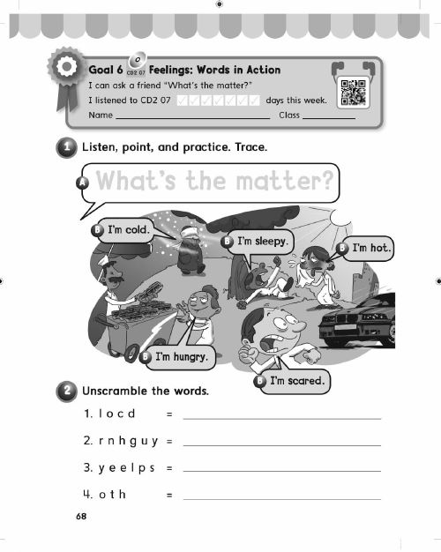
Homework
Page 67/ 68

Slide 25


Teacher : Anfal Al-Ghamdi
@englishanfal

