Slide 1

MEGA GOAL 2.1

Slide 2
UNIT 2

Slide 3
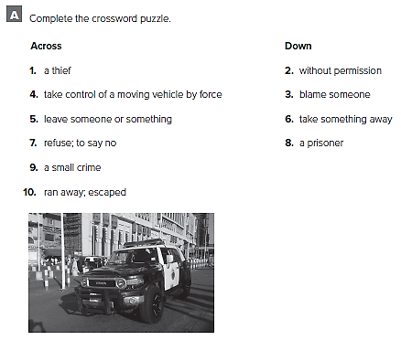

Slide 4
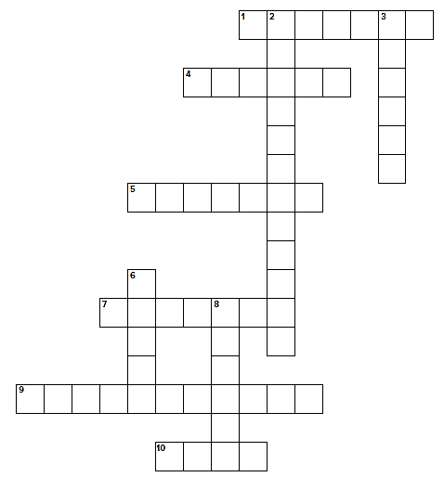
b u r g l a r
n
u
t
h
r
i
z
d
c
c
u
s
e
h i j a c k
a b a n d o n
s
i
z
d e c l i n e
n
m
t
m i s d e m e a n o r
f l e d

Slide 5
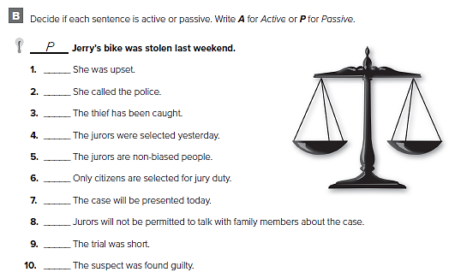
A
A
P
P
A
P
P
P
A
P

Slide 6
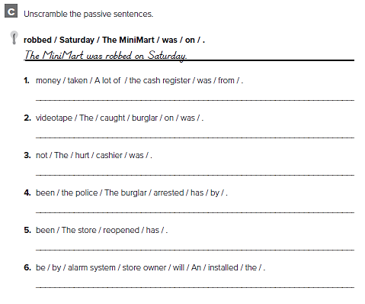
A lot of money was taken from the cash register
The burglar was caught on videotape
The cashier was not hurt
The burglar has been arrested by the police
The store has been reopened
An alarm system will be installed by the store owner

Slide 7
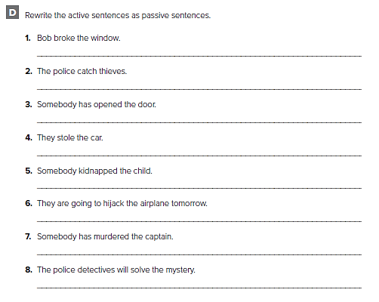
The window was broken by Bob
Thieves are caught by the police
The door has been opened
The car was stolen
The child was kidnapped
The airplane will be hijacked tomorrow
The captain has been murdered
The mystery will be solved by the police detectives

Slide 8
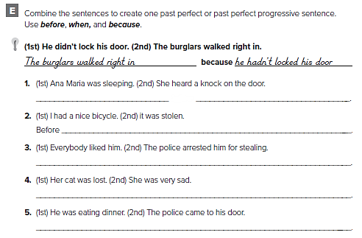
Ana Maria had been sleeping when she heard a knock on the door
it was stolen, I had had a nice bicycle
Before he was arrested for stealing, everybody had liked him
She was very sad because her cat had been lost
He had been eating dinner when the police came to his door

Slide 9
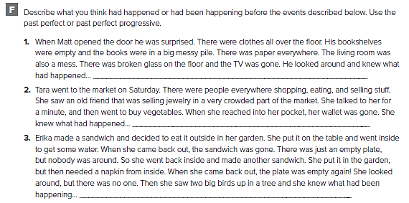
من الممكن أن تختلف الإجابات
Somebody had broken into the house before he got home
Somebody had stolen her wallet when she was talking to her friend
The birds had been eating her sandwiches when she went inside

Slide 10
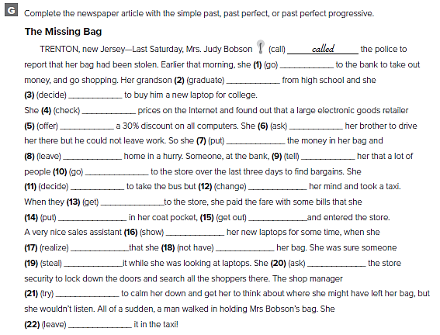
1. had gone
2. had graduated
3. had decided
4. had checked
5. was offering
6. had asked
7. put
8. left
9. had told
10. had been going
11. had decided
12. changed
13. got
14. had put
15. got out
16. had been showing
17. realized
18. did not have
19. had stolen
20. asked
21. tried
22. had left

Slide 11
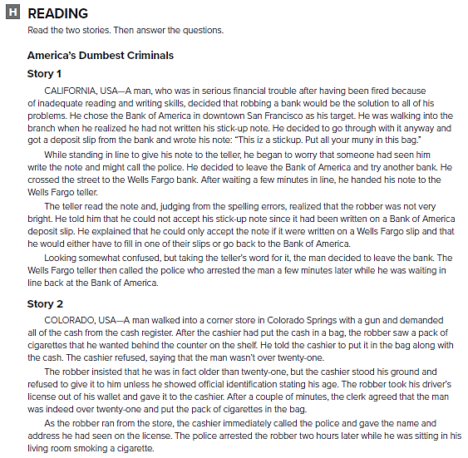

Slide 12
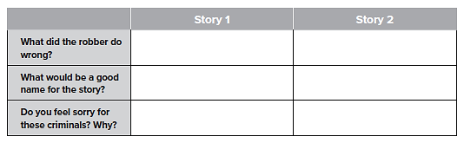
He made mistakes on his stick-up note.
He showed the cashier his driver’s license
It Pays To Be Able To Read And Write
Old Enough But Not Smart Enough
No. He should not have tried to rob the bank.
No. He should not have tried to rob the store

Slide 13
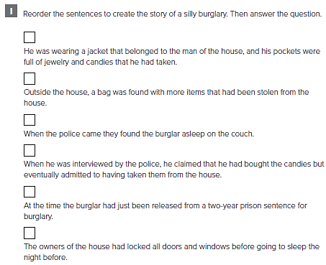
6
7
8
3
1
2

Slide 14
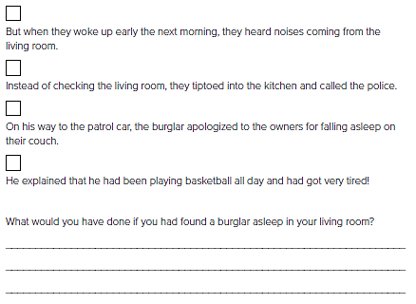
5
4
9
10
من الممكن أن تختلف الإجابات
I would have left the house and called the police.

Slide 15
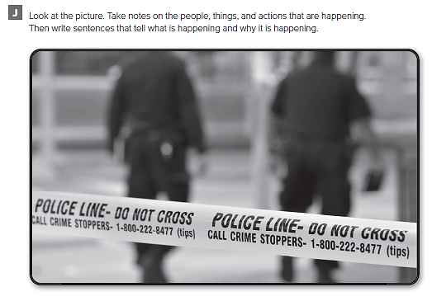

Slide 16
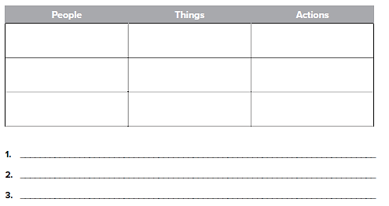
Crime scene tape
Guarding the area
Police
Witnesses
Notebook
Searching
Detectives
Radio
Investigating
من الممكن أن تختلف الإجابات
The crime scene tape is securing the crime area

Slide 17
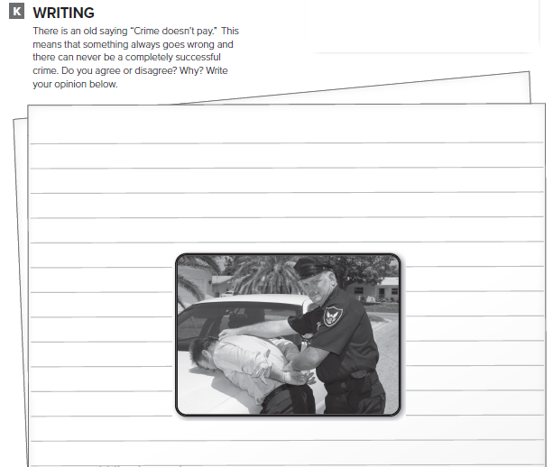
قم بكتابة مقال عن عبارة
“ Crime Doesn't Pay “

Slide 18
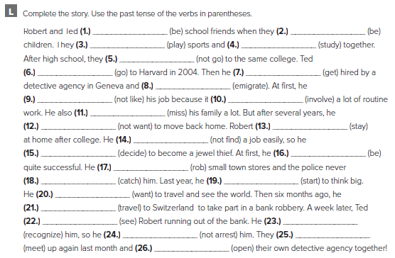
were
were
played
studied
didn’t go
went
got
emigrated
didn’t like
involved
missed
didn’t want
stayed
didn’t find
decided
was
robbed
caught
started
wanted
traveled
saw
recognized
didn’t arrest
met
opened

Slide 19
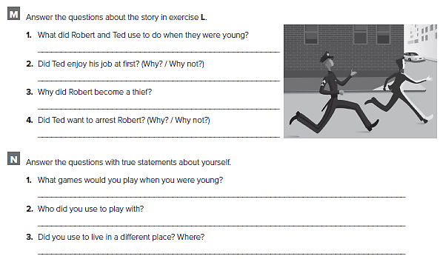
They used to play sports and study together
No, he didn’t because it involved a lot of routine work.
He became a thief because he couldn’t find a job easily.
No, he didn’t, because they were school friends
كل طالب يجيب عن نفسه

Slide 20
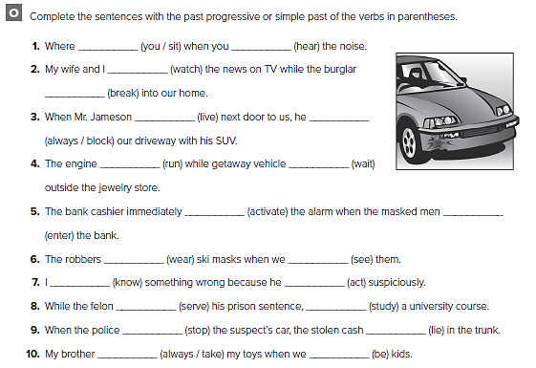
were you sitting
heard
were watching
was breaking
lived
was always blocking
was running
was waiting
activated
entered
were wearing
saw
knew
was acting
was serving
studied
stopped
was lying
was always taking
were

Slide 21
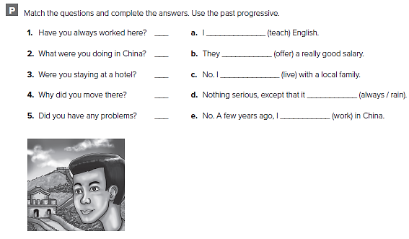
e
a
c
b
d
was teaching
were offering
was living
was always raining
was working

Slide 22
Prepared by
Teacher :
Badr Sayid Al-Shehri

