Slide 1




Slide 2
Mega Goal 1.1
Unit 2 - Careers
3 Grammar
Present Perfect Progressive
Present Perfect Simple
adjective + preposition + gerund
By: Essa Al Hussaini

Slide 3


Previous
Lesson

Slide 4
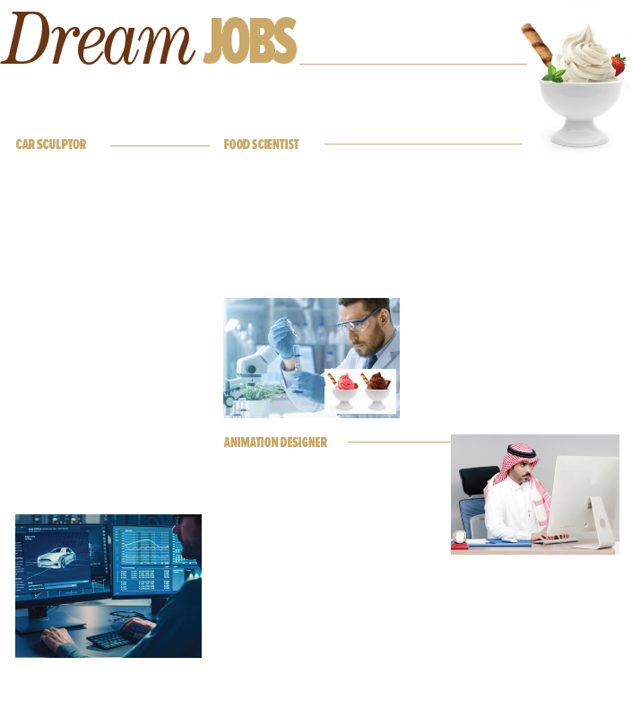
Previous
Lesson
He creates new ice-cream flavors
He makes clay models of cars
Animator

Slide 5
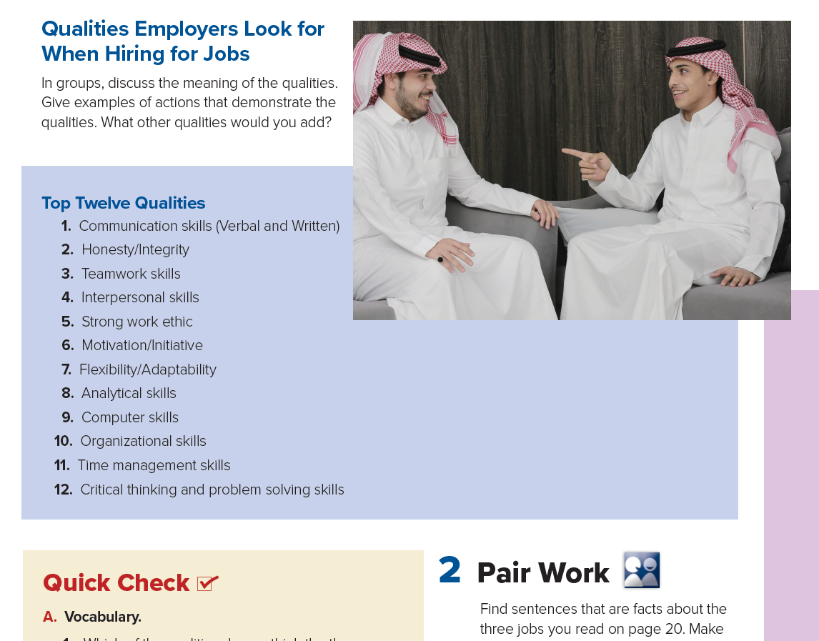

Previous
Lesson
The 21st century skills

Slide 6


Objectives
Form
sentences about actions that started in the past
Form
sentences about results that started in the past
Ask
question using How long .? / How many ..? / How much ..?
Form
sentences using adjective + preposition + gerund

Slide 7



Let’s check what you know
has won
have been winning
Ali __________ (win) four times.
has been win

Slide 8

Let’s check what you know
has traveled
have been traveling
They _________ (travel) for 3 months.
have travel

Slide 9
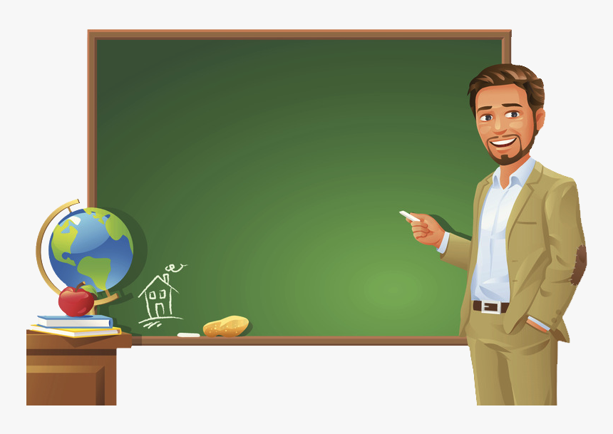
Let’s check what you know
How many
How much
_____________ has he been teaching?
How long

Slide 10

Let’s check what you know
uses
using
I am good at _______ (use) computer.
use

Slide 11
Present Perfect Progressive
vs
Present Perfect Simple

Slide 12





I
You
We
They
have been
V-ing
Present
Perfect
Progressive
to talk about an action that started in the past and recently stopped or is still going on
to emphasize the action
to say HOW LONG something has been happening (duration)
He
She
It
has been
Past
Now
I have been reading a book for two hours.
He has been playing football for 50 minutes.
She hasn't been cooking since March.
How long have you been learning to ski? Since 2020 / for 13 months
duration
Beginning
of the action

Slide 13


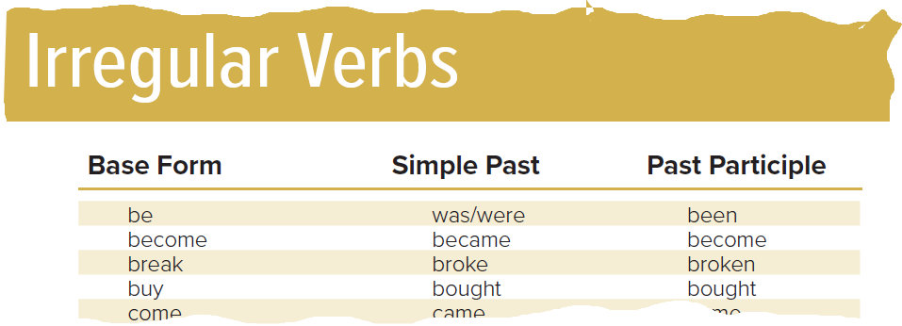
I
You
We
They
have
V3
to emphasize the result of action - (finished action)
to say HOW MANY things have been done (quantity)
Present
Perfect
Simple
He
She
It
has
Past
Now
I have written 30 pages. (write)
He has played two games. (play)
She hasn’t cooked our dinner. (cook)
Ali has never seen that film before. (see)
How many books have you written?
How much money have you spent? (buy)
page 72

Slide 14
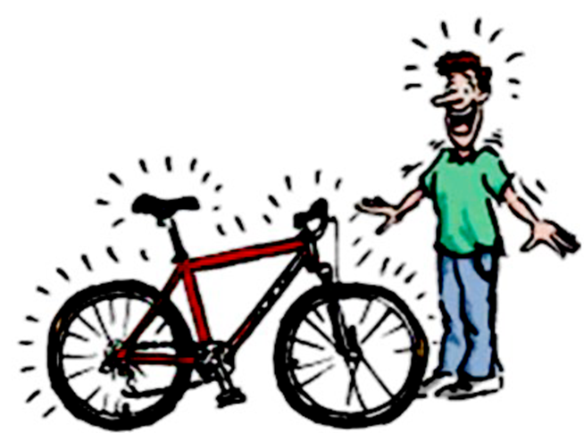
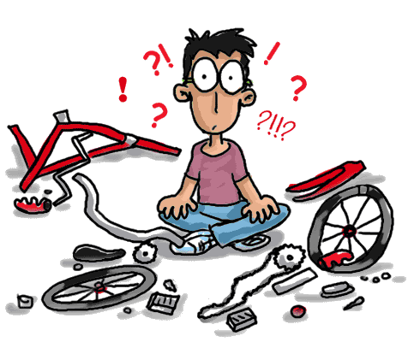

Present
Perfect
Progressive
- Duration
- Activity
Present
Perfect
Simple
- Quantity
- Result
I
You
We
They
have been
V-ing
I
You
We
They
have
V3
He
She
It
has been
He
She
It
has
Past
Now
He has been mending his bike all day
He has mended his bike.
mend

Slide 15


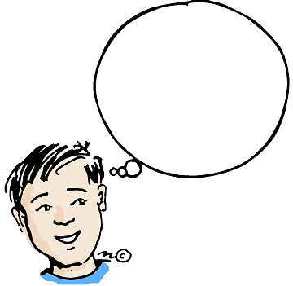
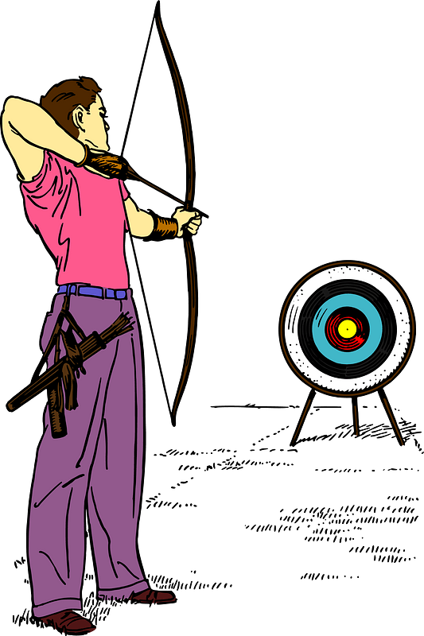
Present
Perfect
Progressive
Duration
Present
Perfect
Simple
Quantity
I __________________________
I
You
We
They
have been
V-ing
I
You
We
They
have
V3
He
She
It
has been
He
She
It
has
Past
Now
How long have you …………………?
How many / much have you …………………?
He has been mending his bike all day
He has mended his bike.

Slide 17


Subject + have / has been + v-ing
Present Perfect Progressive
Present Perfect Simple

Slide 18
Subject + have / has + v3
Present Perfect Progressive
Present Perfect Simple

Slide 19
I __________ climbed a tree 3 times. I’m tired
have has
has
have

Slide 20
She _____________ (read) this book for two hours.
has been reading
have been reading
has reading

Slide 21
He ________ (eat) pizza, he fells full now
has eaten
have been eaten
has eated

Slide 22
They have been working _______ 2016
for
since
all year

Slide 23
You have been studying ______ two hours.
since
all
for

Slide 24
____________ have you been panting this photo?
How many
How long
How much

Slide 25
_____________ cell phones has Ali bought?
How many
How much
How long

Slide 26
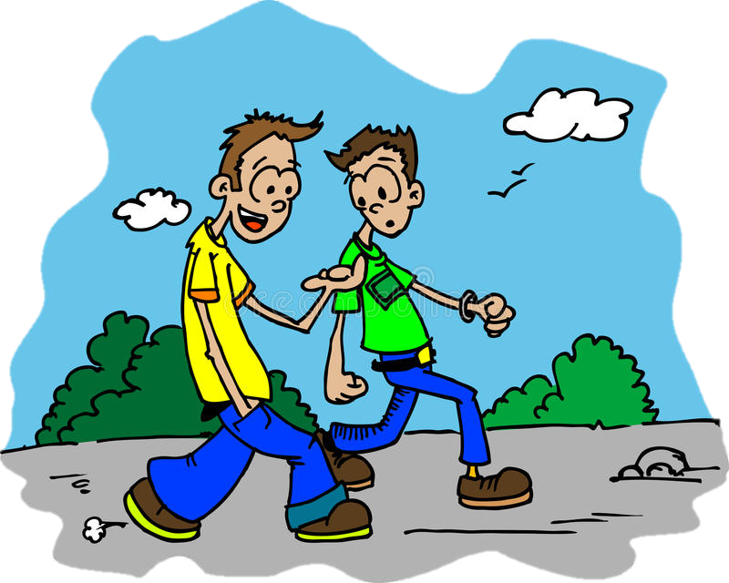
Complete
Yes, I do.
I __________ (ski)
since I was ten years old
have been skiing
Do you know how to ski?

Slide 27
Complete
________ have you _________ (play) football?
How long
I don’t know how to ski.
I’ve been playing for 8 years.
been playing

Slide 28

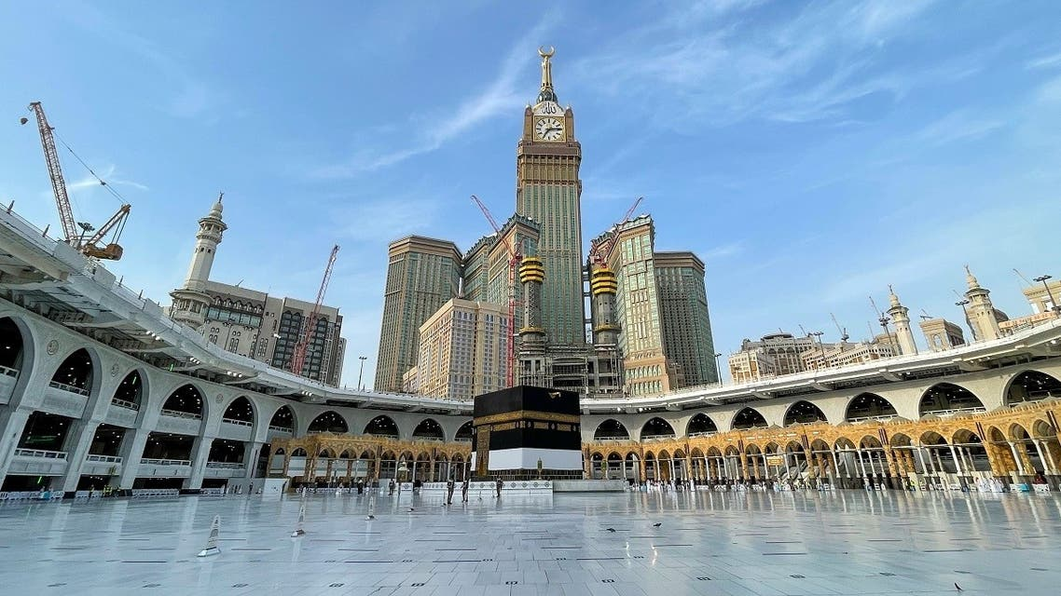
Since the reign of late King Abdulaziz until the current prosperous era of the King Salman, the Kingdom of Saudi Arabia has paid great attention and care for the Two Holy Mosques and Holy Sites to accommodate the increasing numbers of pilgrims, Umrah performers and visitors.

Slide 29


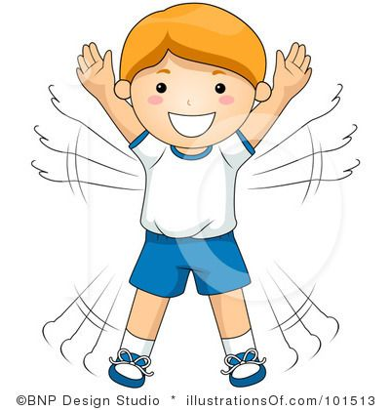
Additional Activity
Practice makes Perfect
https://wordwall.net/play/689/856/52598
https://wordwall.net/play/8014/940/117
https://wordwall.net/ar/resource/8171146
https://wordwall.net/play/4905/643/355

Slide 30
adjective + preposition + gerund
good at
vs
interested in

Slide 31


to talk about someone’s abilities and interests
(how well or badly they can do something)
a verb ending in –ing used as a noun
adjective + preposition + gerund
good at
interested in
I’m good at using computers.
I’m not very good at speaking in public.
He is good at swimming.
I’m interested in working outdoors.
I’m not interested in working in the computer industry.
He is interested in surfing.

Slide 32
to talk about someone’s abilities and interests
(how well or badly they can do something)
a verb ending in –ing used as a noun
I __________ good at / interested in _____________
adjective + preposition + gerund
good at
interested in
I’m good at using computers.
I’m not very good at speaking in public.
He is good at swimming.
What are you good at / interested in?
I’m interested in working outdoors.
I’m not interested in working in the computer industry.
He is interested in surfing.

Slide 33
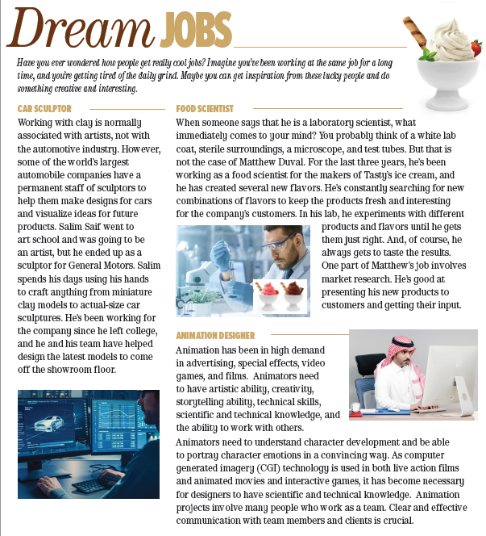



Additional Activity
FIND
Present perfect simple
FIND
Present perfect progressive
20

Slide 34
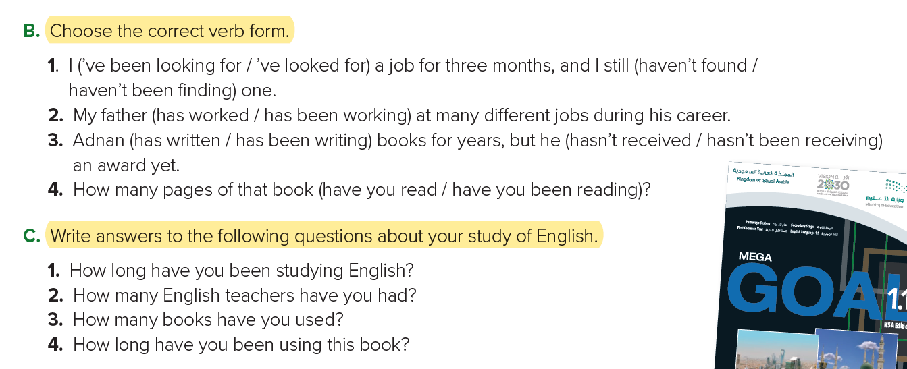
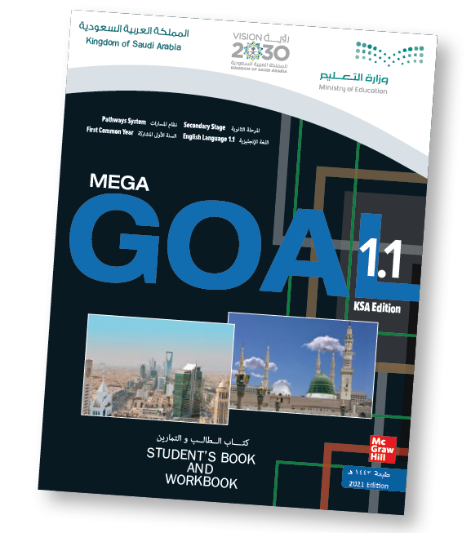
Student’s Book - 22
1. I’ve been studying English for six years.
2. I’ve had three teachers.
3. I’ve used six books.
4. I’ve been using this book for three weeks.

Slide 35
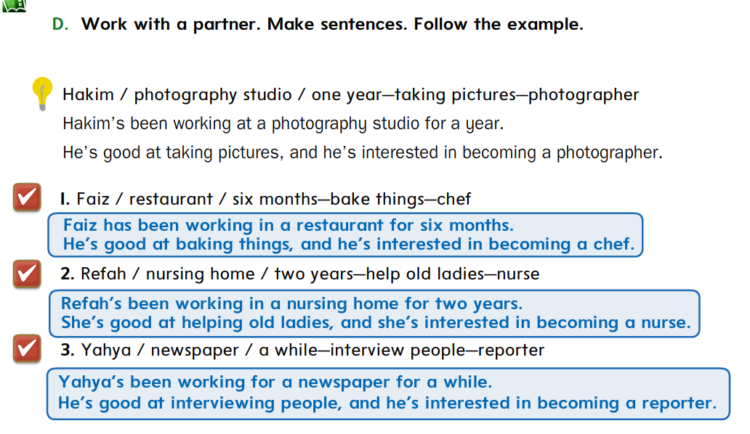

Additional Activity

Slide 36
Additional Activity
F. Ask and answer questions What activity ..? // How long ..? // How many ..?
What has the man at the newsstand been doing?
 You answer
How long has he been waiting?
 You answer
How many cups of coffee have they drunk?
 You answer
Notes:
Answers will vary. Sample answers:
A: What has the utility worker been doing during the rain? B: He’s been trying to repair the stoplight.
A: What has the man at the newsstand been doing? B: He’s been reading a magazine.
A: What has the traffic cop been doing? B: He’s been directing traffic.
A: What has the driver in traffic been doing? B: He’s been listening to the news on the radio.
A: What has the taxi driver been doing? B: He’s been looking at the limousine.
A: What have the people in the café been doing? B: They’ve been drinking coffee.
A: What has the man under the umbrella been doing? B: He’s been waiting for the rain to stop.
A: What has the child been doing? B: He’s been playing in the rain.

Slide 37
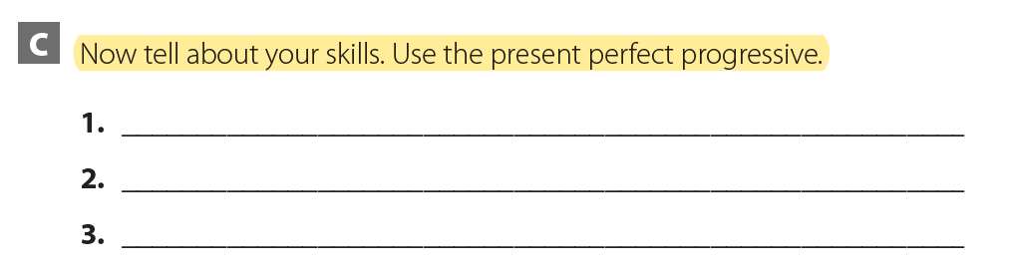
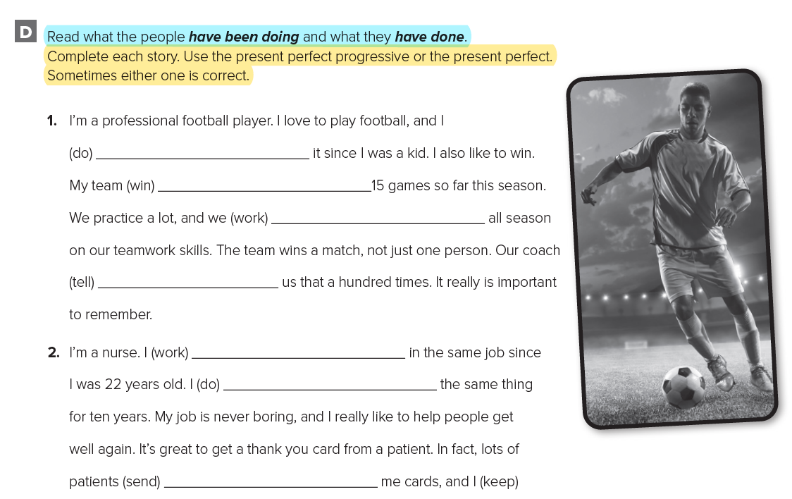
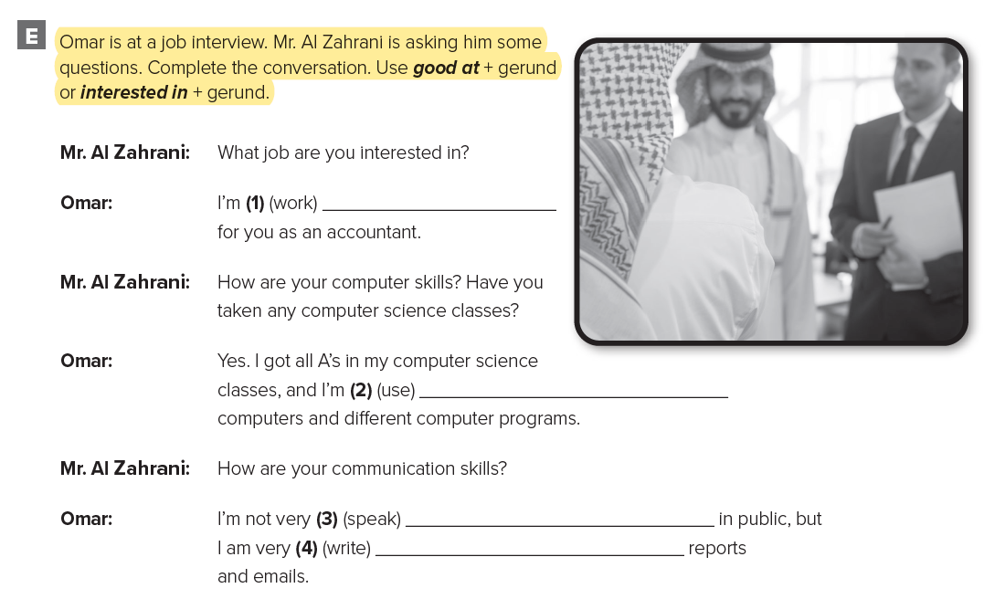

HOMEWORK
WORKBOOK
90
C
91
D
92
E

Slide 38


Slide 39
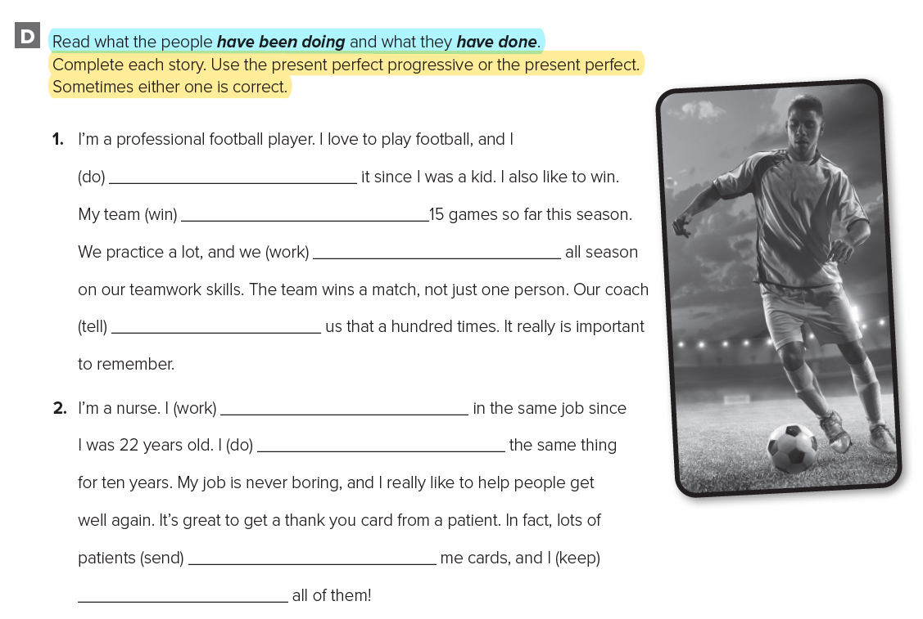
have been doing
has won
WORKBOOK
have been working
91
has told
have been working
have been doing
have sent
have kept

Slide 40
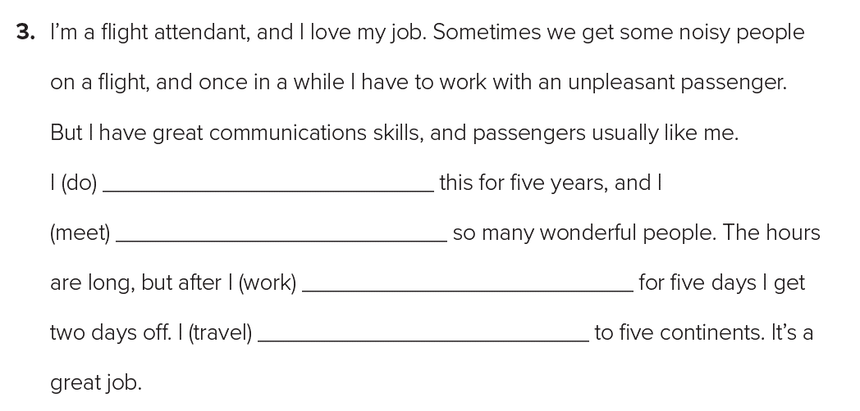
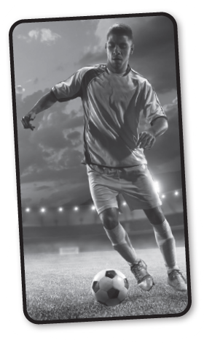
WORKBOOK
have been doing
91
have met
have been working
have traveled

Slide 41
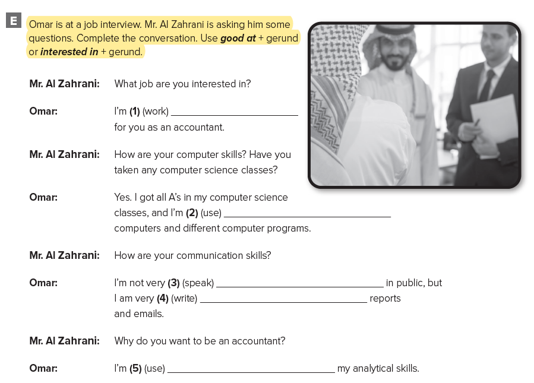
interested in working
WORKBOOK
92
good at using
good at speaking
good at writing
interested in sing

Slide 42
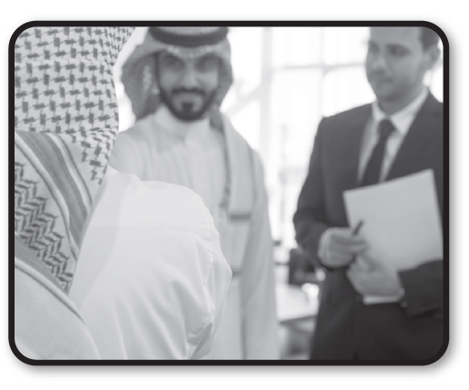
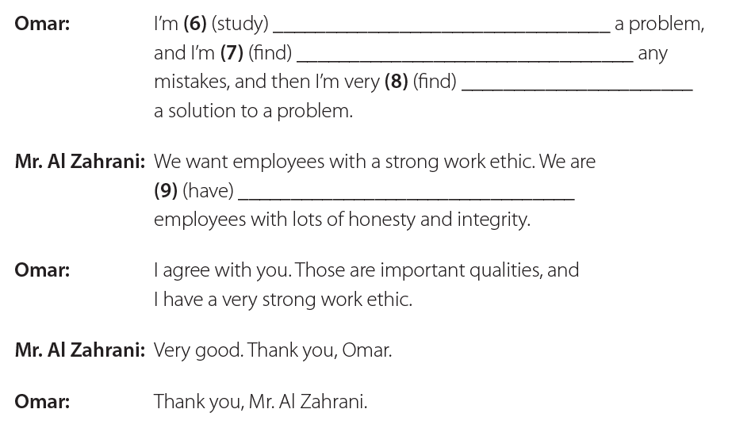
good at studying
good at finding
WORKBOOK
good at finding
92
interesting in having

Slide 43


