Slide 1

Welcome Back ♥
Applied Lesson – Mega Goal 1
Unit 2 - Reading
Presented by : ………
Supervisor : ………………
.School

Slide 2
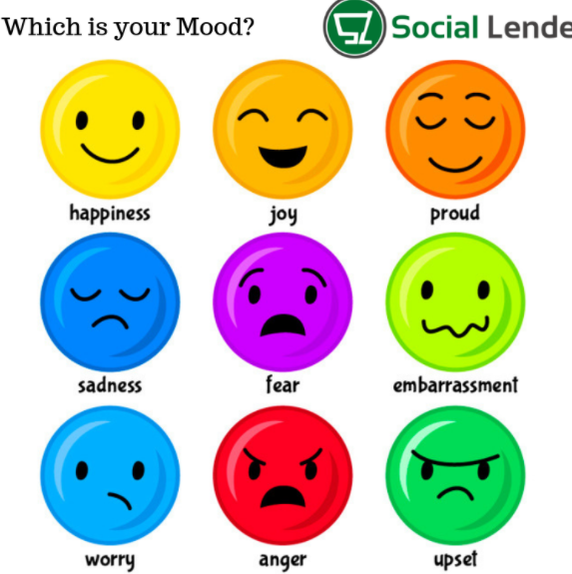

Slide 3
Mega Goal 1
Tuesday
19-2-1442 A.H
6-10-2020

Slide 4


Warm up Activity !!
Can you find 6 hidden words in this puzzle?
1 Minute

Slide 5


Slide 6


Slide 7

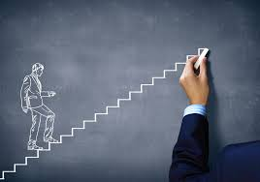
2
U
9- Reading

Slide 8

Warm up!!
Discussion
What should a person do when he wants to
apply for a job?

Slide 9




Warm up!!
What do you know about the following words\ phrases?
The training time
Opening-Internships
The ability to handle something successfully , like difficult situation.
Cope with
Résumé
technical drawing \ Plans for a building, a bridge, etc
Fast-Paced
blueprints
Adj- moving or developing very quickly.

Slide 10

In this lesson you will be able to :
1- Identify some opening internships and the skills required.
2- Summarize and identify specific information in the text.
3- List some Words\Phrases related to the job.

Slide 11
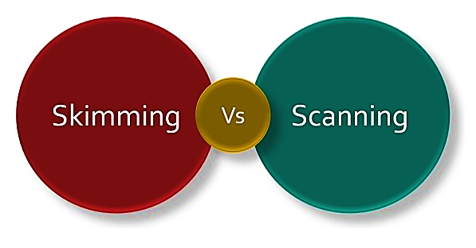
Pre-Reading
What do you know about skim and scan strategy?
is reading quickly
to find the general
overview of the
passage.
is reading quickly to find specific details within the passage.

Slide 12
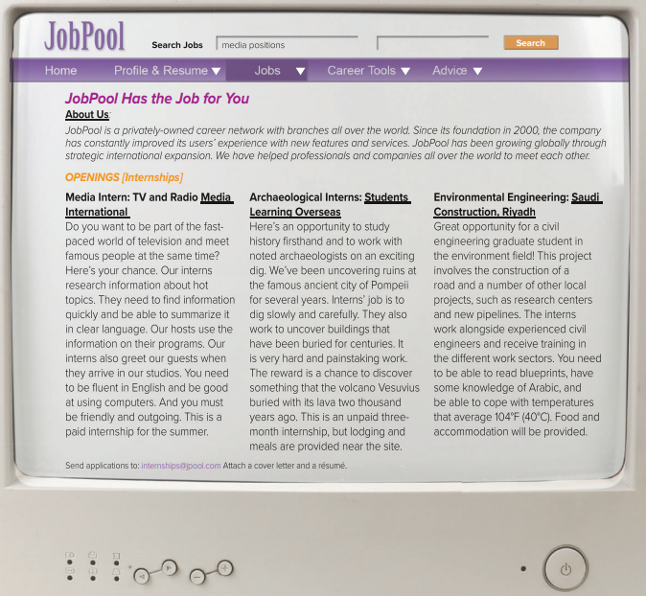
Skimming
Quick Look
What’s this ?
What is the title?
How many paragraphs?
What’s the title of each paragraph?
P. 26
Pre-Reading

Slide 13
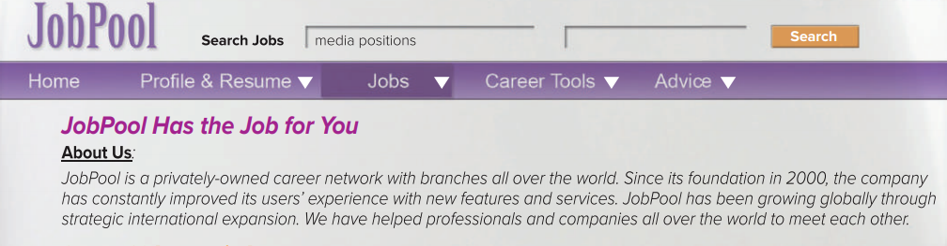
P. 26
1- Reading

Slide 14
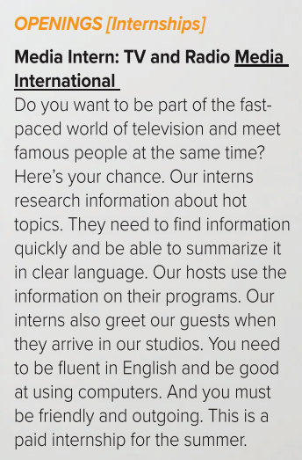

P. 26
While-Reading
Scanning
is a period of work experience offered by an organization for a limited period of time.
Adj- moving or developing very quickly.
1- What a person should be able to do ?
Current, exciting
master of ceremonies/the presenter of a television or radio programe
friendly, sociable

Slide 15
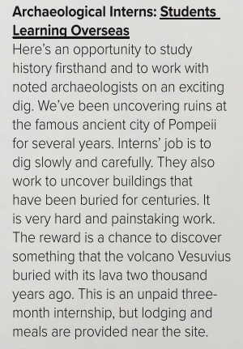


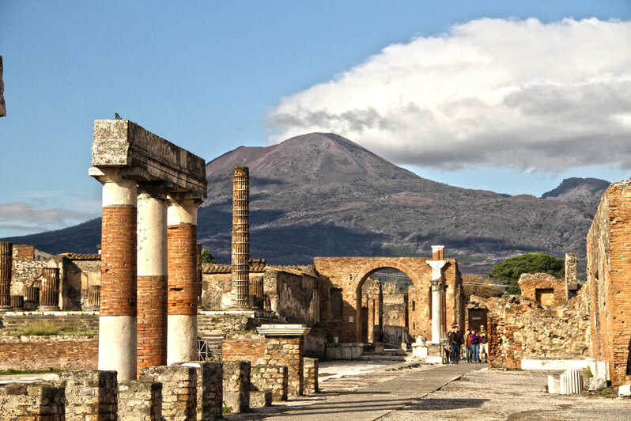

P. 26
While-Reading
Scanning
the scientific study of historic or prehistoric peoples and their cultures .
1- What a person should be able to do ?
Remain of something that has been destroyed- usually an ancient site.
Place where people stay for a short period of time

Slide 16


P. 26
While-Reading
Scanning
an engineer whose training or occupation is in the design and construction especially of public works (such as roads or bridges).
1- What a person should be able to do ?
Plans for a building, a bridge, etc
The ability to handle something successfully , like difficult situation.

Slide 17
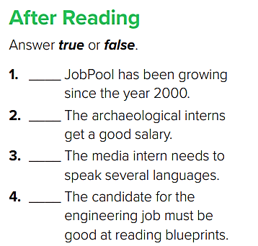
P. 27
T
F
F
T

Slide 18







After-Reading
Mention some examples of Internship/Job Websites:

Slide 19


Slide 20

Any Questions ?

Slide 21

My Creative Students ♥
Homework
Use the internet and search about Popular Internship/job Websites,
Mention 3 Examples.

