Slide 1
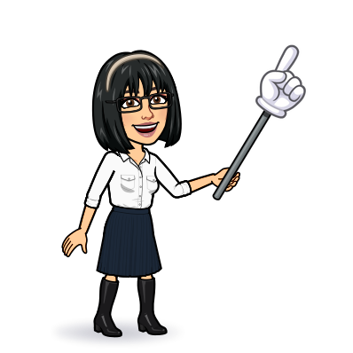
9 writing 10 project
Today:
Date:
- -1445
Page 16
By: Dalal Al-Juaid

Slide 2
match each question to it's answer.
write a question for each information.
Warm up
Write about yourself.
questions
summative

Slide 3
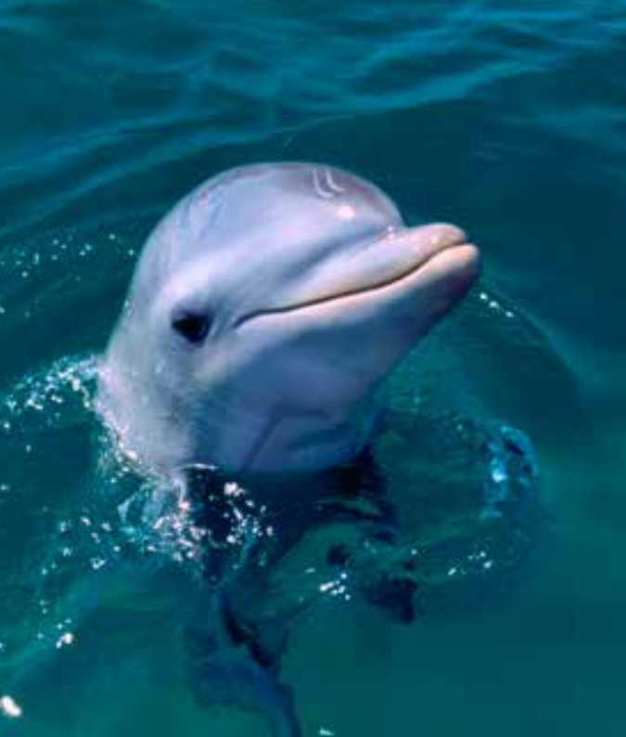
Life span
Revision
adolescent
……….. #
#
……..

Slide 4
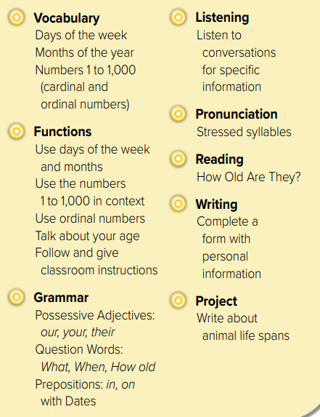

Slide 5
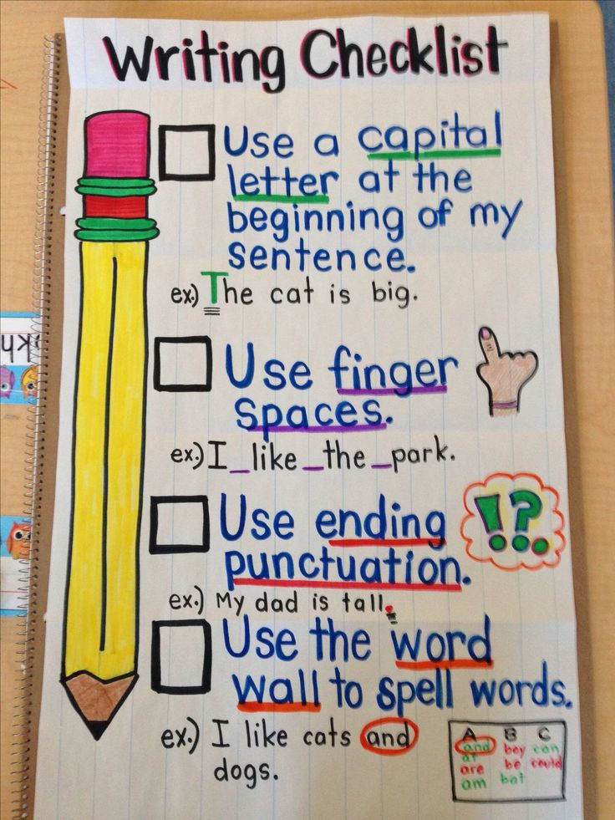
hot seat
Ask anything about me ?
Warm up
Use different question words:
Who – what – how – where – when - why
questions
summative

Slide 6
Page 16
Think pair share
What
4
How
6
Warm up
How
1
Where
3
When
2
What
5
questions
summative

Slide 7
Page 16
Which other words have capital letters?
the first word in a sentence
titles such as Miss, Mr., Mrs.
Warm up
questions
summative

Slide 8
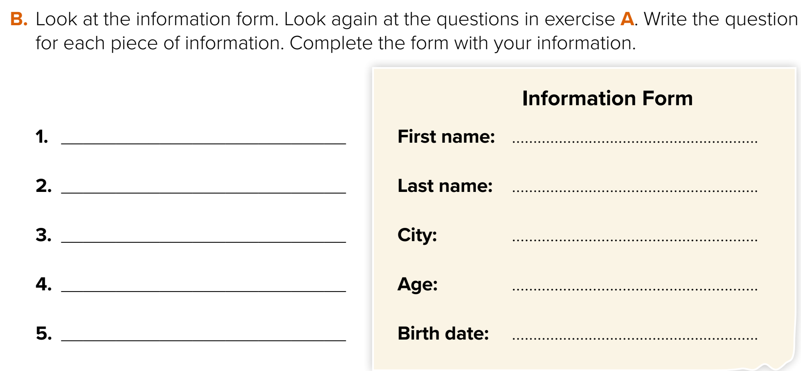
Think pair share
What is your first name?
Dalal
What is your last name?
Al-Juaid
Warm up
Where are you from?
Taif
How old are you?
39
When is your birth date?
February 18
questions
summative

Slide 9
Think pair share
Correct the mistake:
I
Sara
i am sara. I am from saudi arabia .
Warm up
Saudi Arabia
questions
summative

Slide 10
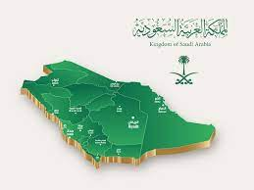
Warm up
What is the capital of Saudi Arabia?
How do you feel about it?
questions
summative

Slide 11
page 194 Ex(K)
for practice writing
Warm up
questions
summative

Slide 12
p.194
Dalal
14
fifth
March
Dareen
14
June

