Slide 1
Mega Goal 2.1
Unit 2
Page
Vocabulary Building
Flash Cards
Designed and done by T. Talal Alhazmi
Done by T. Talal Alhazmi

Slide 2

(v) to think that something is probably true without knowing that it is true
assume
(adj) causing feelings of sadness or worry; gloomy or depressing
grim
(n) the hard surface of a road, driveway, etc.
pavement
(n) a situation in which events happen at the same time in a way that is not planned or expected
coincidence
install
(v) to make a machine or a service ready to be used in a certain place
suspect
(n) a person who is believed to be possibly guilty of committing a crime
display
(n) an arrangement of objects as a decoration, or advertisement
insure
(v) to provide insurance for something, such as a house, car, or health

Slide 3
Mega Goal 2.1
Done by Talal Alhazmi

Slide 4
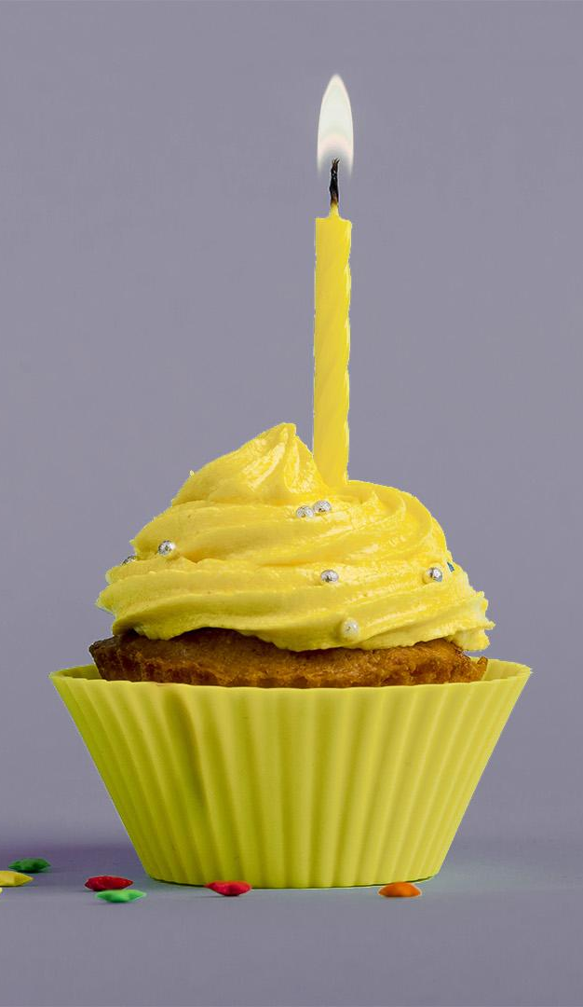
Term of use
License Agreement
This PowerPoint project, including game slides and associated content is a copyrighted to Teacher. Talal Alhazmi.
Do not submit copies or modifications of this project to any website that requires sign in or paid subscription.
You may download the PowerPoint, make archival copies, and customize the project only for your personal use or use within your school and not for resale.
Don’t allow to delete my name.

