Slide 1

Unit 4
Around the World
part 1

Slide 2
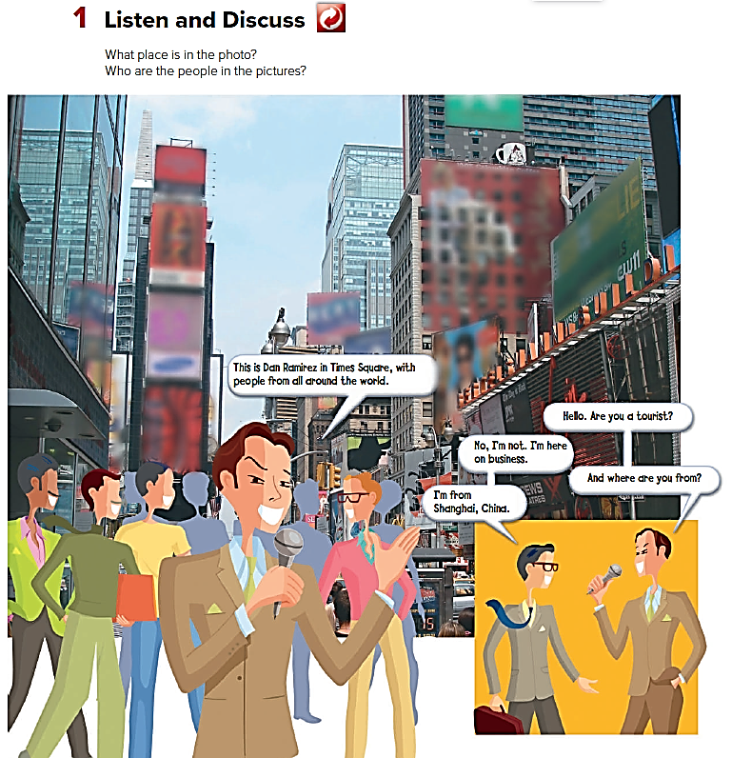


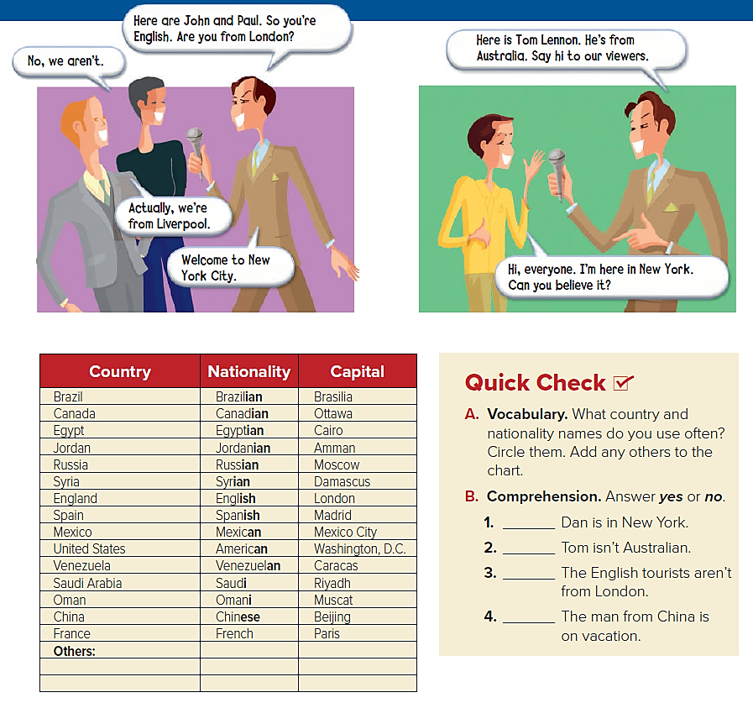

Slide 3
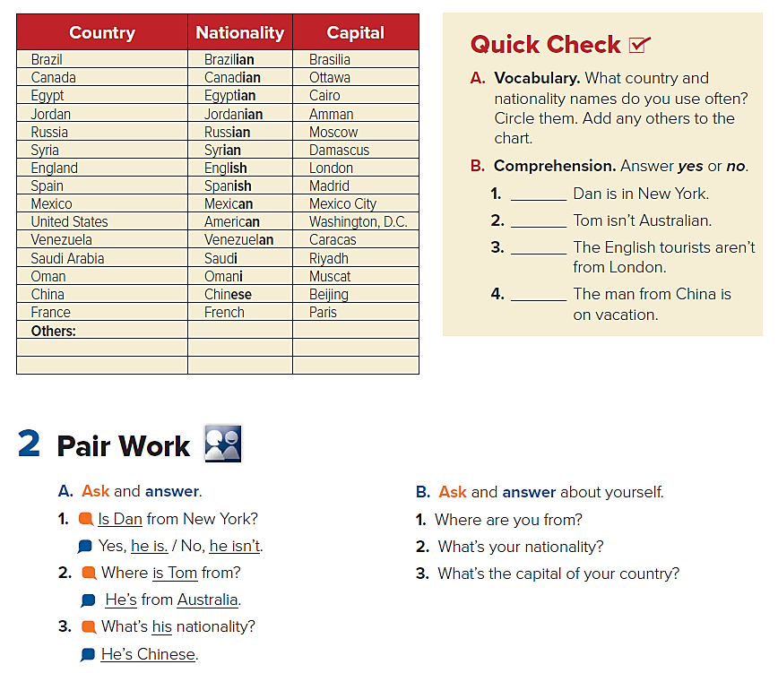
Yes
No
Yes
No

Slide 4
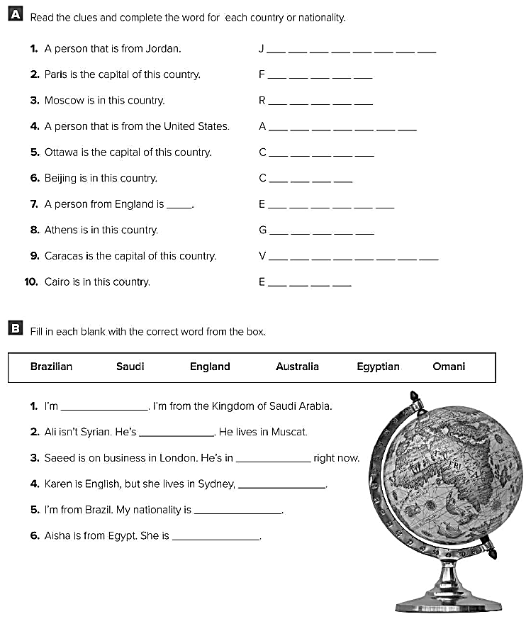
Jordanian
France
Russia
American
Canada
China
English
Greece
Venezuela
Egypt
Saudi
Omani
England
Australia
Brazilian
Egyptian

