Slide 1

Unit 4
Around the World
part 2

Slide 2
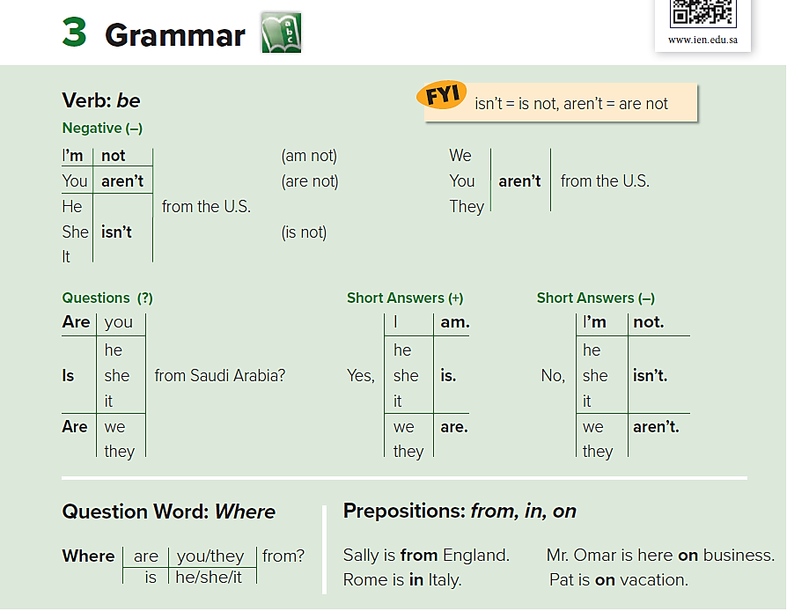

Slide 3
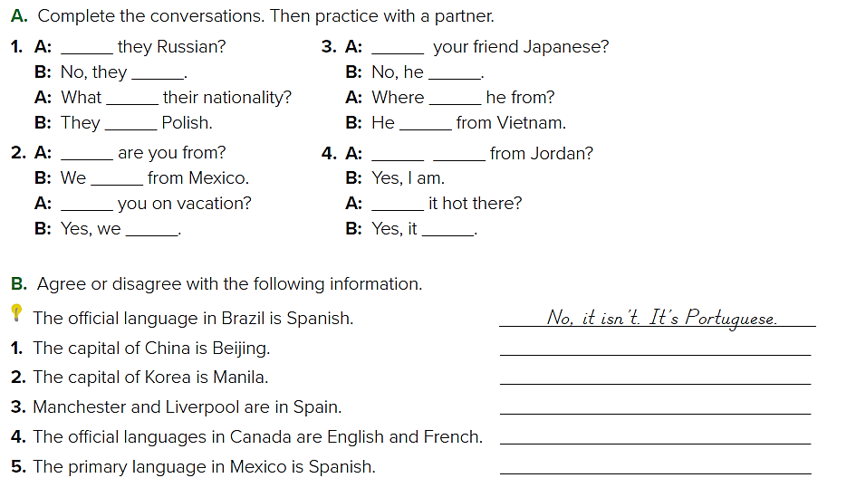
Are
Are
aren’t
isn’t
are
is
are
is
Are
Are
you
are
Are
Is
are
is
Yes, it is
No it isn’t. the capital of Korea is Seoul
No they aren’t. They are in England
Yes, They are
Yes, it is

Slide 4
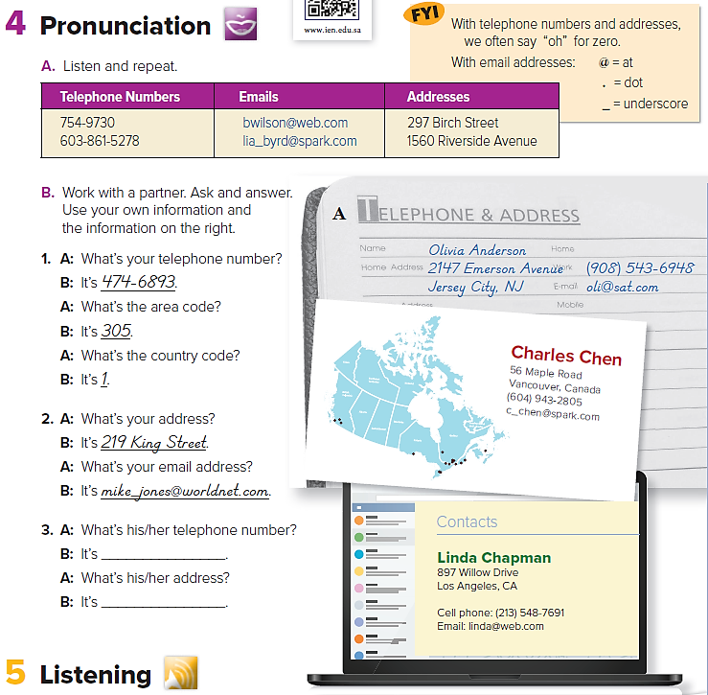


Slide 5
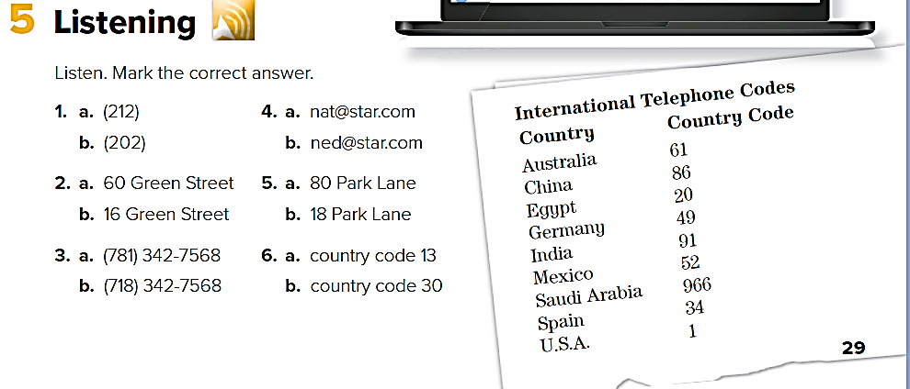

Slide 6
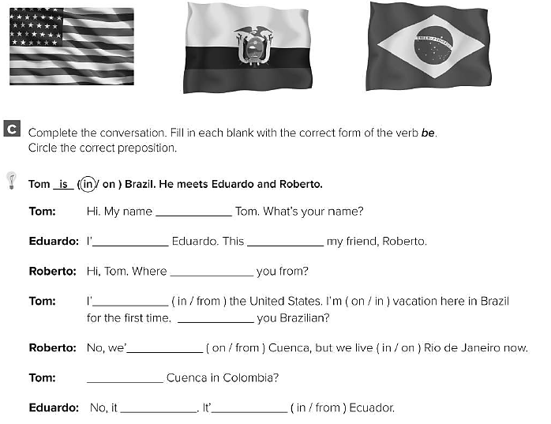
is
m
is
are
m
are
re
Is
isn’t
s

Slide 7
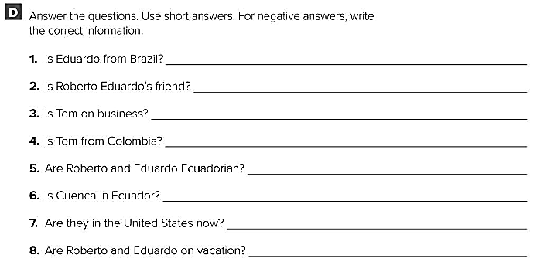
No, he isn’t. He is from Ecuador
Yes, he is
No, he isn’t. He’s on vacation.
No, he isn’t. He’s from the United States.
Yes, they are.
Yes, it is.
No, they aren’t. They are in Brazil now.
No, they aren’t. They live in Rio de Janeiro.

