Slide 1

Unit 4
Around the World
part 4

Slide 2
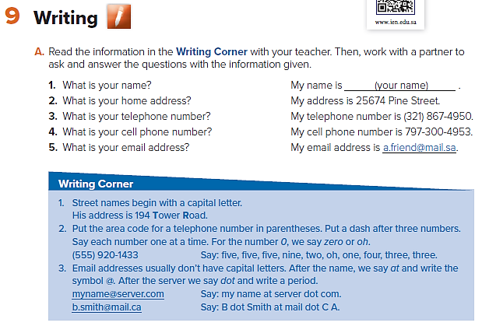

Slide 3
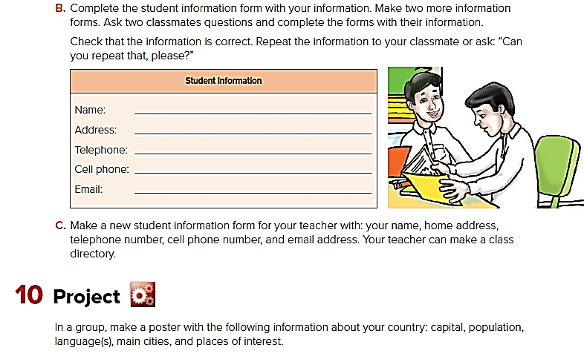

Slide 4
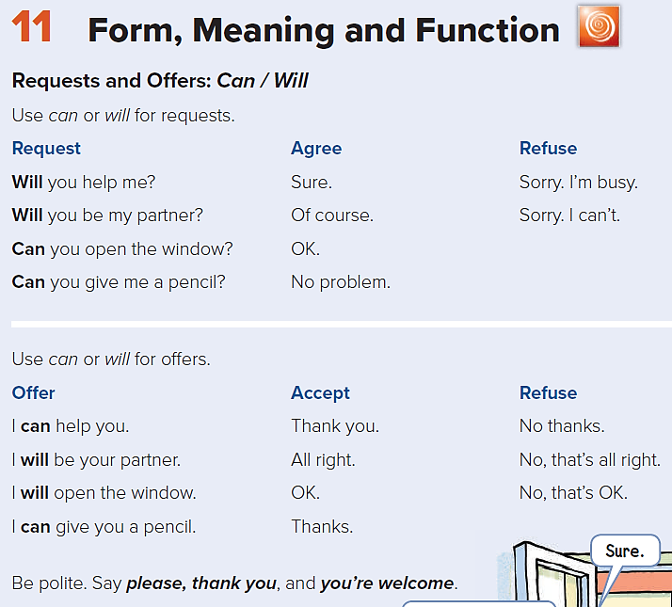

Slide 5
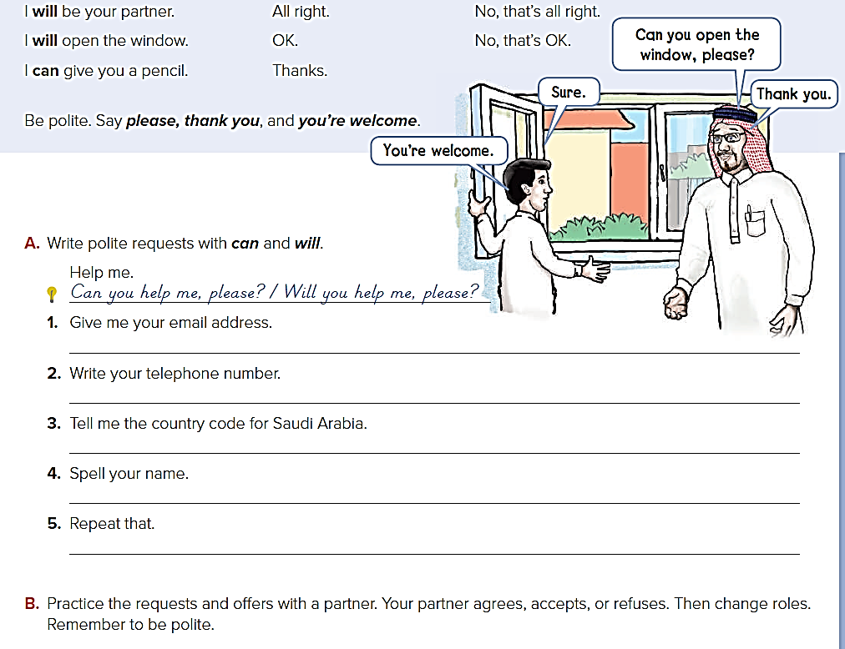
Can/Will you please give me an eraser?
Can/Will you close the door, please?
Can/Will you please be my partner?
Can/Will you open your books, please?
Can/Will you please repeat that?

Slide 6
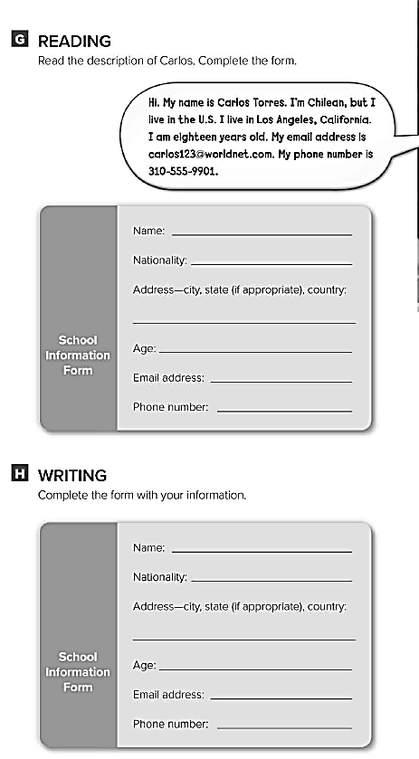
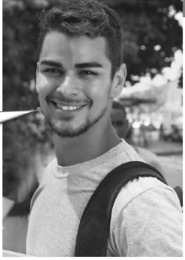
Carlos Torres
Chilean
Los Angeles, California, U.S.
18
carlos123@worldnet.com
310-555-9901

