Slide 1



Slide 2

Warm up
https://www.liveworksheets.com/cb1232685bs

Slide 3
Objectives:
At the end of this session, the students will be able to:
Ask and answer about countries and nationalities

Slide 4

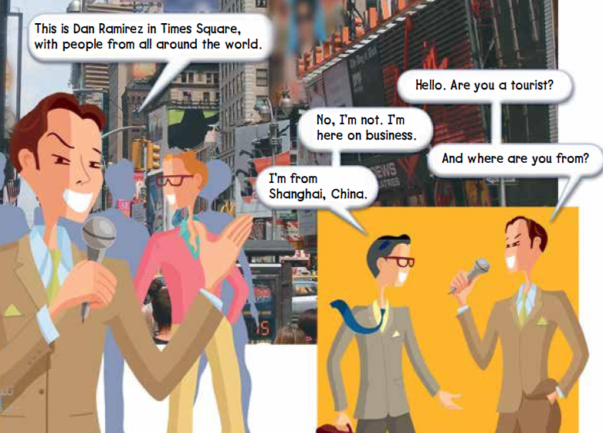
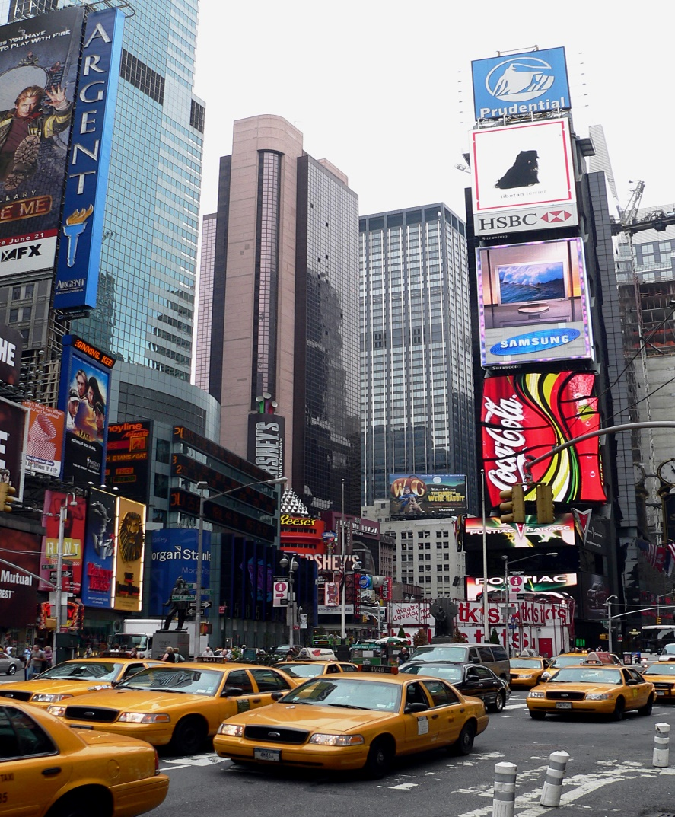

Page 26
listen and repeat or speak along with the recording.
Who’s Dan Ramirez?
He’s a reporter from a television station.
He’s talking to people in Times Square in New York City.
tourist = someone traveling on vacation
on business = refers to someone traveling for work
What is Times Square?
☺ Times Square is a popular tourist destination.
There are a lot of stores and restaurants there.

Slide 5

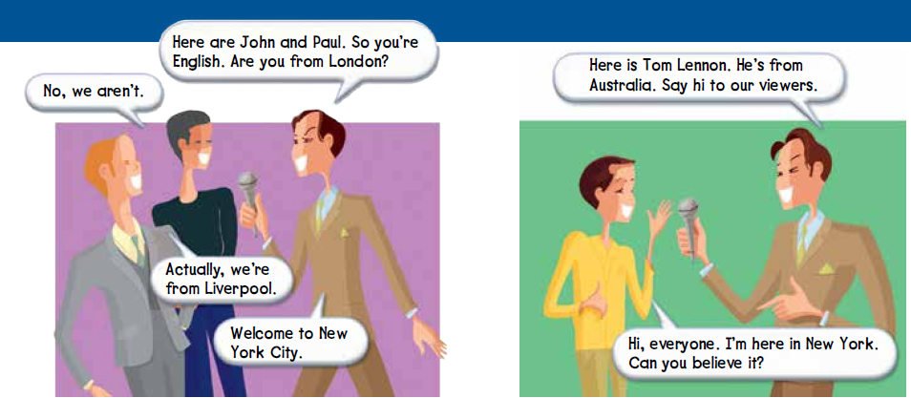

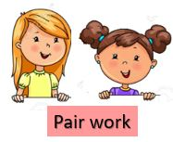
Page 27
viewers = the people who are watching the television program
What are their names?
Where are they from?
Where is Tom from?
What’s their nationality?
What’s his nationality?
Choose one conversation to practice. Then have different pairs act out each conversation for the class.

Slide 6
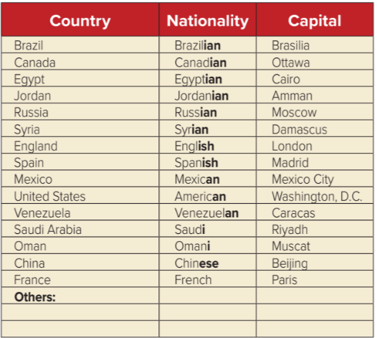

Page 27
Is your/ our country in the chart?
If it is, point to it.
If it isn’t, write it in at the bottom of the chart under “Others.”
Listen and repeat the words or speak along with the recording

Slide 7


Page 27
Circle the country and nationality names in the chart that you use often. Then they write down other countries that you talk about often
write the names of other countries, nationalities, and capitals that you choose.
Read your lists for the class.
Write the new countries, nationalities, and capitals on the board.
Find the countries on a world map

Slide 8
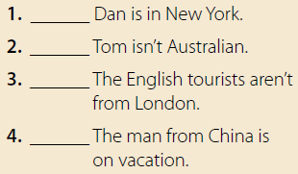
Page 27
yes
no
Tom is Australian.
yes
no
He’s on business.

Slide 9


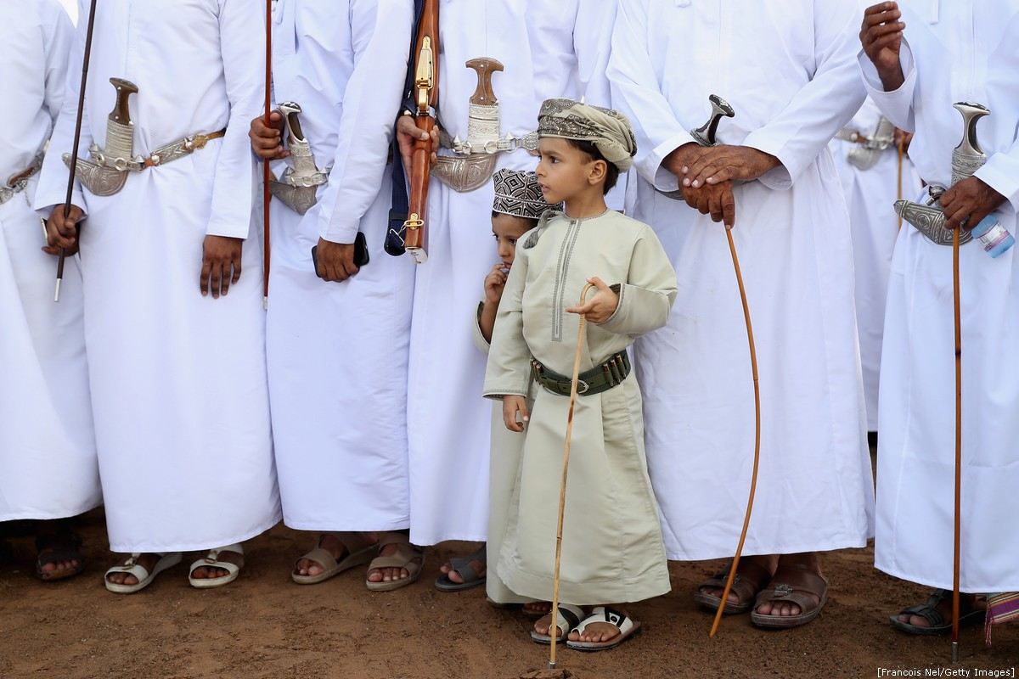

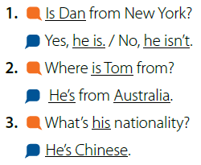
Page 27
listen and repeat or speak along with the recording.
Model the first conversation with a volunteer. Use a different name.

Slide 10


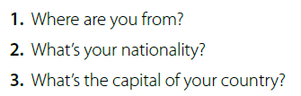
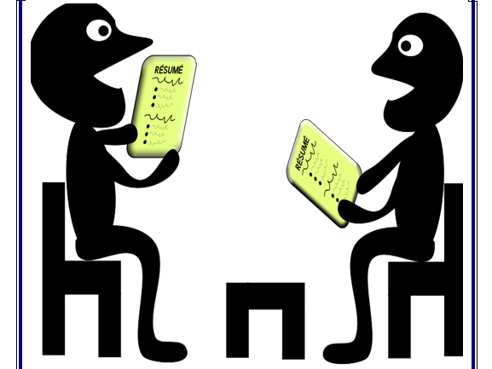
Page 27
Ask and answer the questions about yourselves with true information

Slide 11







page 101

