Slide 1

Objectives:
At the end of this session, the students will be able to:
answer questions about personal information
establish a conversation including information about nationality and country

Slide 2



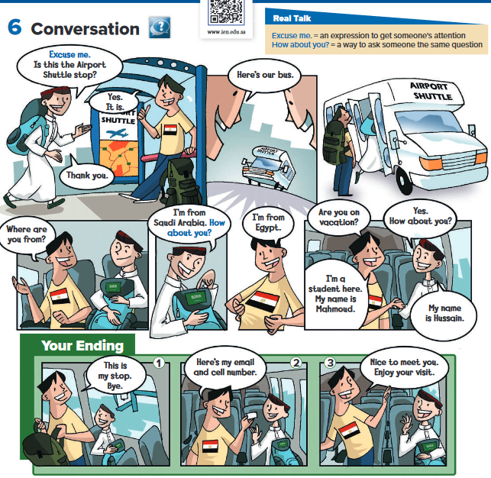

at the comic strip
Page 30
Where are the people going?
to the airport
What are their names?
Mahmoud and Hussain

Slide 3


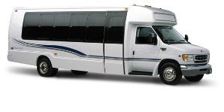
Page 30
Listen and follow along with the text and the pictures
What is the shuttle? it’s a bus. A shuttle is a form of transportation that travels
back and forth between two points. It can be a bus, train, or airplane.

Slide 4

Page 30
Which ending you think is the most likely?
Find out how many students chose each ending and write the results on the board.
Why did you choose each ending?

Slide 5

Page 30
Find the expressions Excuse me and How about you? in the conversation.
Describe other situations in which you might say Excuse me

Slide 6
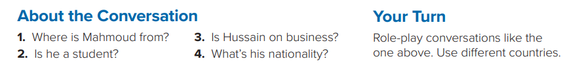
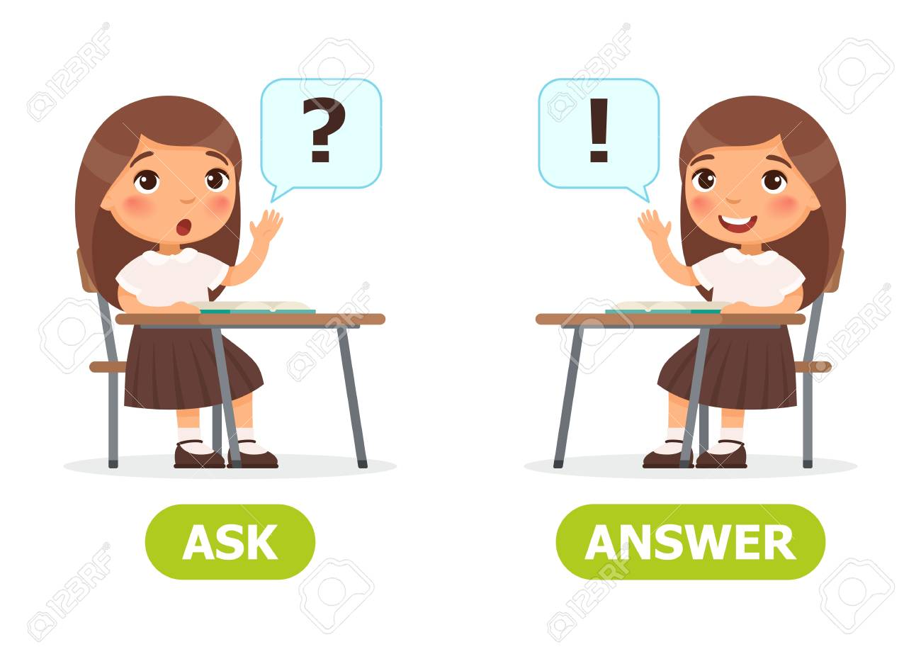
Page 30
Take turns asking and answering the questions.
1. He’s from Egypt.
2. Yes, he is.
3. No, he isn’t. He’s on vacation.
4. He’s Saudi.

Slide 7

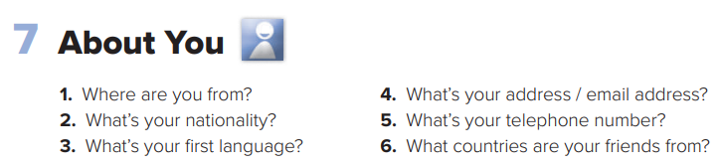

Page 30
One student in the group the role of reporter.
Your job is to report some of the information from the group conversation to the class.
the reporter from each group to tell the class two or three interesting things about the people in their group.

Slide 8




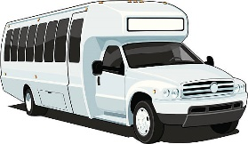
Page 30
Role-play the conversation with a partner.
You choose one of the endings to use in the conversation.
Act out the conversation for the class
Place two chairs in front of the class as the seats on the shuttle bus.
Students can act out getting on and off the bus.

Slide 9
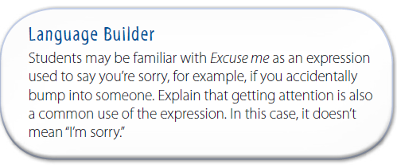

Slide 10
