Slide 1


Where are you from?
How old are
you?
SPIN
What’s your
friend’s name?
How do you spell
Your name?
How are you today?
tekhnologic
Notes:
5 Segments

Slide 2
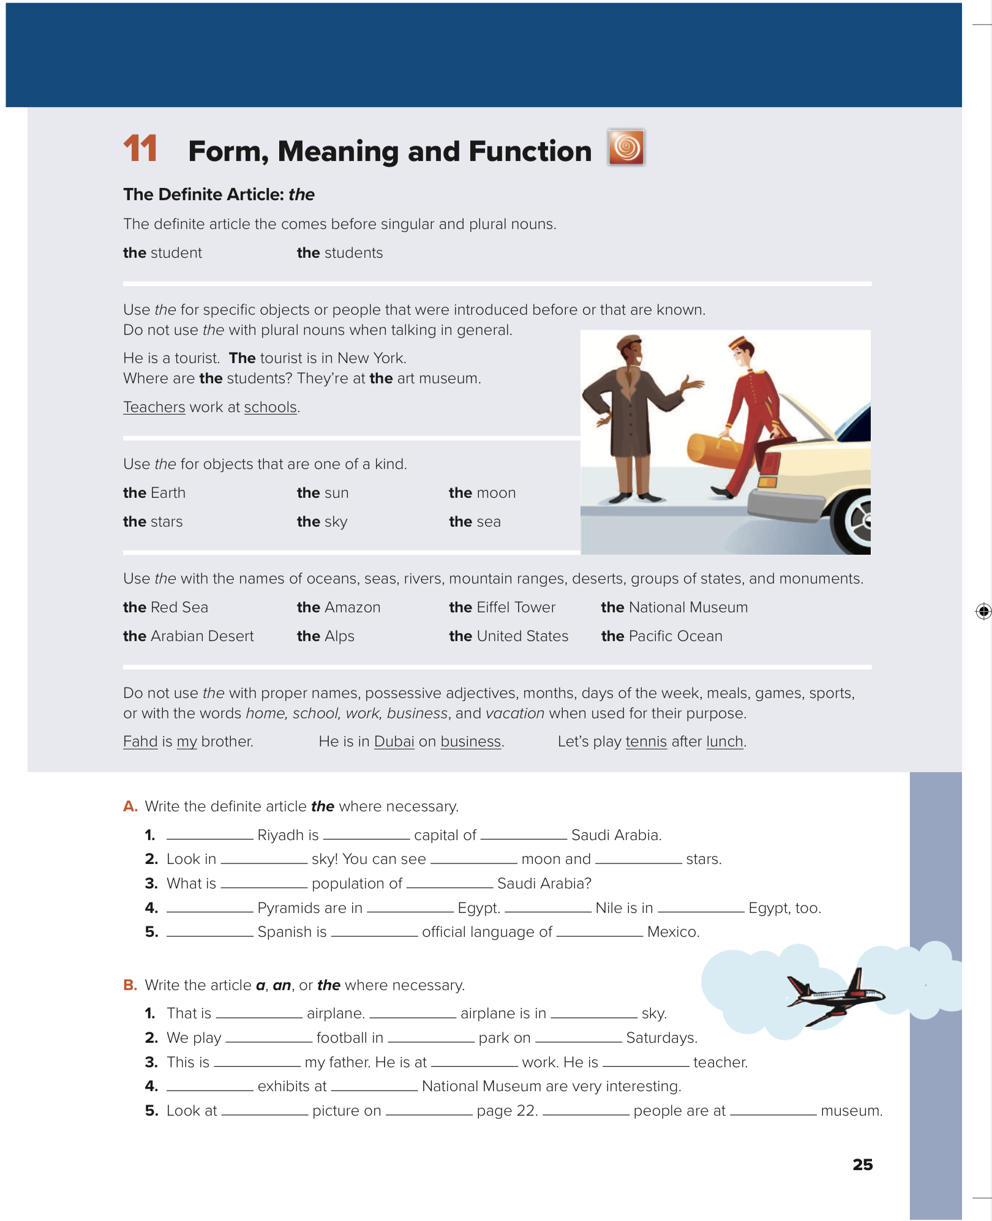

What’s That?
Unit 3
Page 25

Slide 3
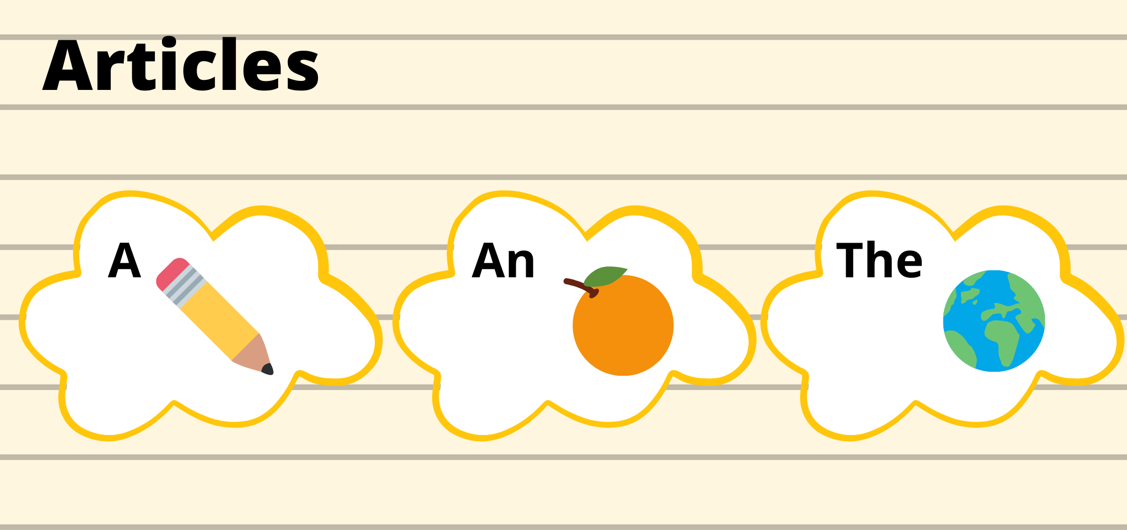

Slide 4
Indefinite
articles
an
a
An apple
A bicycle
T.BUSHRA ALSWAILEM

Slide 5
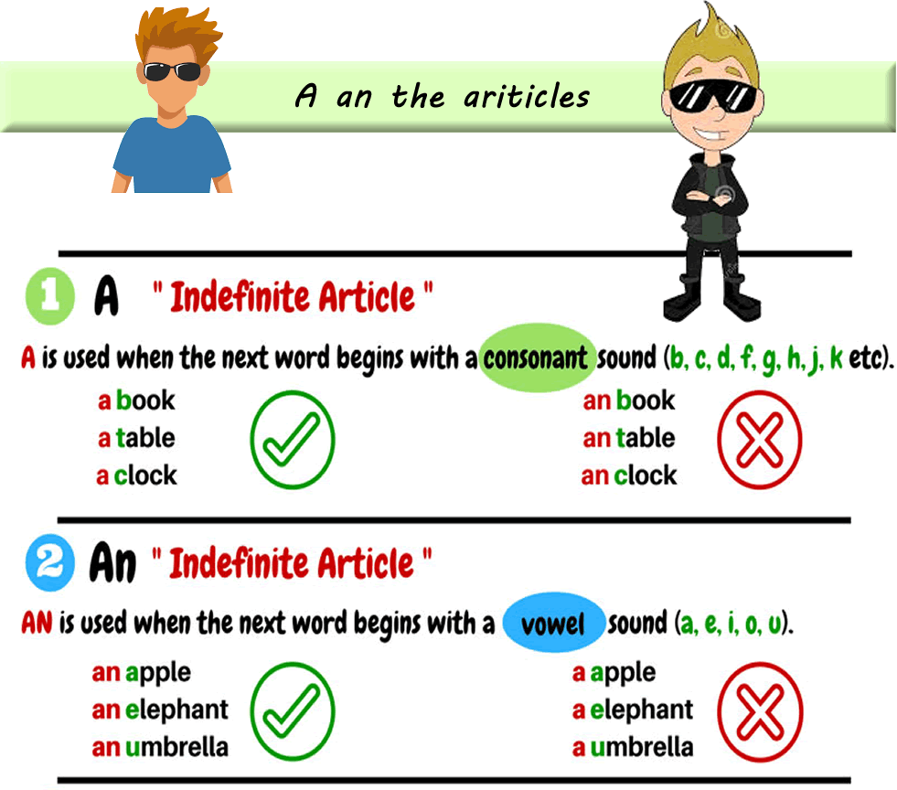

Slide 6
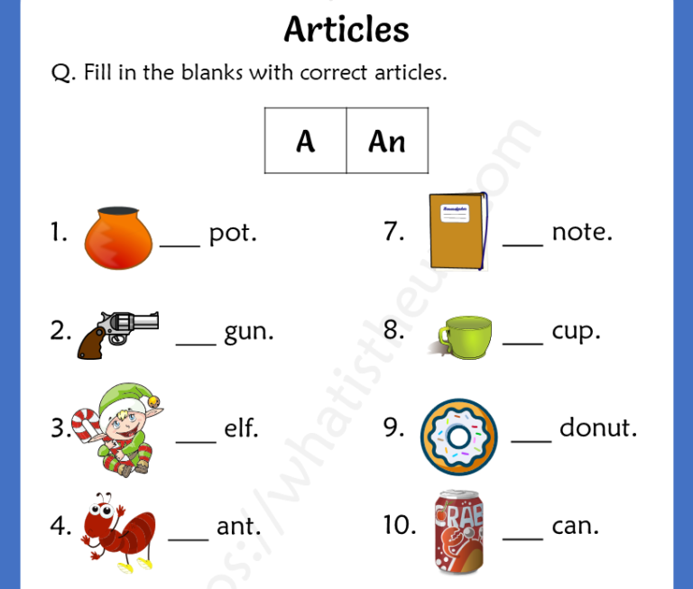

Slide 7
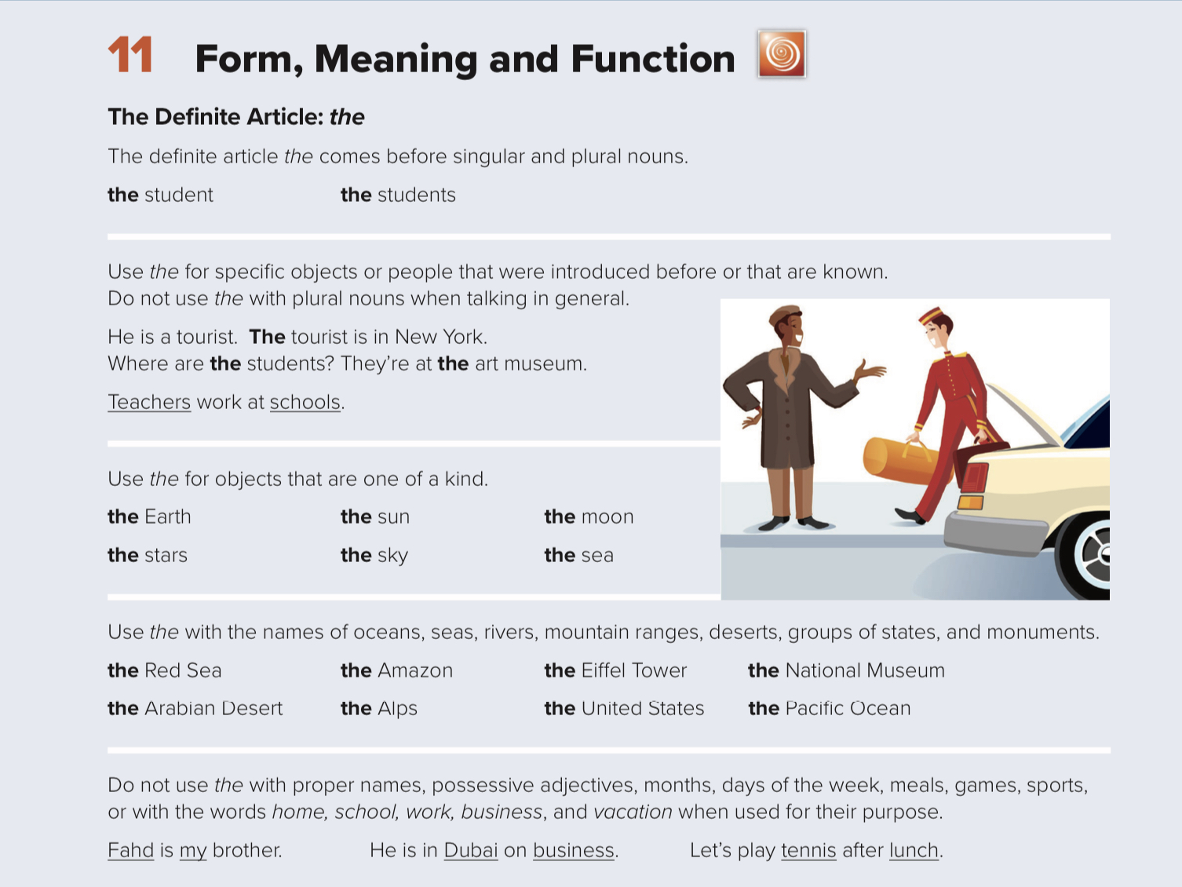

Slide 8
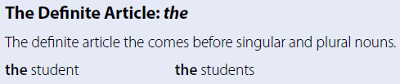




























Page 25

Slide 9
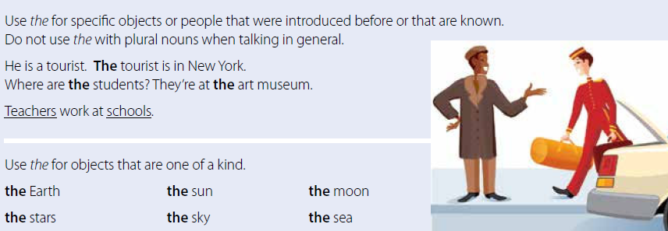
Page 25

Slide 10
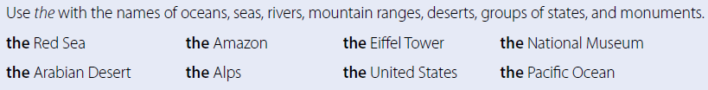
Page 25
more examples of the names of rivers, seas, deserts, mountain ranges, and monuments.
The Nile River
The Amazon River
The Mississippi River
Arabian Sea
Pacific Ocean
Mediterranean Sea
The Himalayas Mountains
The Rub al Khali desert
The Sarawat Mountains
The Sahara Desert
The Alps Mountains.
The Great Victoria Desert

Slide 11



Don’t use (the) with:
Games
Hide and seek
Proper names
Ahmad ,Dubai,Sara,Sony,Twitter
the
Months
September,October ,November
Days
Saturday,Sunday, Monday
Meals
Breakfast, lunch , dinner
sports
Football, jogging ,swimming ,hocky
T.BUSHRA ALSWAILEM

Slide 12
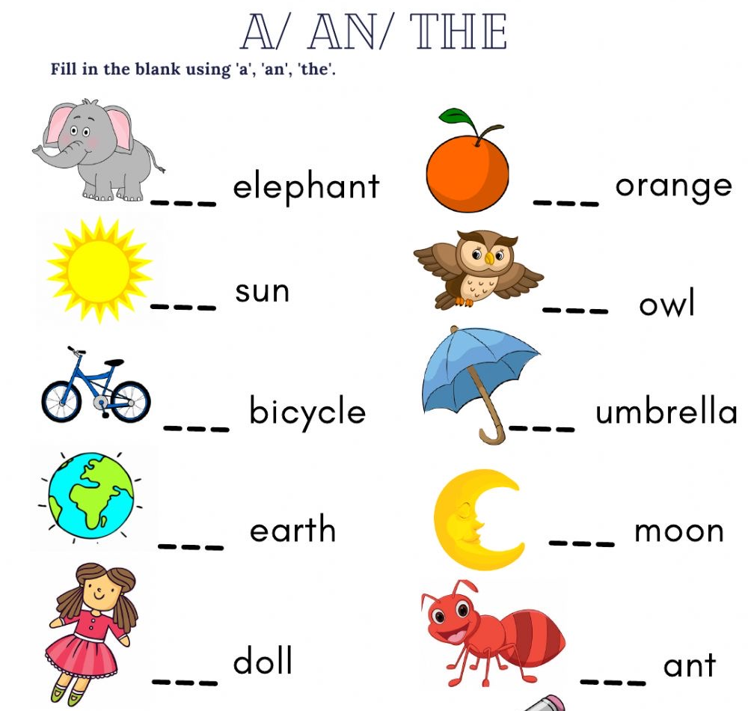

Slide 13
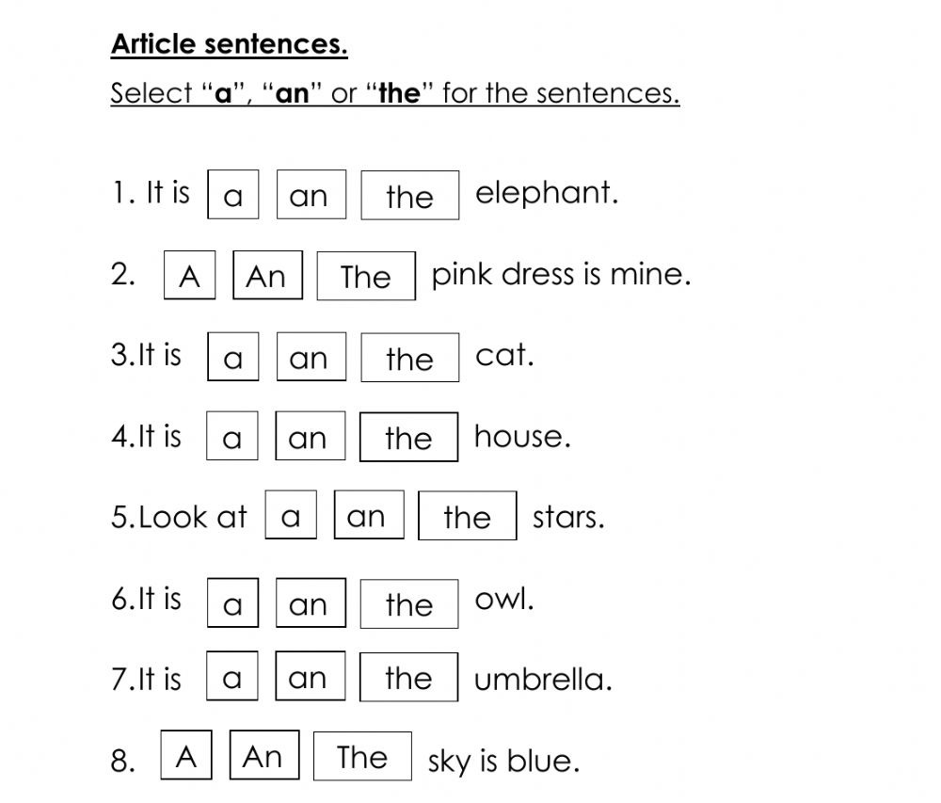

Slide 14
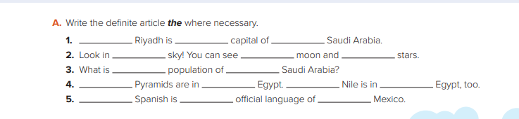
the
×
×
the
the
the
The
×
The
the
×
×
×
the
×

Slide 15
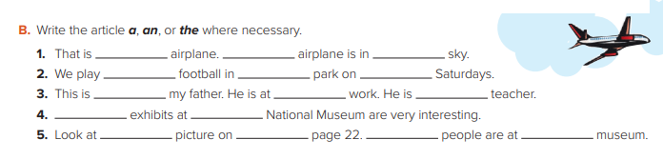
an
the
the
×
the
×
a
×
×
the
The
the
the
the/a
×

Slide 16
Unit 3 Worksheet
https://www.liveworksheets.com/ac1255505il

Slide 17
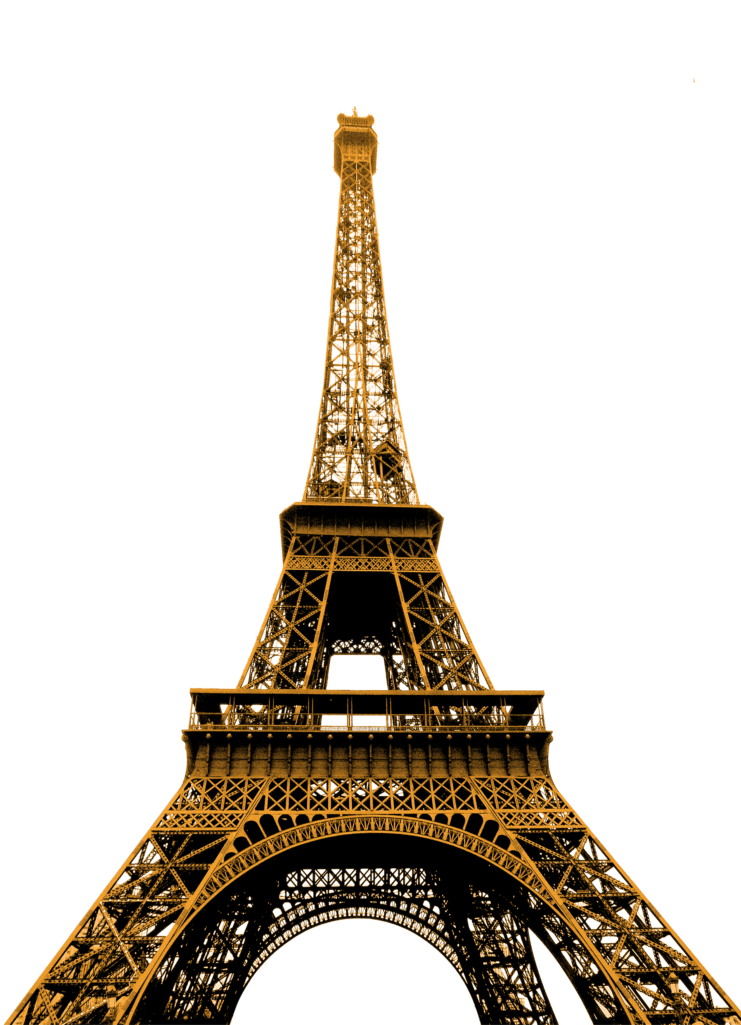
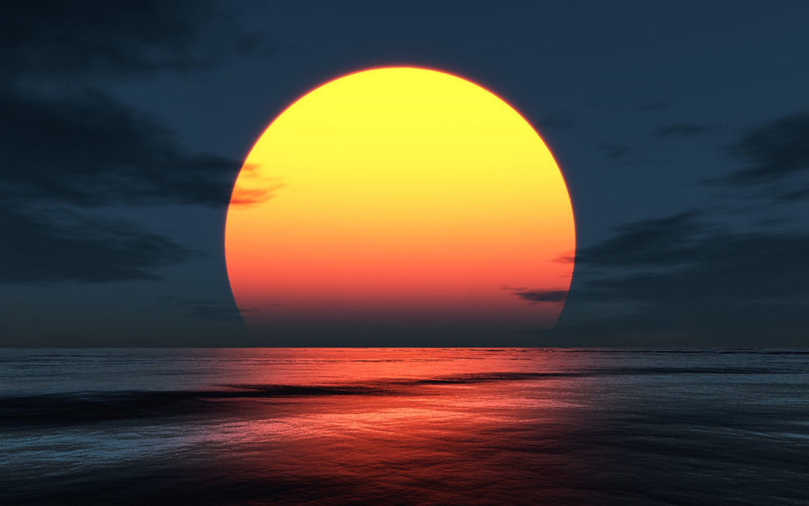
Definite article
the
Known people or objects
Groups of states and monuments
One of a kind
The Eiffel tower
The national museum
Stars, sun,
Sky, moon,
earth ,
The tour guide is an expert.
The United states
T.BUSHRA ALSWAILEM

Slide 18
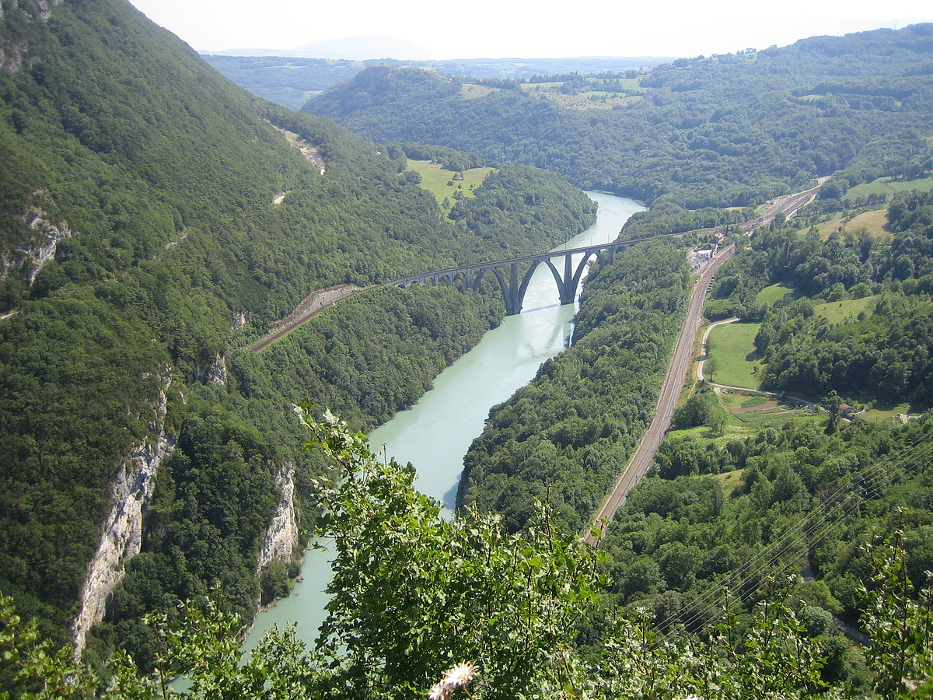
geography
the
Names of mountain range
Names of seas
Names of oceans
Names of deserts
The Pacific ocean
The Red Sea
The Arabian desert
The Alps
T.BUSHRA ALSWAILEM

