Slide 1

7th/sep/2023
Super goal 1
U: 2
What day is today?
Reading
- How old are they?

Slide 2
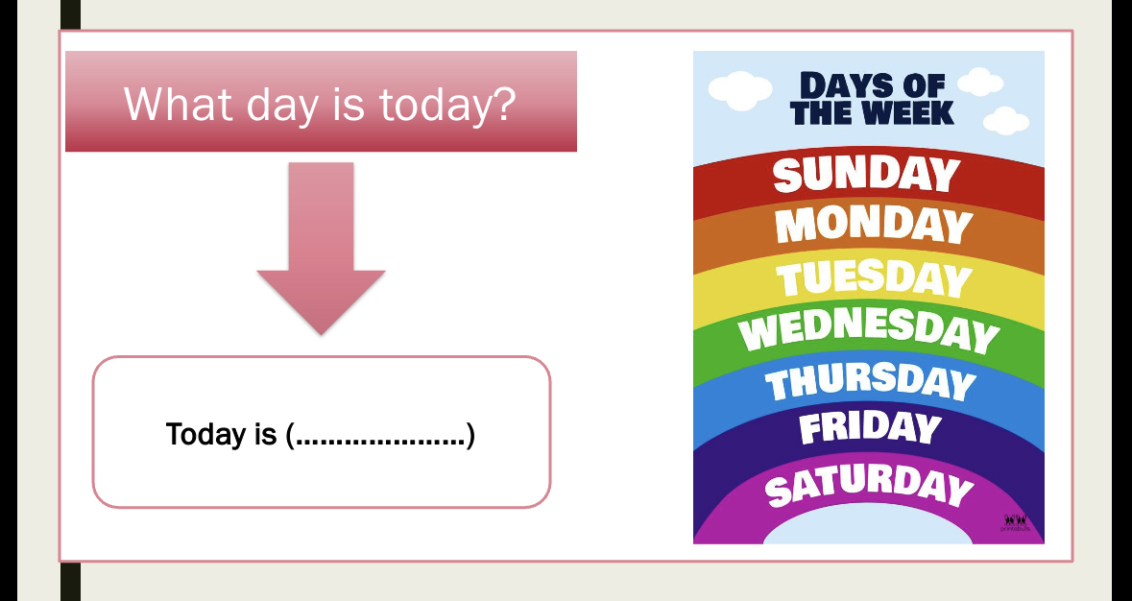

Slide 3
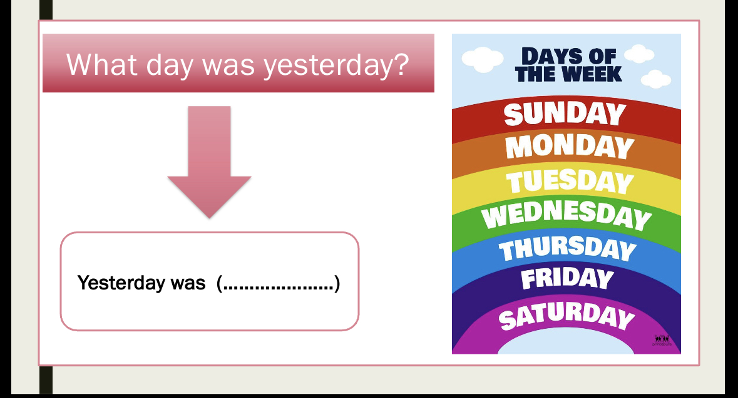

Slide 4
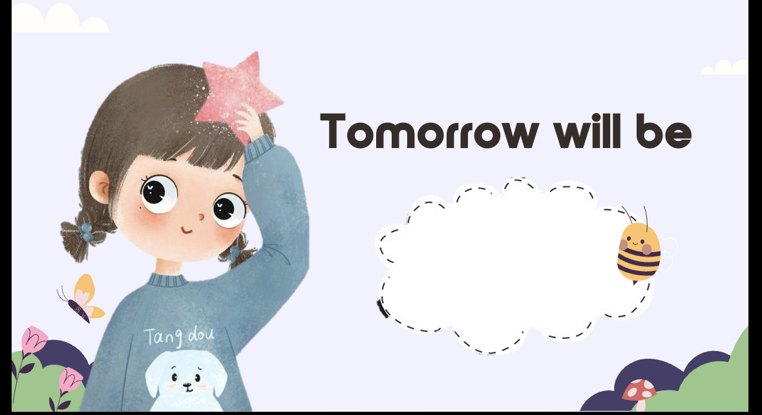

Slide 5
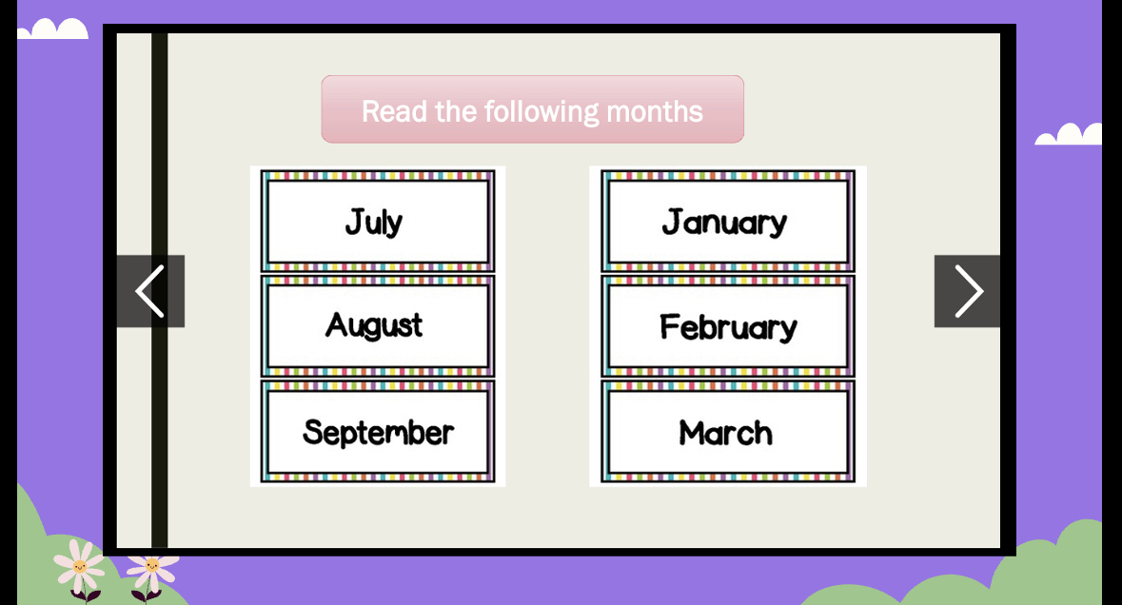

Slide 6
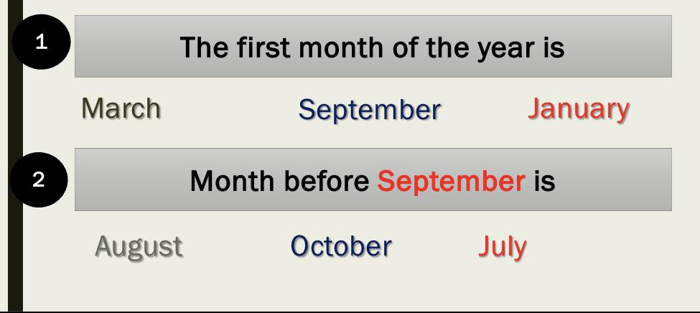

Slide 7
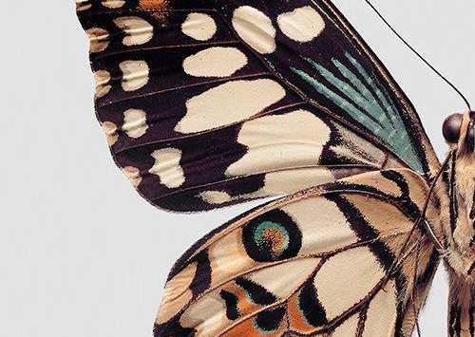
Learning objectives :
Read the text
Answer the question about the text
Research about different animal life ..

Slide 8
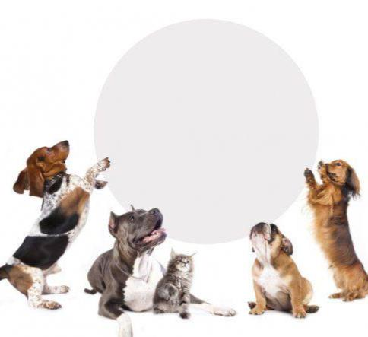
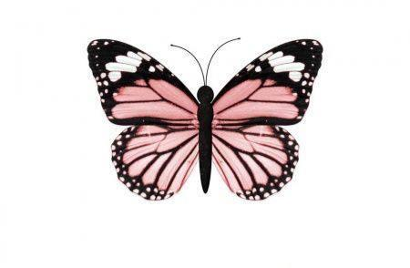
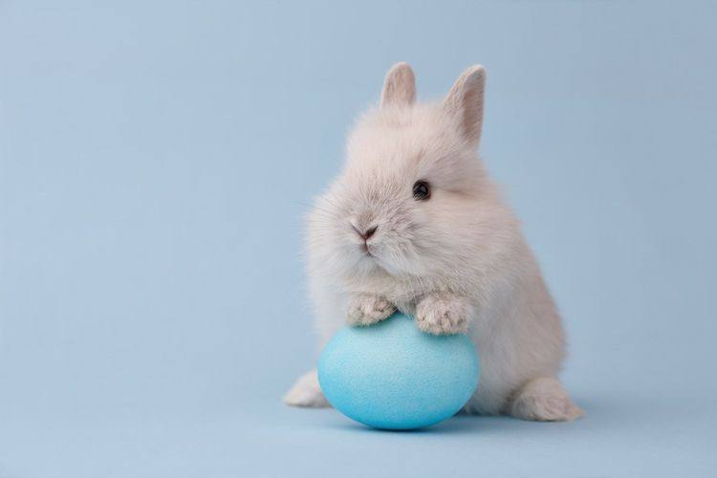
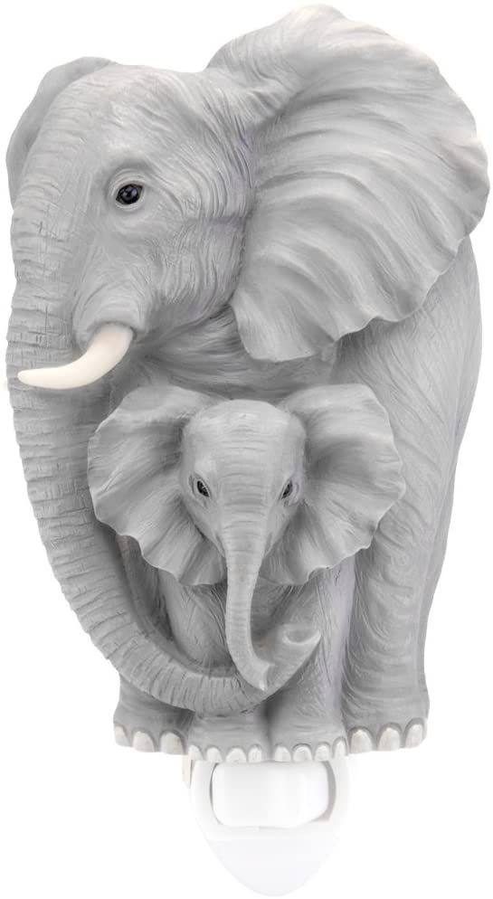
Dogs
Rabbit 🐇
Butterfly 🦋
Which animal is this?
Elephant 🐘

Slide 9

Well done 👍

Slide 10
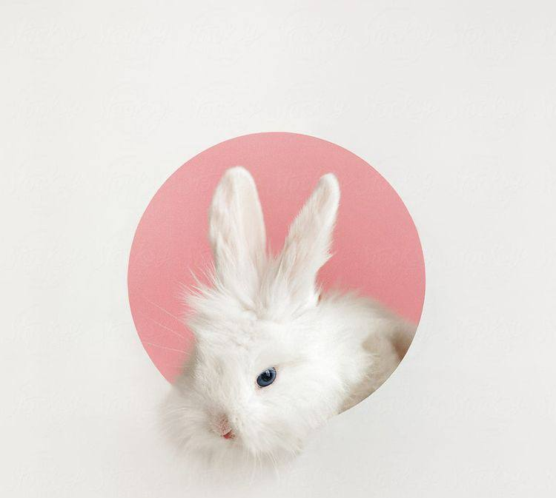
Have you seen a Zoo in Saudi Arabia before?
  https://youtu.be/470PQveXX8o

Slide 11
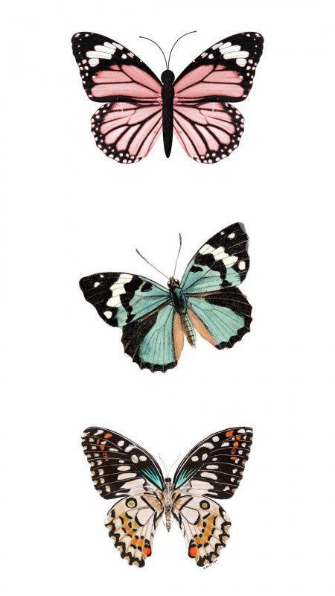
Before Reading:
What do you think the reading is about?
It’s about animals

Slide 12
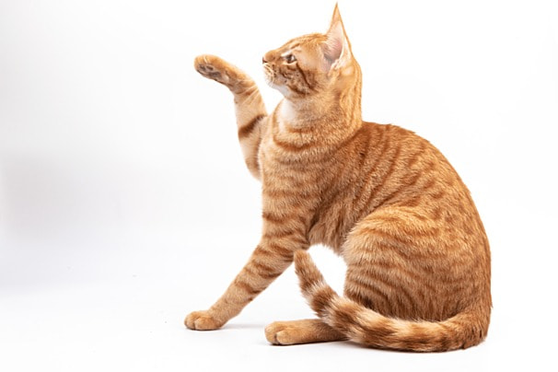
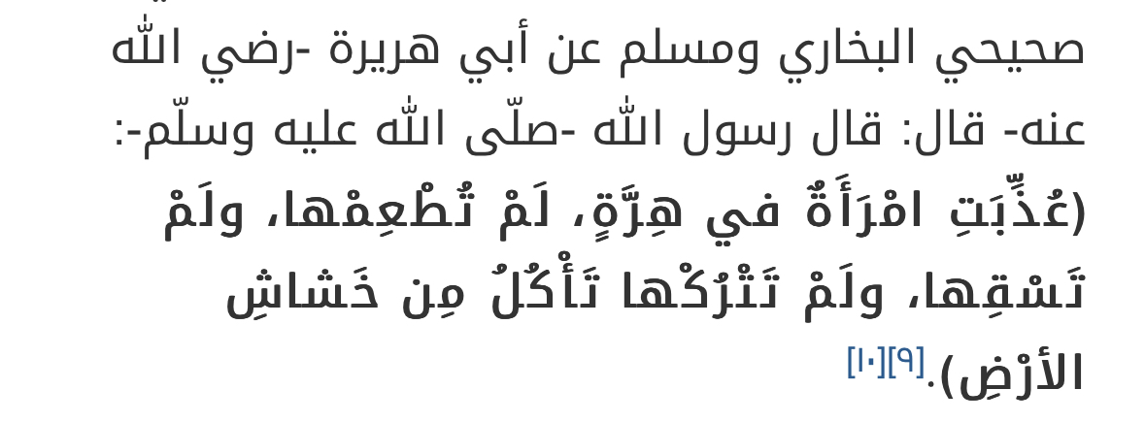

Slide 13
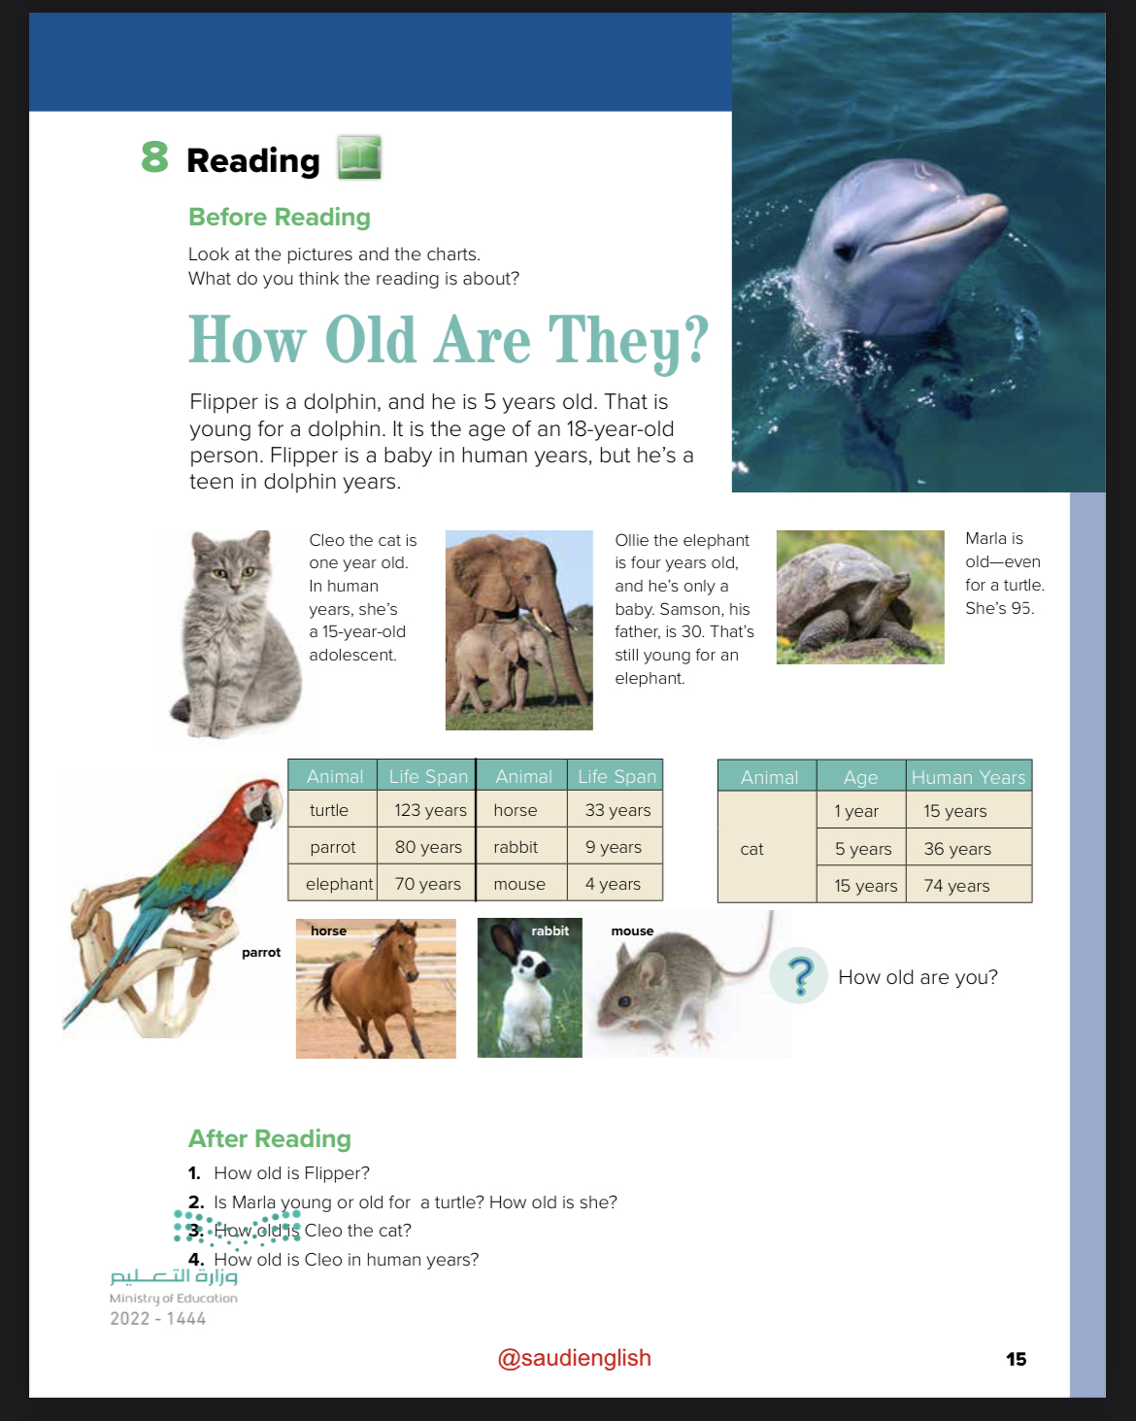
Reading
Could you read the title of the texts ?!
Could you scan the text
What’s the meaning of : adolescent
What’s the meaning of : life span?

Slide 14
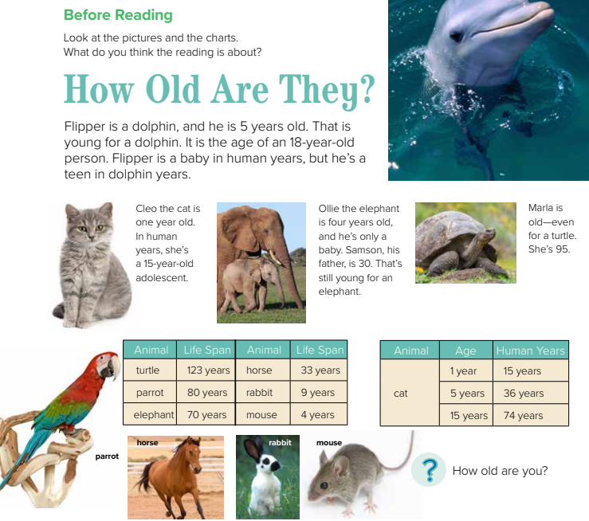


Slide 15
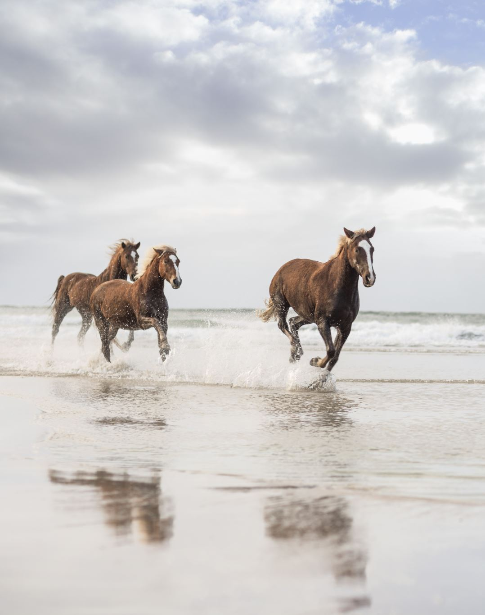
What is the life span of a horse ?

Slide 16
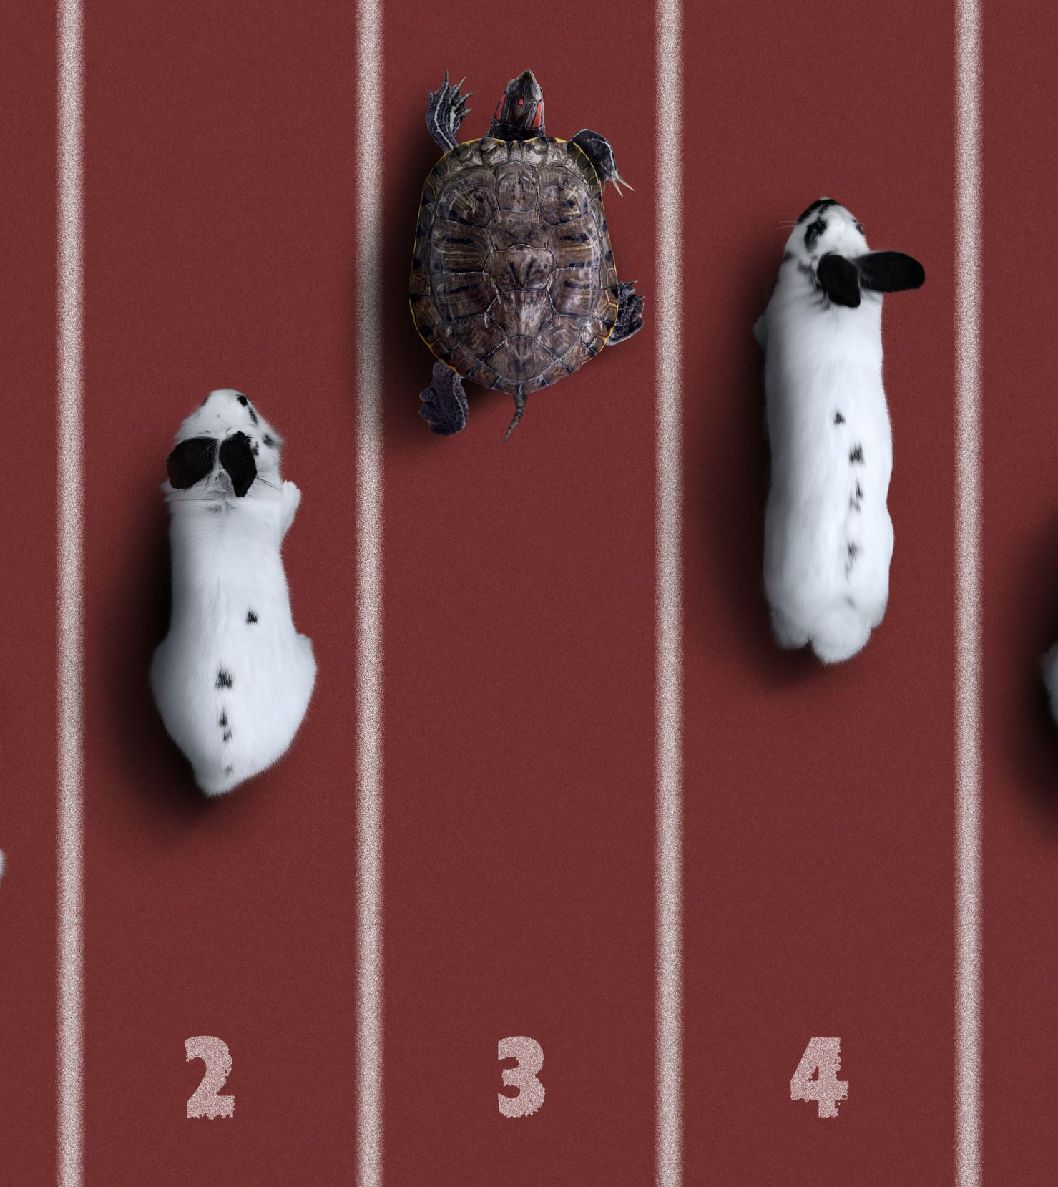
Which animal has a life span of 123 years ?
Notes:
Whi

Slide 17
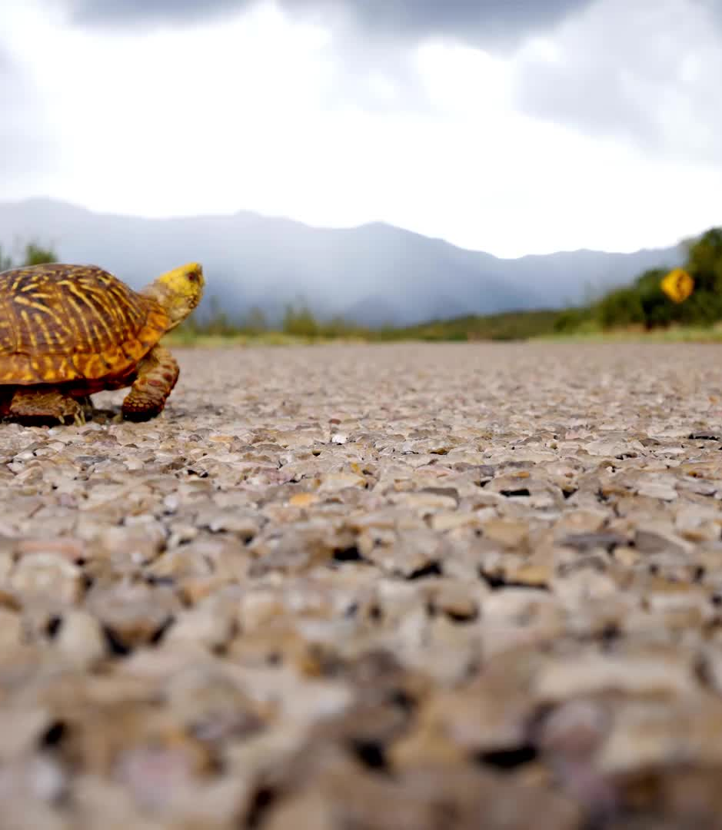
What kind of animal is marla ?

Slide 18
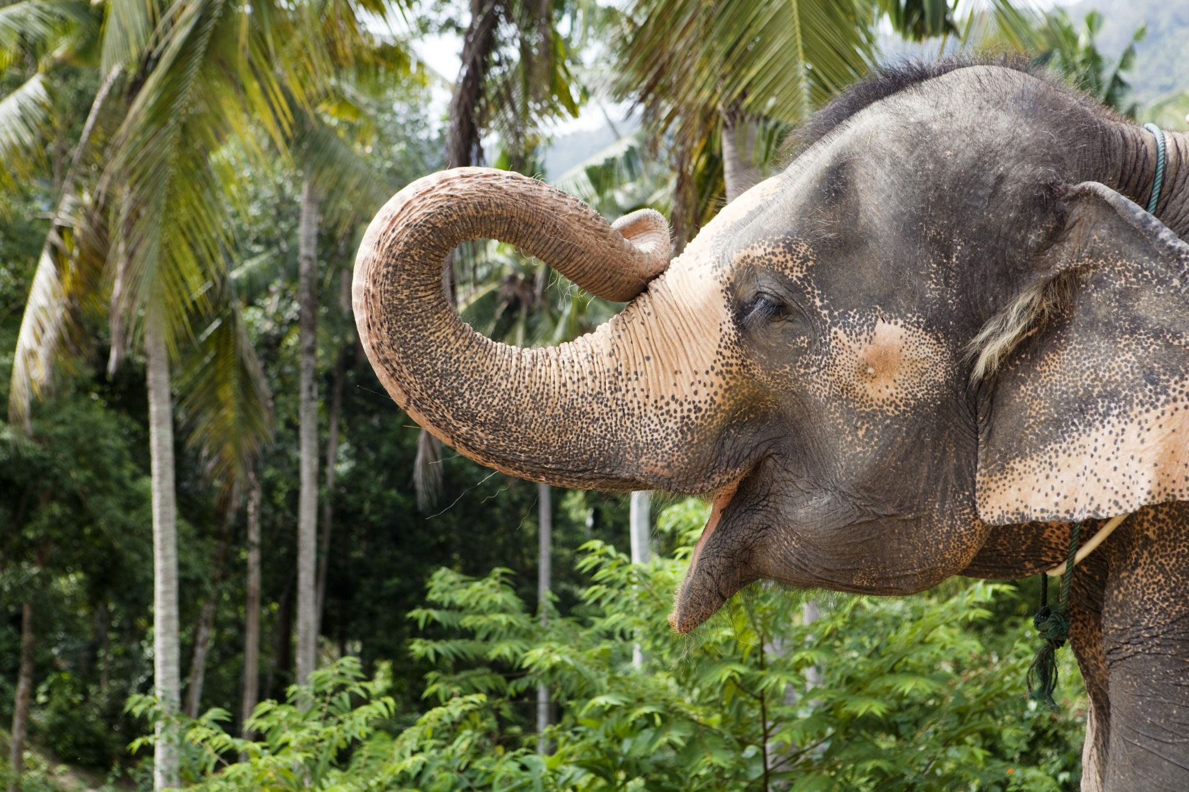
How old is Ollie ?

Slide 19

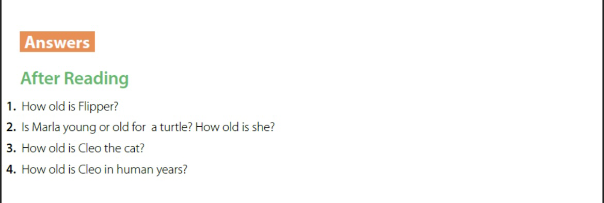

Slide 20
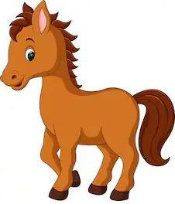
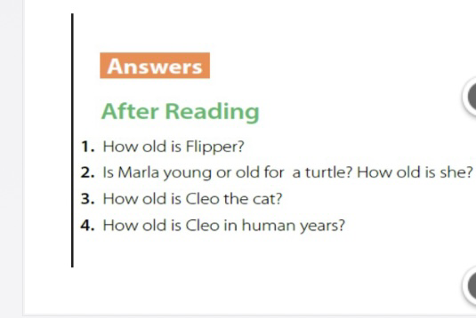
5 years old .

Slide 21
5 years old .
She is old . She is 95.

Slide 22
5 years old .
She is old . She is 95.
1 year old .

Slide 23
5 years old .
She is old . She is 95.
1 year old .
15 years old

Slide 24
Well done 👍

Slide 25
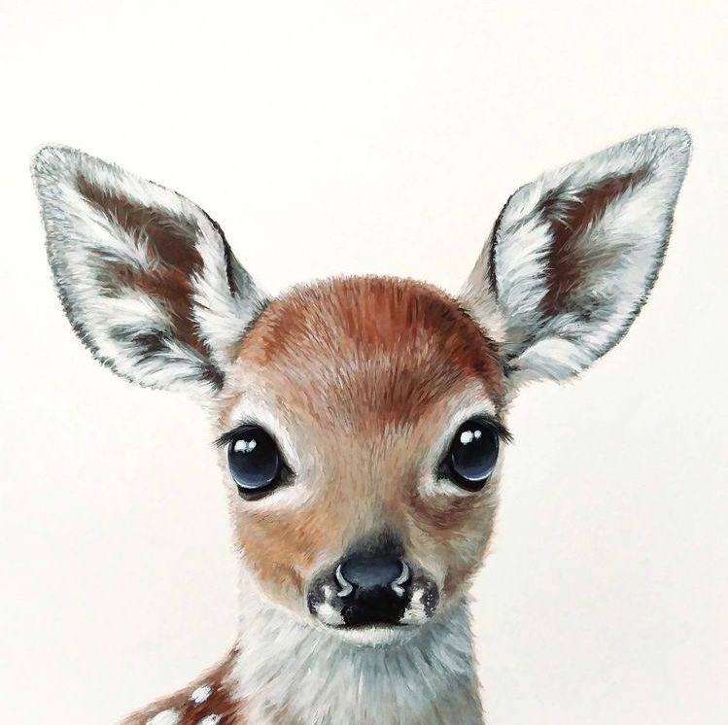
H.W
P:192
Ex. F

Slide 26
Thank you so much for listening!
See you tomorrow

