Slide 1

Mega Goal 1
Listen & discuss
U: 3 L:1

Slide 2
Objectives
1
2
3
discuss
Answer
Vocabulary
Science fiction
Questions related to the text
Match words

Slide 3

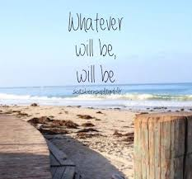
The title of the unit , What does it mean ?
Some things cannot be prevented from happening.

Slide 4


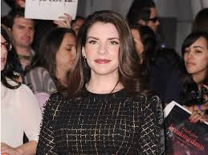
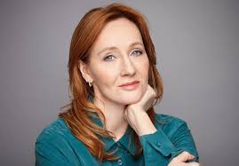
Warm Up
What kind of books do you like to read ?
Have you ever read a novel ?
Who is your favorite author ?

Slide 5


A period of 100 years .
We are in the 21th century

Slide 6


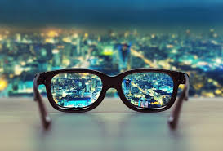
Book p. 34
What words does it make you think of?

Slide 7
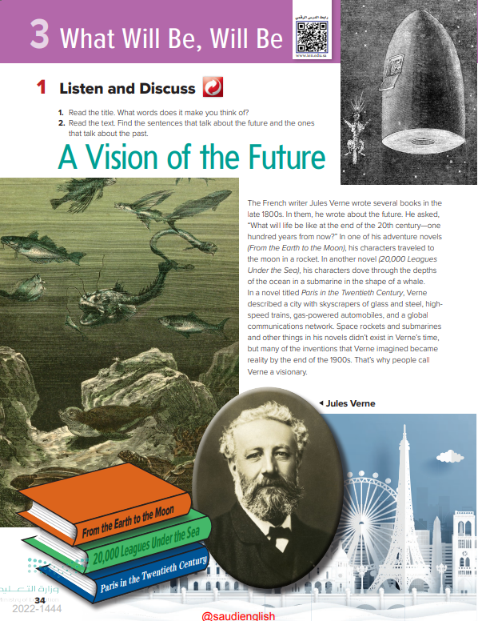
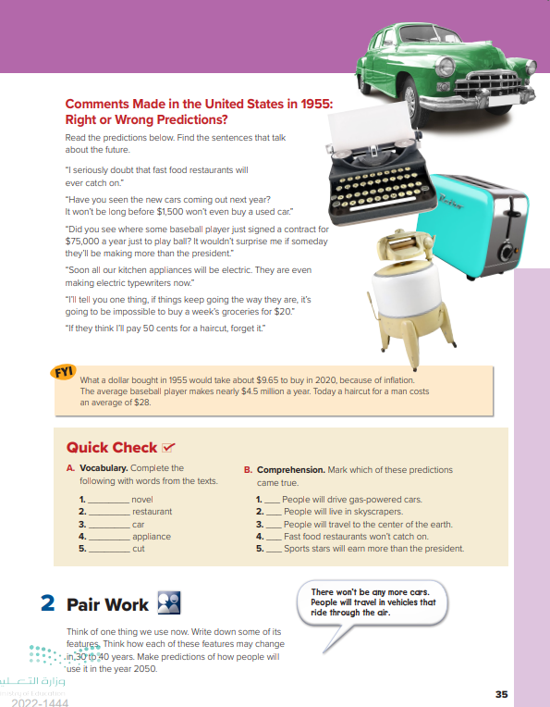
34
35

Slide 8
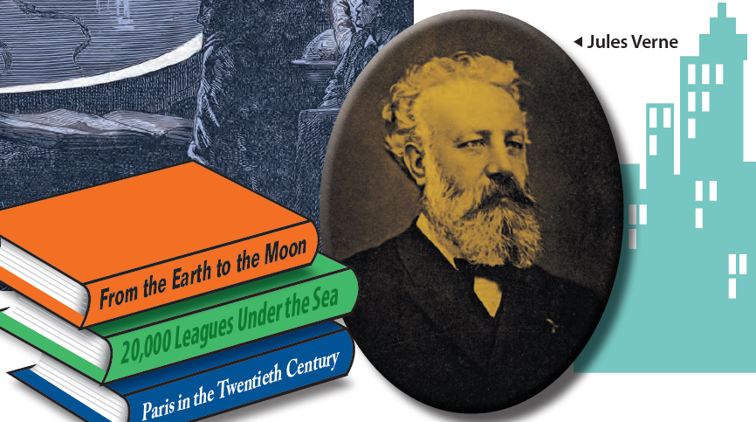
What do you know about Jules Verne

Slide 9
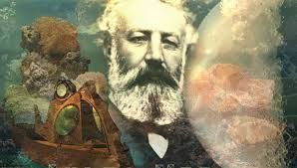
What do you know about Jules Verne
He was a French novelist who lived from 1828–1905, and is considered the father of science fiction.
He was interested in science and geography and wrote a series of novels about journeys in which he talked about many scientific and technological achievements of the 20th century.
He is especially famous for the novels A Journey to the Center of the Earth and 20,000 Leagues Under the Sea.

Slide 10
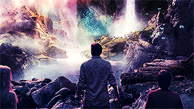
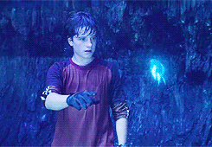
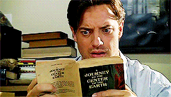
A Journey to the Center of the Earth

Slide 11
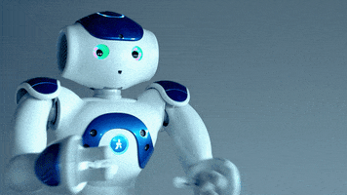
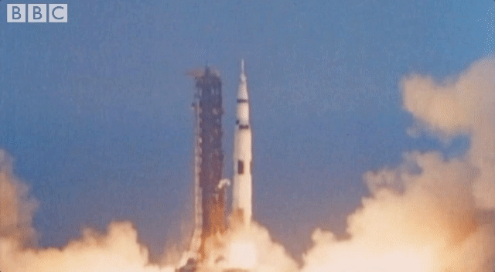
Science Fiction
This is a type of literature based on science . It had its beginnings in the late 19th century.
At that time, things such as robots, space travel, and invasions from outer space were fantasies .

Slide 12
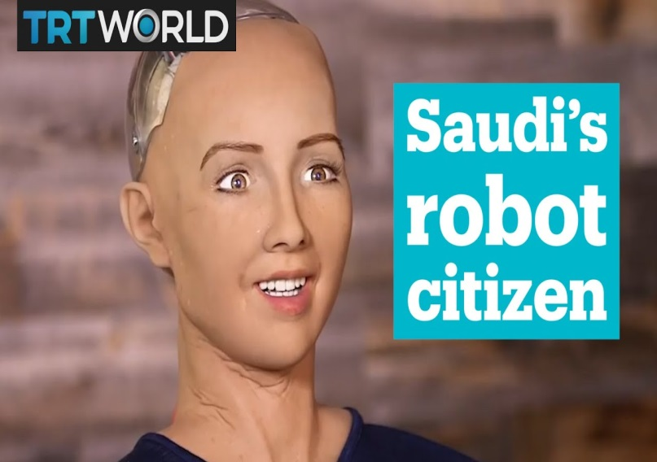
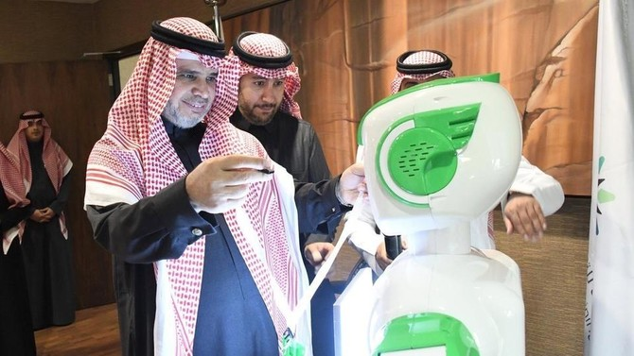
Saudi Arabia
Saudi Arabia becomes first country to give a robot citizenship .
Saudi Arabia - first robot gets its first job at government .

Slide 13
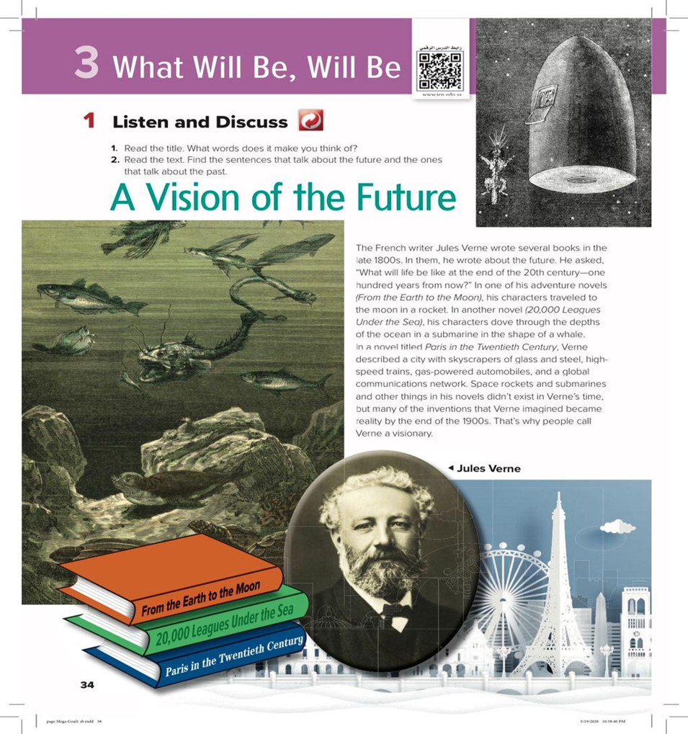
Listening Time

Slide 14


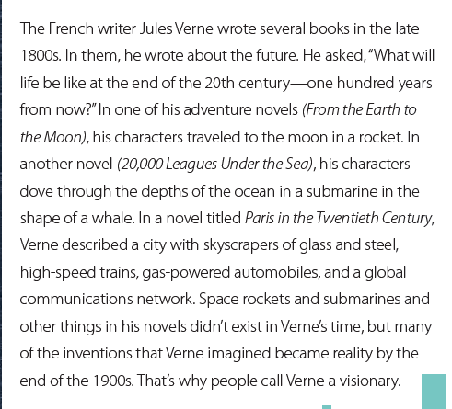
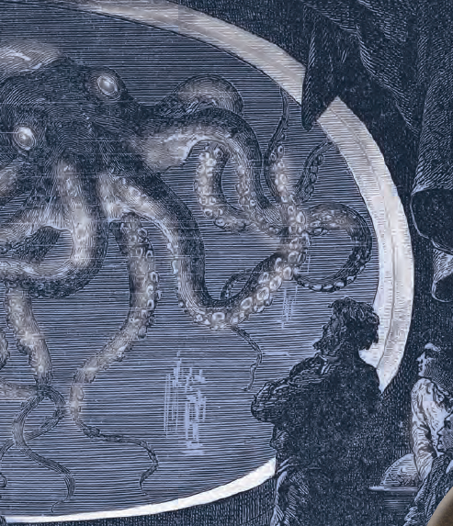
Listening
Find the sentences that talk about the future and the ones that talk about the past.

Slide 15
Listening
Find the sentences that talk about the future and the ones that talk about the past.
What did Jules Verne say life would be like?
What does it mean ‘ vision ?
Vision means the ability to see.
Why do people call him a visionary?

Slide 16
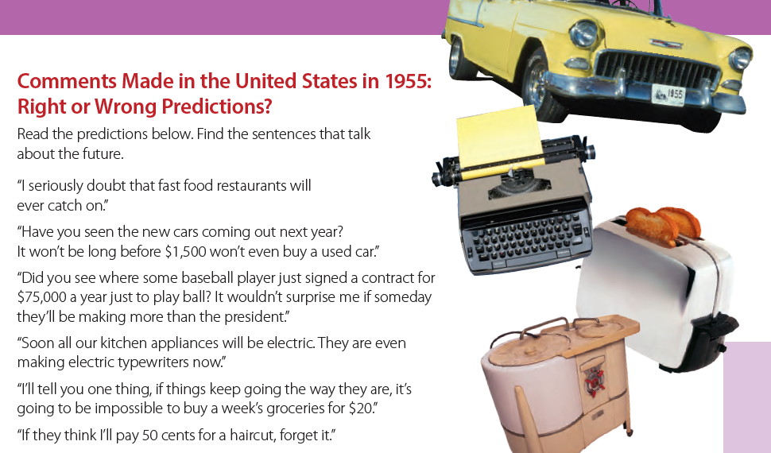
Listening
Can you tell me If the prediction was right or wrong.

Slide 17
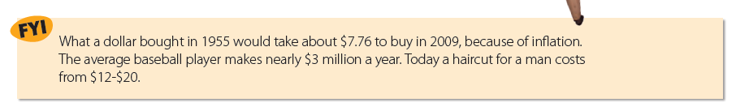

Slide 18
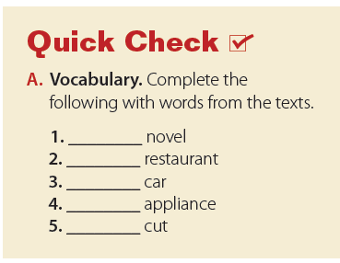
adventure
Fast food
used
kitchen
hair

Slide 19
