Slide 1

Unit 3
When Are You Travelling?
Form, meaning & function

Slide 2
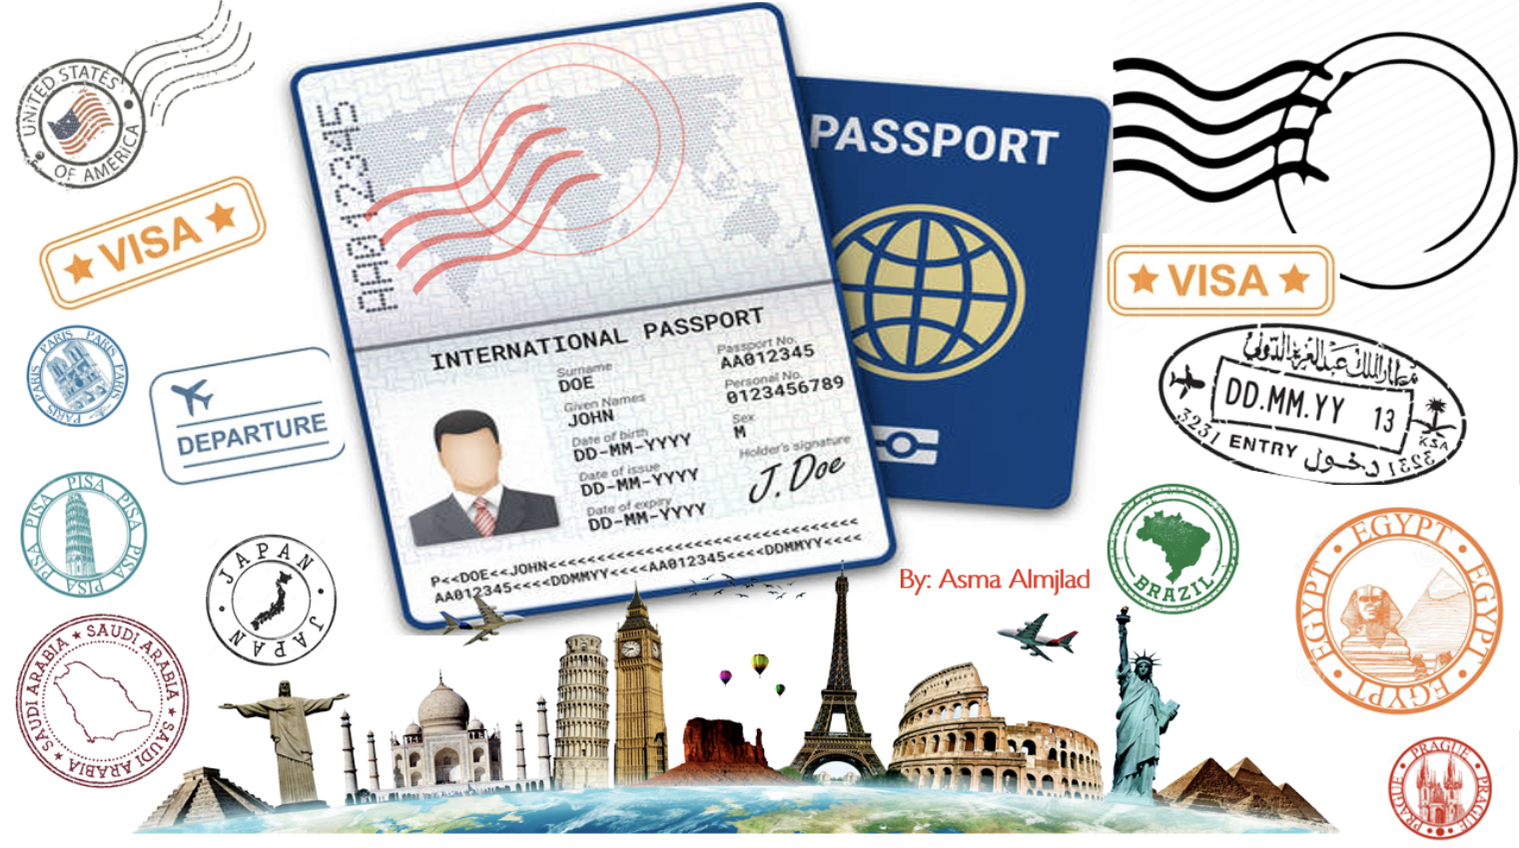

Slide 3
بسم الله الرحمن الرحيم
Day:
Date:

Slide 4


Learning Objectives
Use conjunction in time clauses correctly
identify the meaning of prepositions of movement
use prepositions of movement correctly

Slide 5
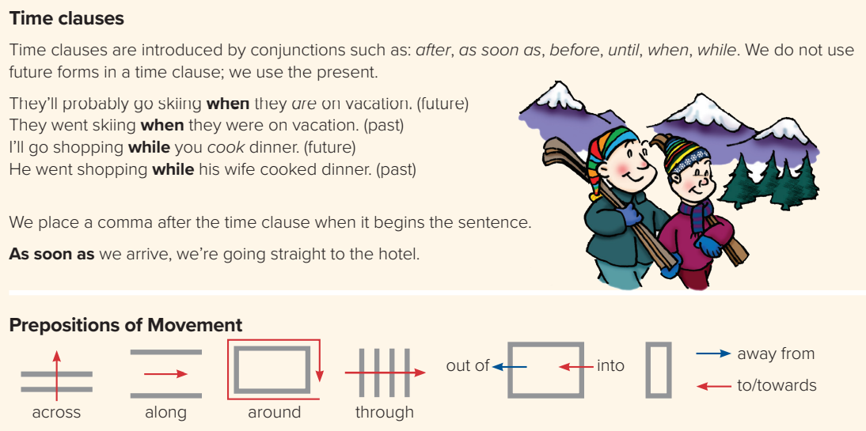
Page:31
I’ll text you as soon as l hear from them.
I’ll stop by after I finish work.
We can’t leave until the bell rings.
As soon as we get to Hawaii, we’re heading to the beach. When we get home, we’ll give you a call.

Slide 6

Let’s Practice

Slide 7
Page:30
Walk across the room.
Walk around the room.
Put your book into the bag.
Take your book out of the bag.
Go towards the door.
Move away from your desk.

Slide 8

Let’s Practice

Slide 9
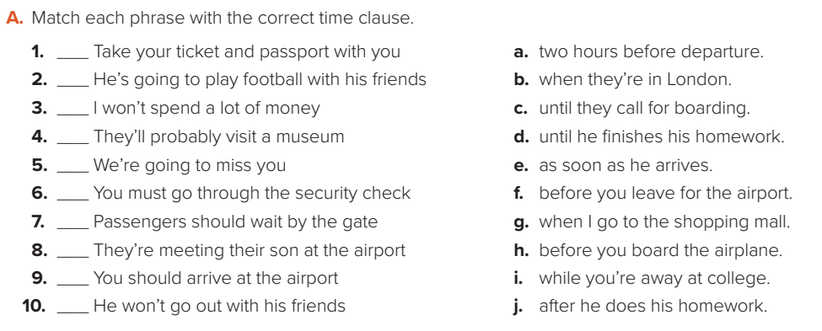
f
j
g
b
i
h
c
E
a
d

Slide 10
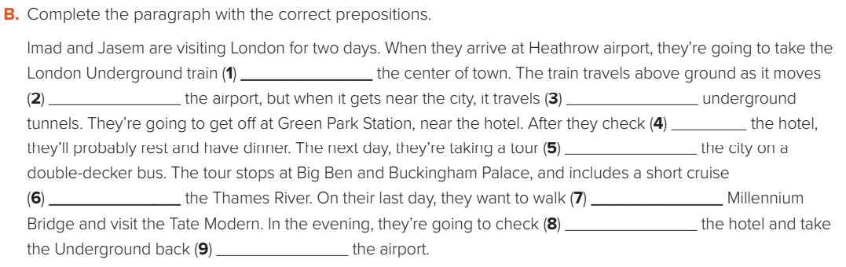
towards/to
away from
through
into
around
along
across
out of
to

Slide 11


Homework
( SINGLE LARGE HEADER )

