Slide 1
Mega Goal 1.1
Unit 2 - Careers
10 Writing
By: Essa Al Hussaini

Slide 2



Slide 3


Objectives
Take
notes on a written text
Write
a cover letter

Slide 4

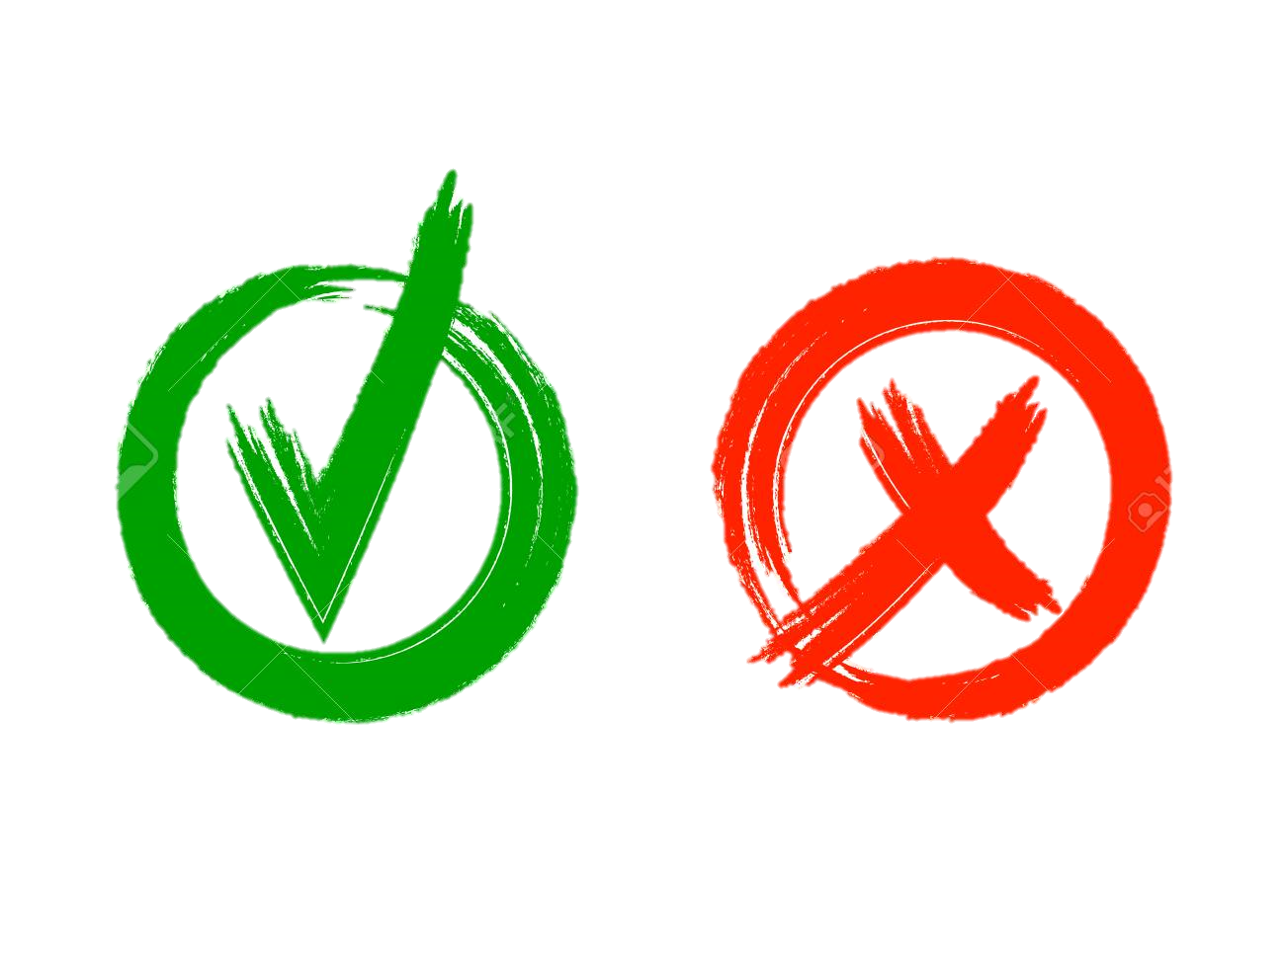
Revision
a Degree is a / an ......
experience
skill
qualification

Slide 5
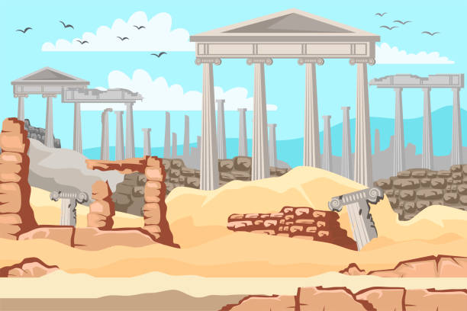
Revision
You have to be interested in historical sites and finding ancient things.
Archaeological intern
Environmental Engineer
Media Intern

Slide 6

Revision
hardworking,
patient,
working with others
are ……
Personal education
Personal award
Personal characteristic

Slide 7

Revision
An environmental engineer needs to be able to read …
cope with temperature
blueprints
newspaper

Slide 8
Revision
Integrity at work is a/an ......
Personal experience
Personal accommodation
Personal Quality

Slide 9



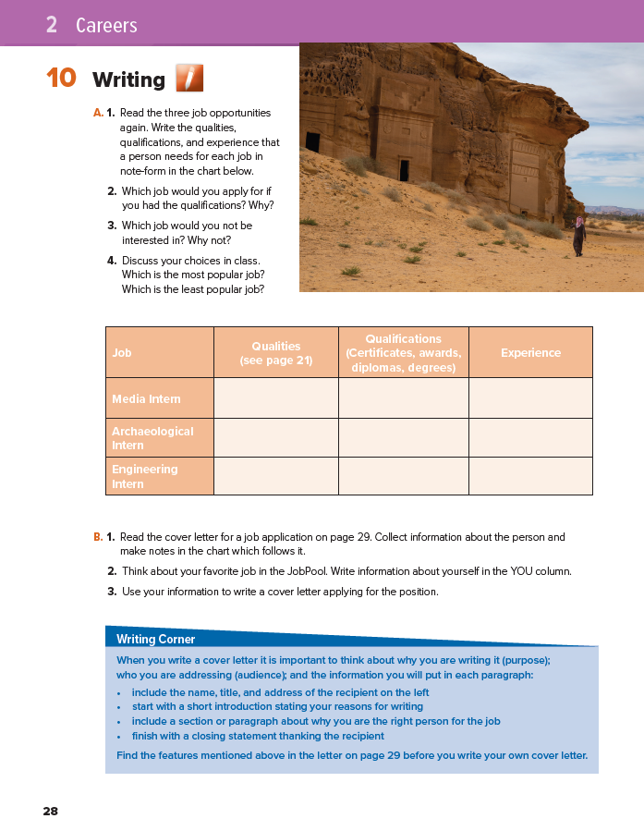
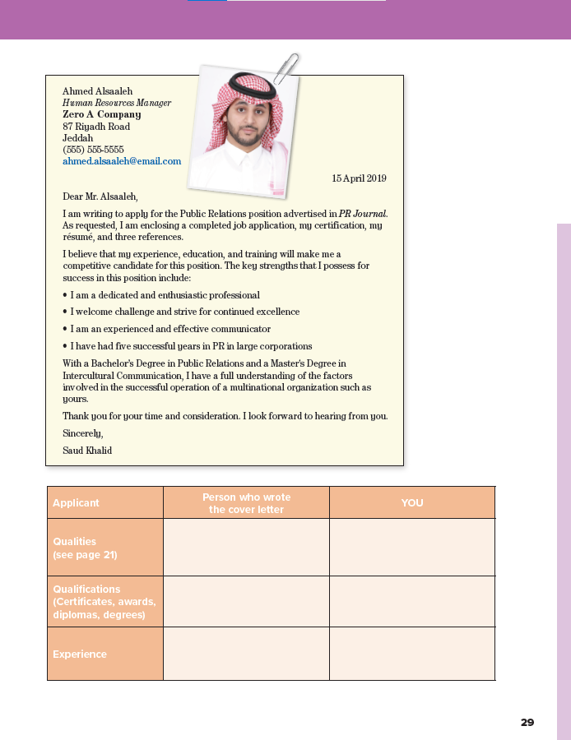

28-29

Slide 10
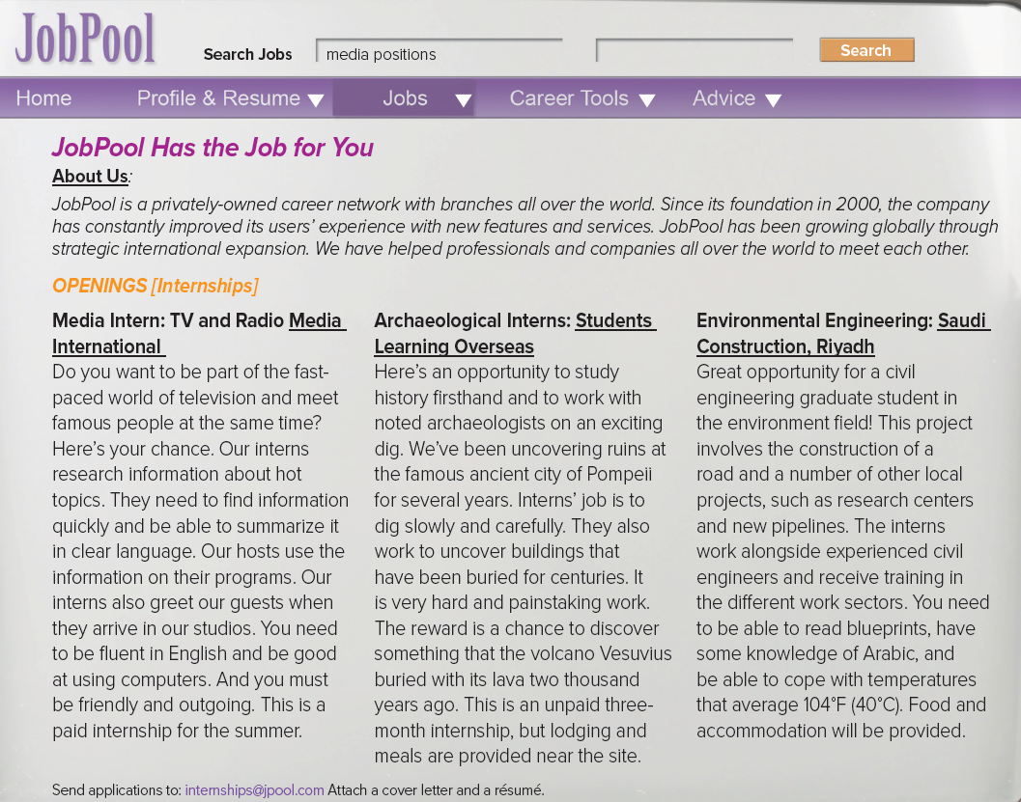


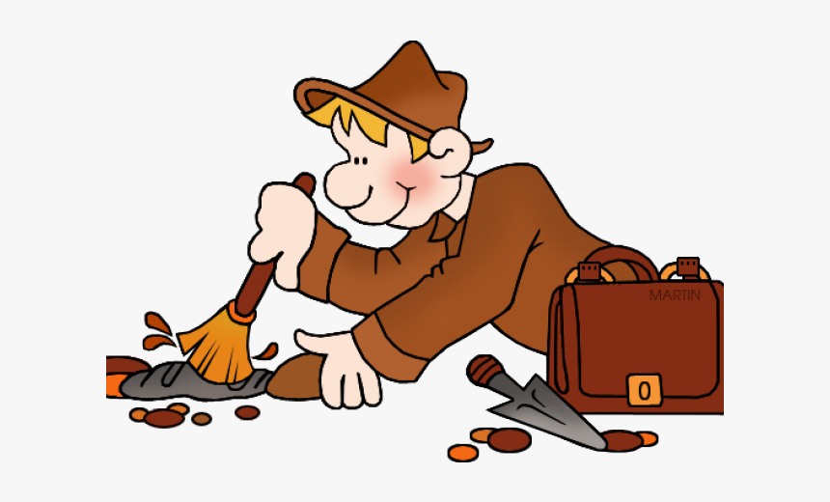
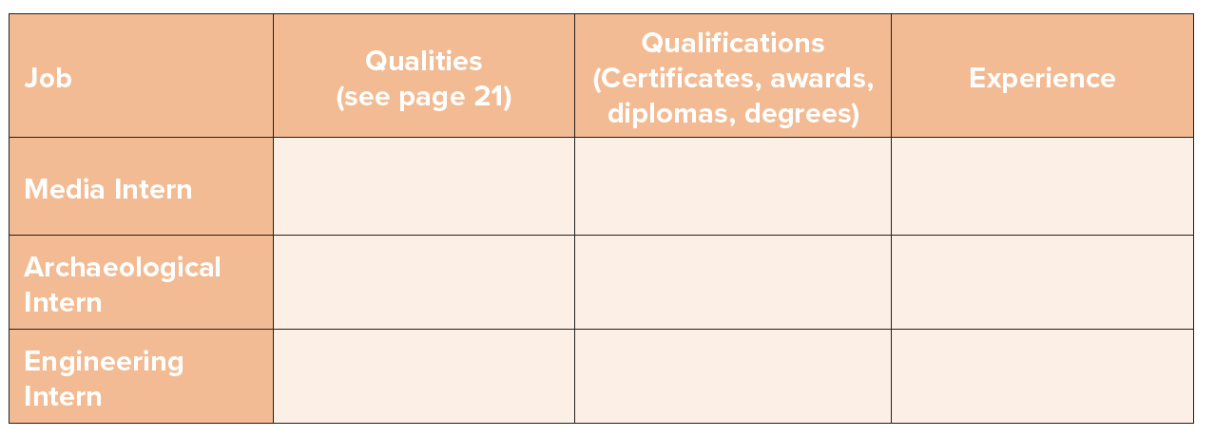



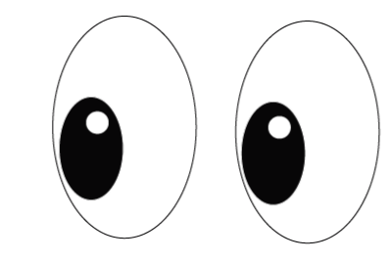
Read again and find

Slide 11
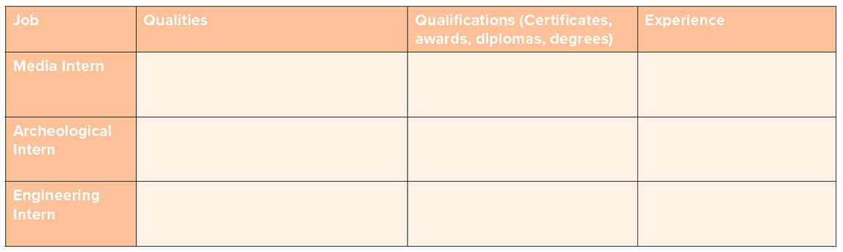

Slide 12
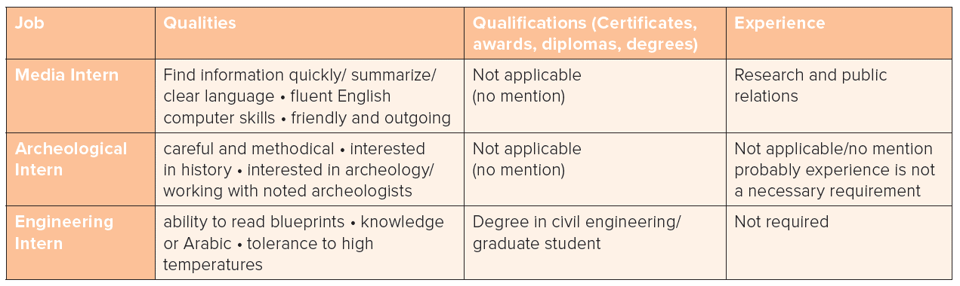

Slide 13
Why?
Why not?
I would / wouldn’t apply for …
because ….
Which job
would / wouldn’t
you apply for?

Slide 14


the most / least popular job is ..

Slide 15
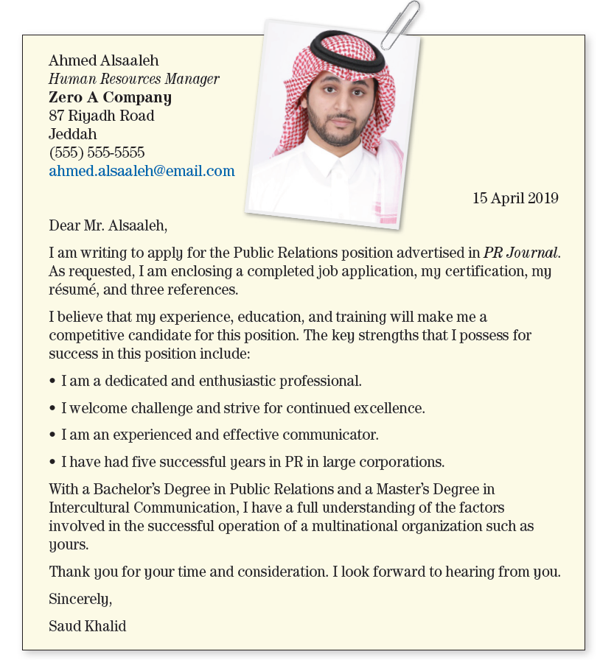
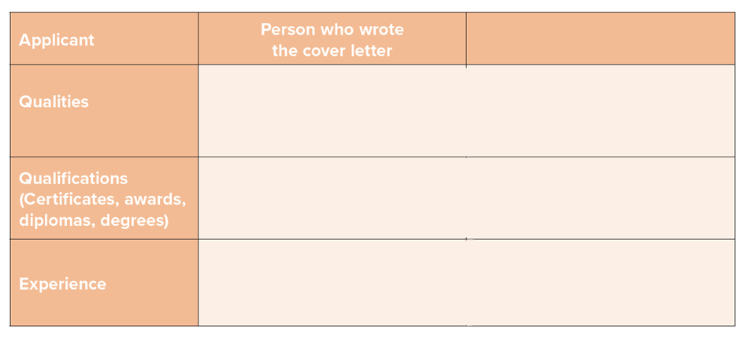
Read
cover letter
Collect
information
Make notes
- dedicated / enthusiastic
- competitive & strifeful to be excellent
- Communication skills
- Bachelor’s Degree in Public Relations
- Master’s Degree in intercultural communication
5 years in PR in large corporation
Notes:
A cover letter is a written document commonly submitted with a job application outlining the applicant's credentials and interest in the open position.
Since a cover letter is often one of only two documents sent to a potential employer,
a well- or poorly-written letter can impact whether the applicant is called for an interview.

Slide 16

your favorite job in the JobPool.
e.g.
Write information about yourself
- dedicated / enthusiastic
- competitive & strifeful to be excellent
- Communication skills
Communication skills
Interpersonal skills
Teamwork
- Bachelor’s Degree in Public Relations
- Master’s Degree in intercultural communication
Degree in Media
5 years in PR in large corporation
Host a TV program in 2018

Slide 17
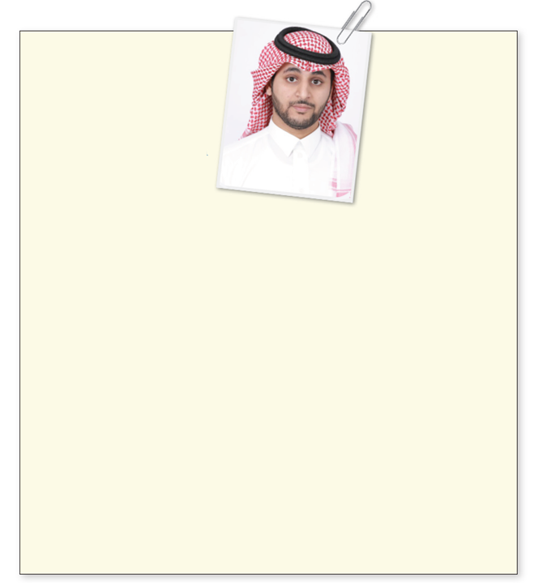
your favorite job in the JobPool.
Writing Corner
e.g.
Write information about yourself
When you write a cover letter it is important
to think about why you are writing it (purpose);
who you are addressing (audience); and the information you will put in each paragraph:
- dedicated / enthusiastic
- competitive & strifeful to be excellent
- Communication skills
Communication skills
Interpersonal skills
Teamwork
- Bachelor’s Degree in Public Relations
- Master’s Degree in intercultural communication
Degree in Media
5 years in PR in large corporation
Host a TV program in 2018

Slide 18
Recipient address
Writing Corner
When you write a cover letter it is important
to think about why you are writing it (purpose);
who you are addressing (audience); and the information you will put in each paragraph:
include the name, title, and address of the recipient on the left
start with a short introduction stating your reasons for writing
include a section or paragraph about why you are the right person for the job
finish with a closing statement thanking the recipient
introduction
reasons for writing
closing

Slide 19
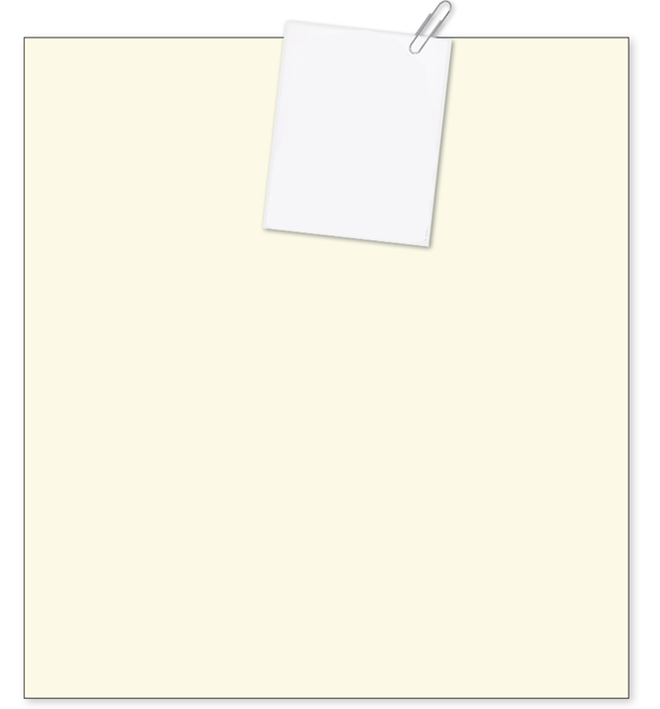
Recipient address
Use your information to write a cover letter applying for the position
A TV Host
introduction
Communication skills
Interpersonal skills
Teamwork
reasons for writing
HOMEWORK
Degree in Media
Host a TV program in 2018
closing
Notes:
A cover letter is a written document commonly submitted with a job application outlining the applicant's credentials and interest in the open position.
Since a cover letter is often one of only two documents sent to a potential employer,
a well- or poorly-written letter can impact whether the applicant is called for an interview.

Slide 20


Recipient address
Use your information to write a cover letter applying for the position
an interior designer
introduction
- good at communicating
- interested in working with people
- Friendly / creative / flexible
reasons for writing
It’s your choice
Degree in in Interior Design
Architecture course
Manager for 3 years in Furniture Design Company, Al-Ahssa
closing
Notes:
A cover letter is a written document commonly submitted with a job application outlining the applicant's credentials and interest in the open position.
Since a cover letter is often one of only two documents sent to a potential employer,
a well- or poorly-written letter can impact whether the applicant is called for an interview.

Slide 21


