Slide 1






Slide 2
Mega Goal 1.1
Unit 2 - Careers
9 Reading
JobPool
By: Essa Al Hussaini

Slide 3



Slide 4

Revision
day in a day out … means
same pattern
very bored
a positive event

Slide 5
Revision
talk me out of it … means
positive event
convince me
very bored

Slide 6
Revision
I didn’t feel safe.
______ I found a man guided me the way
bored to death
same pattern
luckily

Slide 7
Revision
It’s the same thing day after day.
I’m ________.
I need to change the routine
luckily
bored to death
very excited

Slide 8


Objectives
Analyze
information on a job website format
Discuss
other ways to find a job
Read
an article
Answer
questions on the reading text

Slide 9

Brainstorming
How can you find a job nowadays?
Notes:
You can find a job by checking
Online network, career fairs, search the internet, voluntary fairs, internship, recruitment agencies
Searching jobs using Internet can save time, money and convenient.

Slide 10
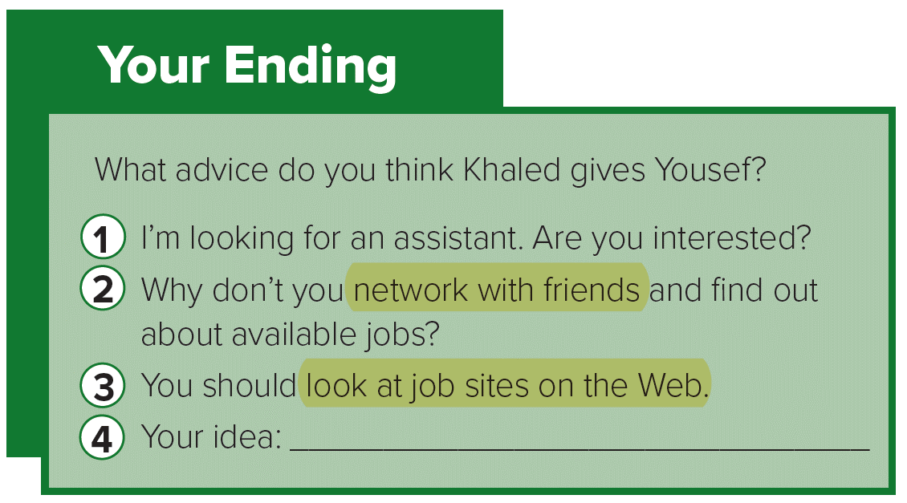
Advices from previous lesson

Slide 11
Reading Strategy
Analyzing Format

Slide 12




Format & design
Give you insight to the topic
Analyzing Format
Title
Let you predict the reading text
subtitles
Provide information

Slide 13
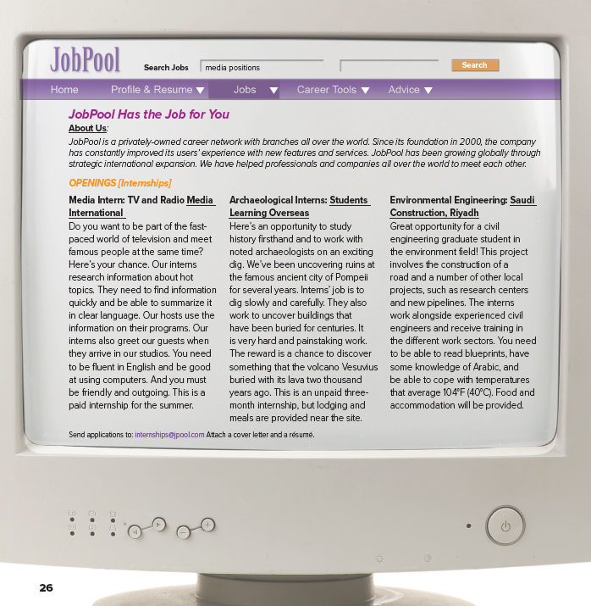
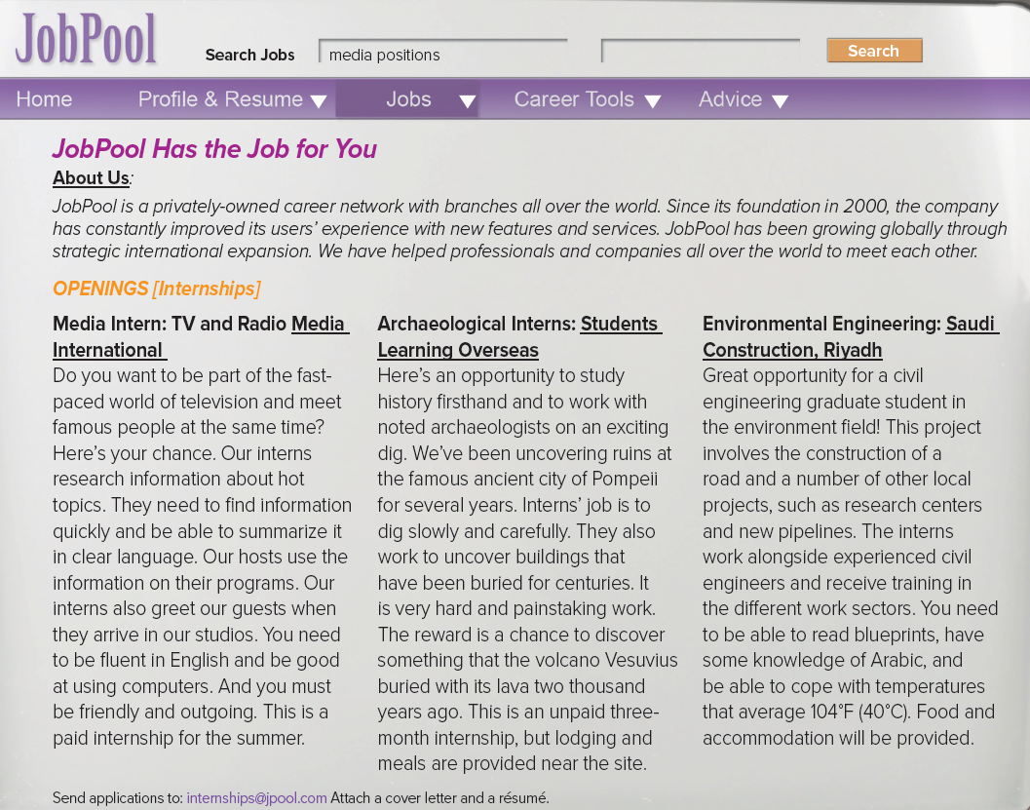

26

Slide 14
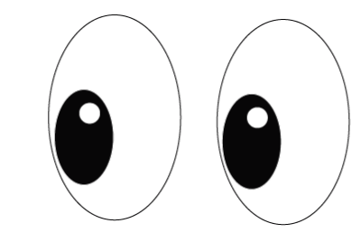
Where might you see like this?
Title?
Subtitles?
By the end of the lesson,
I will learn …..
How is it arranged?
Notes:
I WILL learn something related to job opportunities and time training
Internship = training time
the position of a student or trainee who works in an organization, sometimes without pay,
in order to gain work experience or satisfy requirements for a qualification.

Slide 15

find the sentences that say what a person should be able to do in each job
Notes:
Internship = training time
the position of a student or trainee who works in an organization, sometimes without pay,
in order to gain work experience or satisfy requirements for a qualification.

Slide 16

What should a person
be able to do in each job?

Slide 17
What should a person
be able to do in each job?
Which way ..
works best?
How do you find jobs NOWADAYS?
How was it in the past?
Notes:
You can find a job by checking
Online network, career fairs, search the internet, voluntary fairs, internship, recruitment agencies
Searching jobs using Internet can save time, money and convenient.

Slide 18

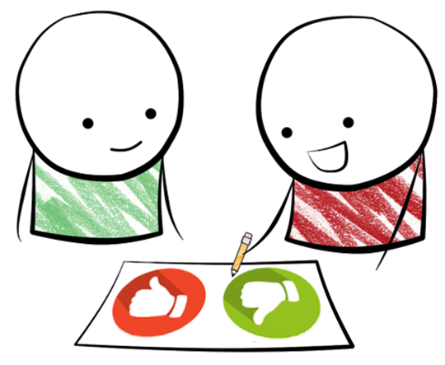
Additional Activity
Discuss
using internet job services
Pros
Cons

Slide 19

Read and describe
JobPool *
Notes:
JobPool is = website = a job site on the web : a career network to improve users’ experience with new features and services.
It has helped professionals and companies all over the world to meet each other.

Slide 20
Notes:
JobPool is = website = a job site on the web : a career network to improve users’ experience with new features and services.
It has helped professionals and companies all over the world to meet each other.

Slide 21



Listen and read along

Slide 22

Understanding Check
Is it a paid position?
What do TV interns research?
Is it
year-round?

Slide 23
Understanding Check
Where is the archeological internship?
What do you think characteristics needed are?
Is it a paid position?
hardworking,
patient,
working with others
How long is the internship?

Slide 24


Understanding Check
Who should apply for the internship in Saudi Arabia?
How to apply for the internship?
What will they do?
Skills needed?
What will be provided?
Notes:
a cover letter = a letter of application, is submitted with a résumé.
a very important part of the job-seeking process
It tells all about the candidate in just a few words.
The cover letter has to encourage companies to want to read the résumé.
It has to make the candidate stand out in some way.

Slide 25
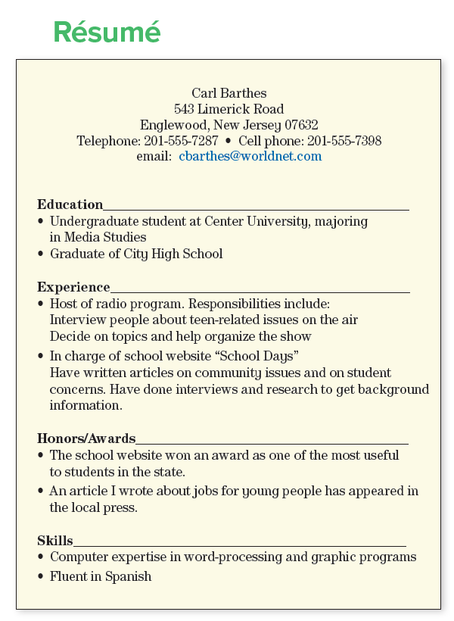

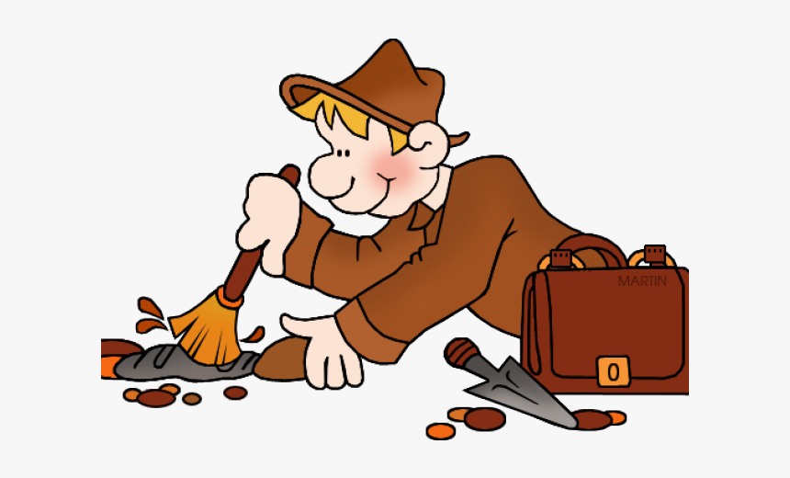

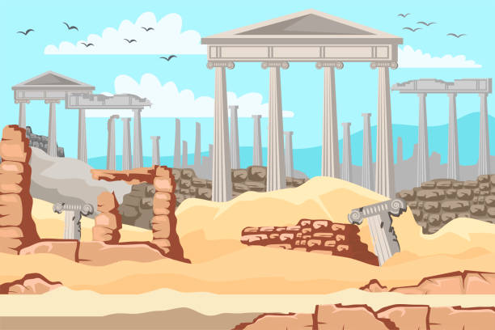

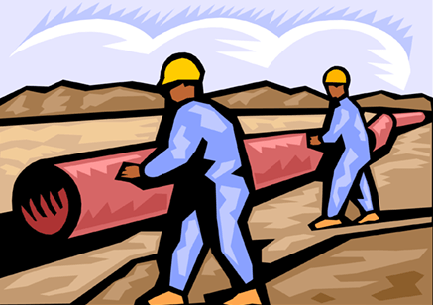
any unfamiliar words?
Notes:
a cover letter = a letter of application, is submitted with a résumé.
a very important part of the job-seeking process
It tells all about the candidate in just a few words.
The cover letter has to encourage companies to want to read the résumé.
It has to make the candidate stand out in some way.

Slide 26

Listen and follow along
RESUME is organized and ordered depending on the person and the job being applied for.

Notes:
pay attention to how RESUME is organized.
The different sections (Education, Experience, etc.) are typically included,
but that the order may vary depending on the person and the job being applied for.
For example,
someone with the required skills, but not a lot of work experience,
may decide to list skills first.

Slide 27
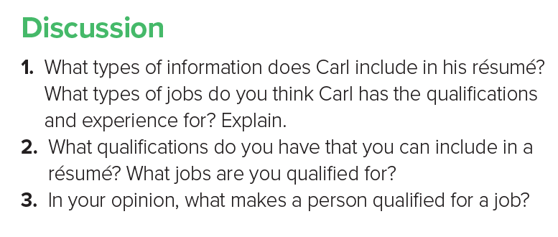

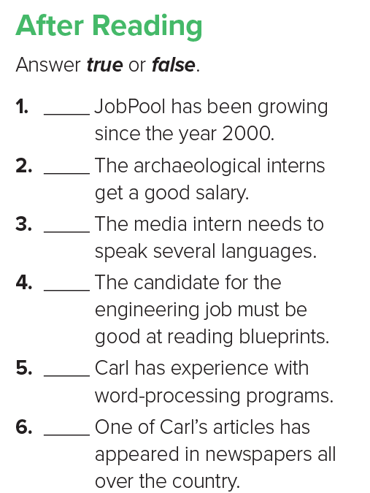
Notes:
pay attention to how RESUME is organized.
The different sections (Education, Experience, etc.) are typically included,
but that the order may vary depending on the person and the job being applied for.
For example,
someone with the required skills, but not a lot of work experience,
may decide to list skills first.

Slide 28

T
F
F
T
T
F
Show all
Notes:
pay attention to how RESUME is organized.
The different sections (Education, Experience, etc.) are typically included,
but that the order may vary depending on the person and the job being applied for.
For example,
someone with the required skills, but not a lot of work experience,
may decide to list skills first.

Slide 29


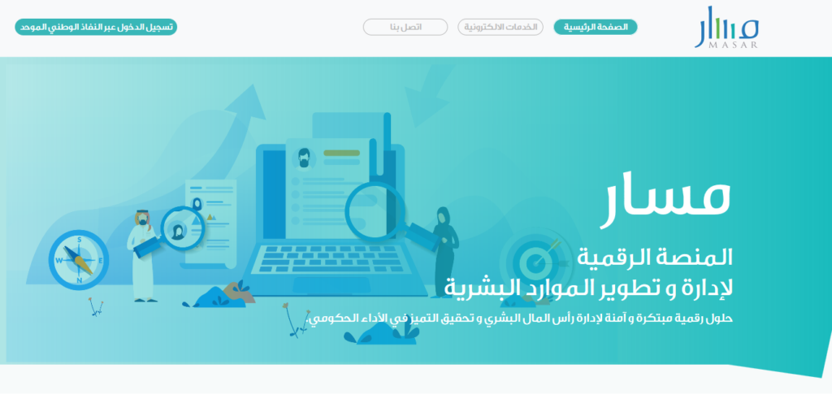

Slide 30
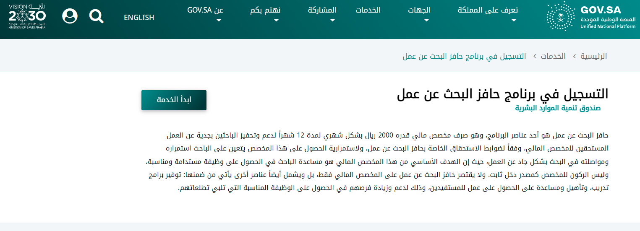


Slide 31
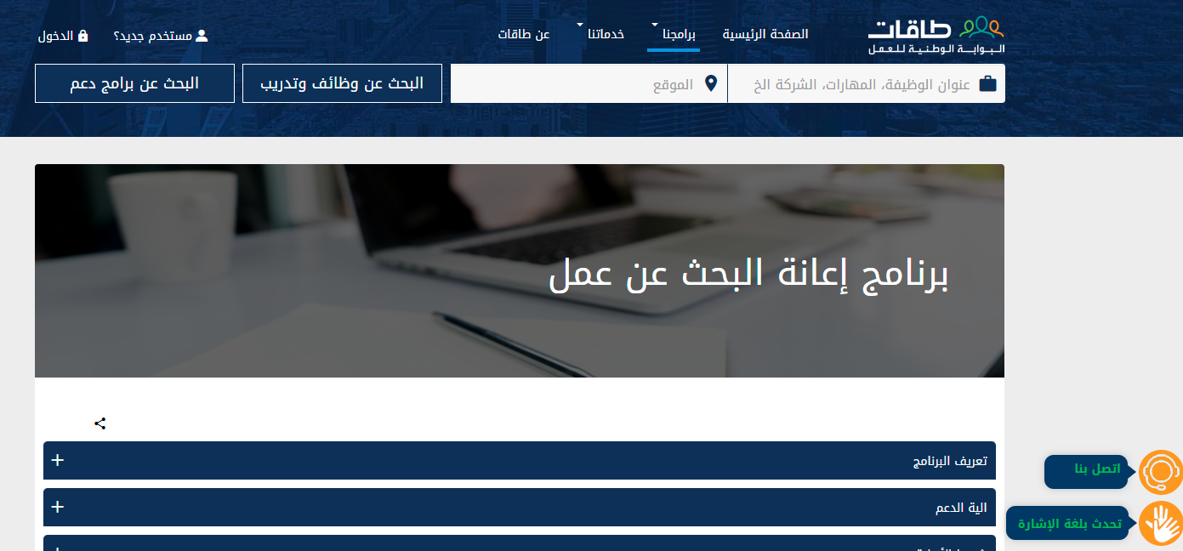


Slide 32


