Slide 1

My body
We can 1
Unit : 2
Lesson:1
Tr: Kholoud AlGhamdi

Slide 2
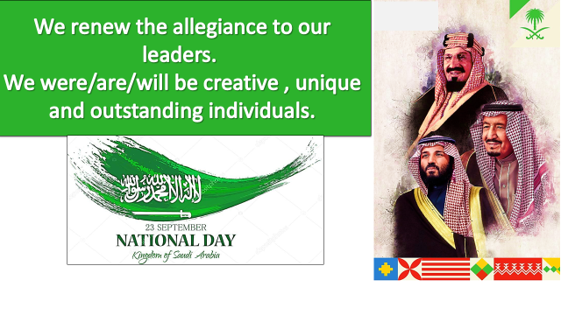
Have you celebrated Saudi national day?

Slide 3
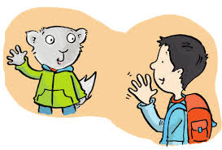
Say hi to Safroot…
Hello,,
How are you?
Hi Safroot,,
I’m fine thanks

Slide 4



Name some colors you took last unit
What is your favorite color?

Slide 5

Objectives:
1- to introduce the body parts..
2- to listen and do the body actions
3- practice saying close and open your eyes..
4- to write letters I and j .

Slide 6
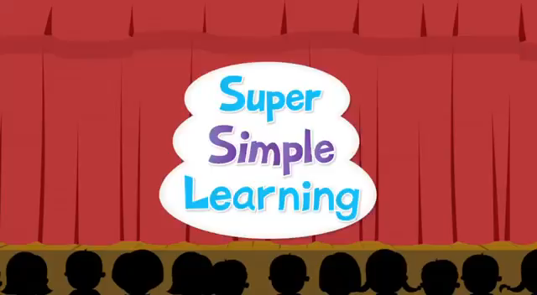
..

Slide 7
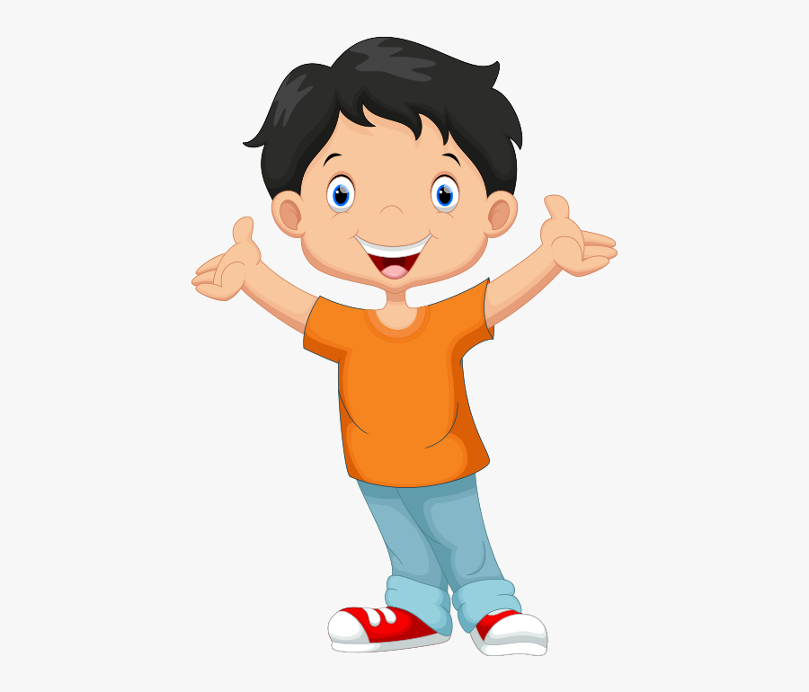
My body
body

Slide 8

eyes
eye

Slide 9

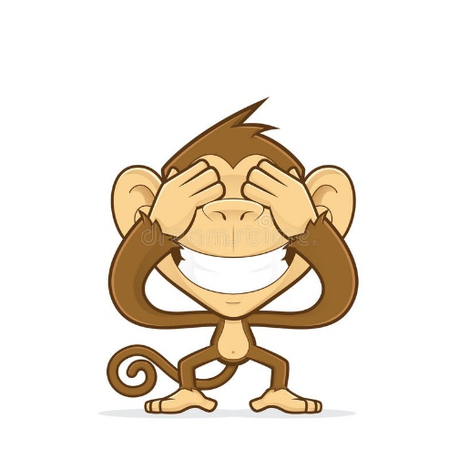
Close your eyes !!

Slide 10
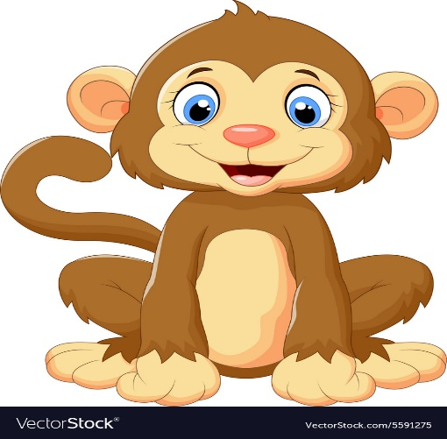
Open your eyes !!

Slide 11
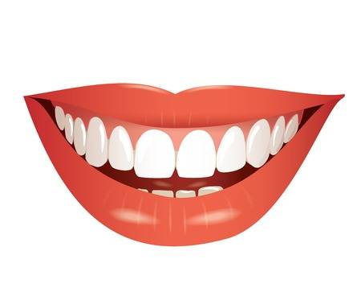
Mouth
قال الله (ولا يغتب بعضكم بعضا)

Slide 12
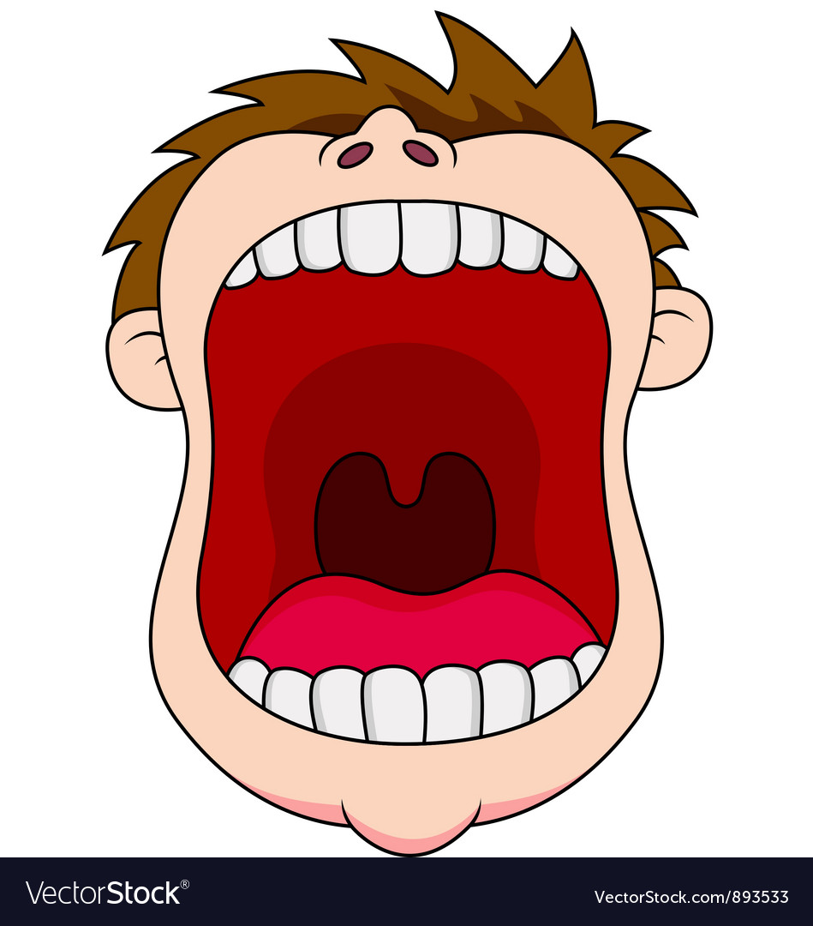
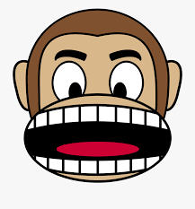
Open your mouth !!!

Slide 13
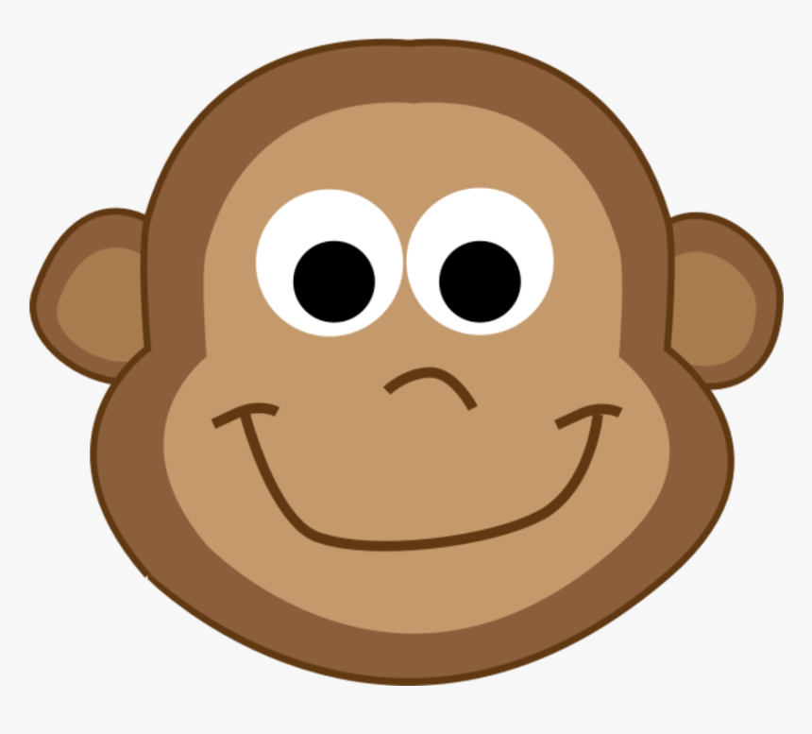
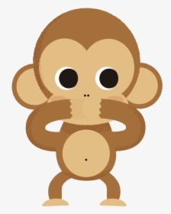
Close your mouth !!

Slide 14
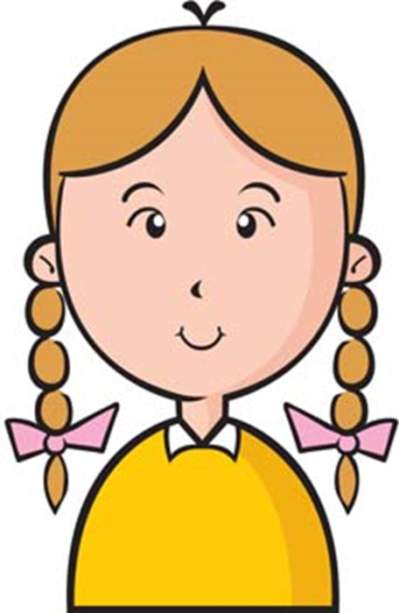
Head
head

Slide 15
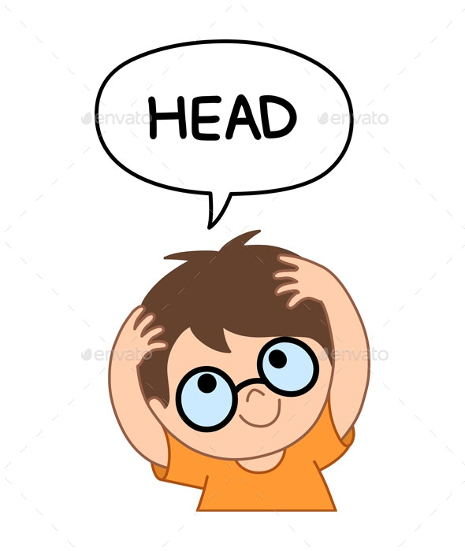
Touch your head !!

Slide 16
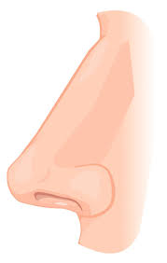
Nose

Slide 17
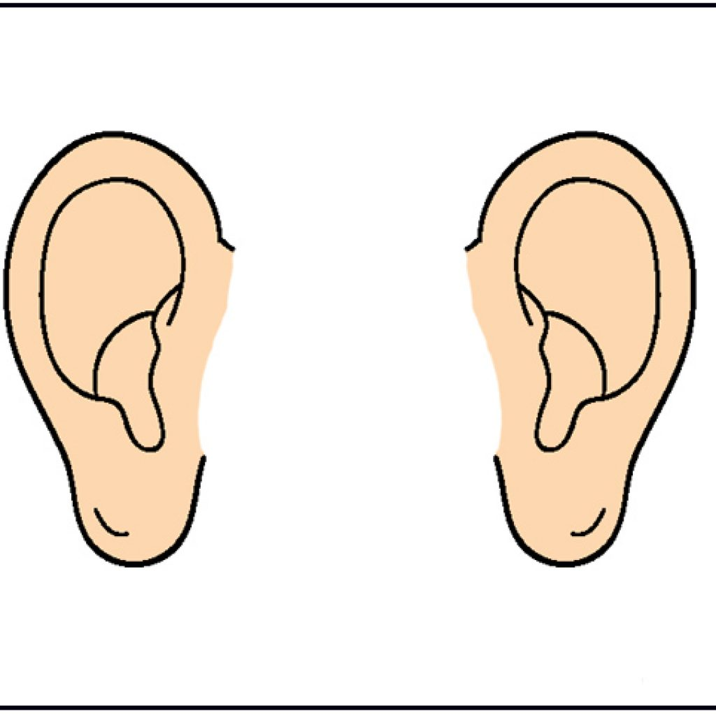
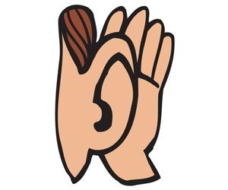
ears
How many ears do you have ??
ear

Slide 18
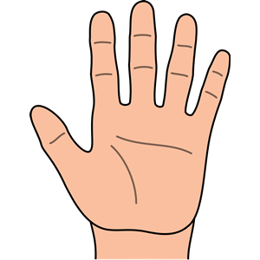
hand
How many hands do you have ??

Slide 19
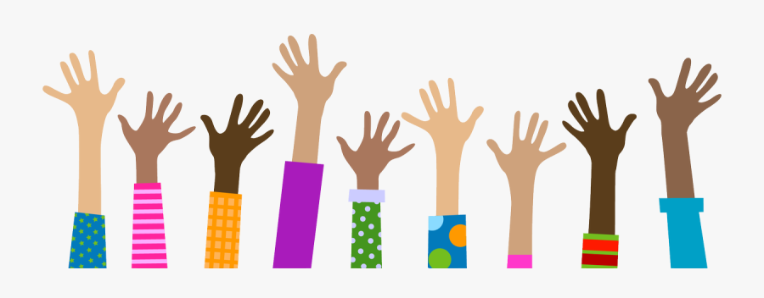
Raise your hands!!
hands

Slide 20
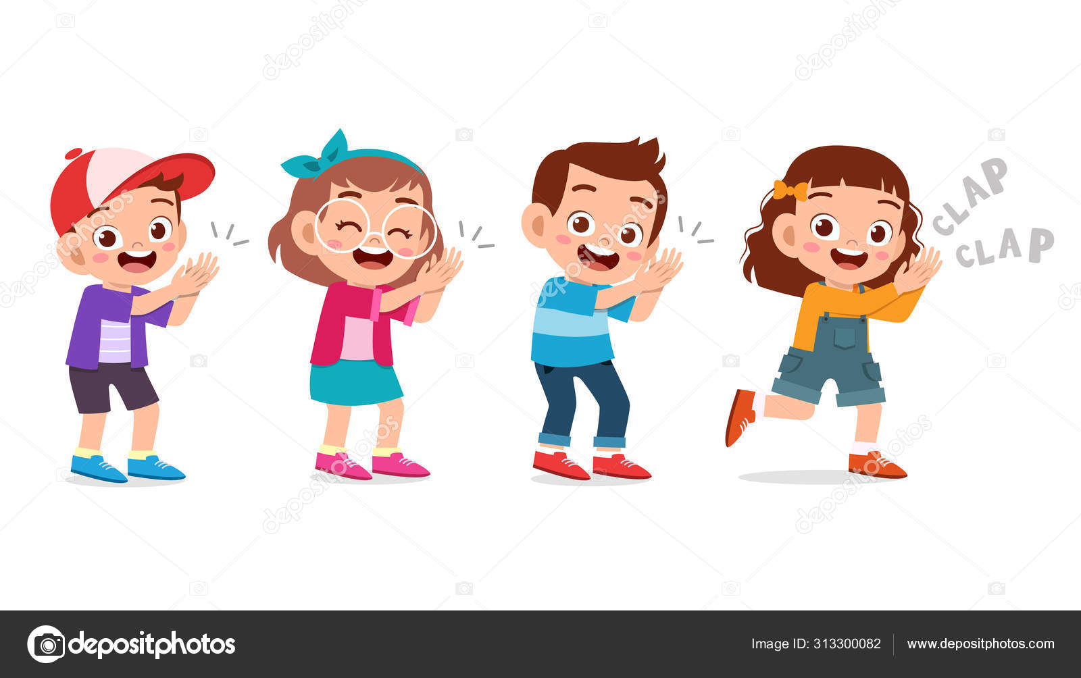
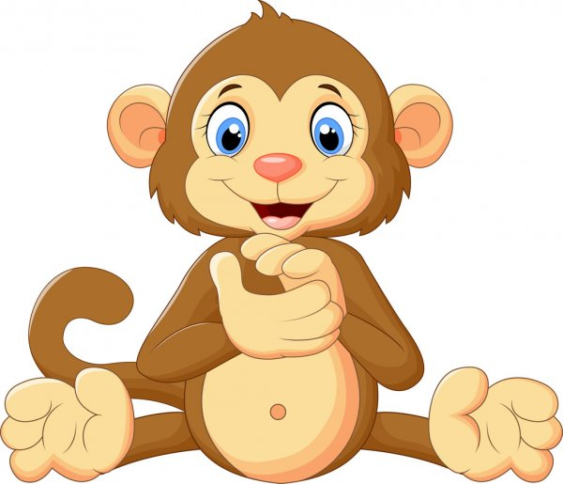
Clap your hands !!

Slide 21
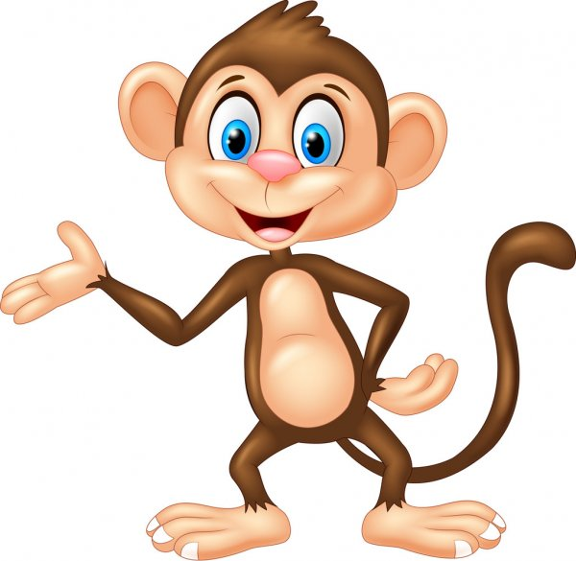
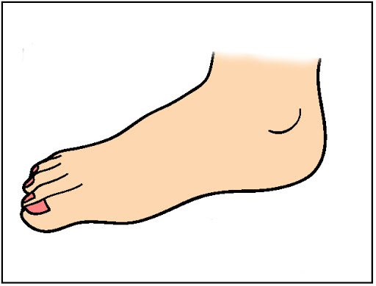
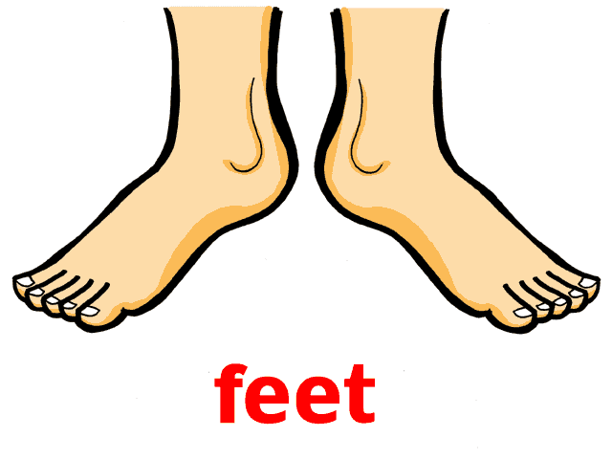
foot
Do you have three feet ?

Slide 22
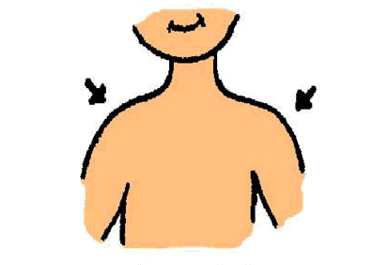
shoulders

Slide 23
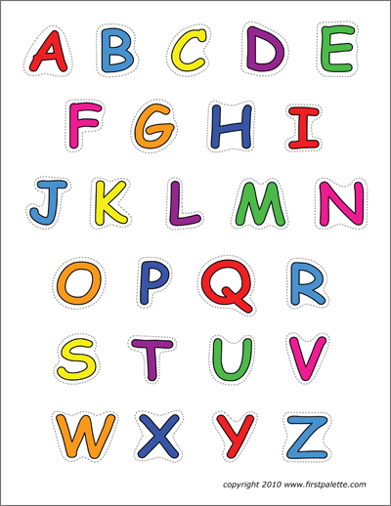

Let’s chant ..

Slide 24


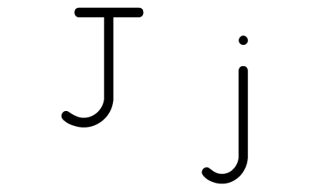
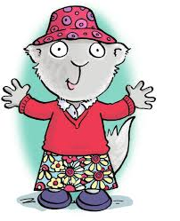
..

Slide 25
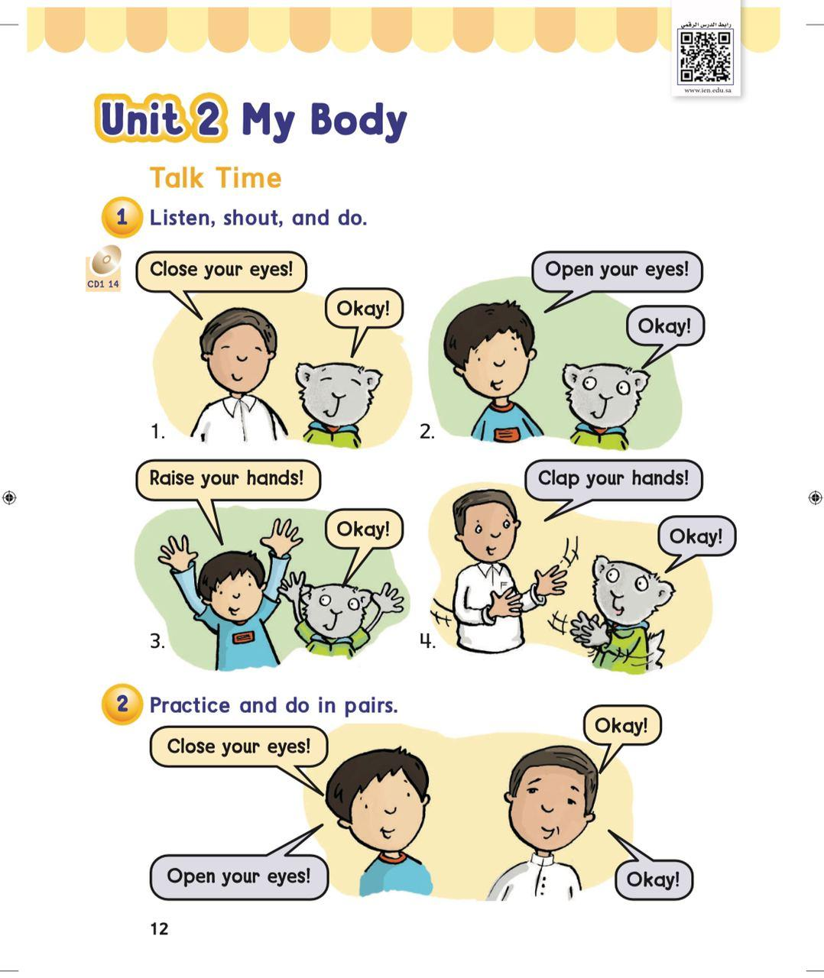
Open your books.. P12

Slide 26
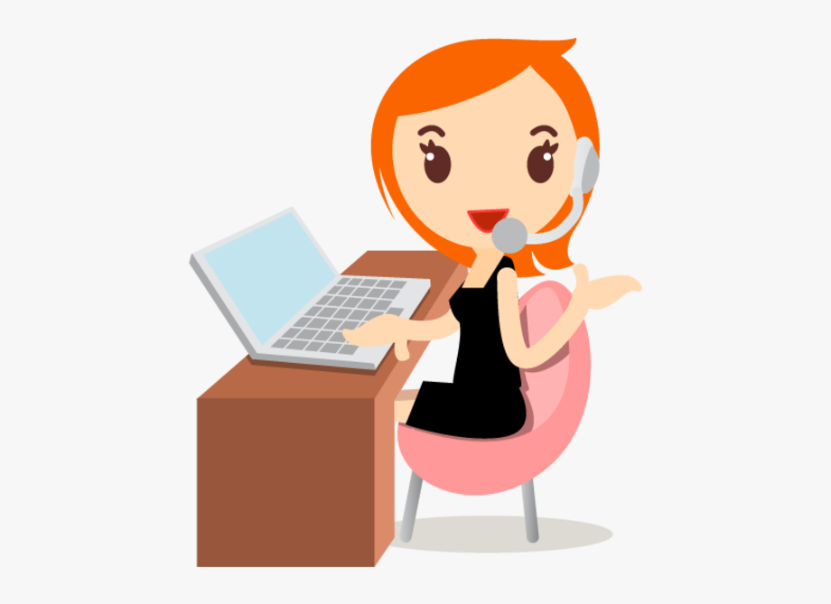
Have a nice day
Good bye..
Tr : Kholoud Al Ghamdi

