Slide 1
Unit 2
Influential People
Form , Meaning & Function
Mega Goal 3.1
Done by : Entisar Al-Obaidalla

Slide 2
Lesson Objectives
01
02
03
Use
Use
Ask
04
05
06
Differentiate
Ask and Talk
Apply
the present perfect simple tense
Time expressions with for and since correctly
Questions with : How long ……..? Correctly
Between the past simple and the present perfect tense
About personal experience using : Have you ever ……?
The rules to do the exercises

Slide 3
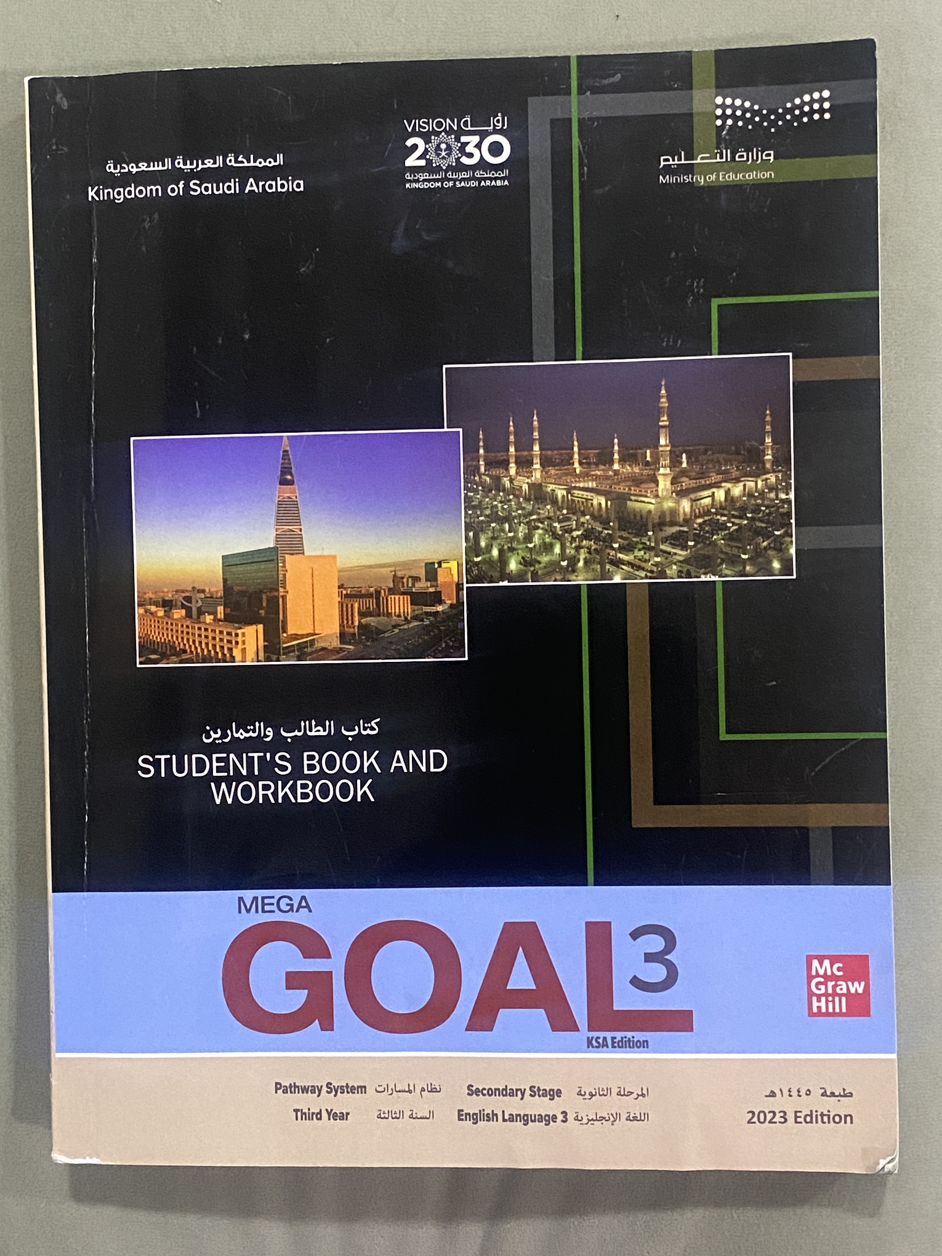
Open your student’s book p. 30

Slide 4
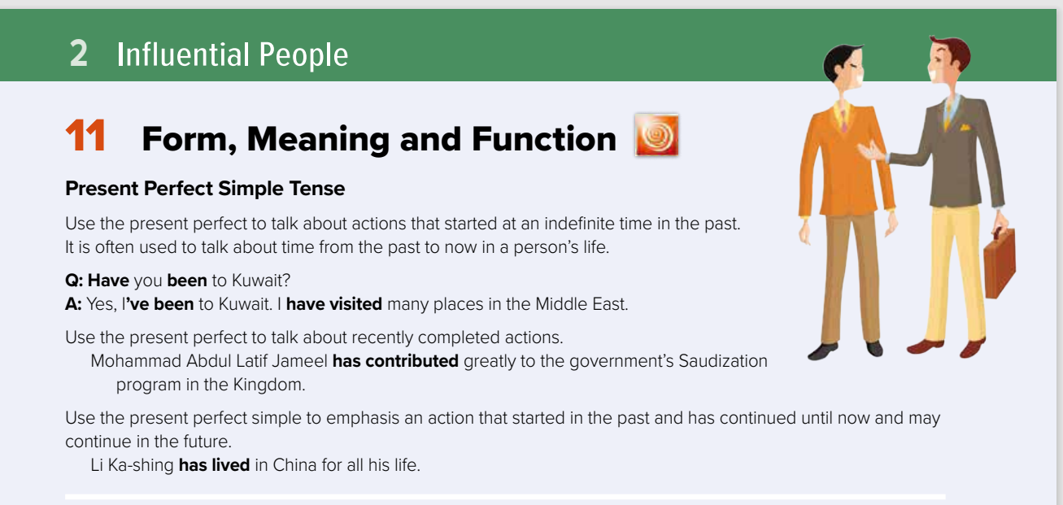

Slide 5


Form :
LET’S
LOOK
AT THE
FORMIT.
I have + v .p.p (3)
You have worked
We have written
They
He has + v .p.p (3)
She has worked
It has written
I haven’t + v .p.p (3)
You haven’t worked
We haven’t written
They
He hasn’t + v .p.p (3)
She hasn’t worked
It hasn’t written
ed (regular)
3 (irregular

Slide 6
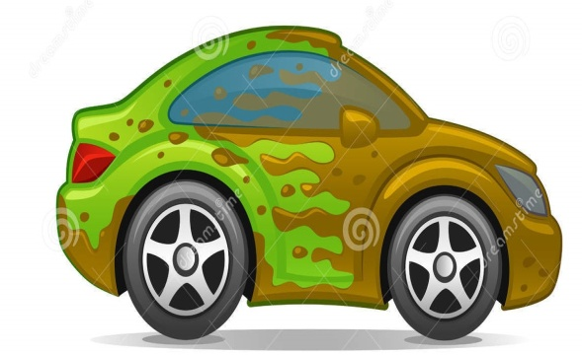
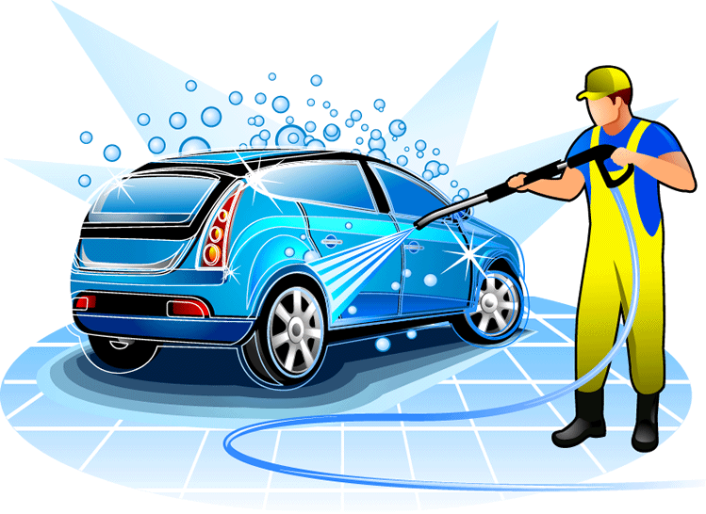
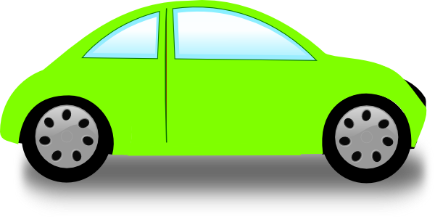
LET’S
LOOK
AT THE
USES
1. For an action that happened in the past but whose results are obvious in the PRESENT.
Ali’s car is dirty.
He washes the car.
He has washed the car.
to emphasize the result of the action which is complete now

Slide 7


LET’S
LOOK
AT THE
USES
2. For an action that has JUST finished.
Maher is eating lunch.
 He has just eaten lunch.
Time expression:
just

Slide 8


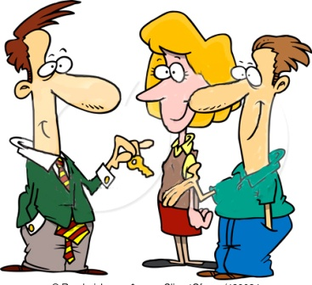


3. For an action that started in the past and hasn’t finished.
LET’S
LOOK
AT THE
USES
We bought the house in 2000.
We still live in the neighborhood.
We have lived here for 15 years.
We have lived here since 2000.
Time expressions: for, since

Slide 9
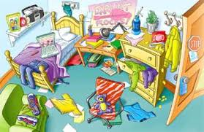

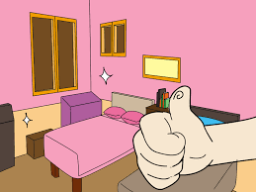

LET’S
LOOK
AT THE
USES
4. For an action that happened in unspecified time.
The children have tidied their room.

Slide 10
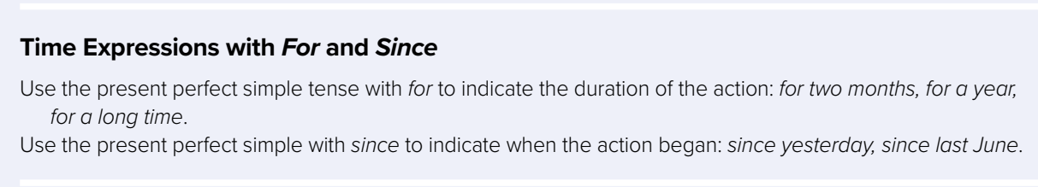
For and Since

Slide 11
eight o’clock.
Tuesday.
2020.
I have been here since May.
April 3, 2001.
yesterday.
last month.
For:To indicate the duration of the action ..
Examples:
For two months , for a year , for a long time…
ten minutes.
two hours.
five days.
I have been here for about two weeks.
almost six months.
many years.
a long time.
Since:To indicate when the action began ..
Examples:
Since yesterday , since last June , since the morning

Slide 12
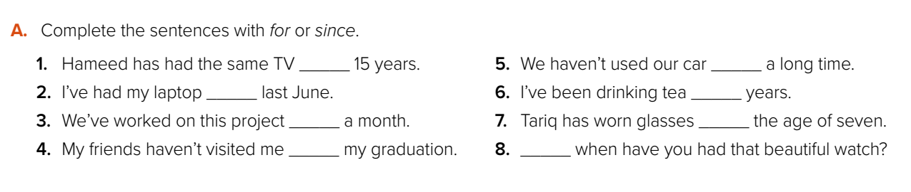
for
for
since
for
for
since
since
since

Slide 13

How long …..?

Slide 14
How Long ?
how long = كم مدة
Q: How long has the clothing store been in operation?
A: It has been in operation since 1975.
A: It has been in operation for 40 years.

Slide 15
Open your student’s book p. 31

Slide 16
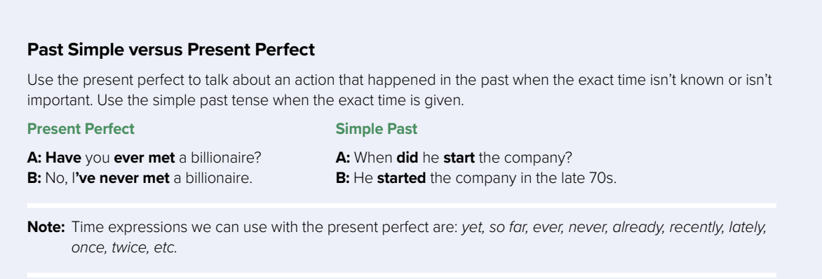

Slide 17
Past Simple vs Present Perfect
Present Perfect
Past Simple
Time is specific
Time isn’t specific
Use the present perfect to talk about an action that happened in the past when the exact time isn’t known or isn’t important.
Present Perfect
A: Have you ever met a billionaire?
B: No, I’ve never met a billionaire.
Use the simple past tense when the exact time is given.
Simple Past
A: When did he start the company?
B: He started the company in the late 70s.

Slide 18
Note:
Time expressions we can use with the present perfect are:
yet, so far, ever, never, already, recently, lately, once, twice, etc.

Slide 19
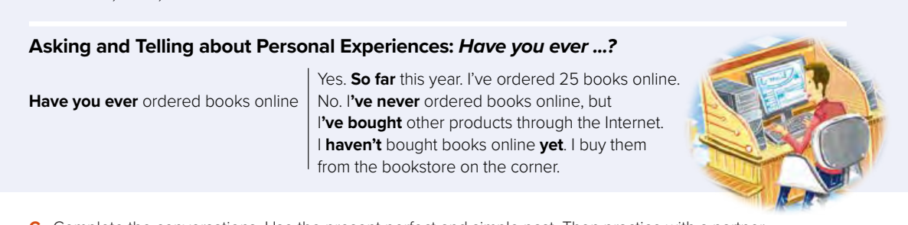
Asking and telling about Personal Experience

Slide 20
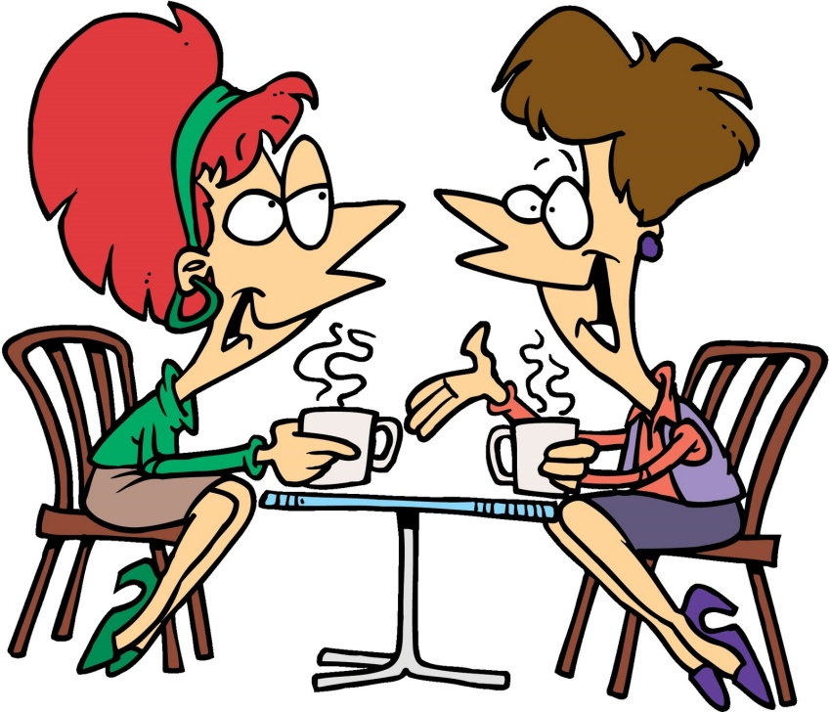
To talk about personal experiences ..
Have you ever been to London?
Of course , I have been to London a lot of times .It is such an amazing city

Slide 21
Authority
Present Perfect | Past Tense
have/has + verb 3 (participle) | Verb 2
Happened in the past until present (effect or event) | Happened in the past, ended in the past
He has drunk all of the milk. We need to buy some more for tomorrow | He drank all of the milk this morning. Thus, he often went to toilet.
He has waited for your for a long time. Go and meet him for once | He waited for two hours, then he left.

Slide 22
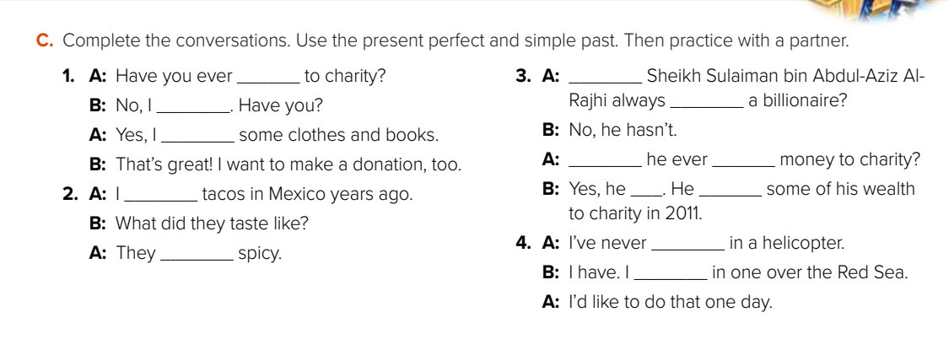
given
Has
Haven’t
been
gave
Has
given
ate
has
given
been
were
flew

Slide 23
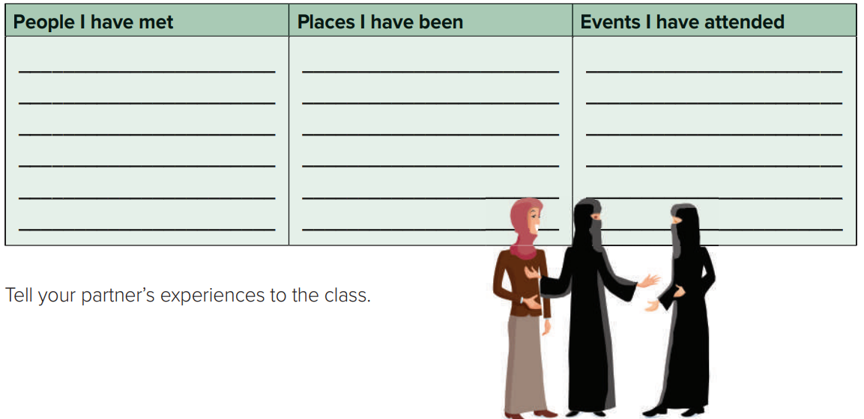

Slide 24
Homework your workbook p. (240) , exercise ( O)

Slide 25

Thanks!

