Slide 1
Unit 2
Influential People
Writing
Mega Goal 3.1
Done by :Entisar Al-Obaidallah

Slide 2
Lesson Objectives
Fill in
the blanks with suitable word or phrase
1
3
2
Read
Write
the text for specific information
a descriptive
essay about a famous and/or wealthy person.

Slide 3
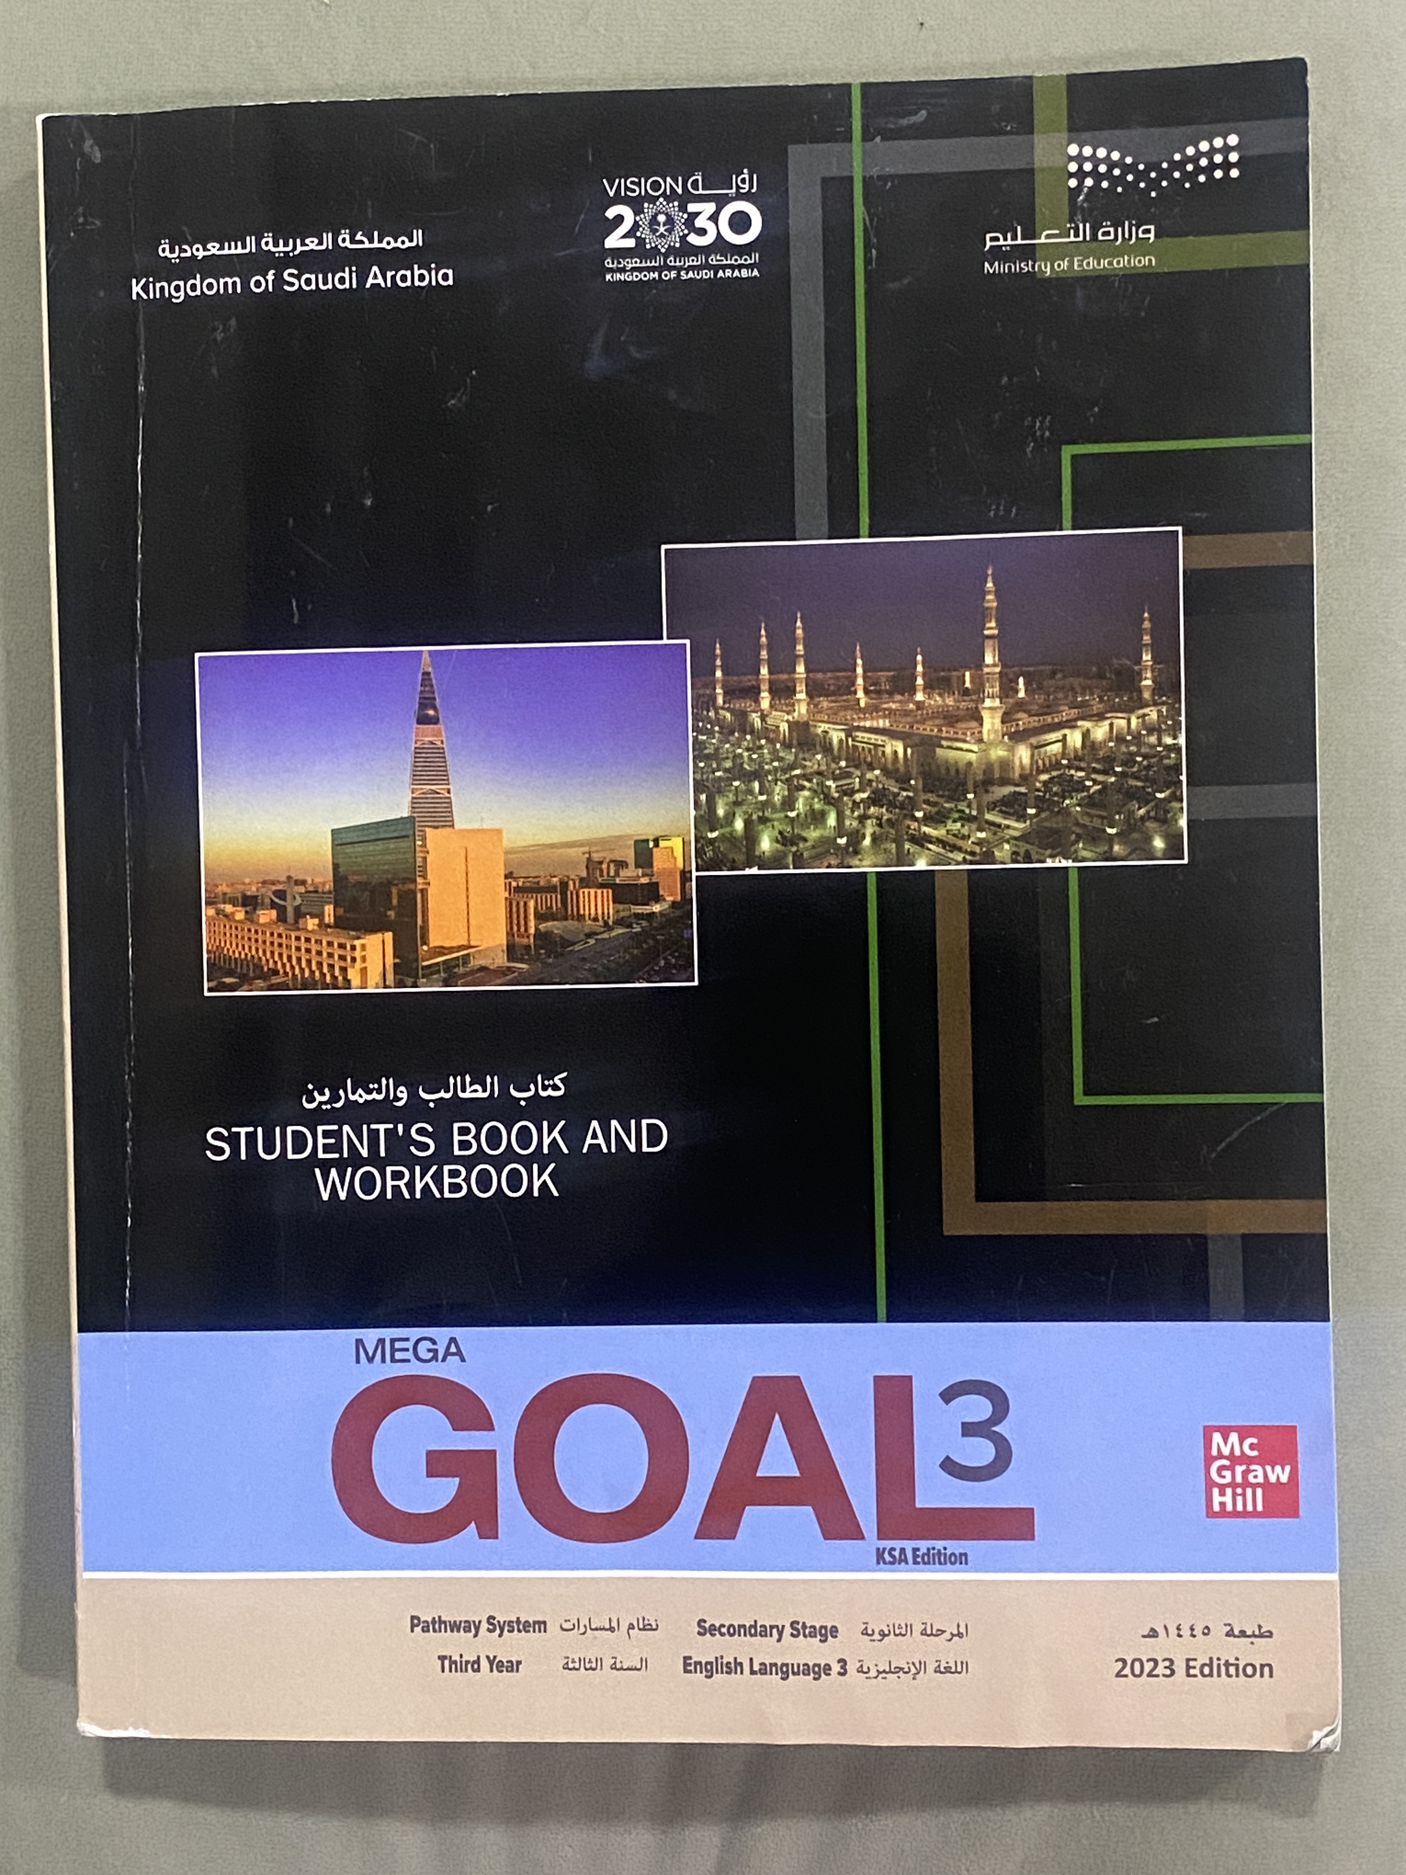
Open
Your student's book P. 28

Slide 4
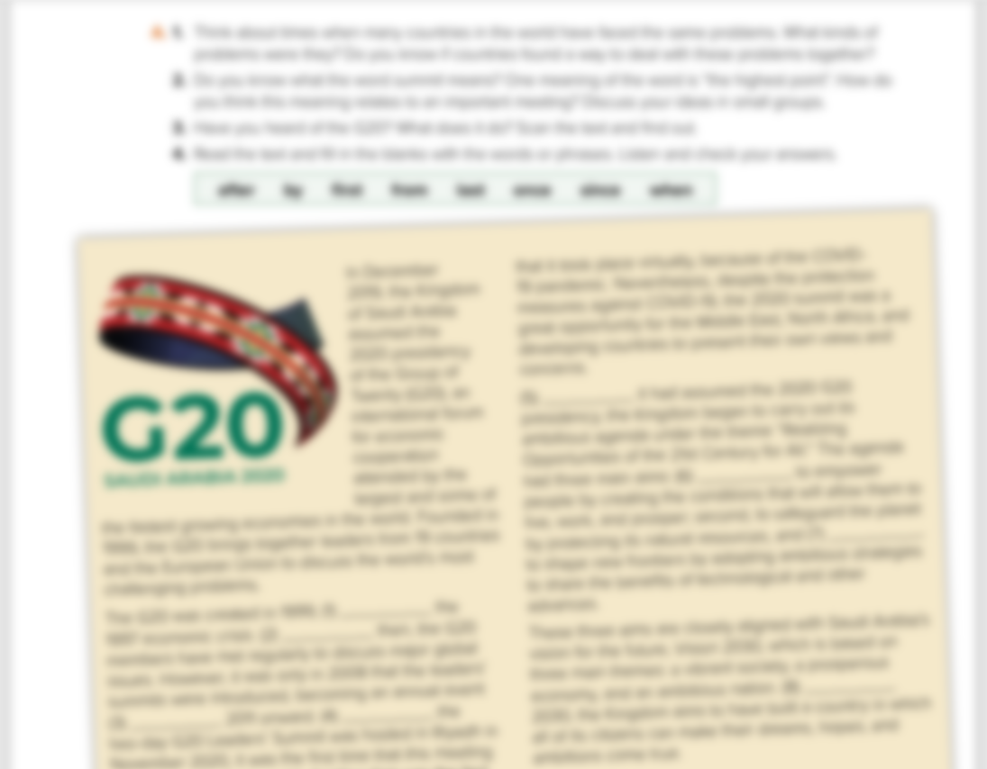
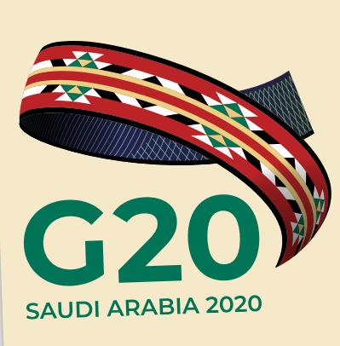

What does the picture represent?
Can you guess the meaning of the word “summit.”
Can you tell me some information about the G20

Slide 5
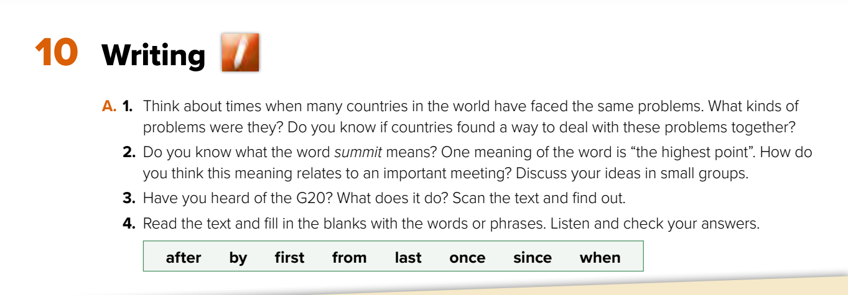
2- A summit is a meeting of different countries’ leaders or heads of government.
The G20 is an international forum that brings together the leaders
from 19 countries and the European Union to discuss the world’s
most challenging problems

Slide 6
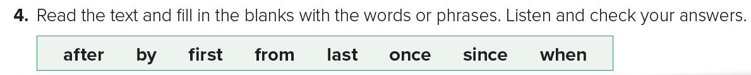

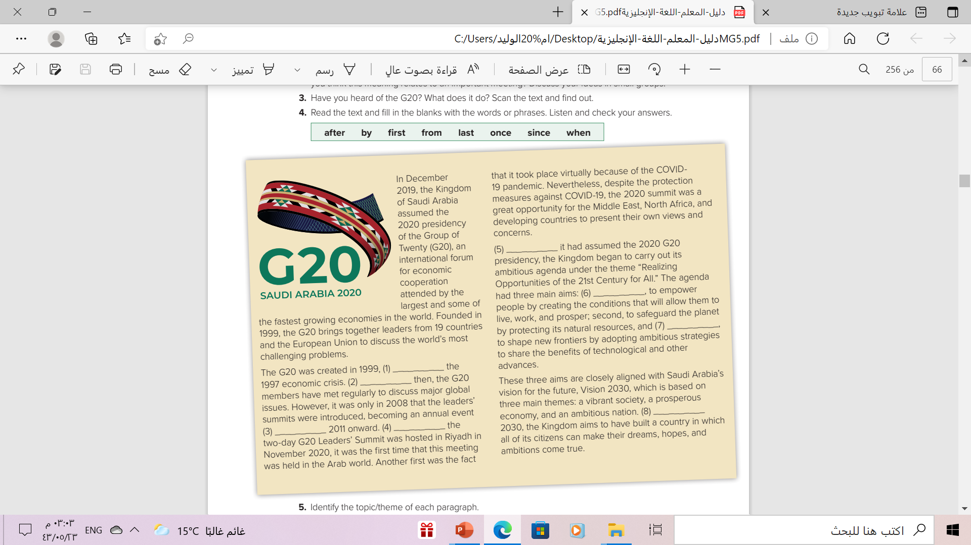
once
first
last
after
since
by
from
when

Slide 7
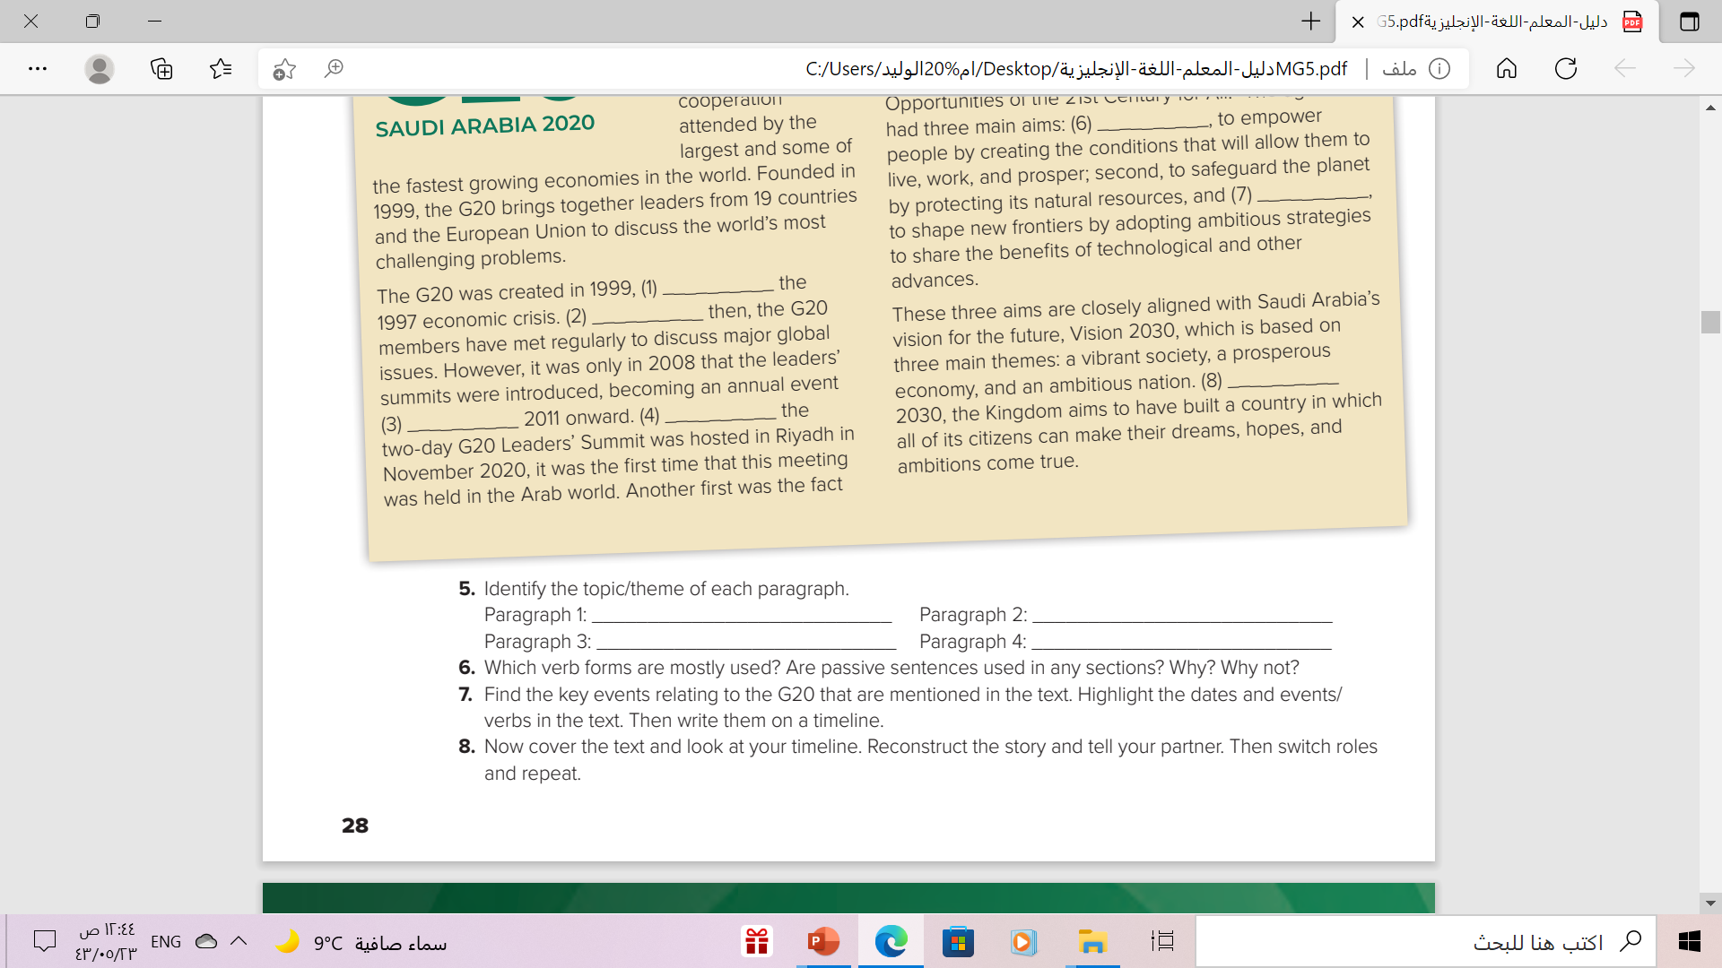
Answer these questions
what (G20) is and does
The G20 Leaders’ Summit
The aims of Saudi Arabia’s G20
presidency
The link between the Kingdom’s G20 aims and Vision 2030
Paragraph 1: What the G20 is and does
Paragraph 2: The G20 Leaders’ Summit
Paragraph 3: The aims of Saudi Arabia’s G20 presidency
Paragraph 4: The link between the Kingdom’s G20 aims and Vision 2030.

Slide 8
Answer these questions
Past forms are mostly used.
Yes , they are
They’re used to focus attention on the action rather than on the person, organization, or country that carries out the action, because the action is more important
Past simple: assumed, founded, was, took place, was, began, had
Past perfect: had assumed
Passives: was created, were introduced, was hosted, was held

Slide 9
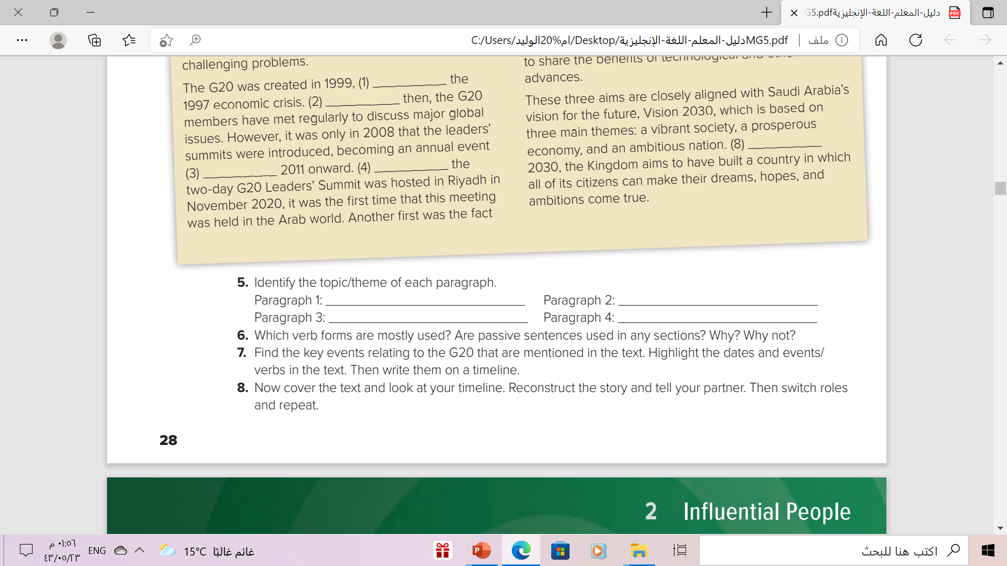
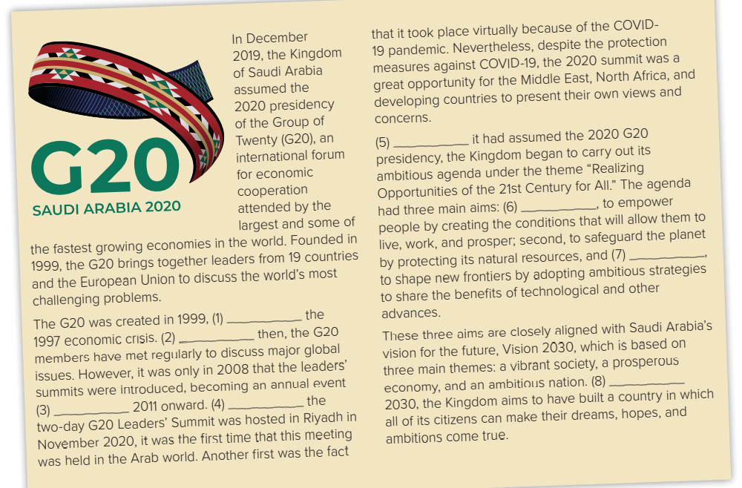
Answer these questions
1999 – G20 is founded
2008 – leaders’ summits introduced
2011 – summits become annual events
Nov. 2020 – Saudi Arabia hosts G20 Leaders’ Summit
2020-held in Riyadh, because of the COVID- 19 pandemic

Slide 10
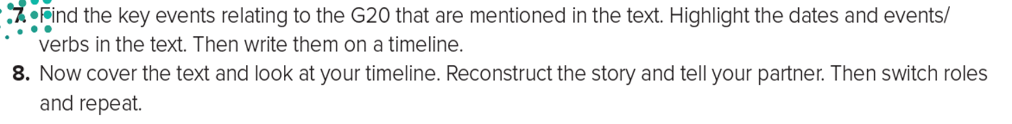
Answer these questions
1999
G20 is
founded
2008 leaders’ summits introduced
2011
summits become annual events
2020.Dec
Saudi Arabia hosts G20 Leaders’ Summit
2020.Nov
held in Riyadh, because of the COVID- 19 pandemic

Slide 11
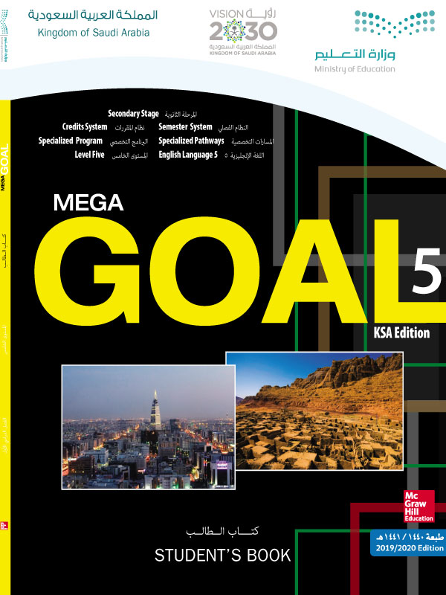
Open
Your student’s book p. (29)

Slide 12
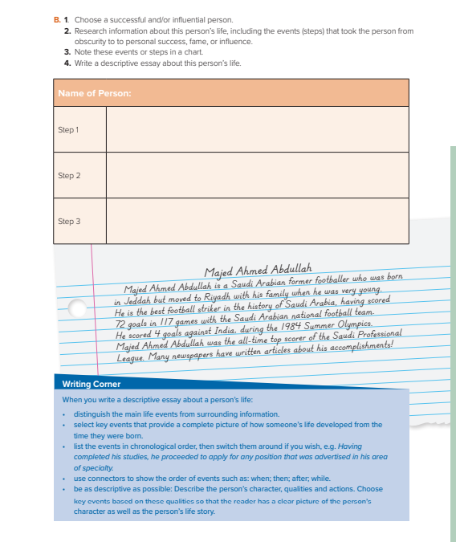
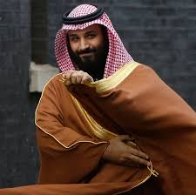
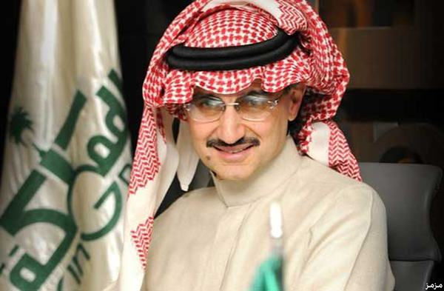
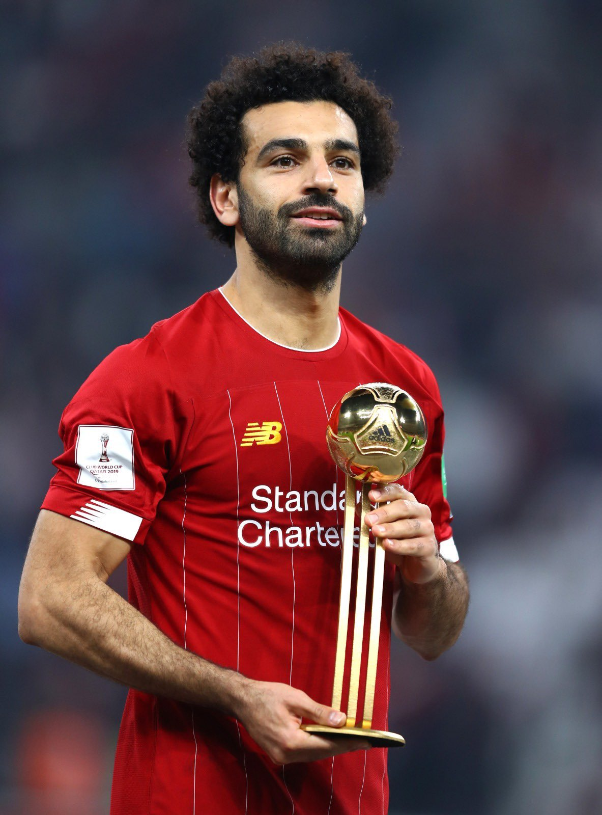
Choose famous and wealthy person
Write the events or steps in the chart
Write a descriptive essay about this person's life
Follow these rules when you write your descriptive essay

Slide 13
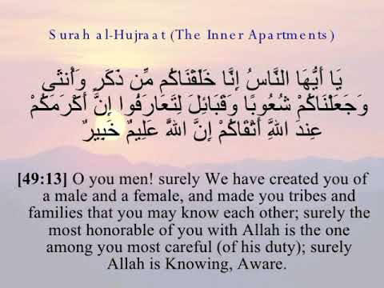
From the Holy Quraan

Slide 14

Home Work
Your work book p.18

Slide 15

Thanks

