Slide 1
Unit 2
Influential People
Reading
Mega Goal 3.1
Done by : Entisar Al-Obaidallah

Slide 2
Lesson Objectives
Read
For specific information
Answer
Some some questions about the passage
Complete
The chart with notes about how to be successful in your life
Talk
about a successful story

Slide 3
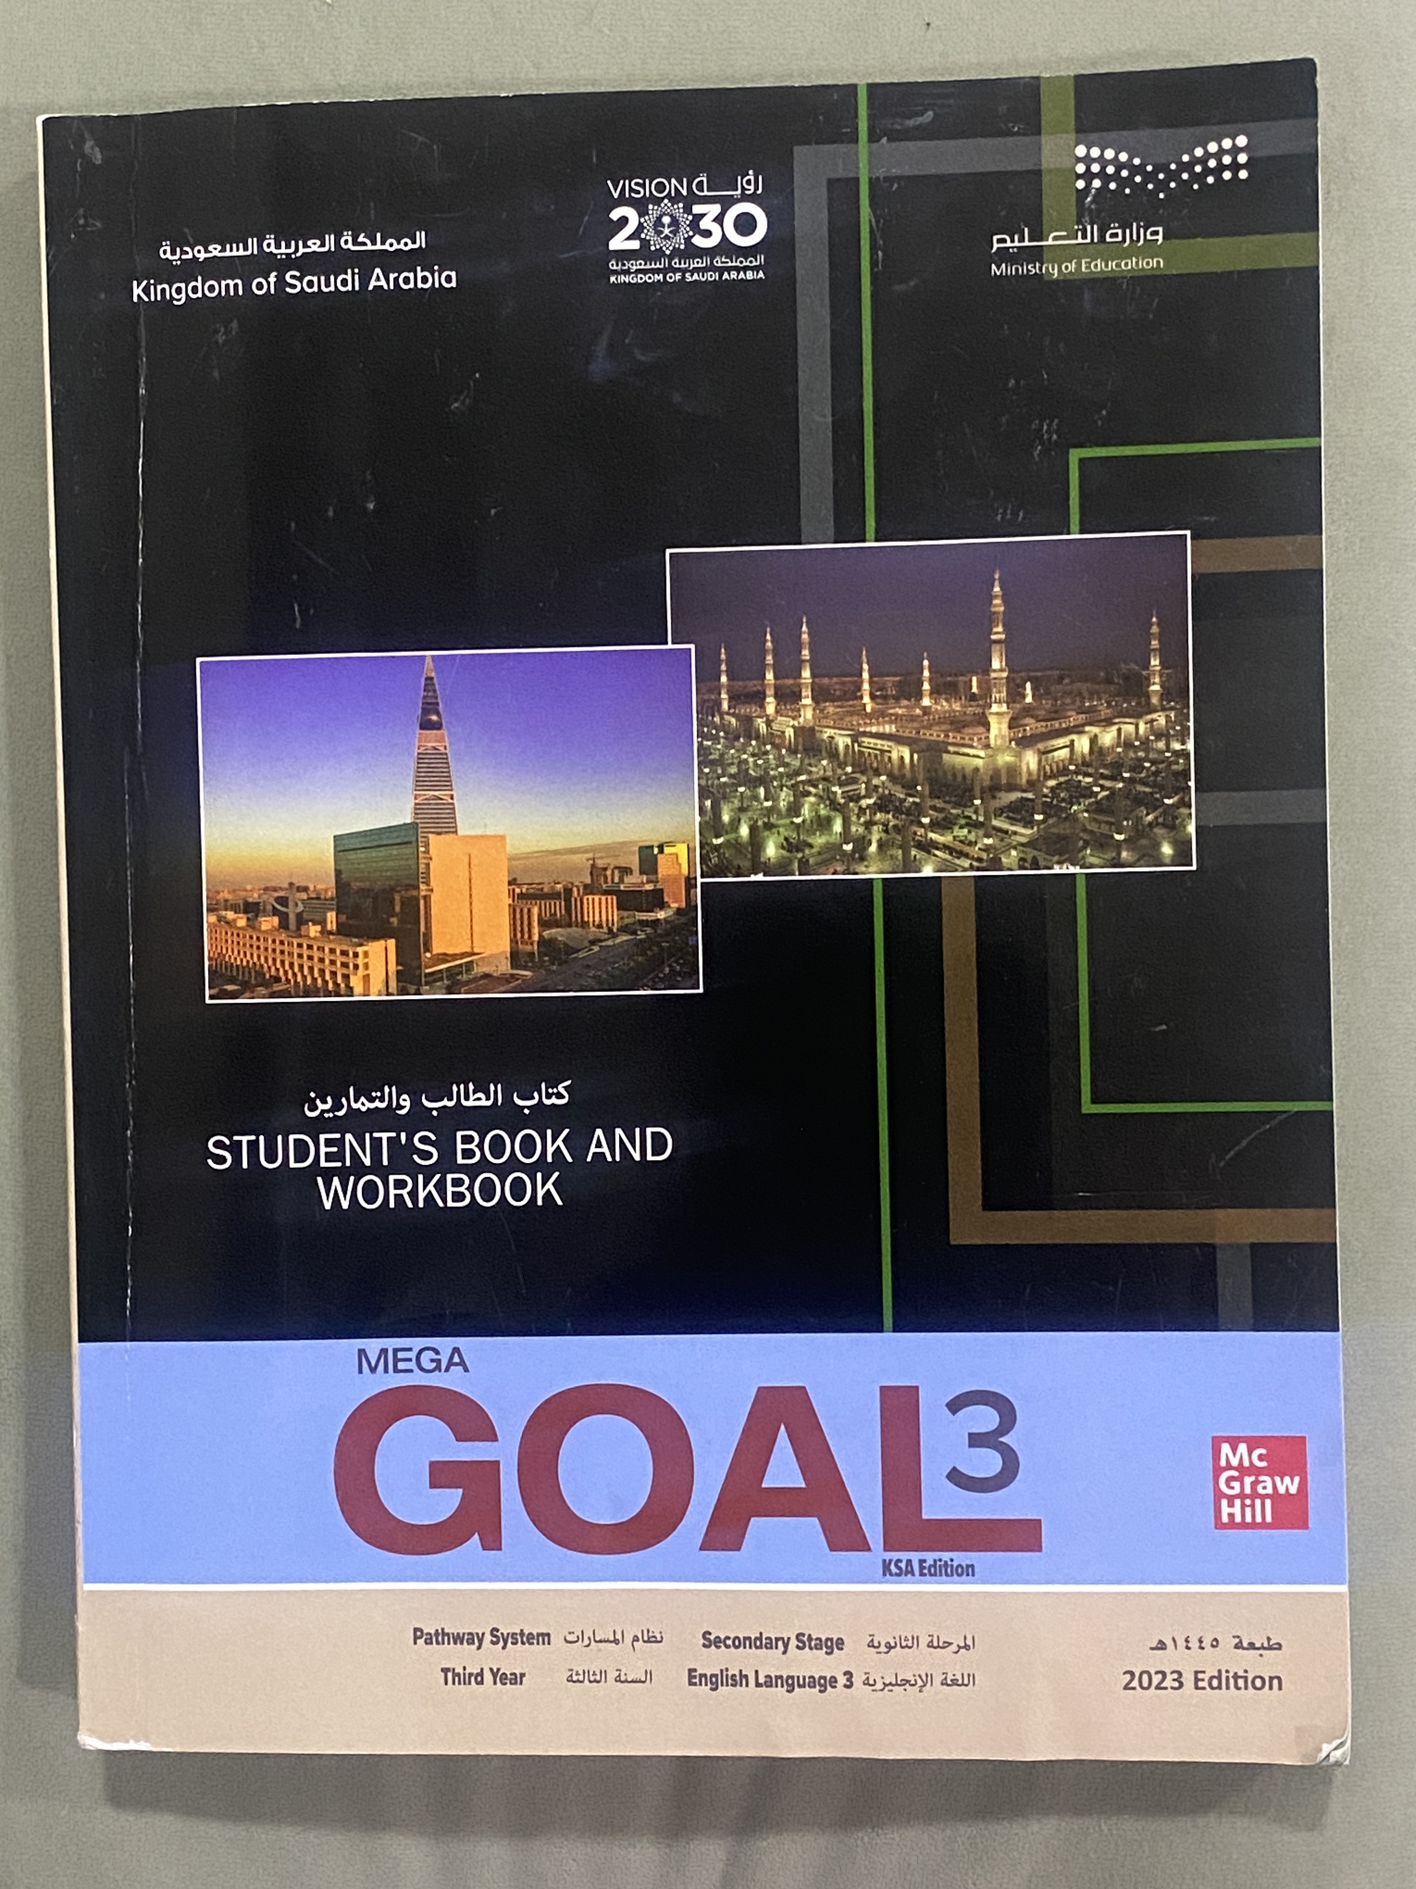
Open
your student’s book
p. 26

Slide 4
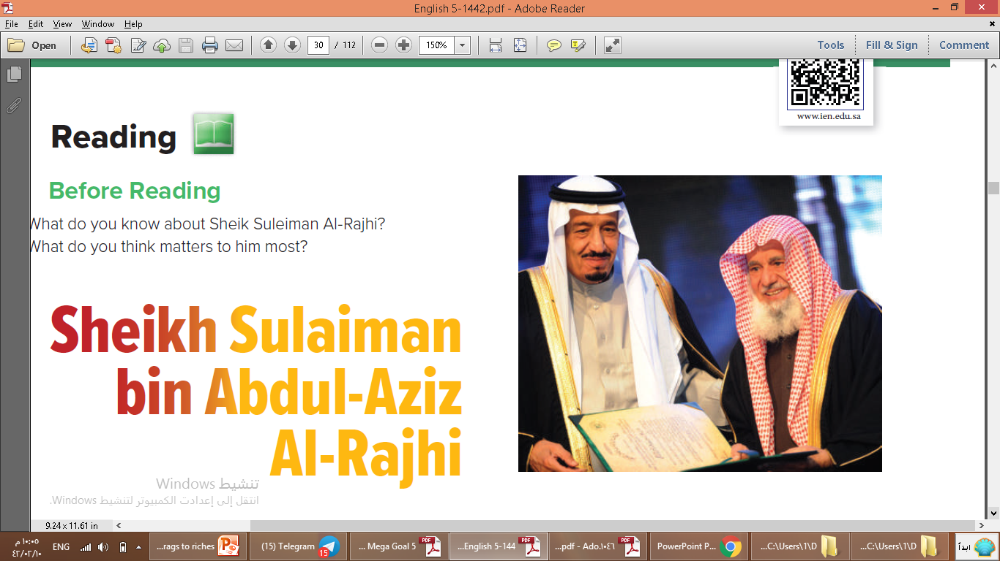
1. Before Reading
Who can you see in this photo ?
King Salman bin Abdul Aziz and Sheikh Sulaiman bin Abdul-Aziz Al-Rajhi
Where do you
think this photo was taken?
it was probably during an interview or awards ceremony
Does he look
like a successful business man?
Yes , he does

Slide 5

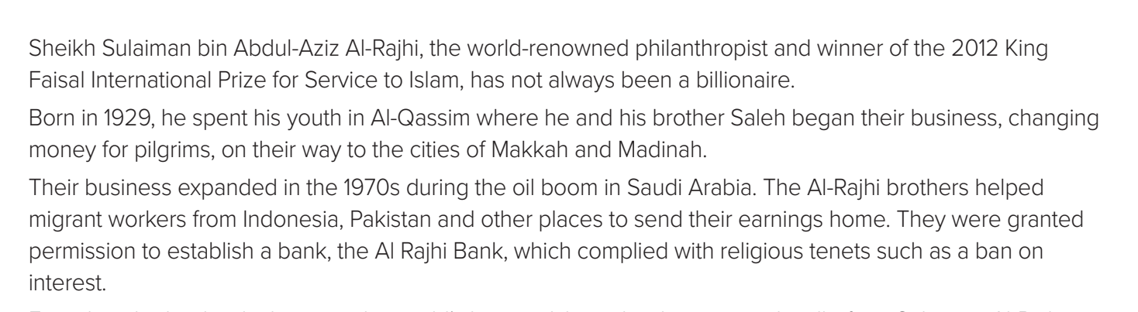
2. During Reading
When and where was he born?
He born in 1929, in Al-Qassim
How did he start his business and who was his partner?
He and his brother Saleh began their business, changing money for pilgrims, on their way to the cities of Makkah and Madinah.

Slide 6
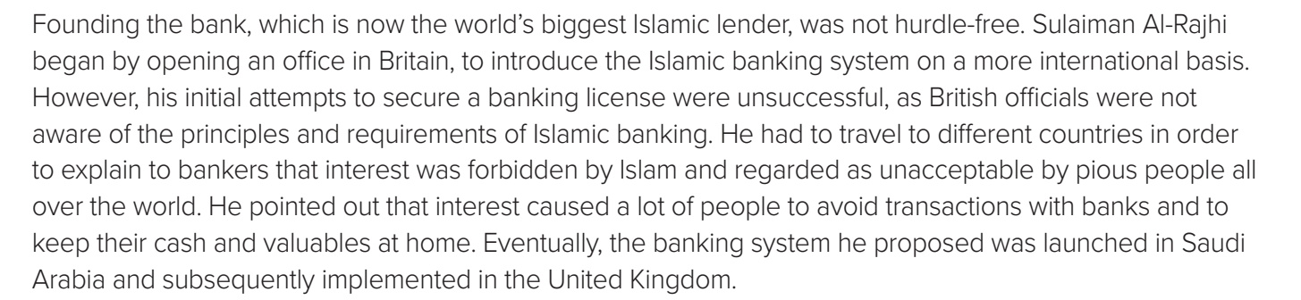
Why does Sulaiman Al-Rajhi began by opening an office in Britain?
to introduce the Islamic banking system on a more international basis.
Where the banking system he proposed was launched ??
In Saudi Arabia

Slide 7
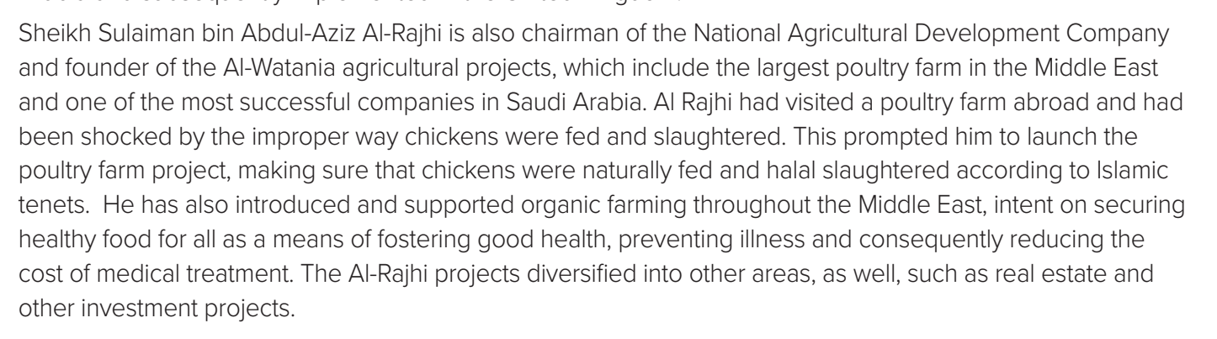
What is the name of agricultural projects he founder of ?
He is the founder of the Al-Watania agricultural projects
Where the banking system he proposed was launched ??
In Saudi Arabia

Slide 8
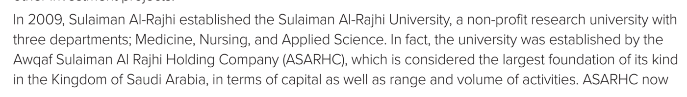
When did Sulaiman Al-Rajhi establishe the Sulaiman Al-Rajhi University
In 2009
How many departments are there in Sulaiman Al-Rajhi University ?
Three departments; Medicine, Nursing and Applied Science.

Slide 9
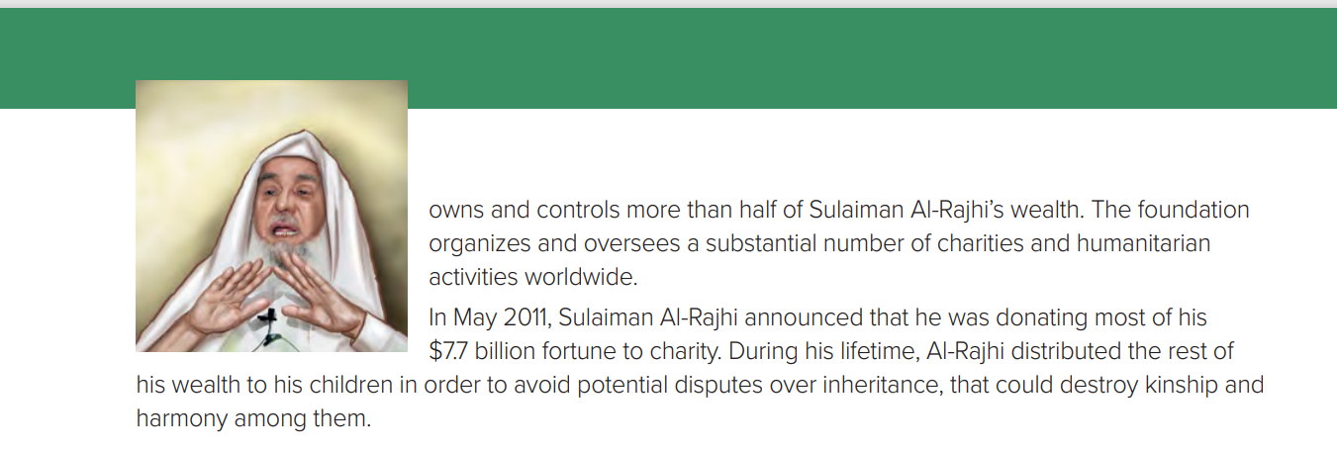
What did Sulaiman Al-Rajhi announce in May 2011?
he was donating most of his $7.7 billion fortune to charity

Slide 10
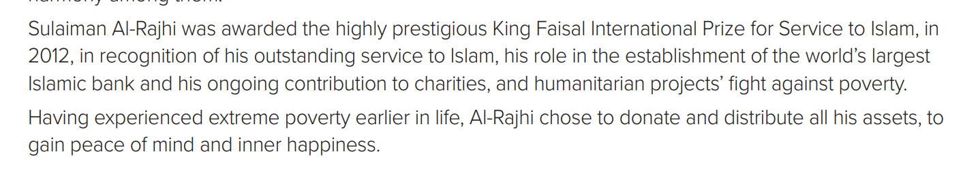
What was Sulaiman Al-Rajhi awarded in 2012?
King Faisal International Prize for Service to Islam
Why did he choose to donate all his assets?
to gain peace of mind and inner happiness.

Slide 11
Open
your student’s book
p. 27

Slide 12

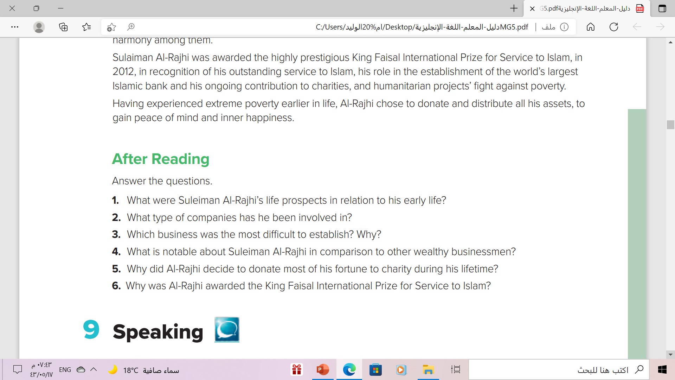
2. After Reading
He did not seem to have much hope of becoming
a billionaire.

Slide 13
2. After Reading
Banking, agricultural development, organic farming, real estate,investment, health and more.

Slide 14
2. After Reading
Islamic banking in the UK because British officials were not aware of the principles and requirements of Islamic banking.

Slide 15
2. After Reading
His work and contribution to education, health and charities worldwide through SAAR, the largest foundation of its kind in the Kingdom of Saudi Arabia.

Slide 16
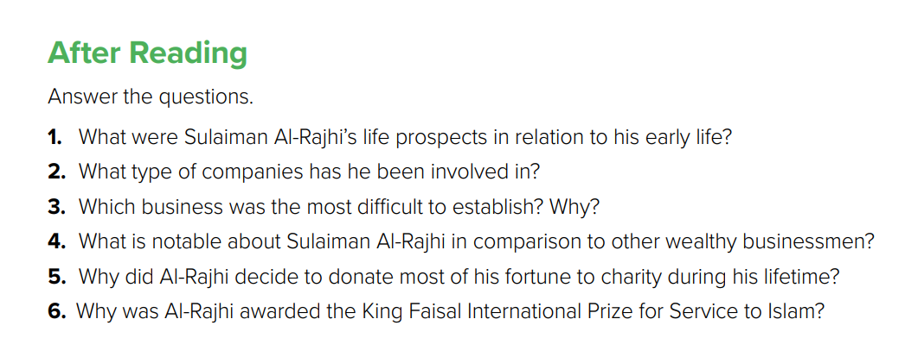
2. After Reading
Having been poor early in life, he was not afraid to donate and
distribute his wealth so he could con

Slide 17
2. After Reading
He was awarded the prize in recognition of his outstanding service to Islam, his role in the establishment of the world’s largest Islamic bank and his ongoing contribution to charities.

Slide 18
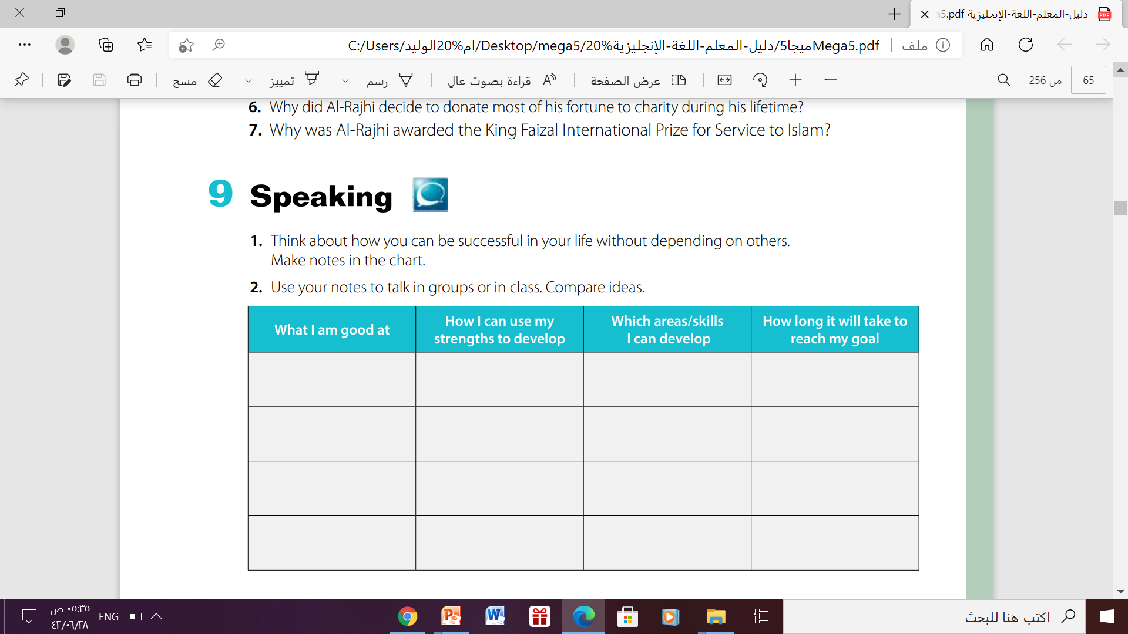






Slide 19

Homework
Workbook p. 236 - Exercises(I)

Slide 20

THANKS!

