Slide 1

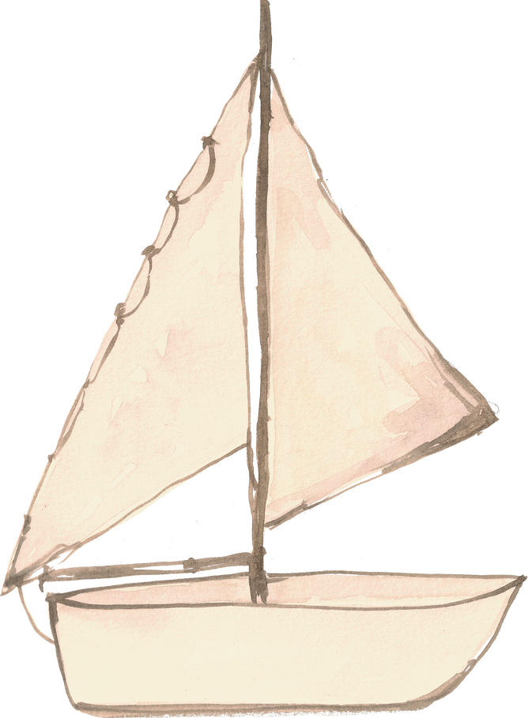
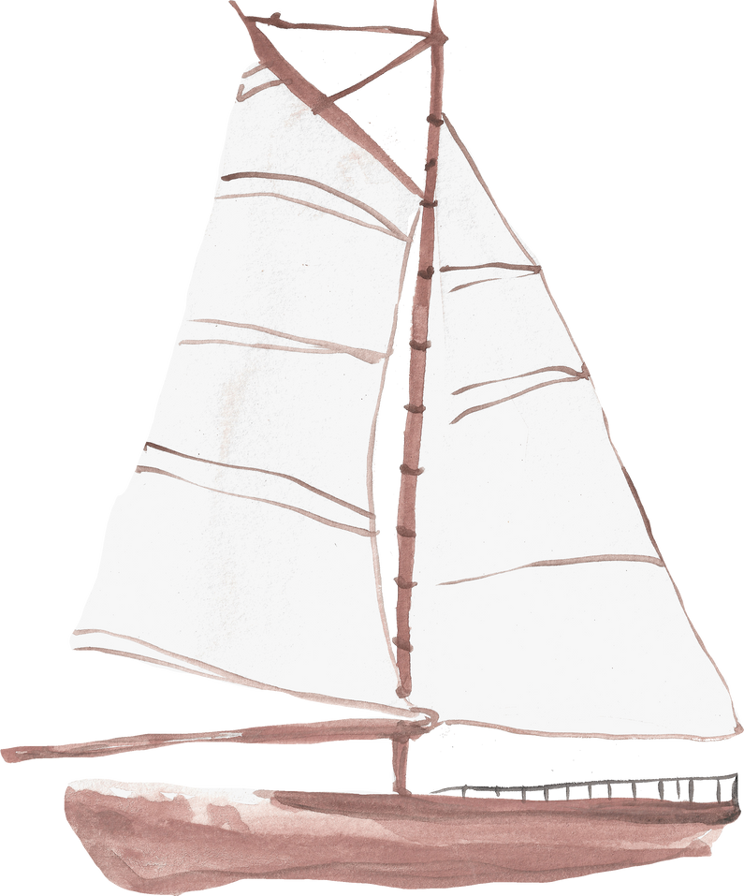



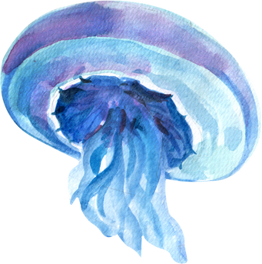
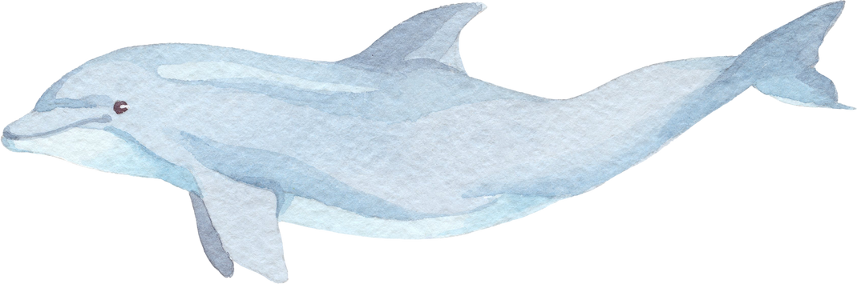
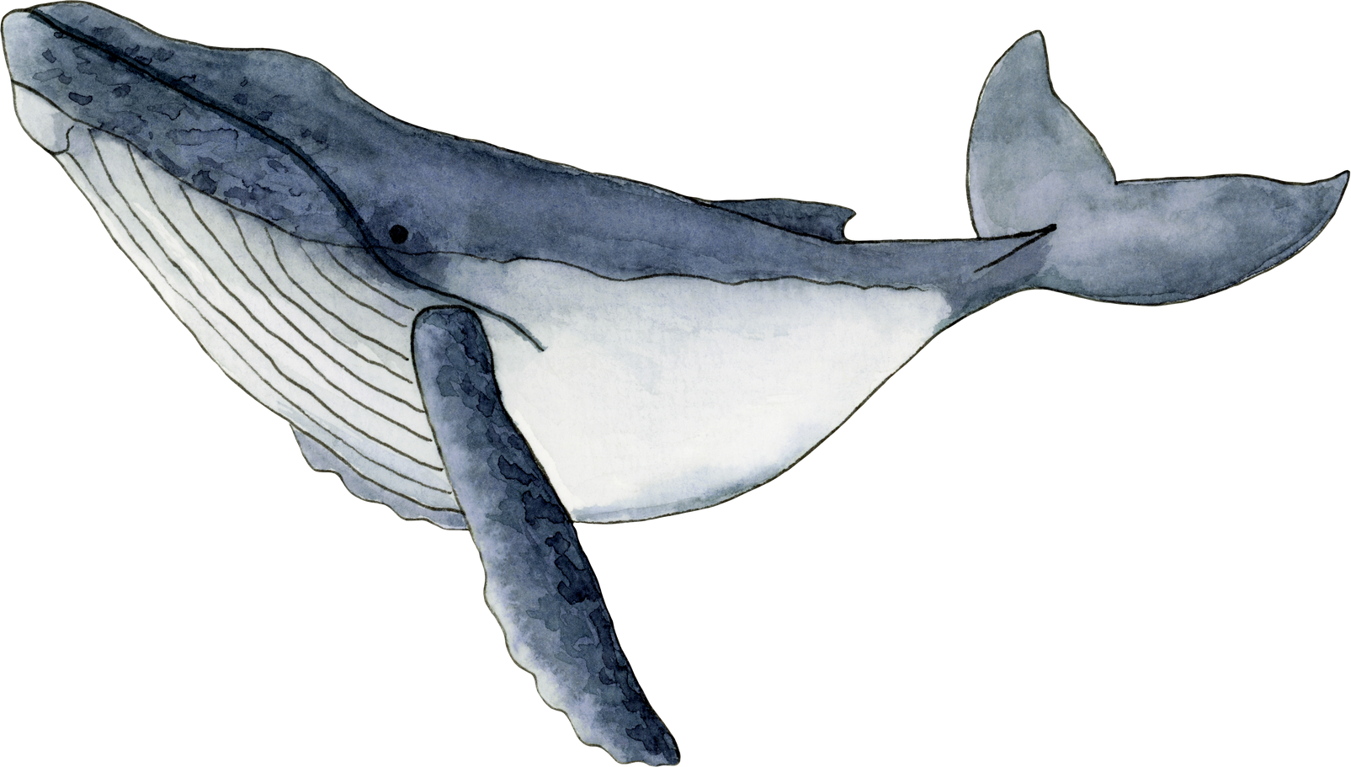

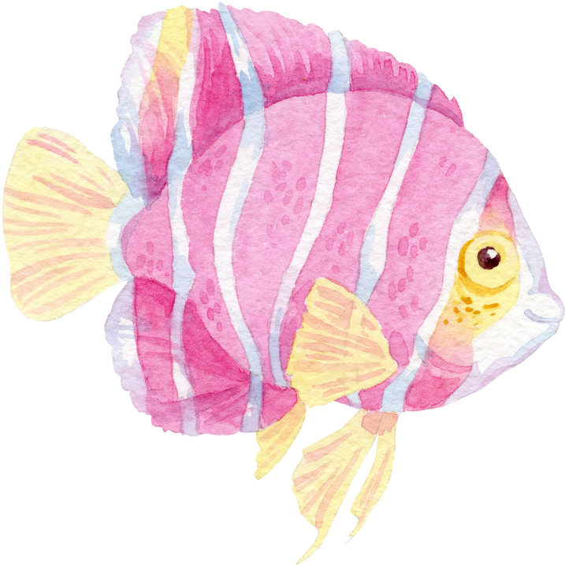
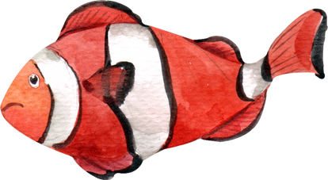
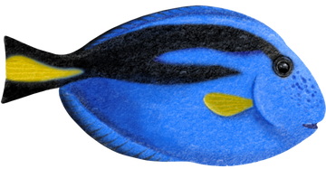
welcome

Slide 2



Slide 3
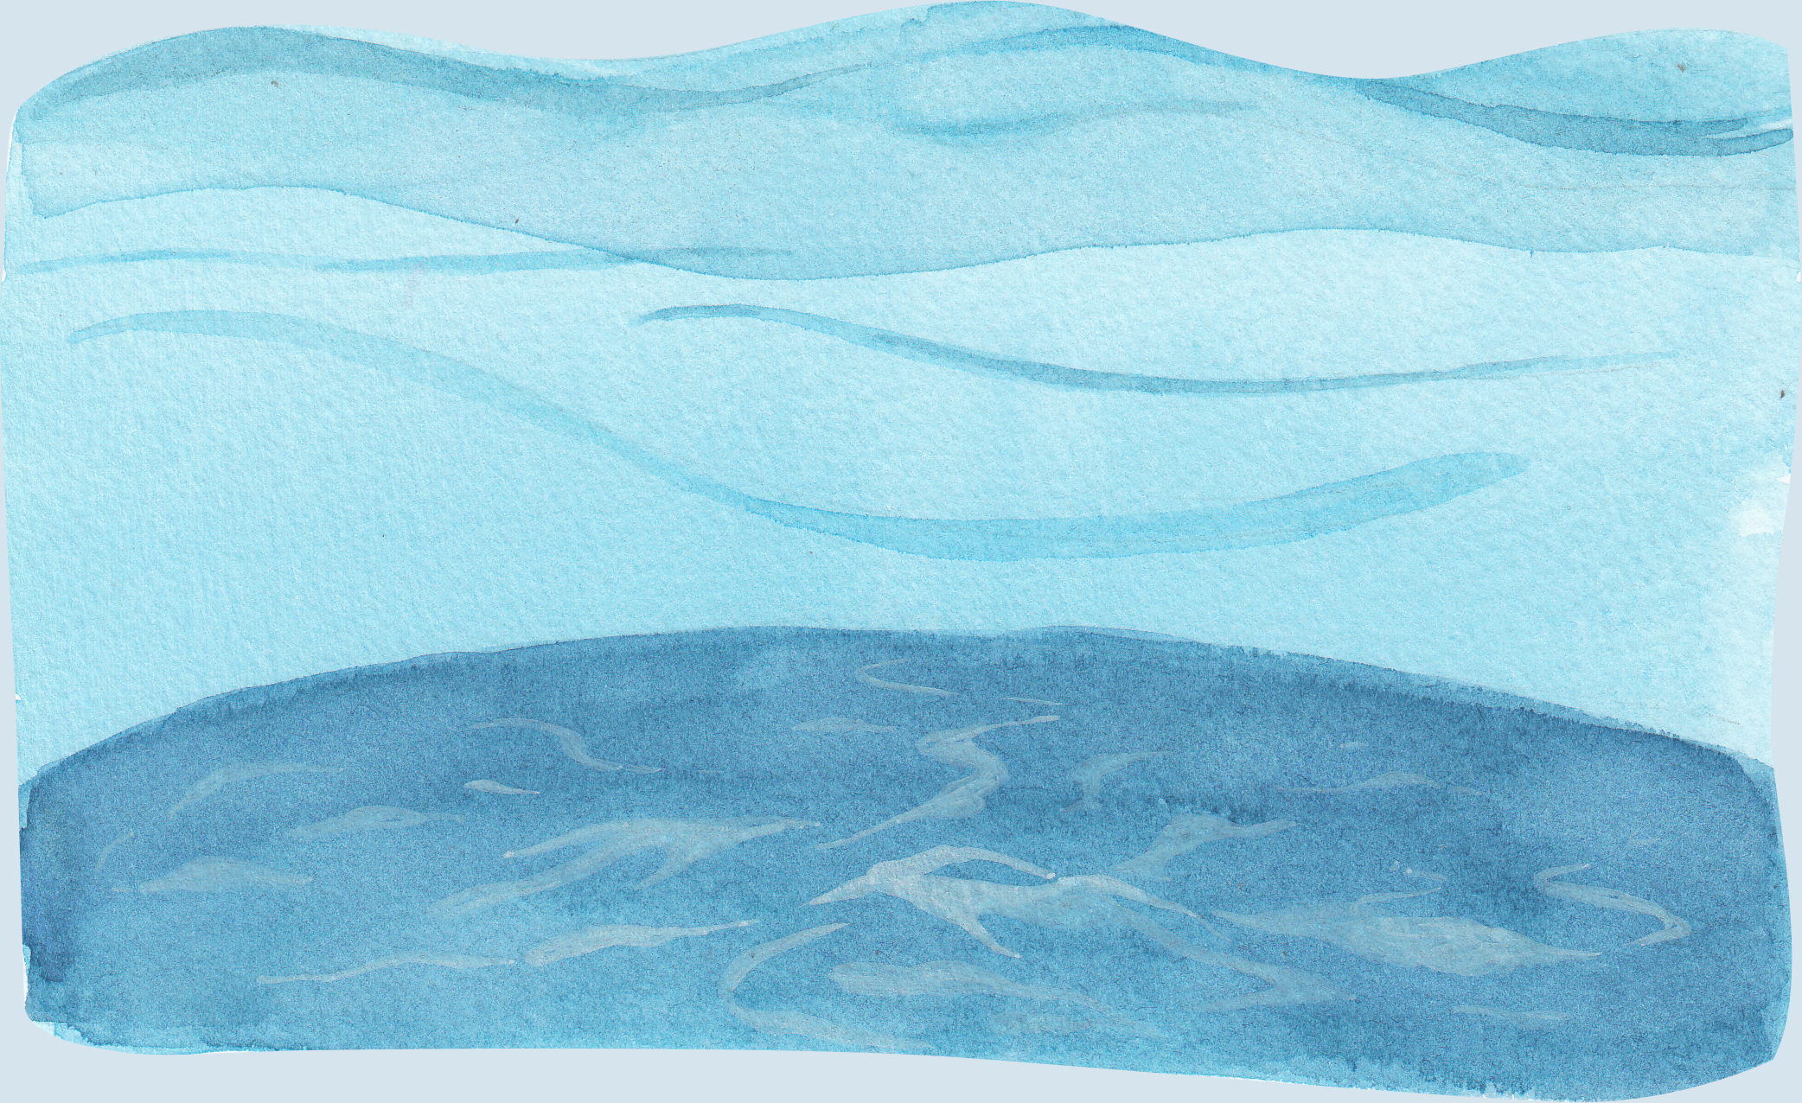
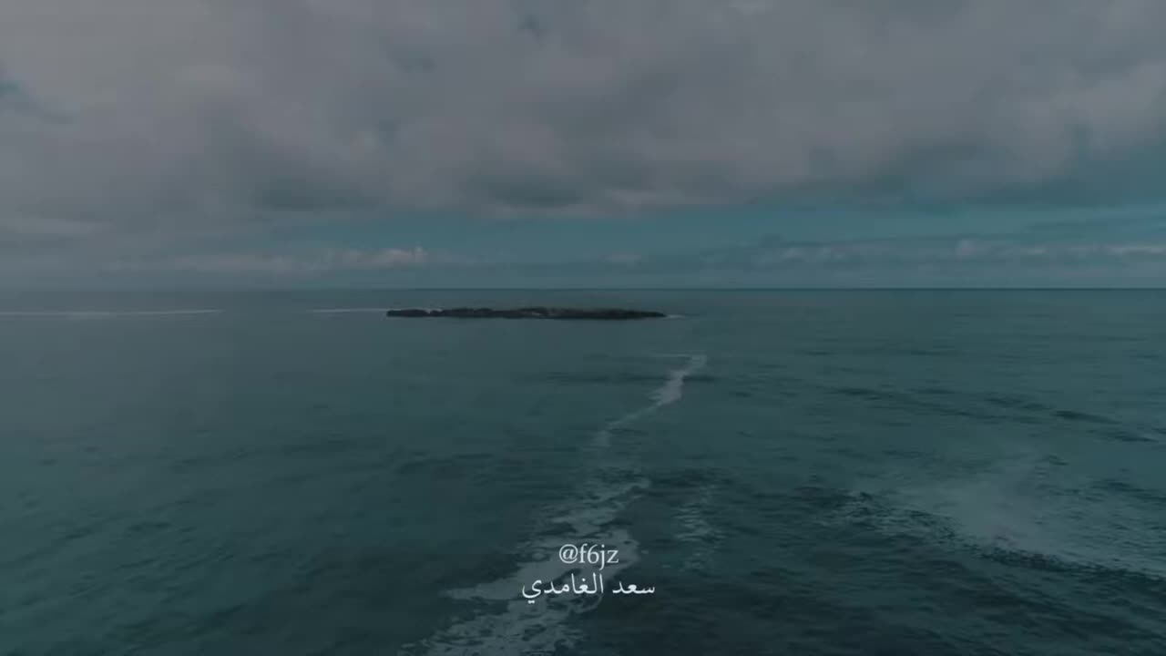

Religion Goal

Slide 4
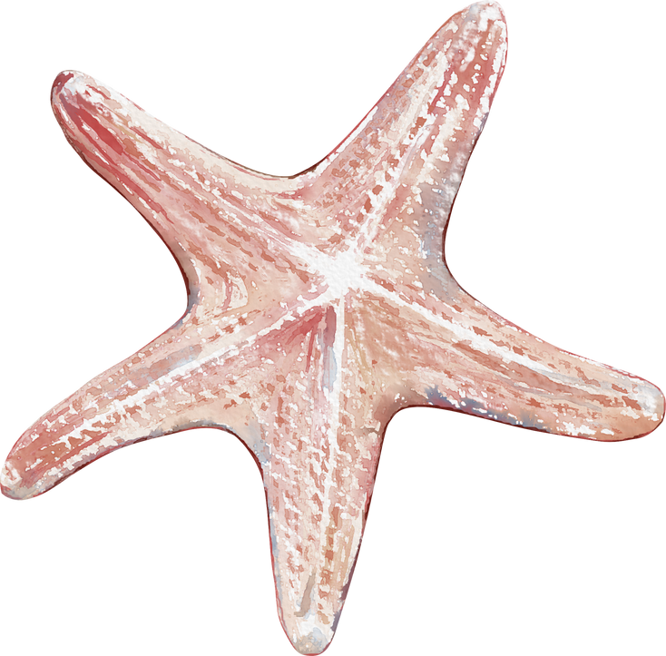
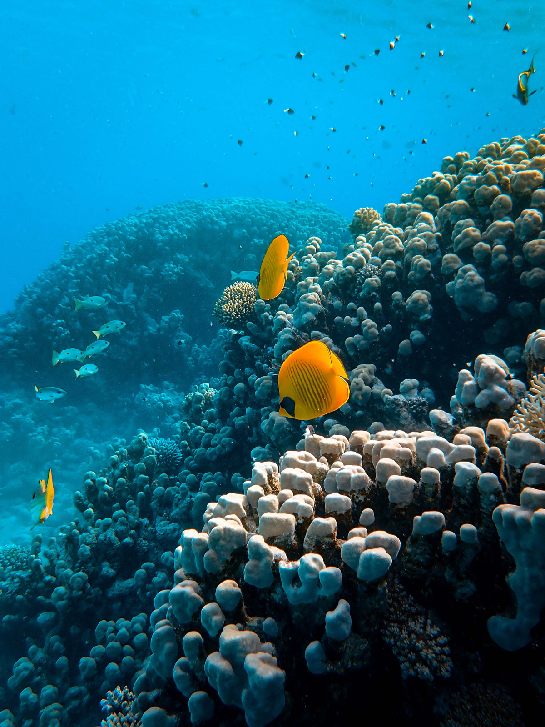


national goal
الإهتمام بنظافة بيئتنا واجب انساني وطني

Slide 5


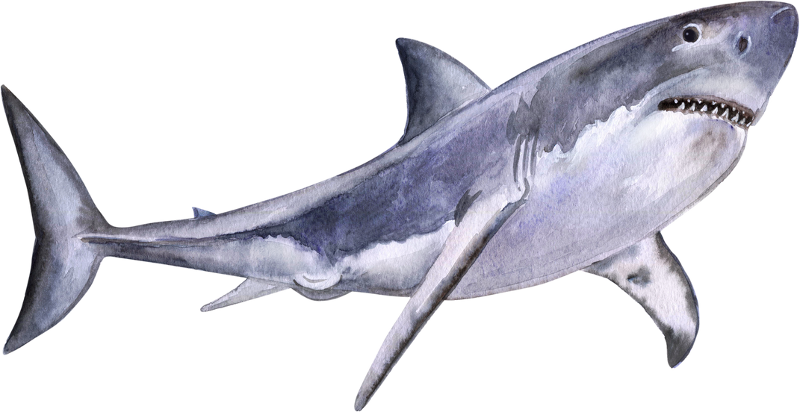
Revision for the previous unit :
What is this?

Slide 6
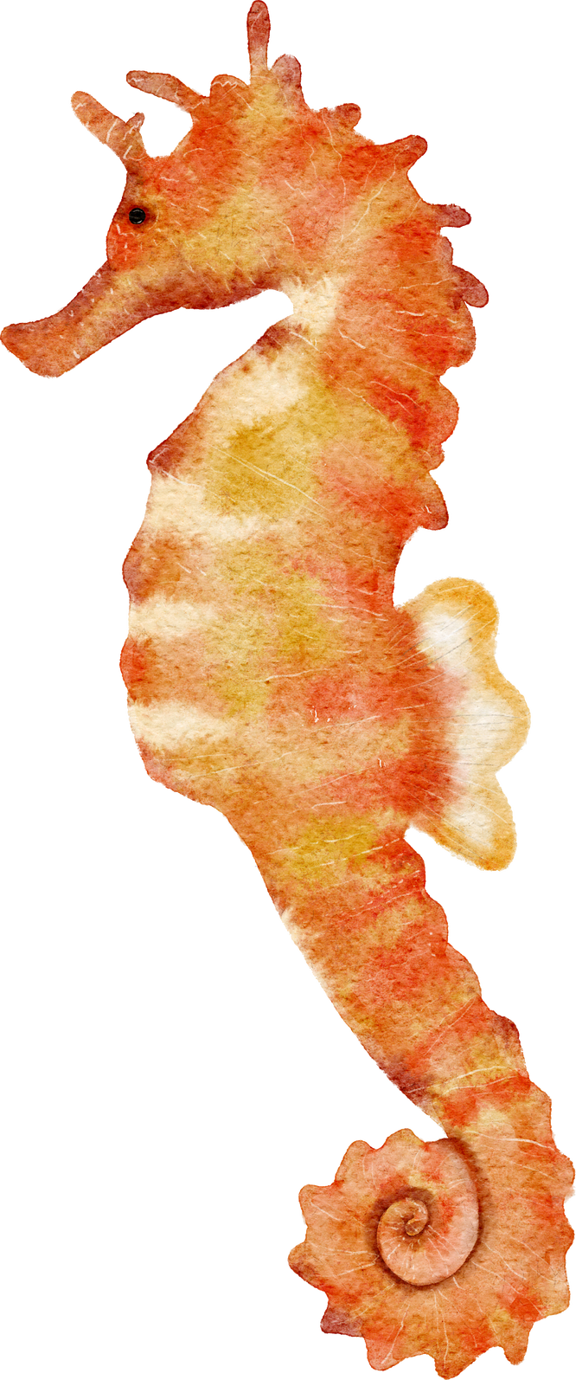
What is this?

Slide 7

Sharks are ……….
scary

Slide 8
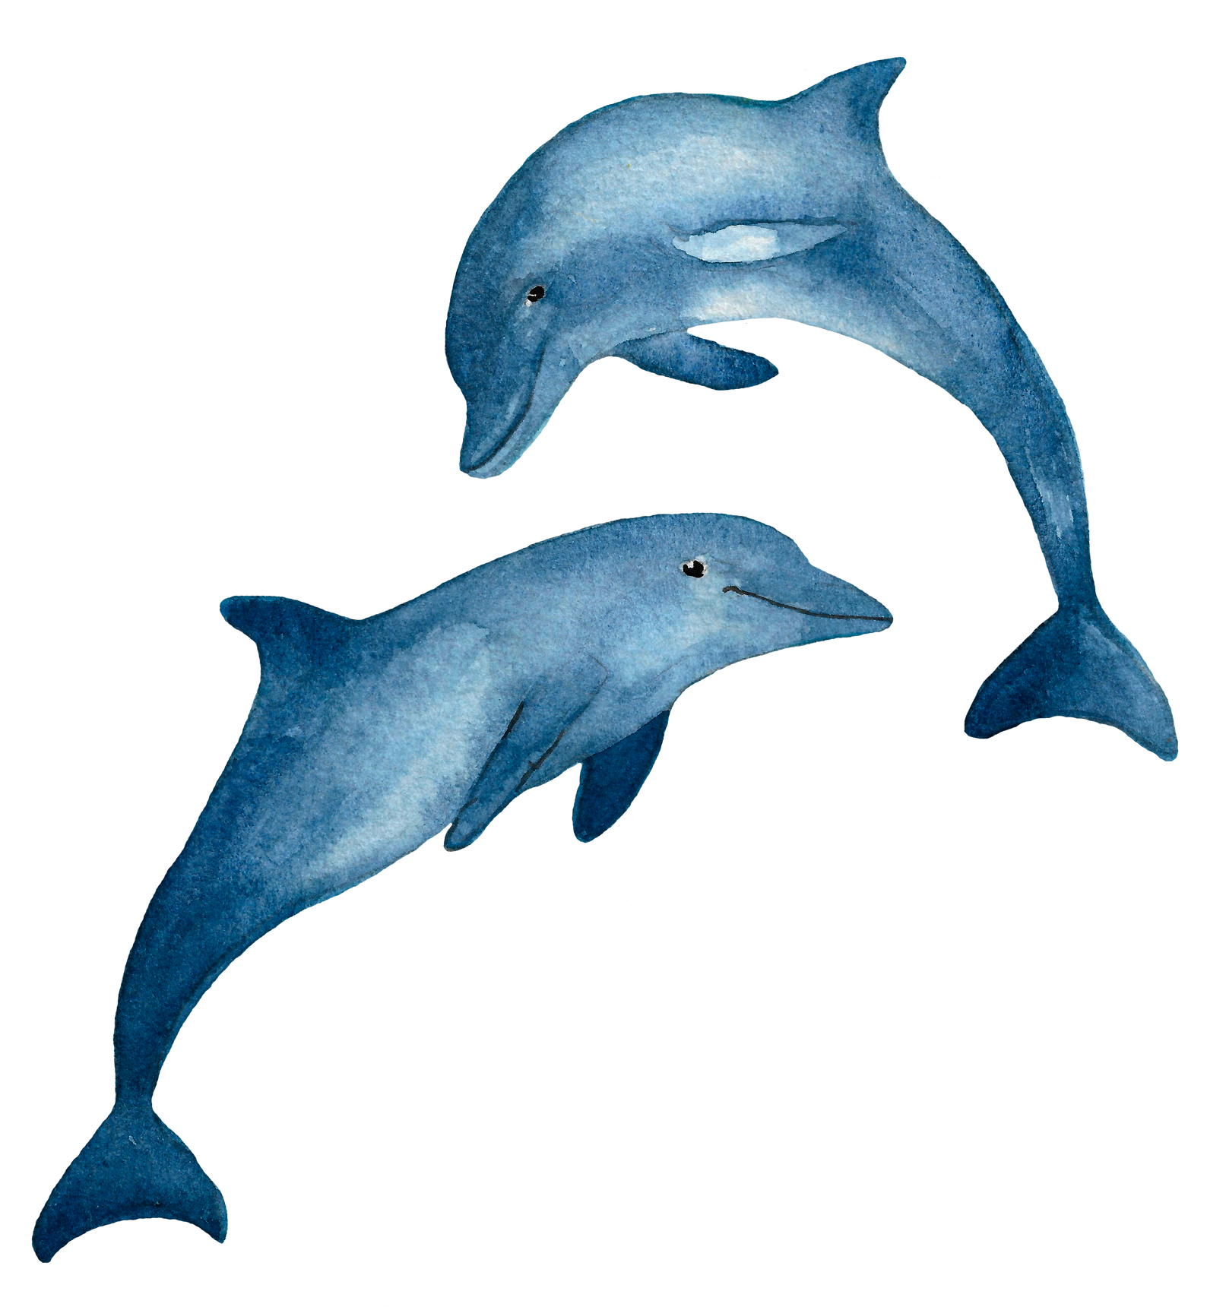
Dolphin is ............
cute

Slide 9
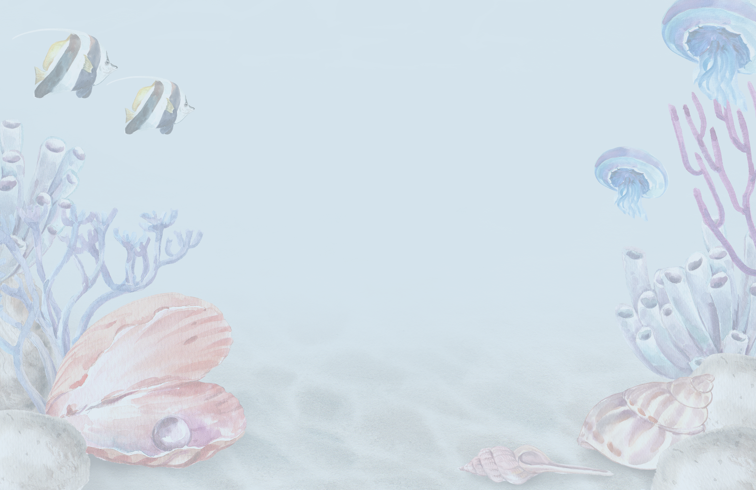


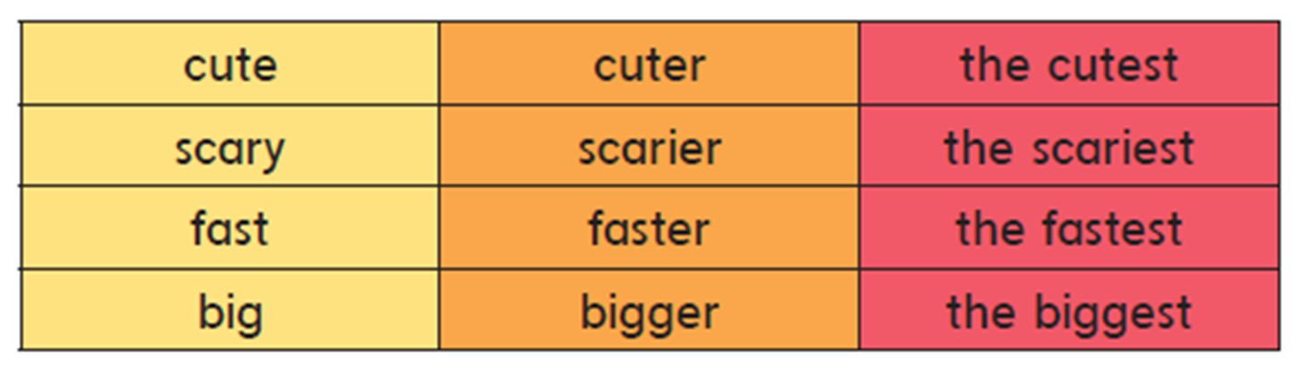
Grammar in Action
Listen , point and say

Slide 10

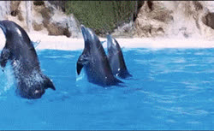
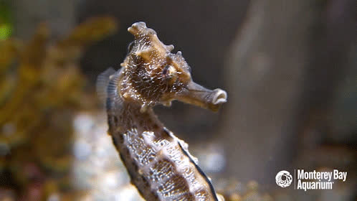
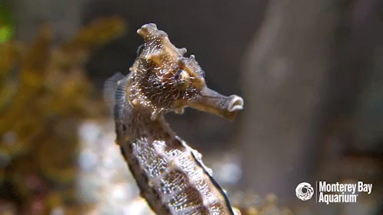
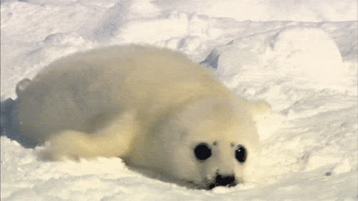
I think
a dolphin is cute
a seahorse is cuter than dolphin
a baby seal is the cutest

Slide 11



I think
whales are fast.
sharks are faster than whales
dolphins are the fastest.

Slide 12



I think
big
bigger than
the biggest
fas
faster than
the fastest
Scary
scarier than
the scariest
tall
taller than
the tallest
Cute
cuter than
the cutest

Slide 13
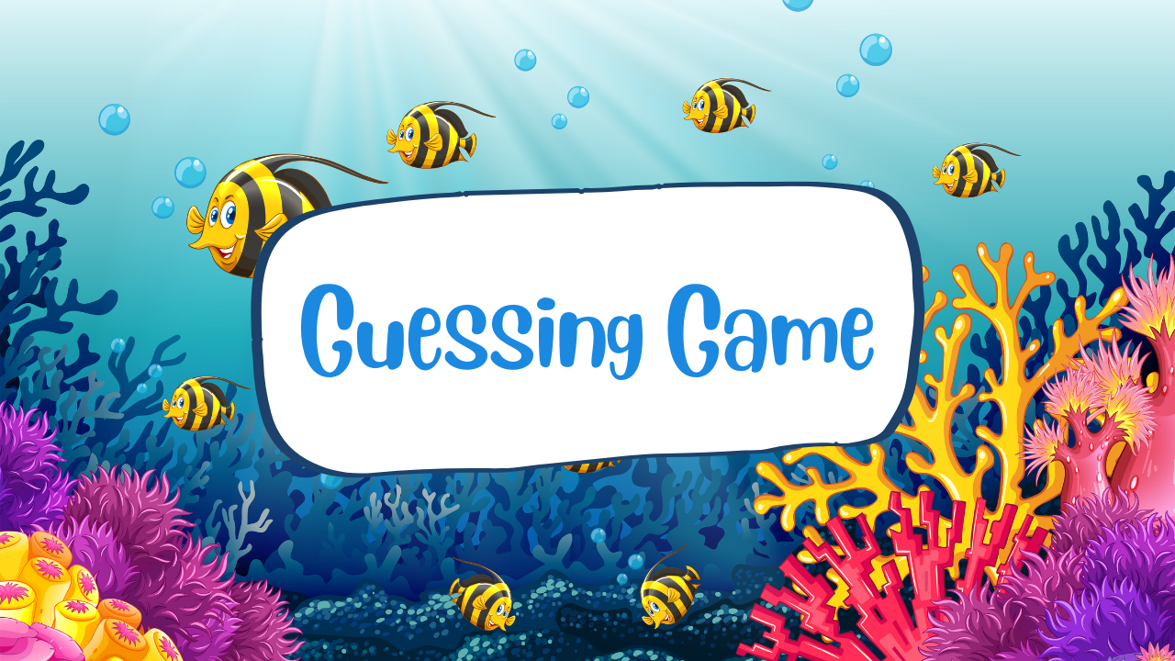

Slide 14
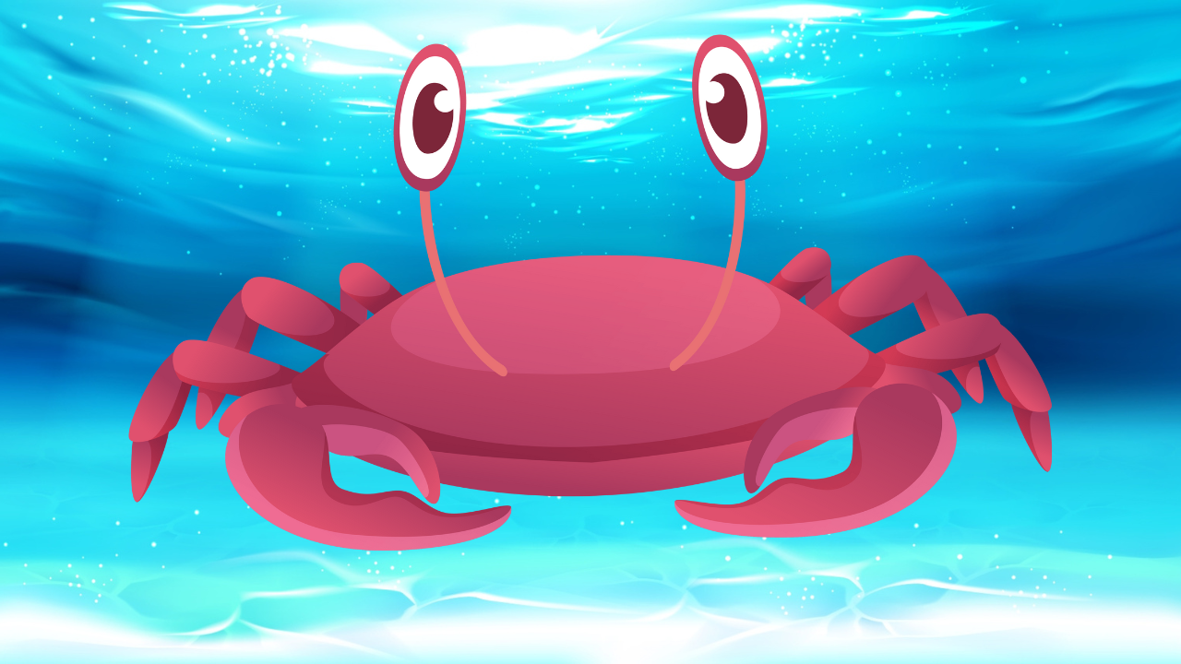
crab
SHOW

Slide 15

whale
SHOW

Slide 16
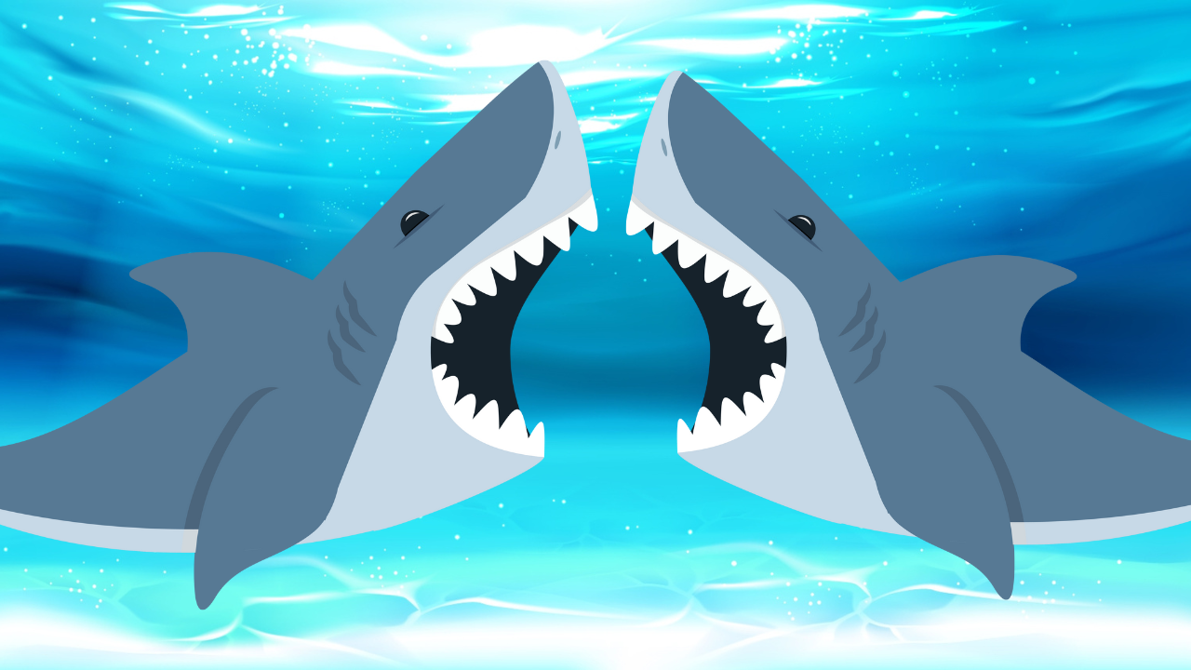
shark
SHOW

Slide 17
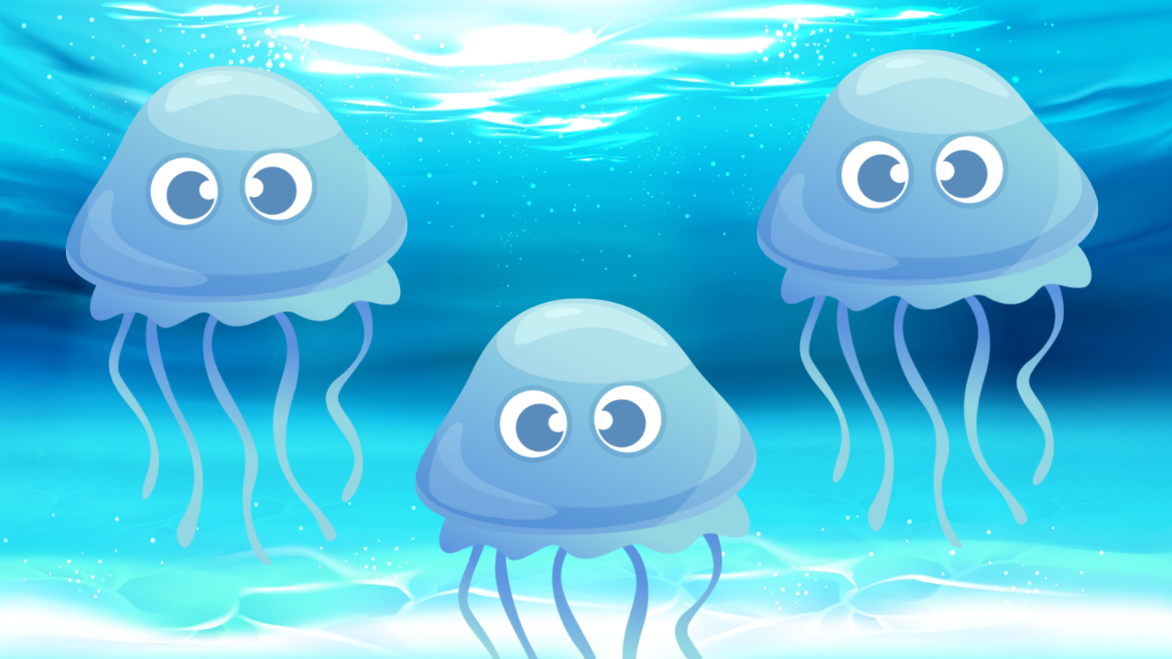
jellyfish
SHOW

Slide 18


Slide 19



Slide 20
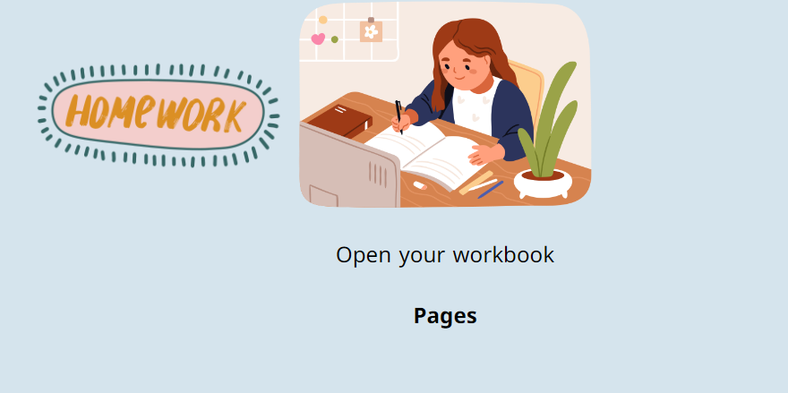

Slide 21

Thank You

