Slide 1
MEGA GOAL 2.1

Slide 2
UNIT 3

Slide 3
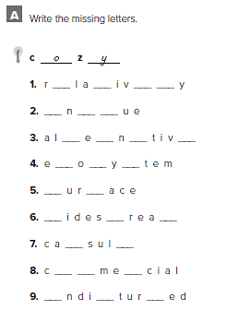
e t e l
u i q
t r a e
c s s
s f
w p d
p e
o m r
u s b

Slide 4
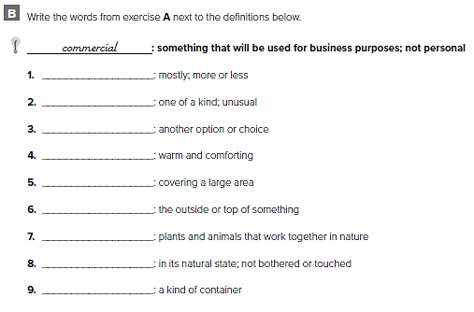
relatively
unique
alternative
cozy
widespread
surface
ecosystem
undisturbed
capsule

Slide 5
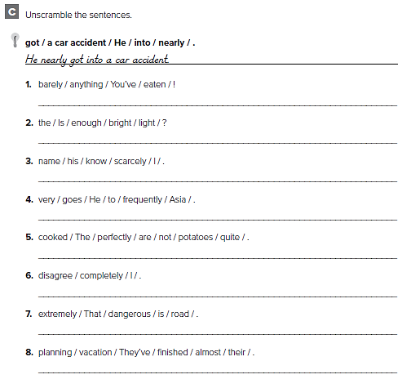
You’ve barely eaten anything!
Is the light bright enough?
I scarcely know his name.
He goes to Asia very frequently.
The potatoes are not cooked quite perfectly.
I completely disagree.
That road is extremely dangerous.
They’ve almost finished planning their vacation

Slide 6
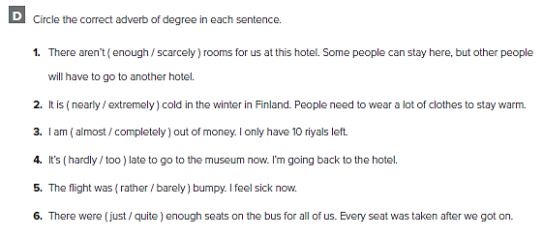

Slide 7
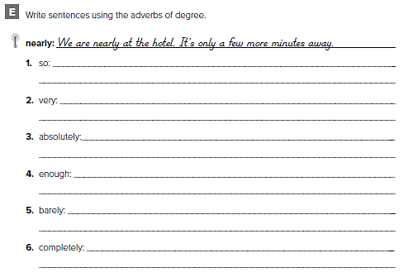
من الممكن أن تختلف الاجابات
It’s so hot in here. Do you have a fan ?
I’m very tired. I want to go to bed now
I’m absolutely sure. I have no questions about it
There isn’t enough tea. I will make more
There’s barely anybody here. Only 3 people
I am completely out of coffee. I don’t have any more

Slide 8
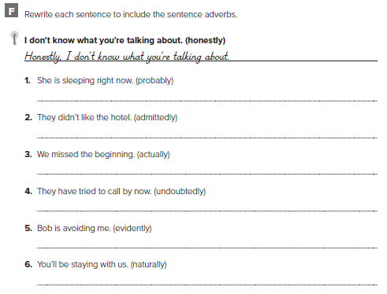
من الممكن أن تختلف الاجابات
She is probably sleeping right now
Admittedly, they didn’t like the hotel
We actually missed the beginning
They have undoubtedly tried to call by now
Evidently, Bob is avoiding me
Naturally, you’ll be staying with us

Slide 9
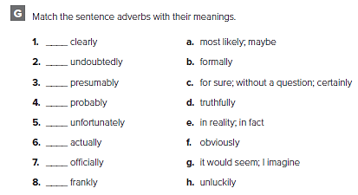
f
c
g
a
h
e
b
d

Slide 10
اقراء عن السكن الشبابي ثم قم بكتابة قطعة عنه

Slide 11
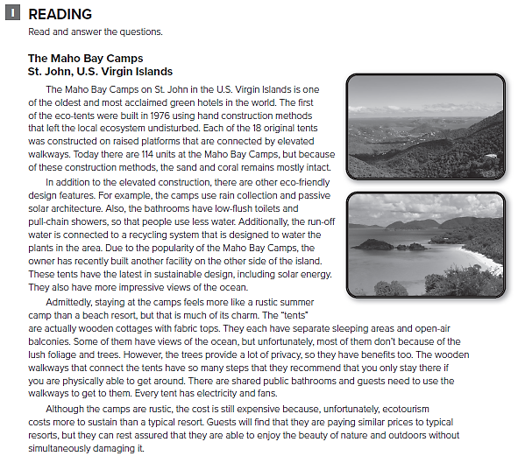

Slide 12
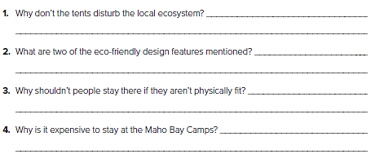
They were built by hand, on raised platforms
Rain collection and passive solar architecture
Because they need to use stairs and walk along walkways
Ecotourism costs more to sustain

Slide 13
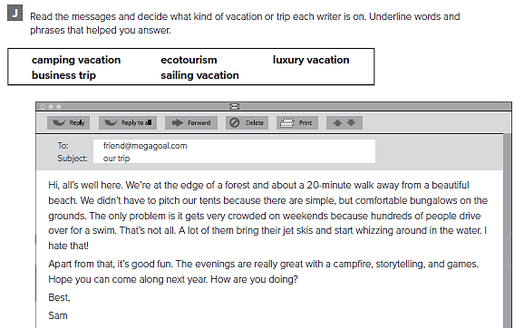
edge of a forest, beautiful beach, pitch tents,
bungalows on the grounds

Slide 14
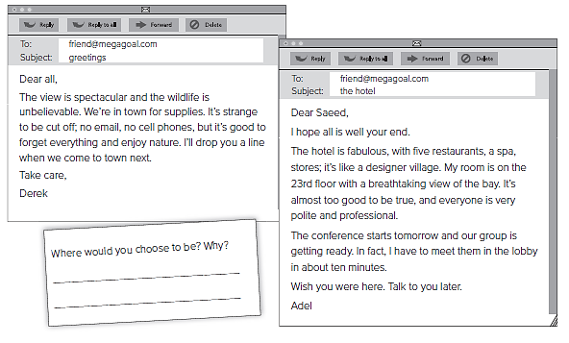
Hotel/fabulous, five restaurants, spa, designer village, breathtaking view of the bay, conference, our group, meet them in the lobby
view/spectacular, wildlife/unbelievable, cut off, no cell phones, nature

Slide 16
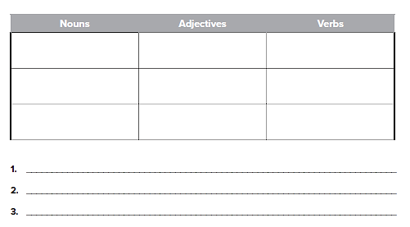
من الممكن أن تختلف الاجابات
Reservoir
Sand
Climate
Hot
Dry
Barren
Evaporate
Dry up
Die
Global warming causes extreme changes in climate
In hot, dry areas, evaporation can result in a huge loss of water

Slide 17
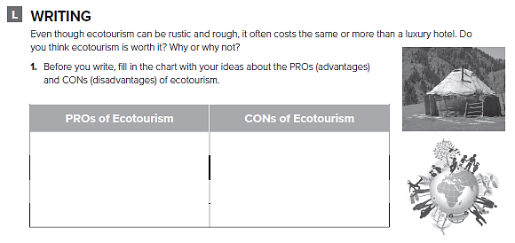
من الممكن أن تختلف الاجابات
Large numbers of ecotourists can damage environment
experiencing nature without causing damage

Slide 18
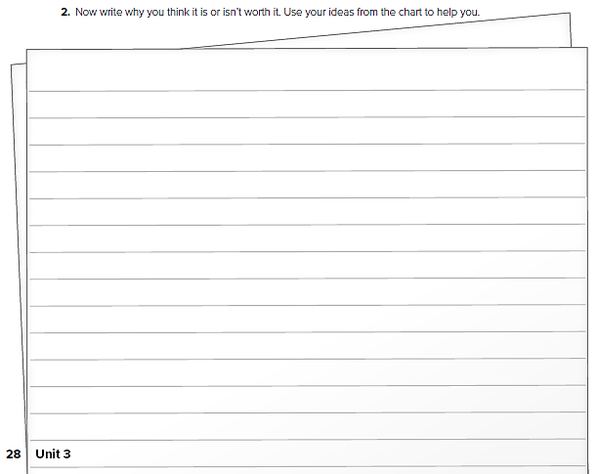
قم بكتابة مقال عن السياحة البيئية

Slide 19
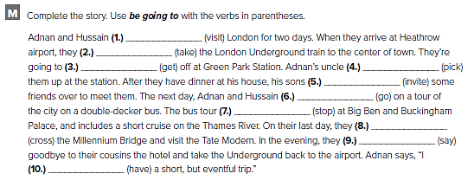
1. are going to visit
2. are going to take
3. are going to get
4. is going to pick
5. are going to invite
6. are going to go
7. is going to stop
8. are going to cross
9. are going to say
1 0 . am going to have

Slide 20
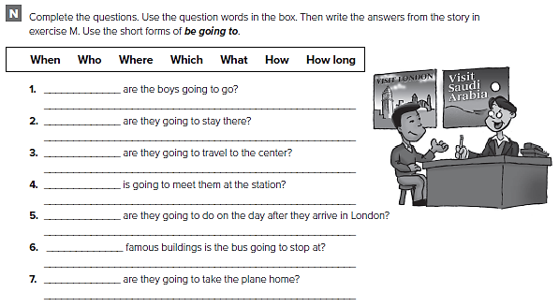
Where
They’re going to go to London.
How long
They’re going to stay for two days
How
They’re going to take the train
Who
Adnan’s uncle
What
They’re going to take a tour of the city
Which
It’s going to stop at Big Ben and Buckingham Palace
When
In the evening on their last day.

Slide 21
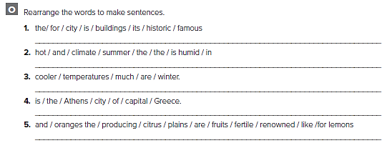
The city is famous for its historic buildings
The climate is hot and humid in the summer
Winter temperatures are much cooler
Ankara is the capital city of Turkey
The fertile plains are renowned for producing citrus fruits

Slide 22
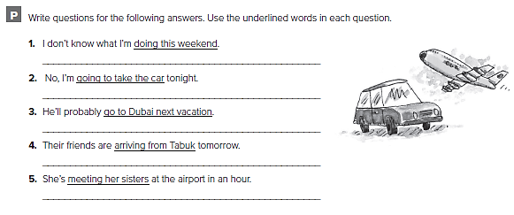
من الممكن أن تختلف الاجابات
What are you doing this weekend?
Are you going to drive home tonight?
Where will he go on his next vacation?
What are their friends doing tomorrow?
Who’s she meeting at the airport in an hour?

Slide 23
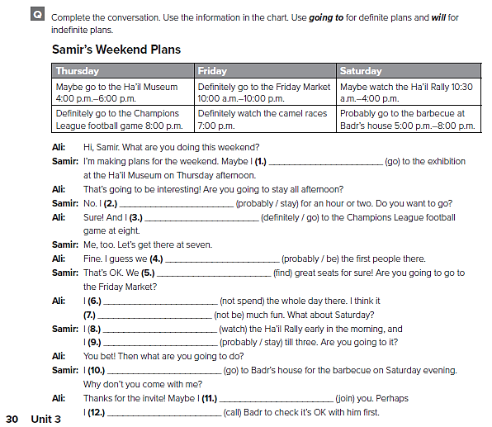
will go
will probably stay
am definitely going to go
will probably be
are going to find
am not going to spend
won’t be
am going to watch
will probably stay
am going to go
will join
will call

Slide 24
Prepared by
Teacher :
Bader Alshehri

