Slide 1
Unit3
What Will They Think of Next
Grammar
Mega Goal 3.1
Done by: Entisar Al-Obaidallah

Slide 2
Lesson Objective
Use
Future perfect progressive correctly
1
3
2
Practice
Practice
Using future perfect
Using the Future with Dependent Time Clauses

Slide 3
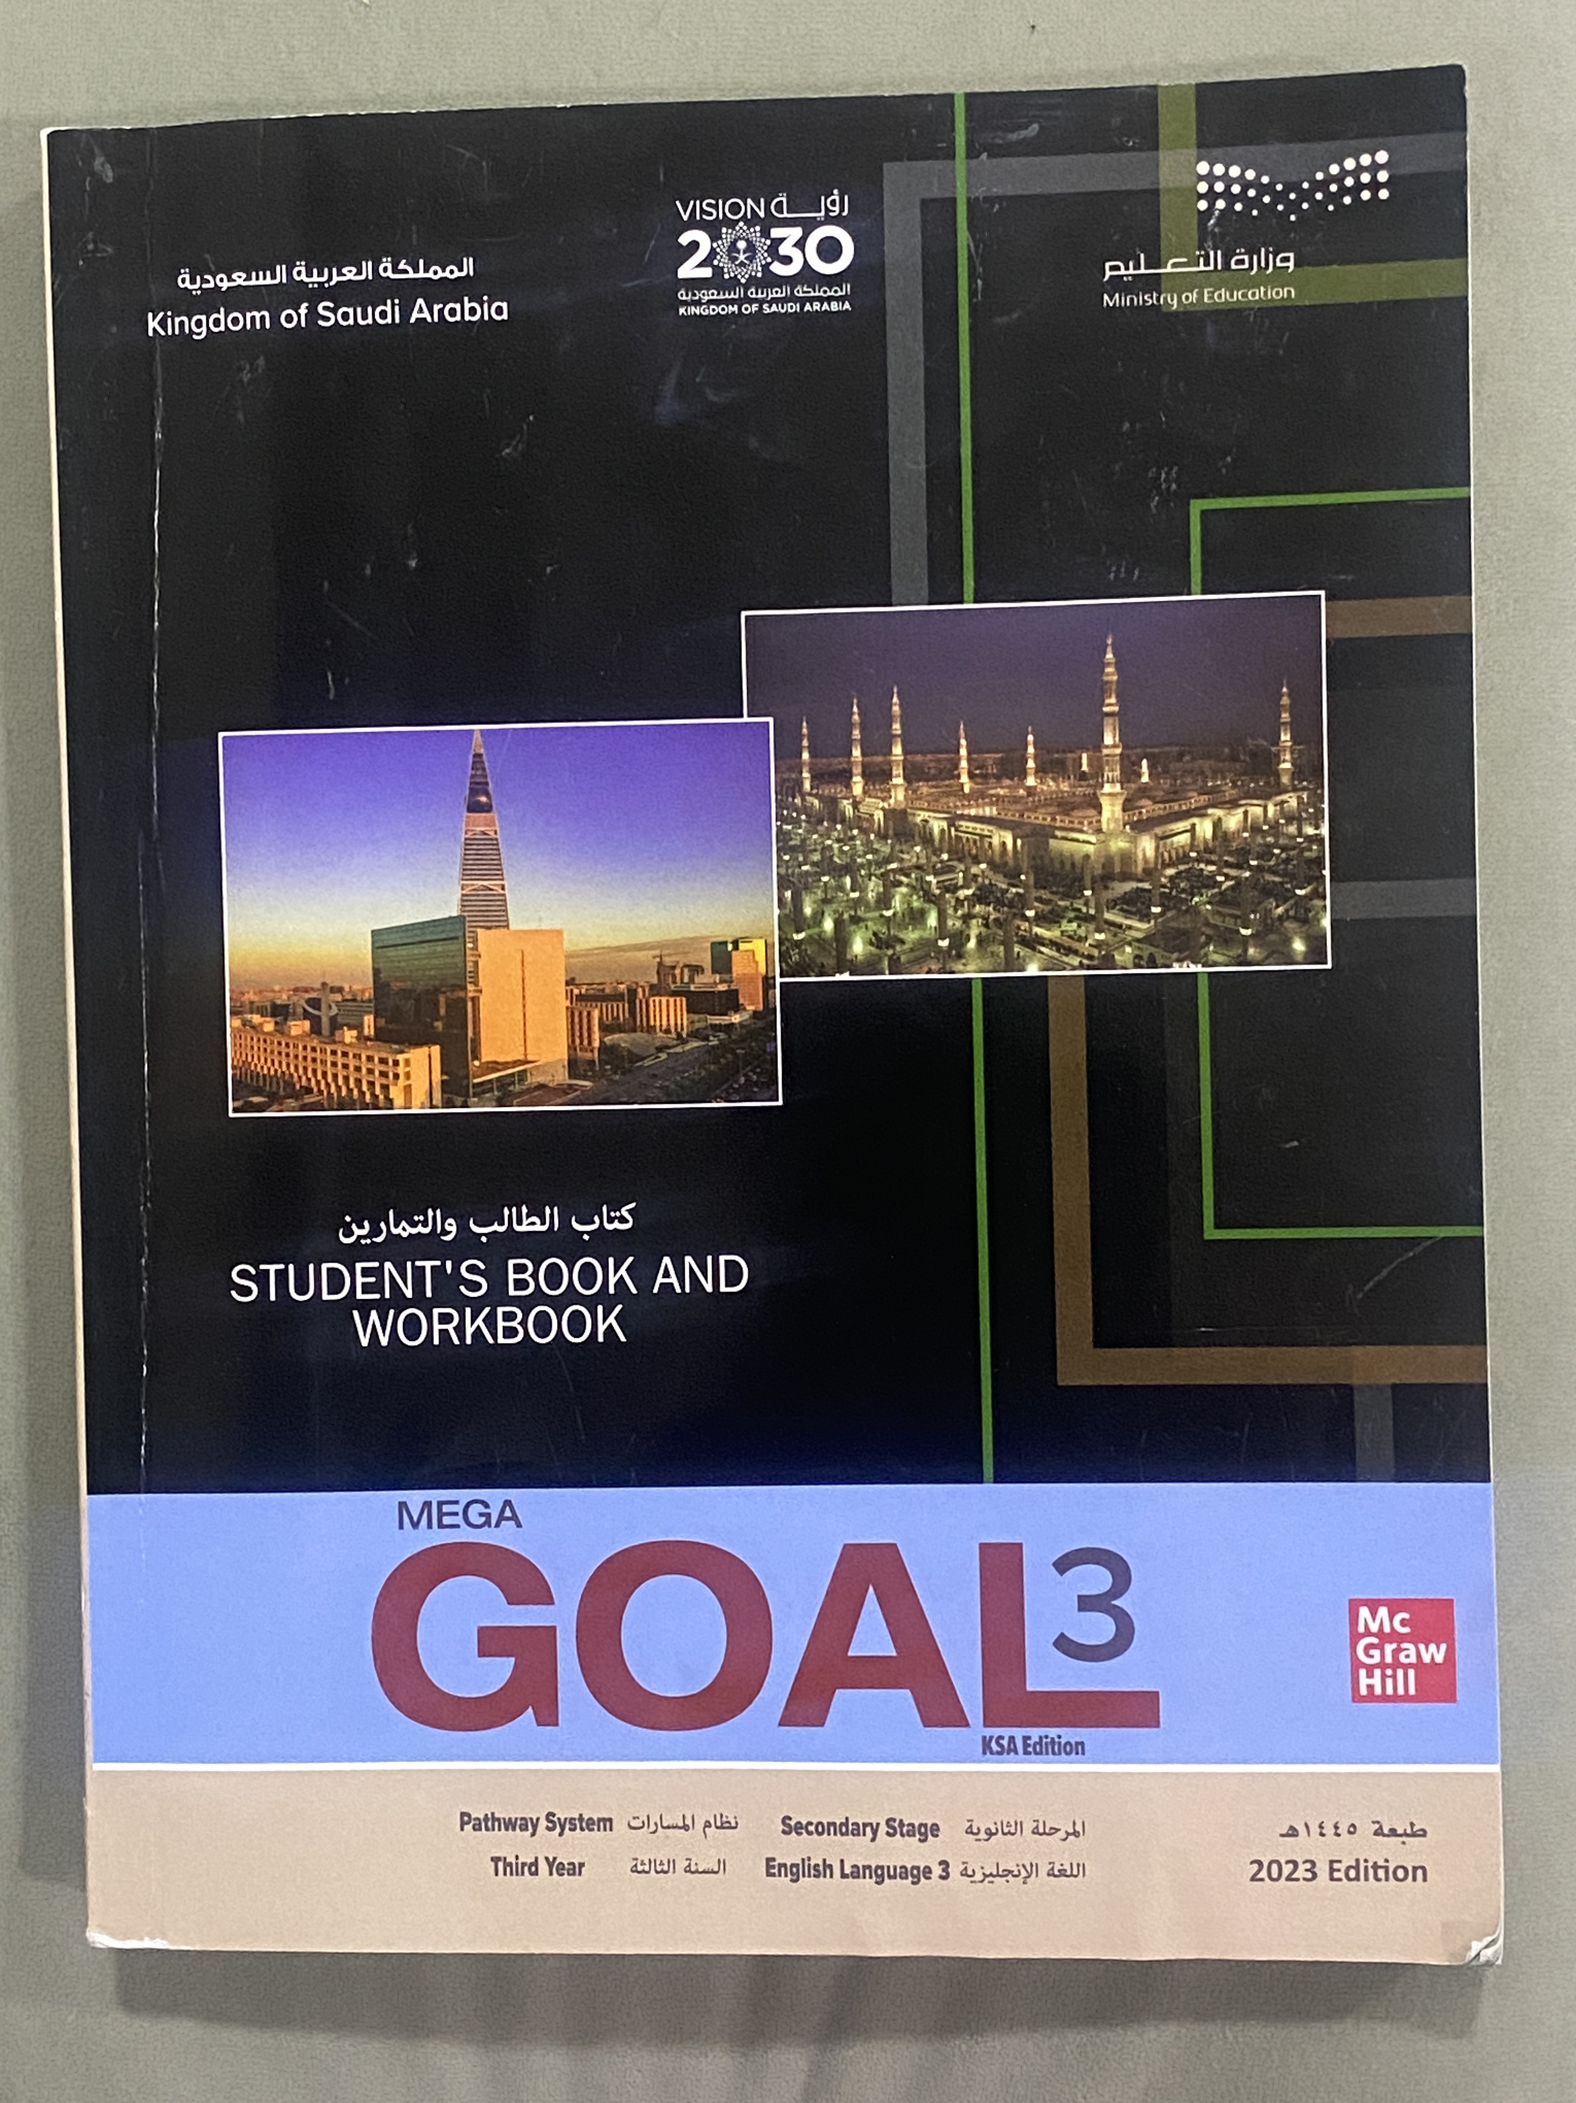
Open
Your student’s book p.36

Slide 4

1
Future Perfect

Slide 5
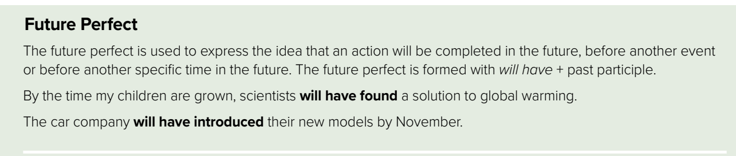
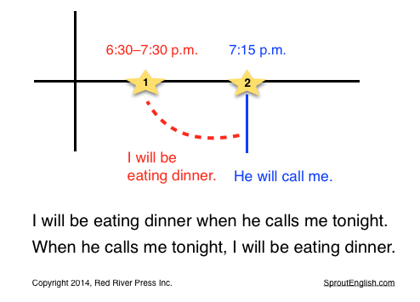
Read the explanation:
Look at this timeline :

Slide 6
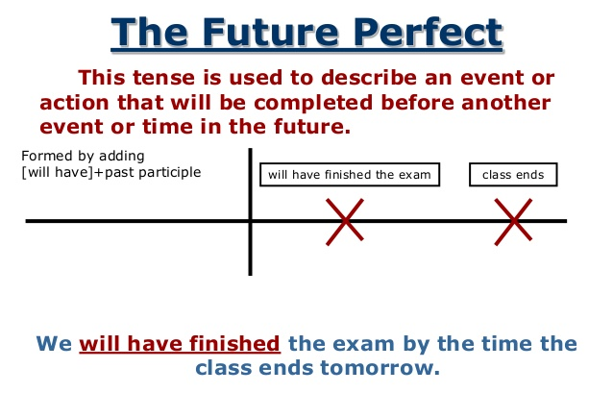
Another example

Slide 7
When we use Future Perfect??
to express an action that will be completed or finished at some time in the future , before another event or before another specific time in the future .
Form :
have
Verb+ p.p(3)
will
+
+
Example
By the end of this week , she will have completed her homework.
By 2021, he will have worked in Japan for exactly 30 years.

Slide 8
In Brief
used
Form
S + will have + (v3)
before another event
before another specific time in the future

Slide 9

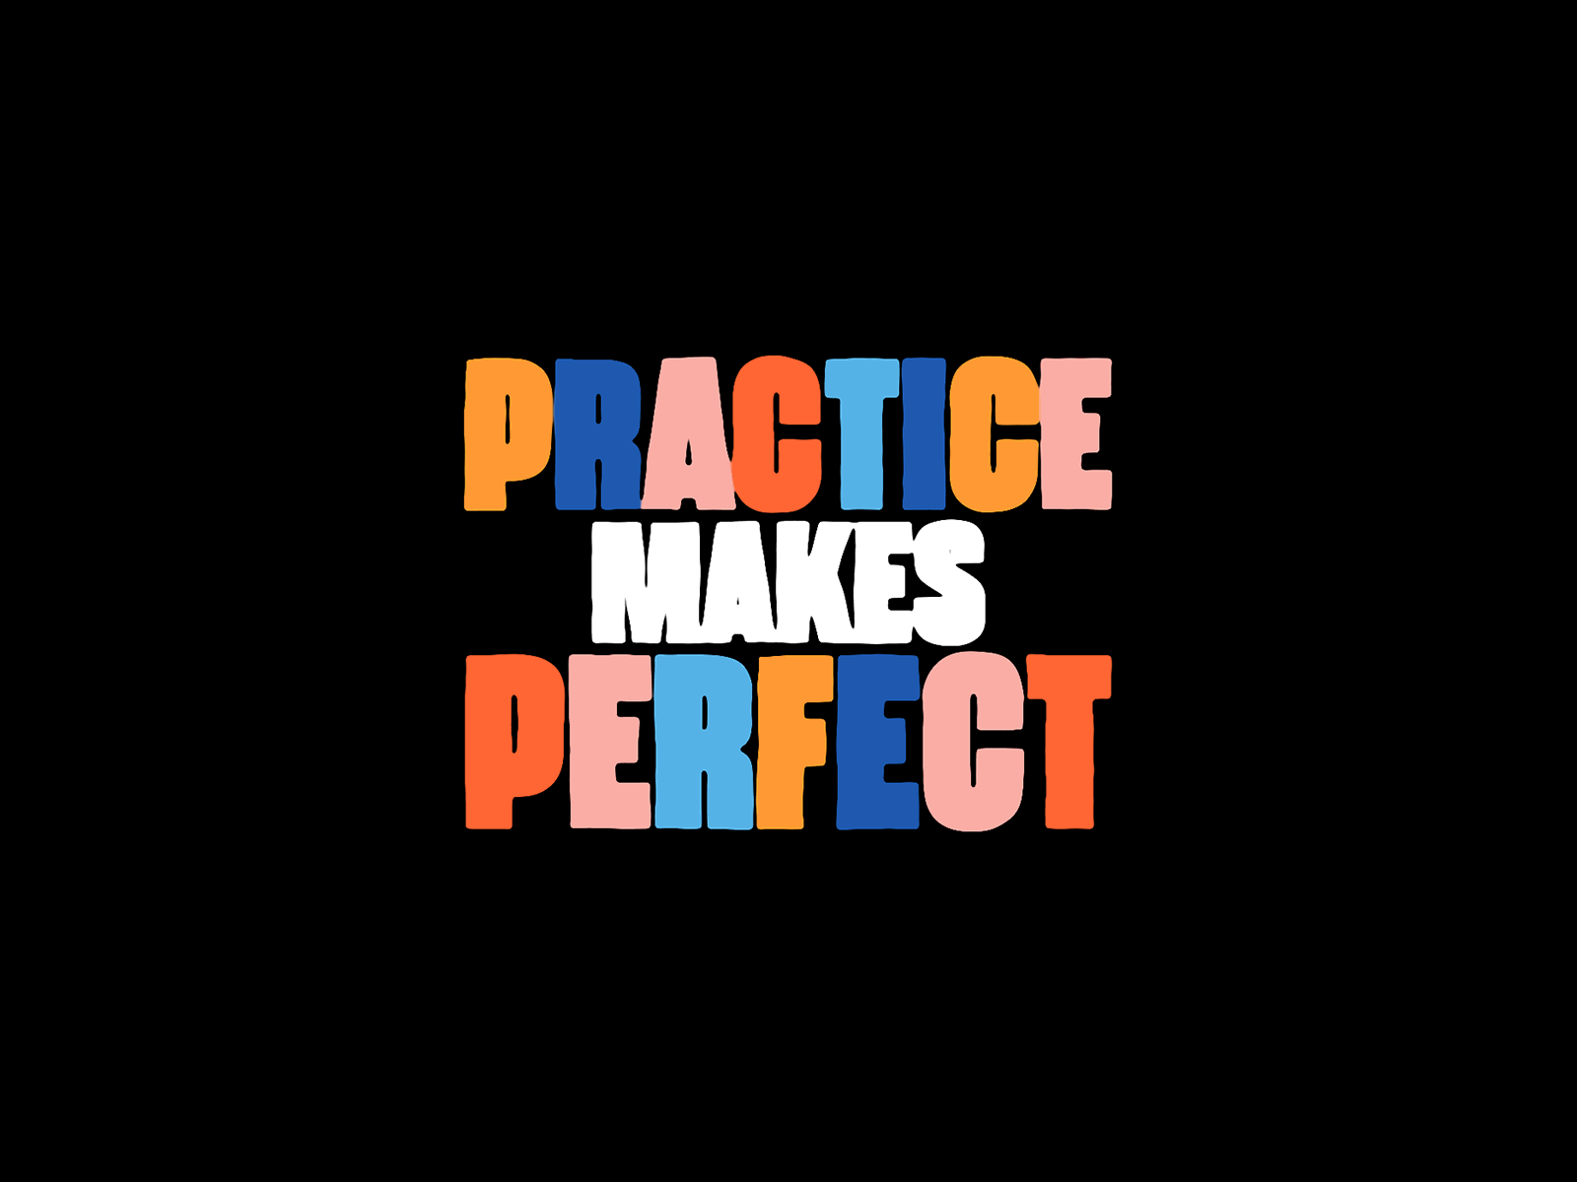
Let’s Practice!!

Slide 10






Use will or won’t
I ________________my mobile by the end of the exam .
won’t have used
Use mobile

Slide 11


Use will or won’t
will have studied
I _________________harder by 11 o’clock am. onThrsday
study harder

Slide 12



Find The FIB
By next year, he graduated from university.
01
By next year, he will have graduated from university.
The plane will have take off by two hours
02
The plane will have taken off by two hours

Slide 13
2
Future Perfect
Progressive

Slide 14
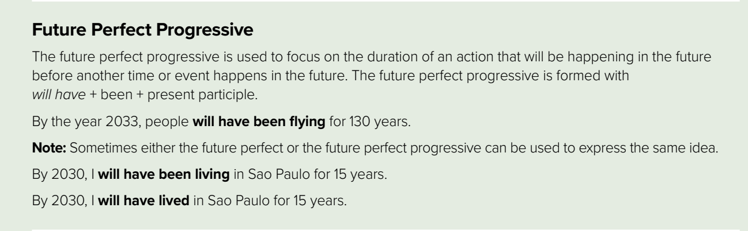
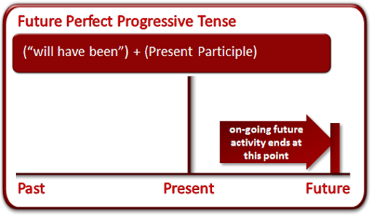
Look at this timeline :

Slide 15
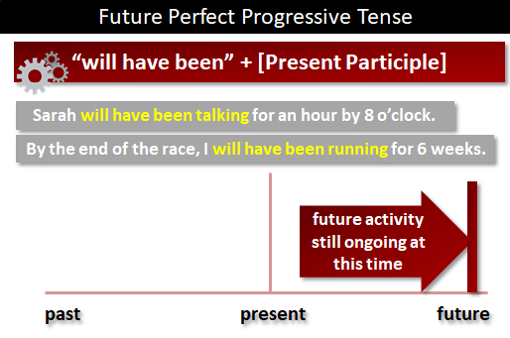
Look at these examples:

Slide 16
When we use Future Perfect Progressive??
to show that something will continue up until a particular event or time in the future. "for two weeks," and "since Friday" are all durations which can be used with the future perfect continuous. .
Form :
Will
Have been
+
Present participle
( v + ing)
+
Example
He will have been working for three hours before you arrive.
She will have been studying for two hours by the time her friend arrives.

Slide 17

Let’s Practice

Slide 18


Complte the sentence using Future Perfect Progressive
He ____________________for three Horus before we arrive
Will have been flying
FLY

Slide 19


Complte the sentence using Future Perfect Progressive
He _____________________for three horus before we arrive
will have been sleeping
sleep

Slide 20
3
The Future Dependent Time Clause

Slide 21
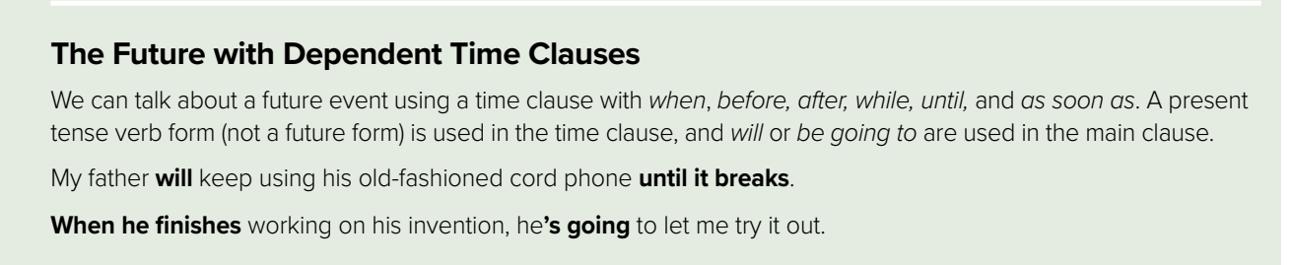

Slide 22
The Future with Dependent Time Clauses
We can talk about a future event using a time clause with when, before, after, while, and until.
A present tense verb form (not a future form) is used in the time clause, and will is used in the main clause
Key Words: when, before, after, while, and until

Slide 23
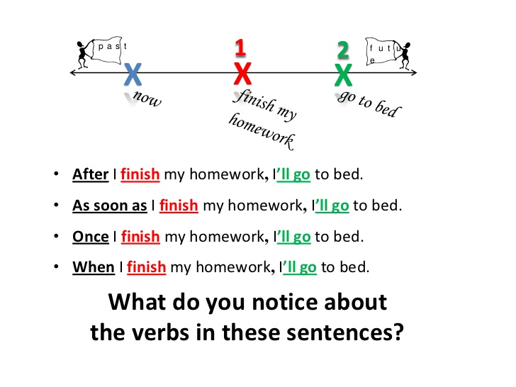

Slide 24

Home Work
Work book, exercise (E) ,
p.( 243)

Slide 25
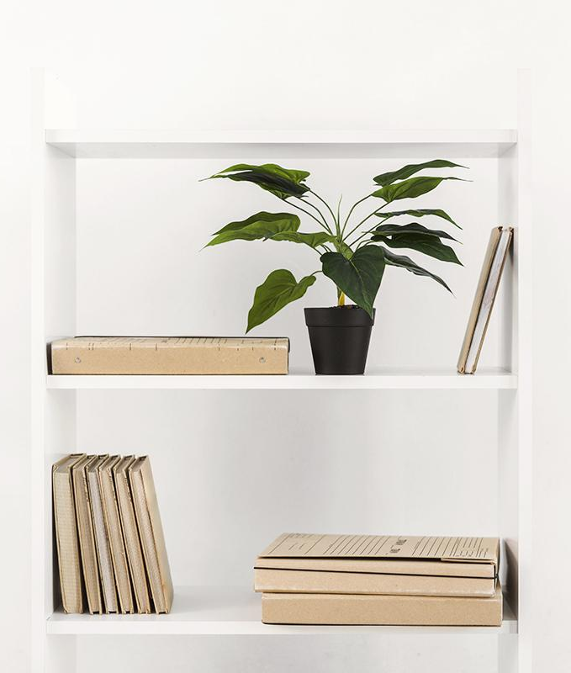

Thanks!

