Slide 1


Revision
What’s your nationality?
What’s your email?
SPIN
Where are you from?
What’s your address?
What’s the capital of your country?
What’s your phone number?
tekhnologic
Notes:
6 Segments

Slide 2

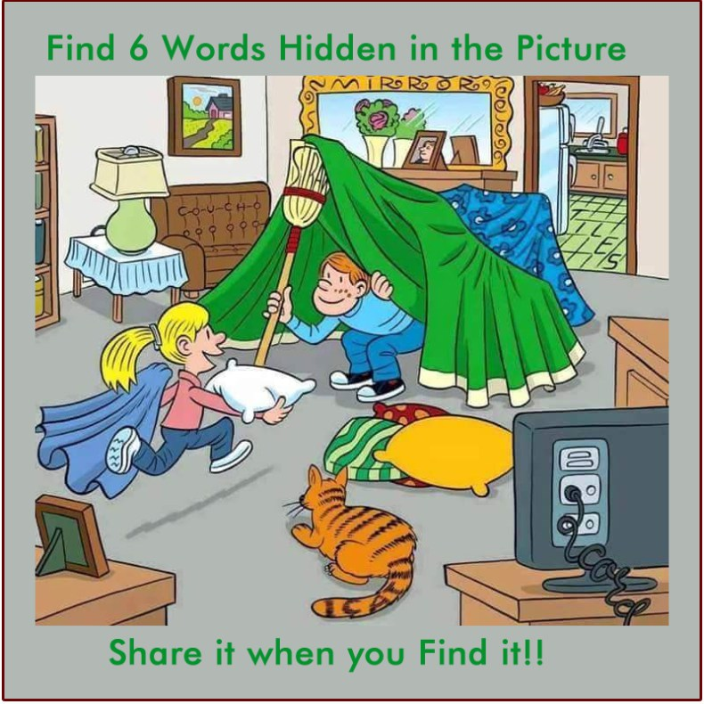
Warm up
Memory game

Slide 3
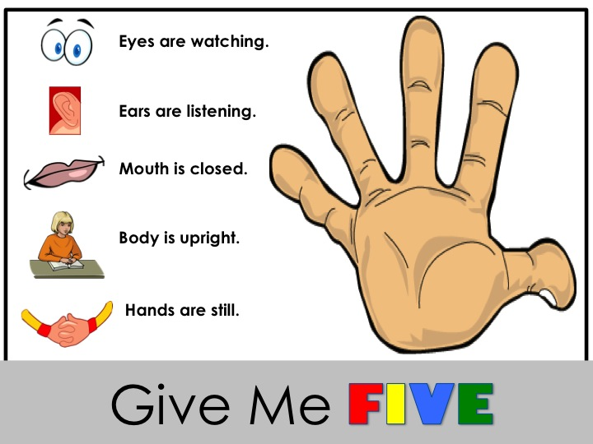

Slide 4

Warm up
https://www.jigsawplanet.com/?rc=play&pid=32034ec9d582

Slide 5
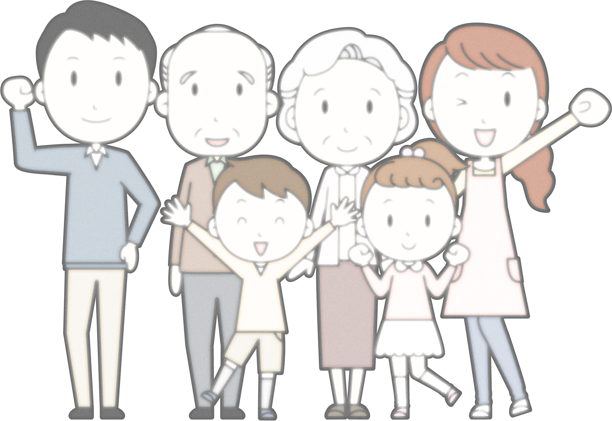

{ وَآتِ ذَا الْقُرْبَى حَقَّهُ }

Slide 6
How many brothers, sisters do you have?
What’s your dad’s name, mum’s name?

Slide 7

Page 40

Slide 8

Objectives:
At the end of this session,
the students will be able to:
Identify family members
Define family relations

Slide 9
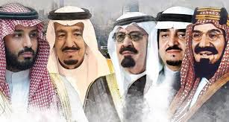
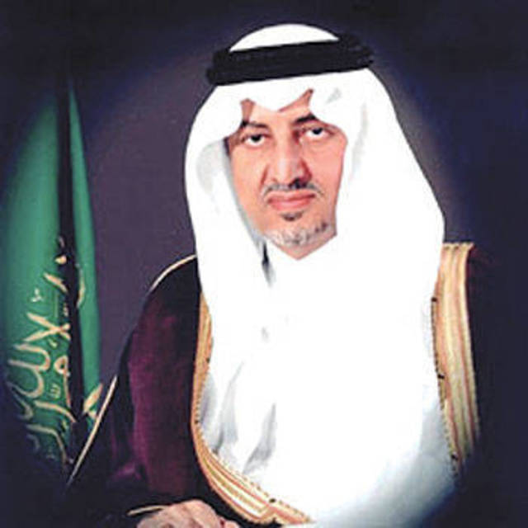
father
uncles
grandfather
son
cousin

Slide 10
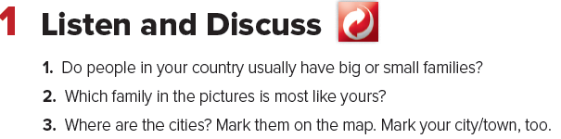

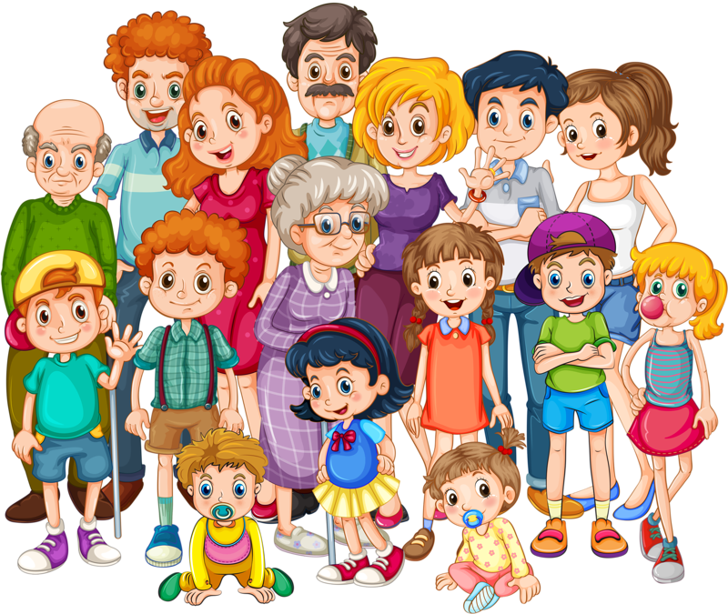
Page 40

Slide 11
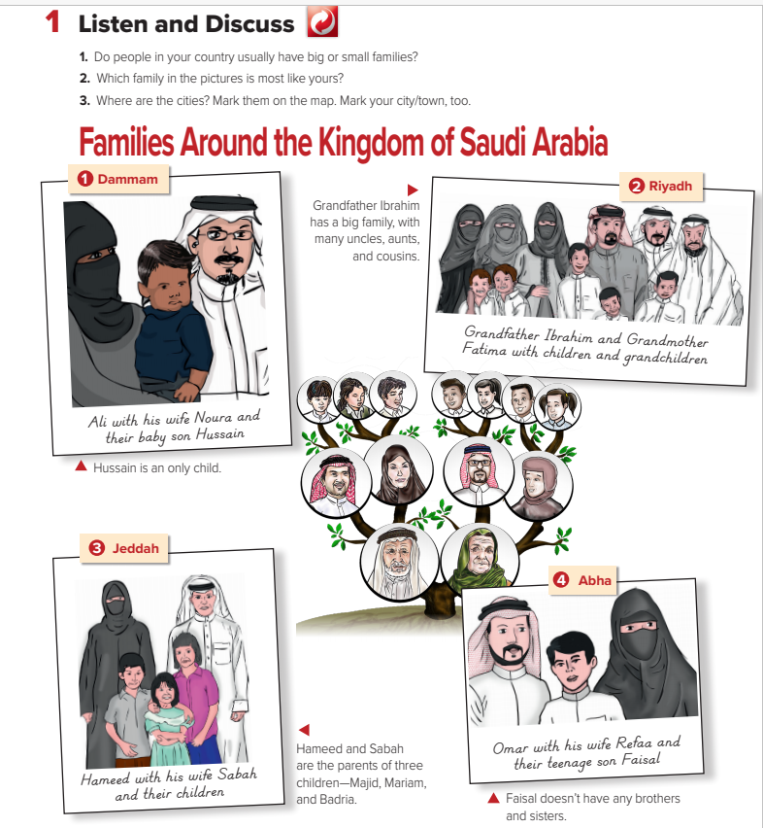
Page 40

Slide 12
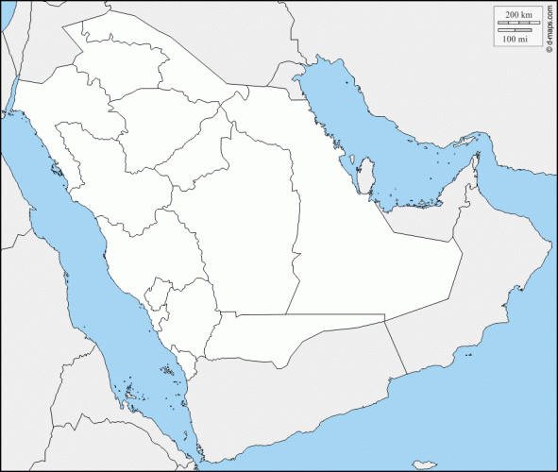
Page 40

Slide 13
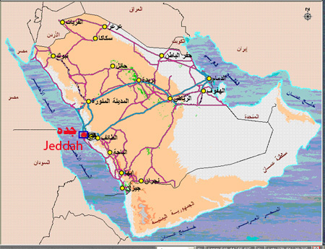

Slide 14
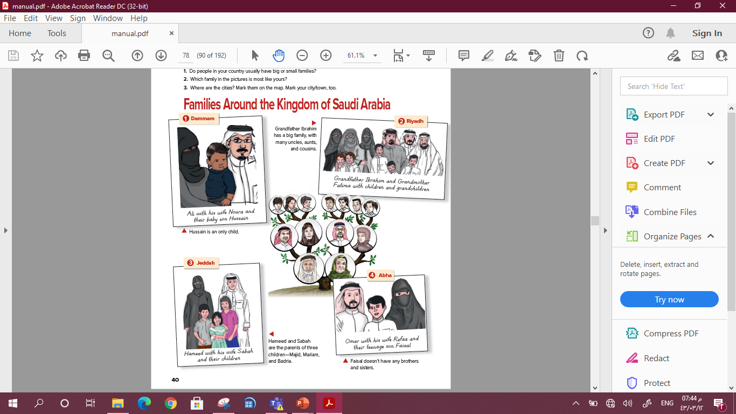

Page 40
Who is Ibrahim’s wife?
Who is Hussain’s father?
Where are they from?
Who is Faisal’s mother?

Slide 15
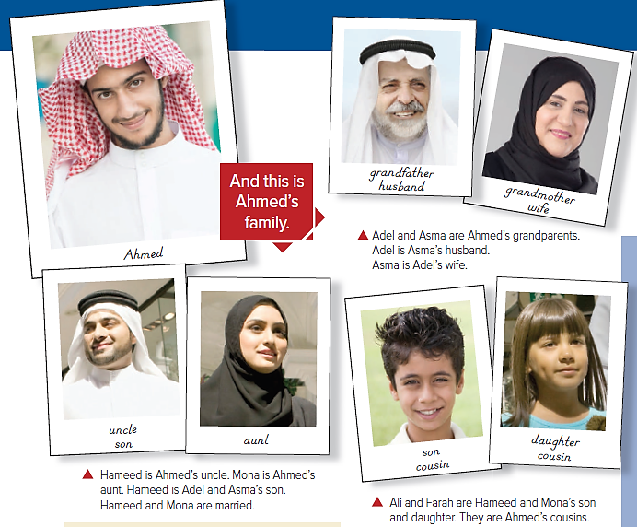

Page 41
Adel
Asma
Mona
Hameed
Ali
Farah

Slide 16
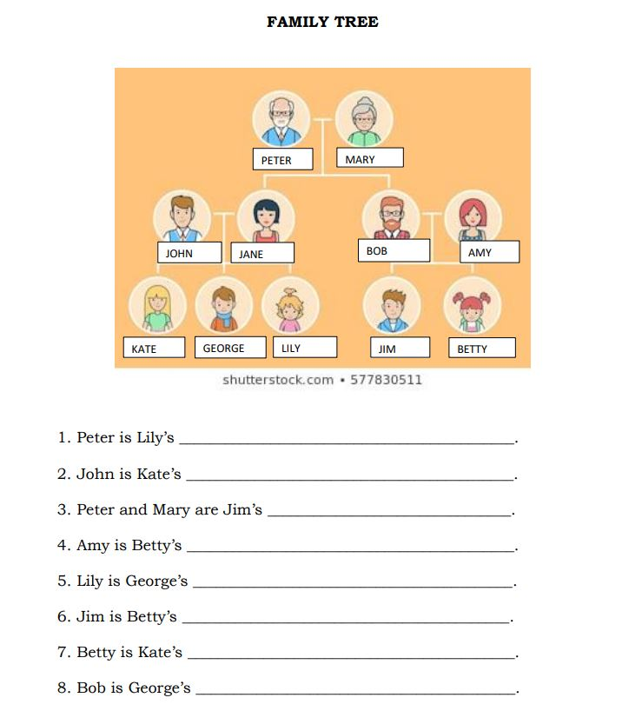

Make a Family Tree for
Ahmed’s family
Adel
Asma
Ahmed’s father
Ahmed’s mother
Hameed
Mona
Ahmed
Ali
Farah

Slide 17
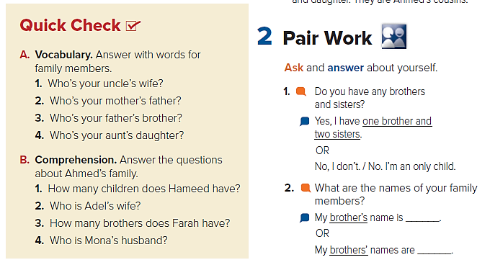

Page 41
1-my aunt
2-my grandfather
3-my uncle
4-my cousin
1-He has two children, a son and a daughter.
2-Adel’s wife is Asma.
3-Farah has one brother.
4-Mona’s husband is Hameed.

Slide 18

Page 41

Slide 19


Slide 20


Comment:

Slide 21

Evaluation
https://www.liveworksheets.com/mi1258601ml

Slide 22

Homework:
Page: 107

