Slide 2
U4 Around The World Form, Meaning and function
Requests and Offers:
can/will

Slide 3
Our objectives for today:
1-make a request using can/will
2-Agree and refuse requests
3-make an offer using can/will
4-Accept/refuse offers.

Slide 5
How to make a request?
Requests
Can/Will
you
request..?

Slide 6
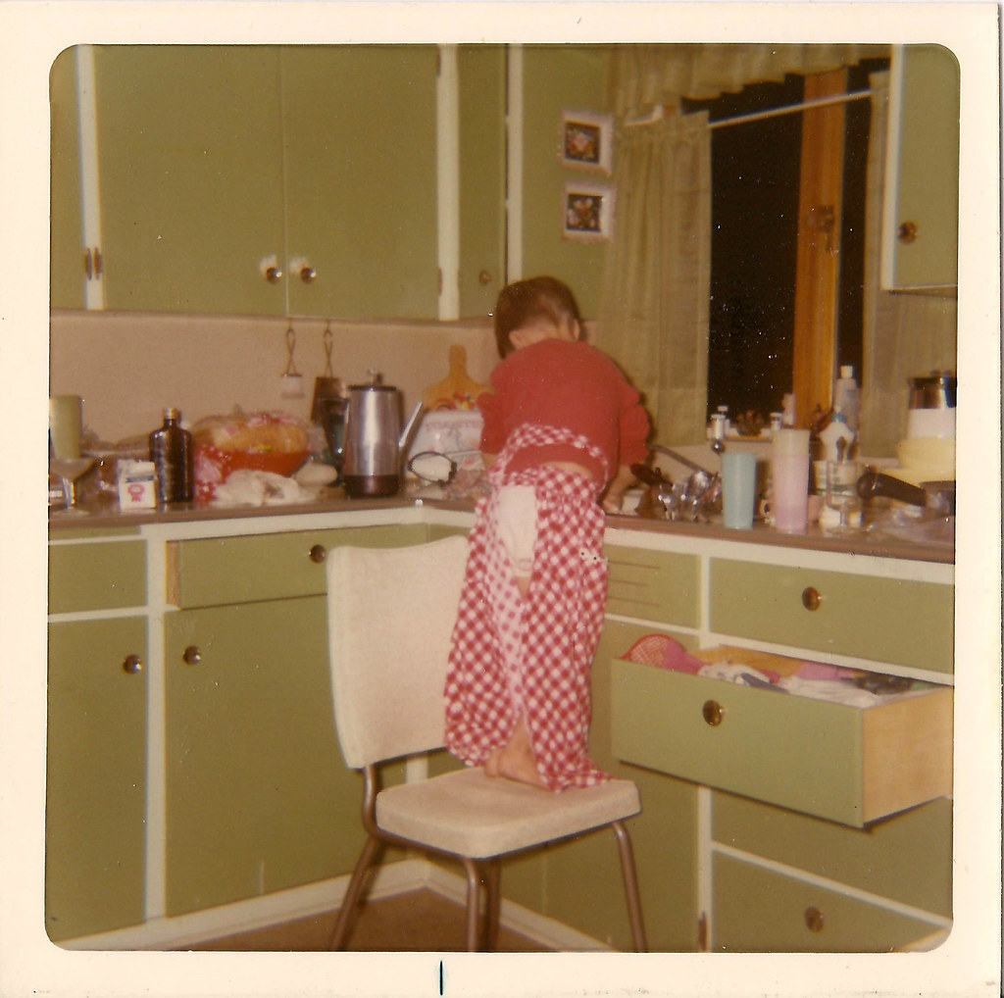
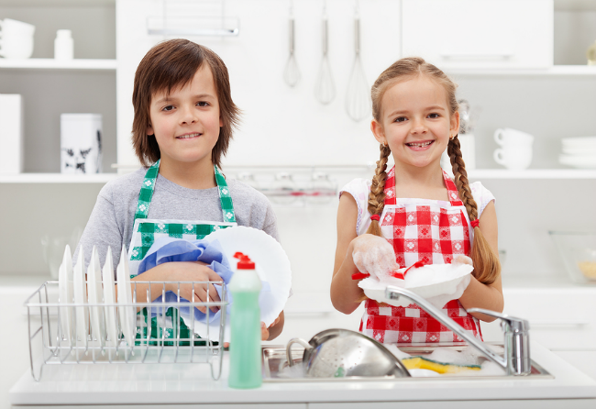
Requests using (can /will):
Can/will you help me?
Of course.
No problem
agree

Slide 7
Requests using (can/will)
Can/will you help me?
Sorry. I can’t
Sorry. I’m busy
refuse

Slide 8
Make a request using (can/will)
Role play strategy
Open the window
Sure/Of course/Ok/No problem
agree
Can/will you open the window?

Slide 9
Make a request using (can/will)
Open the window
Sorry. I’m busy./Sorry. I can’t.
refuse
Can/will you open the window?

Slide 10
Make a request using (can/will)
Rearrange .
You can the close door?
Use the
(chat box)
to write your
answer
هذه الصورة بواسطة كاتب غير معروف مرخصة بالاسم CC BY-NC

Slide 11
Rearrange .
You can the close door?
بدء المؤقت
Done!
30
25
5
20
10
15
You only have 30 sec

Slide 12
Make a request using (can/will)
Rearrange .
You can the close door?
Rearrange .
can you close the door?

Slide 13
How to make an offer ?
Offer
I
can/will
offer.

Slide 14
Make an offer using (can/will)
I’m tired I have a lot of work to do
قال تعالى : (وبالوالدين احسانا)
offer
I will help you.

Slide 15
Make an offer using (can/will)
Thank you
Accept
I will help you.
offer

Slide 16
Make an offer using (can/will)
All right.
Accept
I will help you.
offer

Slide 17
Make an offer using (can/will)
Ok/Thanks
Accept
I will/can help you.
offer

Slide 18
Make an offer using (can/will)
No thanks
Refuse
I will/can help you.
offer

Slide 19
Make an offer using (can/will)
No, that’s all right
Refuse
I will/can help you.
offer

Slide 20
Make an offer using (can/will)
No, that’s OK.
Refuse
I will/can help you.
offer

Slide 21
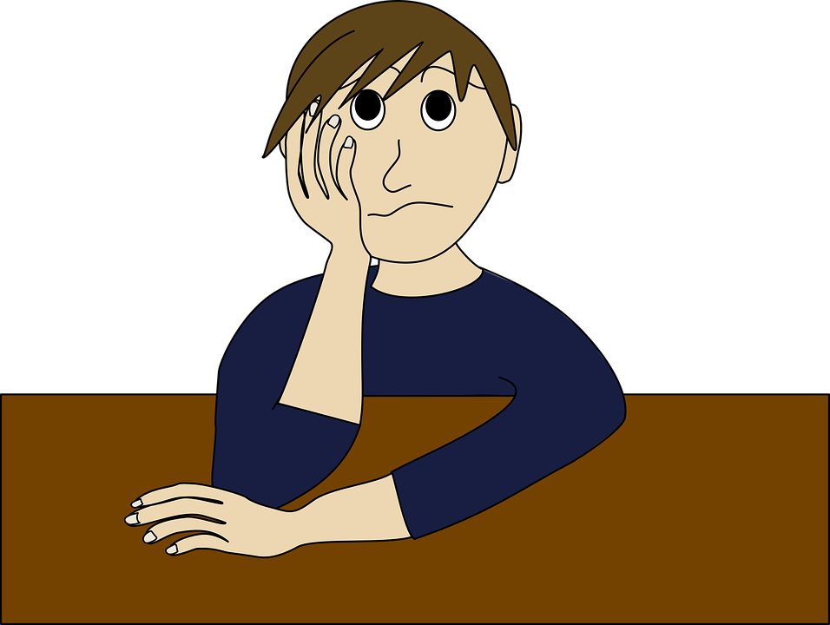
Make an offer using (can/will)
I need a pencil
►Offer your help
►I can give you a pencil.
A friend in need is a friend indeed

Slide 22
Rearrange .
I window the open will
بدء المؤقت
Done!
30
25
5
20
10
15
You only have 30 sec

Slide 23
Be polite
Say (please/thank you/you’re welcome)
Will you help me
,please?

Slide 24
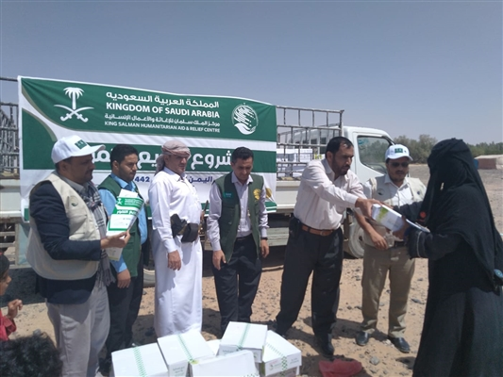
قال رسول الله صلى الله عليه وسلم
مثل المؤمنين في توادهم وتراحمهم وتعاطفهم مثل الجسد إذا اشتكى منه عضو تداعى له سائر الجسد بالسهر والحمى
The King Salman Humanitarian Aid and Relief Center is a Saudi center dedicated to international relief and humanitarian work. It was established on Rajab 27, 1436 AH at the direction of King Salman bin Abdulaziz Al Saud of Saudi Arabia. And it coordinates with international organizations and bodies, with the aim of providing aid to the needy in the world

Slide 25
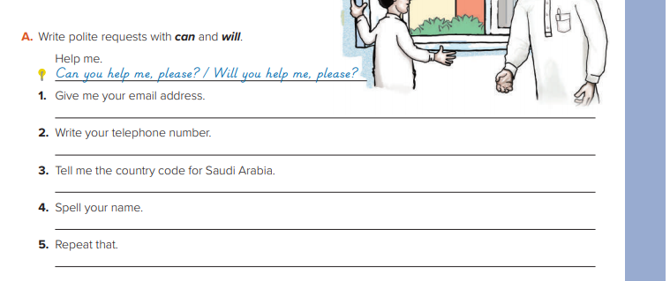
Open your books to page 33

