Slide 1


Unit 5
Families, Families
Lesson 5

Slide 2
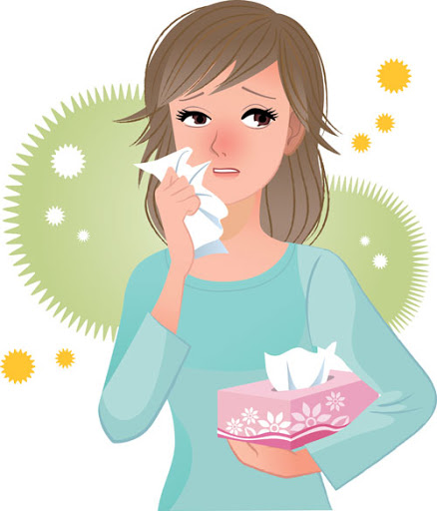
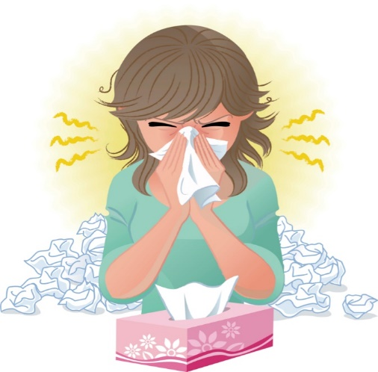
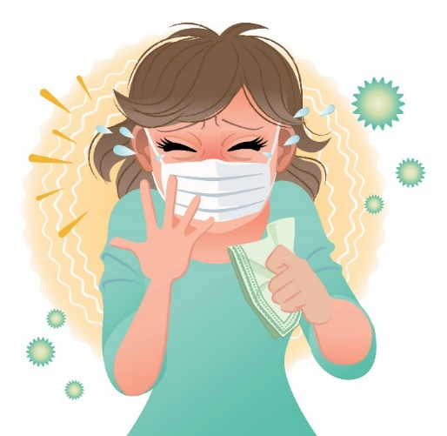
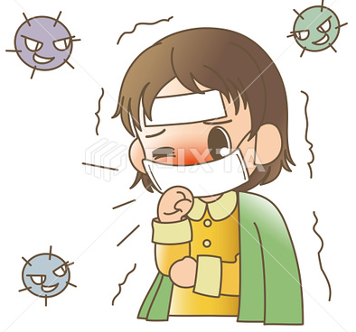
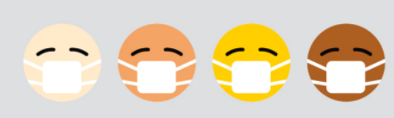
☺Avoid gathering !
Covid 19
☺wear a mask before going out.
☺Social distancing is not a choice, it is a must!
☺Keep a distance of 2 meters to avoid accountability
☺wash hands constantly.

Slide 3






Learning Objectives
Differentiate between regular and irregular plural nouns
Differentiate between singular and plural nouns
make regular plural nouns correctly.
make irregular plural nouns correctly

Slide 4
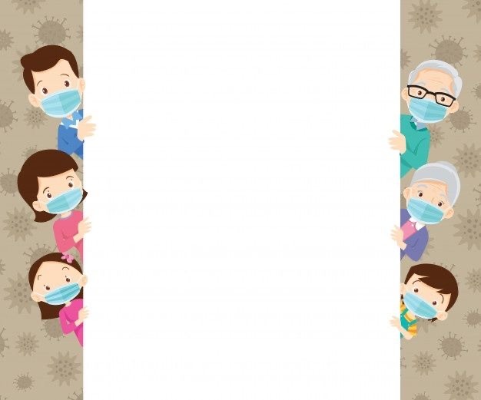
بسم الله الرحمن الرحيم
Day:
Date:

Slide 5
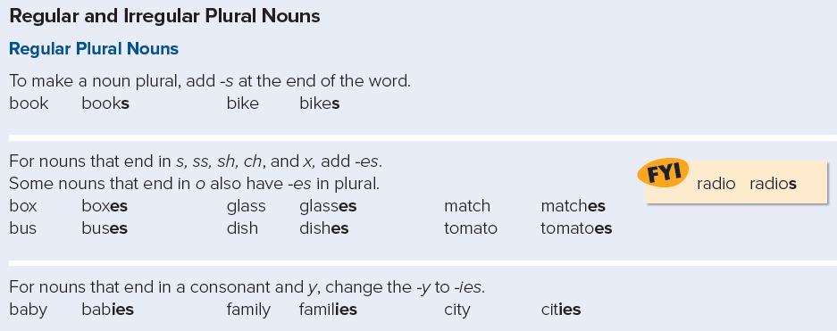

Slide 6
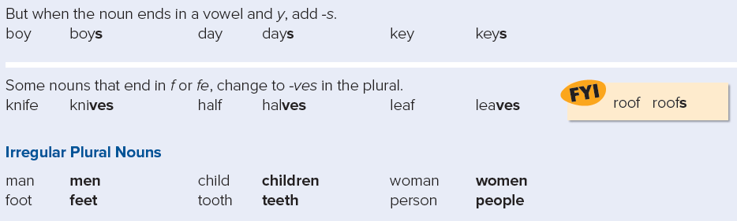

Slide 7

Practice

Slide 8
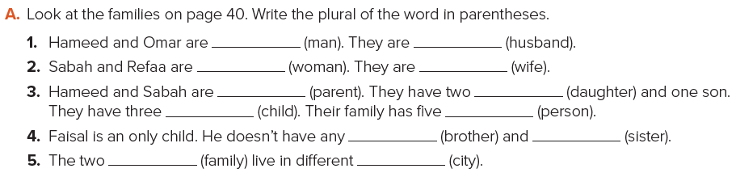
men
husbands
women
wives
daughters
parents
children
people
brothers
sisters
families
cities

Slide 9
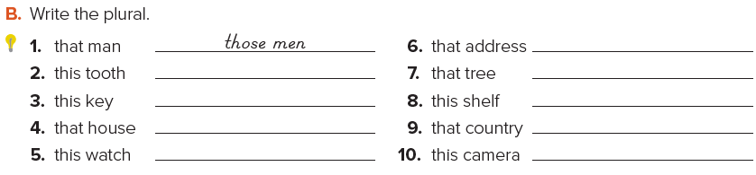
those addresses
those trees
these shelves
those countries
these cameras
these teeth
these keys
those houses
these watches

