Slide 1


Unit 5
Families, Families
Lesson 2

Slide 2
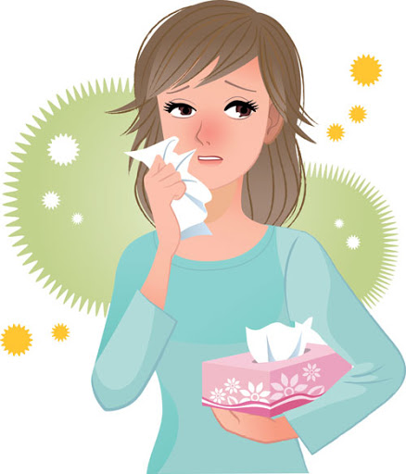
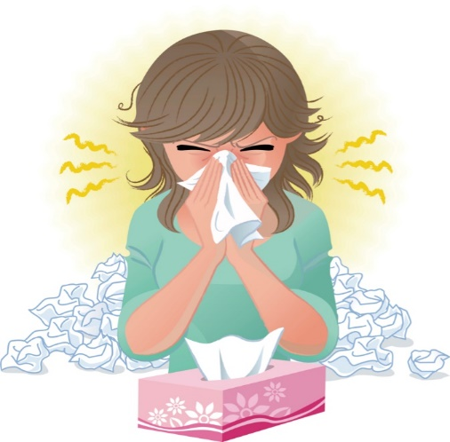
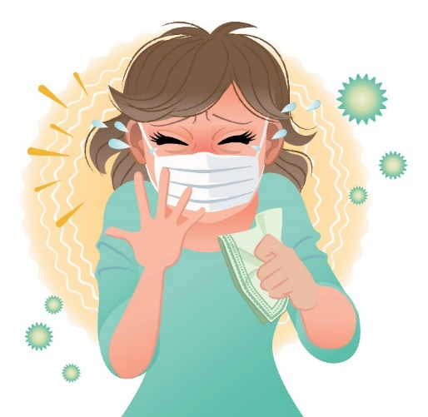
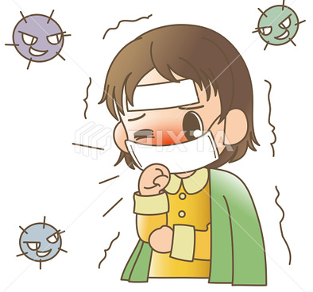

☺Avoid gathering !
Covid 19
☺wear a mask before going out.
☺Social distancing is not a choice, it is a must!
☺Keep a distance of 2 meters to avoid accountability
☺wash hands constantly.

Slide 3






Learning Objectives
Use " have " in questions and sentences
Make questions using " How many – Who "
Use quantity expressions
complete a chart after listening
Apply possessive " s " to singular and plural nouns
practice pronunciation

Slide 4
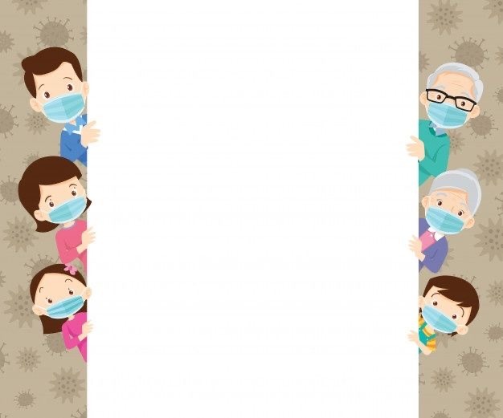
بسم الله الرحمن الرحيم
Day:
Date:

Slide 5
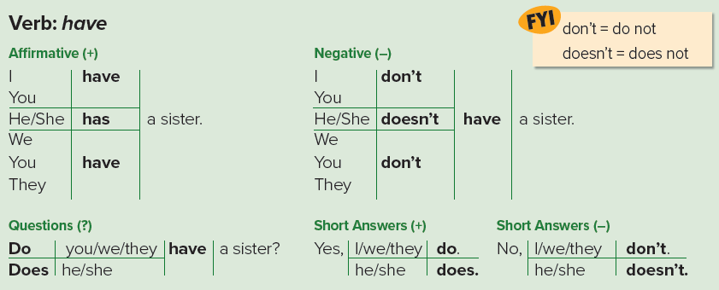

Slide 6
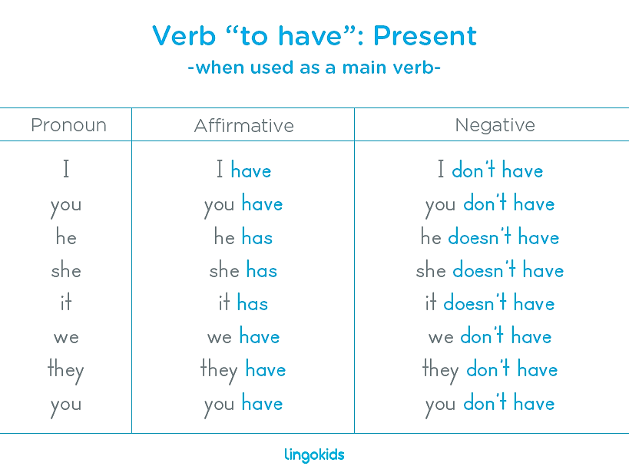

Slide 7

Practice

Slide 8
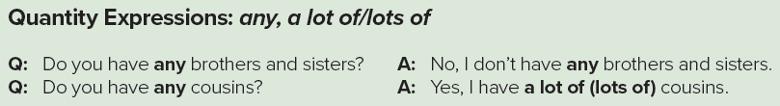

Slide 9
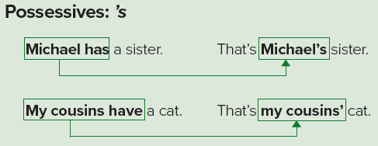

Slide 10
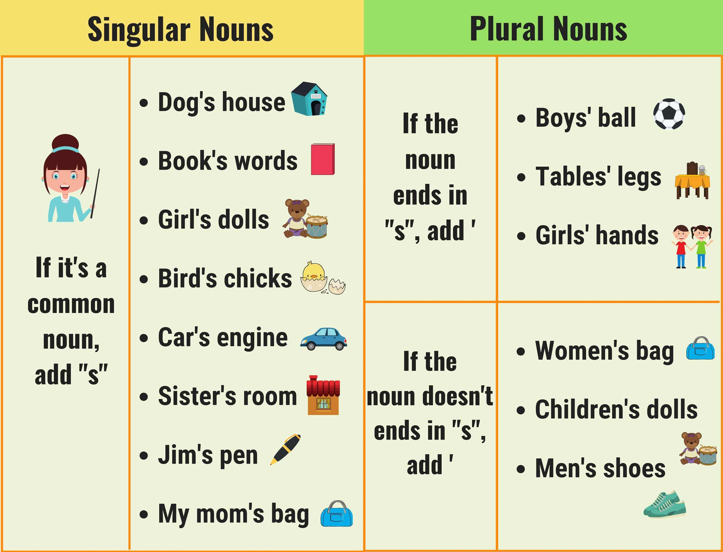

Slide 11
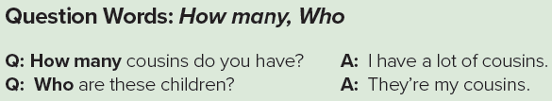

Slide 12
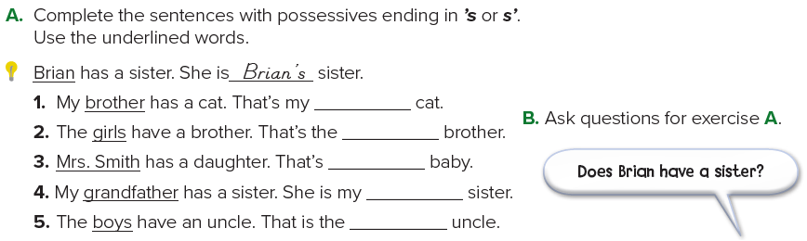
brother’s
girls’
Mrs. Smith’s
grandfather’s’
boys’

Slide 13
brother’s
girls’
Mrs. Smith’s
grandfather’s’
boys’
1. Does your brother have a cat?
2. Do the girls have a brother?
3. Does Mrs. Smith have a daughter?
4. Does your grandfather have a sister?
5. Do the boys have an uncle?

Slide 14
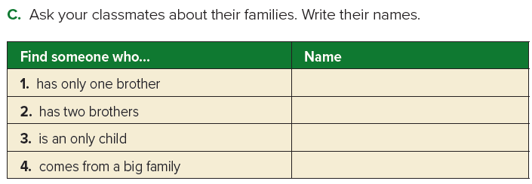

Slide 15
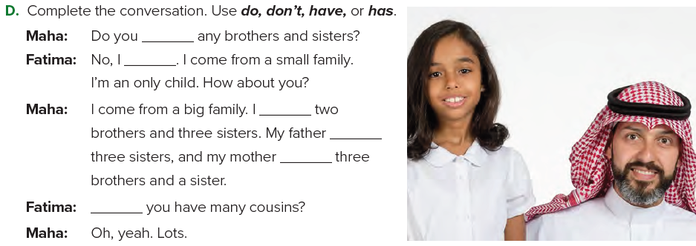
have
don’t
have
has
has
Do

Slide 16

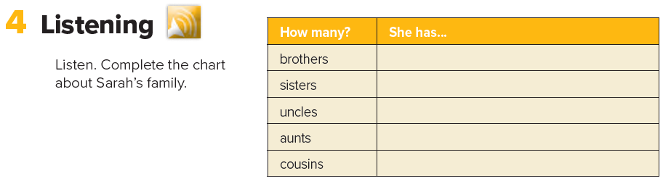
three brothers
two sisters
seven uncles
seven aunts
twenty-one cousins

Slide 17
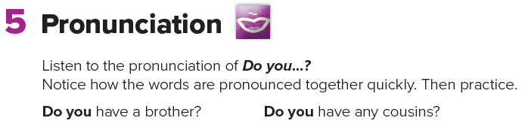

Slide 18
Homework
Page 108

Slide 19
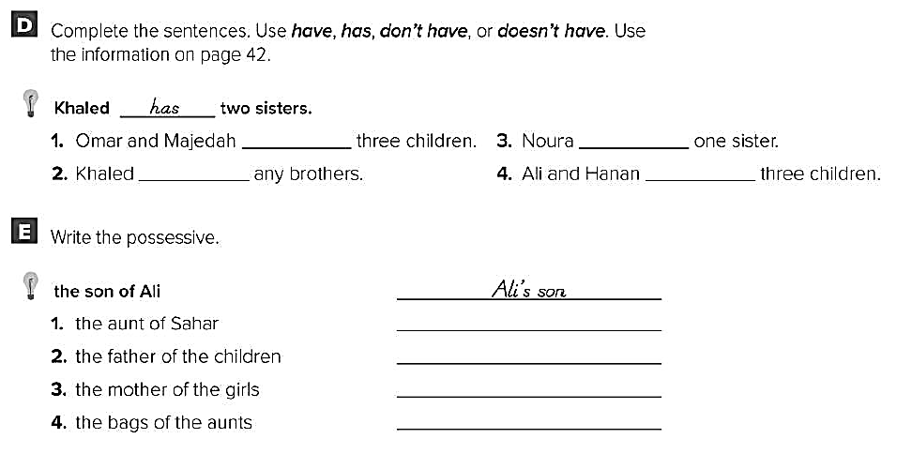
have
has
doesn’t
have
don’t
have
Sahar’s aunt
The children’s father
The girls’ mother
The aunts’ bag

