Slide 1


Unit 5
Families, Families
Lesson 3

Slide 2
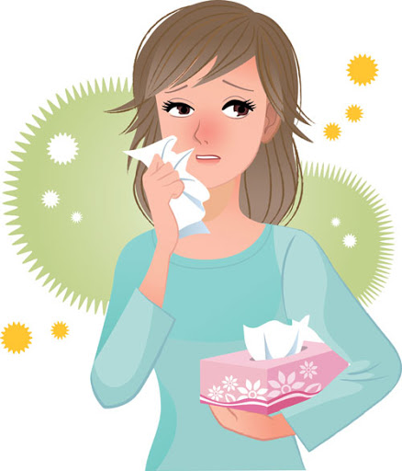
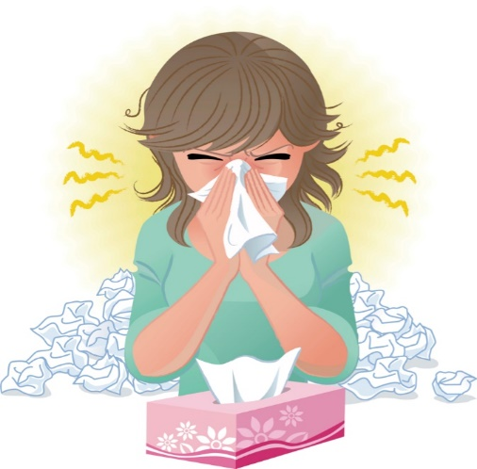
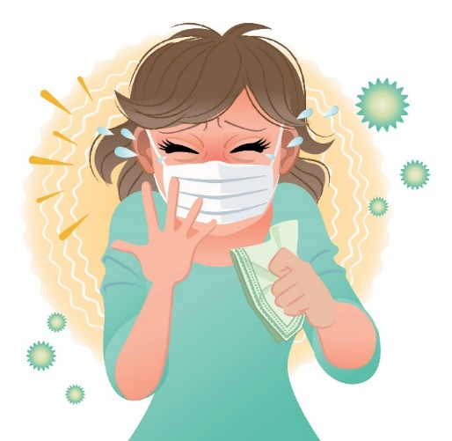
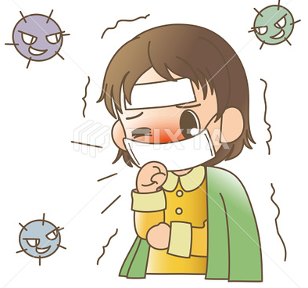

☺Avoid gathering !
Covid 19
☺wear a mask before going out.
☺Social distancing is not a choice, it is a must!
☺Keep a distance of 2 meters to avoid accountability
☺wash hands constantly.

Slide 3






Learning Objectives
Identify the main idea of reading
read a conversation correctly
answer questions after reading about it
practice making a conversation correctly
appreciate the Saudi families’ values

Slide 4
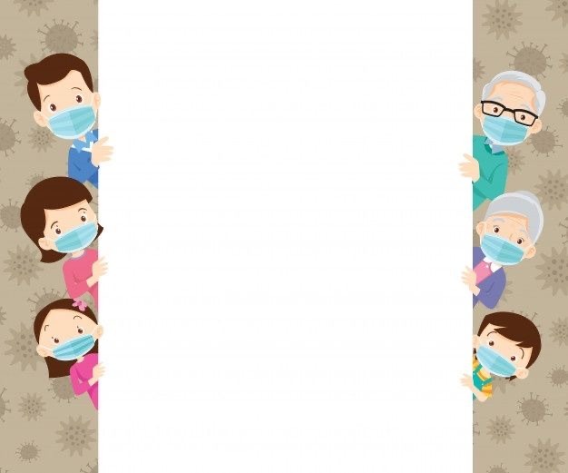
بسم الله الرحمن الرحيم
Day:
Date:

Slide 5
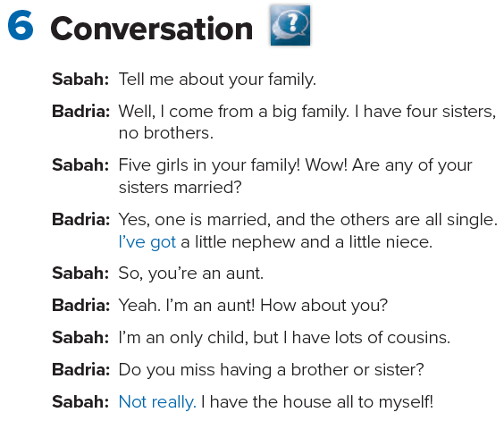


Slide 6
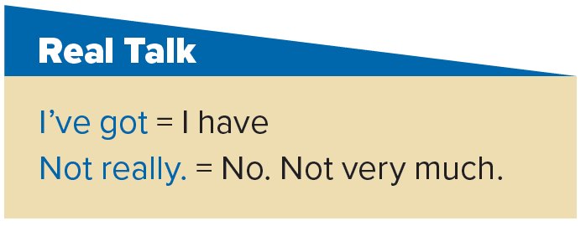

Slide 7
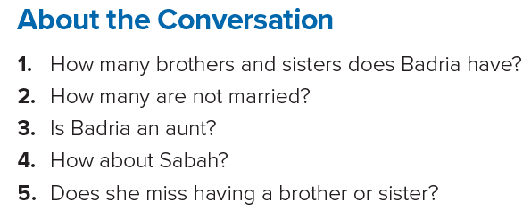
1. She has four sisters. She doesn’t have any brothers.
2. Three of her sisters are single.
3. Yes, she is. She has a niece and a nephew.
4. She’s an only child.
5. No, she doesn’t.

Slide 8
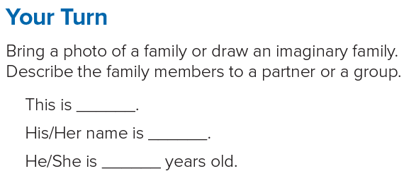

Slide 9
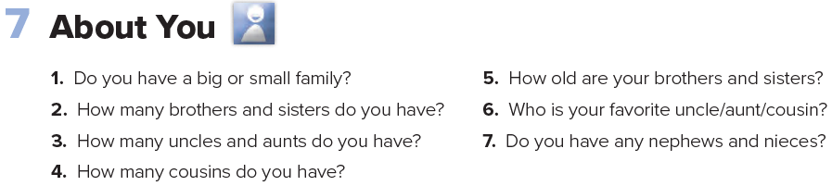

Slide 10
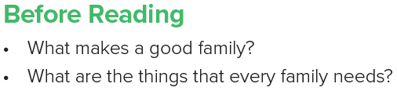


Slide 11
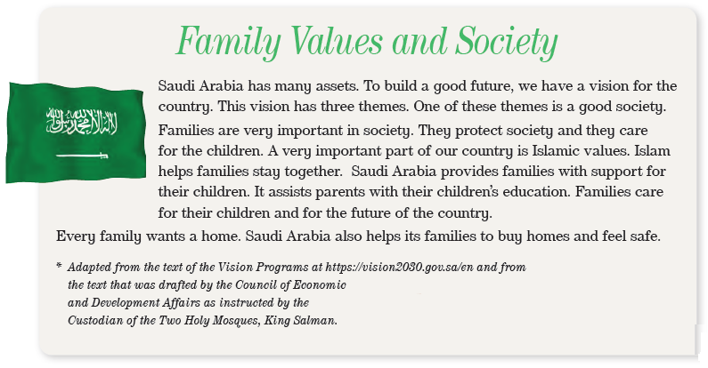
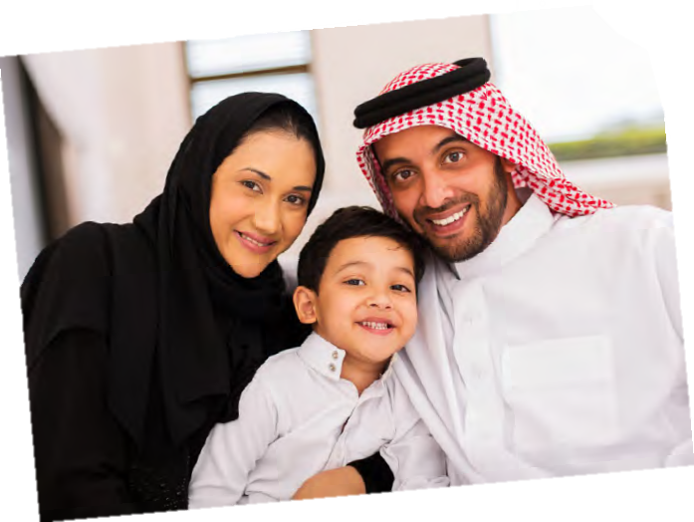
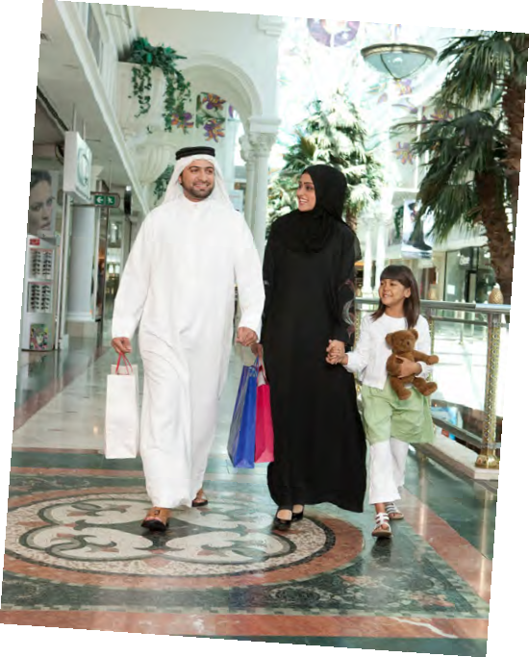

Slide 12
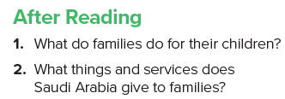
1. Families care for their children and for the future of the country.
2. Saudi Arabia gives families- support for their children; assistance for their children’s education; help to buy homes; help to feel safe.

Slide 13
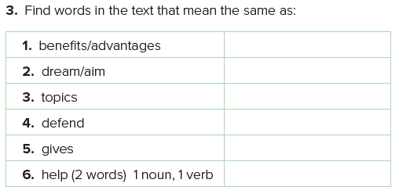
assets
vision
themes
protect
provides
support - assist

Slide 14



Slide 15
Homework
Page 109

Slide 16
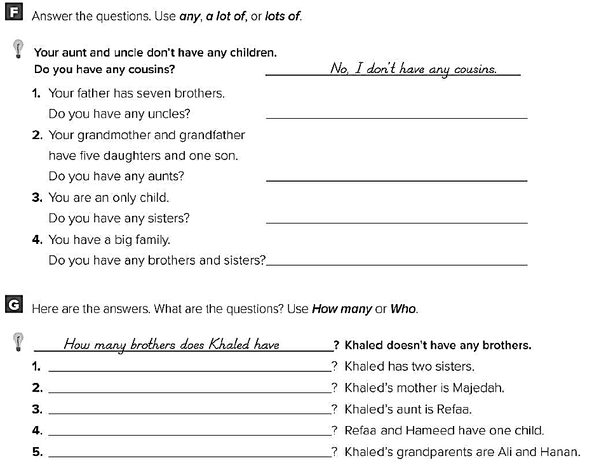
Yes, I have a lot of/lots of uncles
Yes, I have a lot of/lots of aunts
No, I don’t have any sisters
Yes, I have a lot of/lots of brothers & sisters
How many sisters does khaled have
Who is khaled’s mother
Who is khaled’s aunt
How many children do Refaa and Hameed have
Who are khaled’s grandparents

